Slide 1

Cultivate the Climate: A Game of Sustainable Agriculture​
FAO AGRIFOOD SIMULATION GAME
Farmer cards

Slide 2

Farmer
The Farmer assumes the pivotal role of an independent decision-maker in shaping their individual farming approach, encompassing choices in methods, policy adoption, and innovation, while being constrained by the absence of policy creation authority, community-wide enforcement capability, and susceptibility to potential climate policy-related yield impacts.
Player profile

Slide 3

Farmer
Card 1
Index number 21

Slide 4

Farmer
Card 2
Index number 22

Slide 5
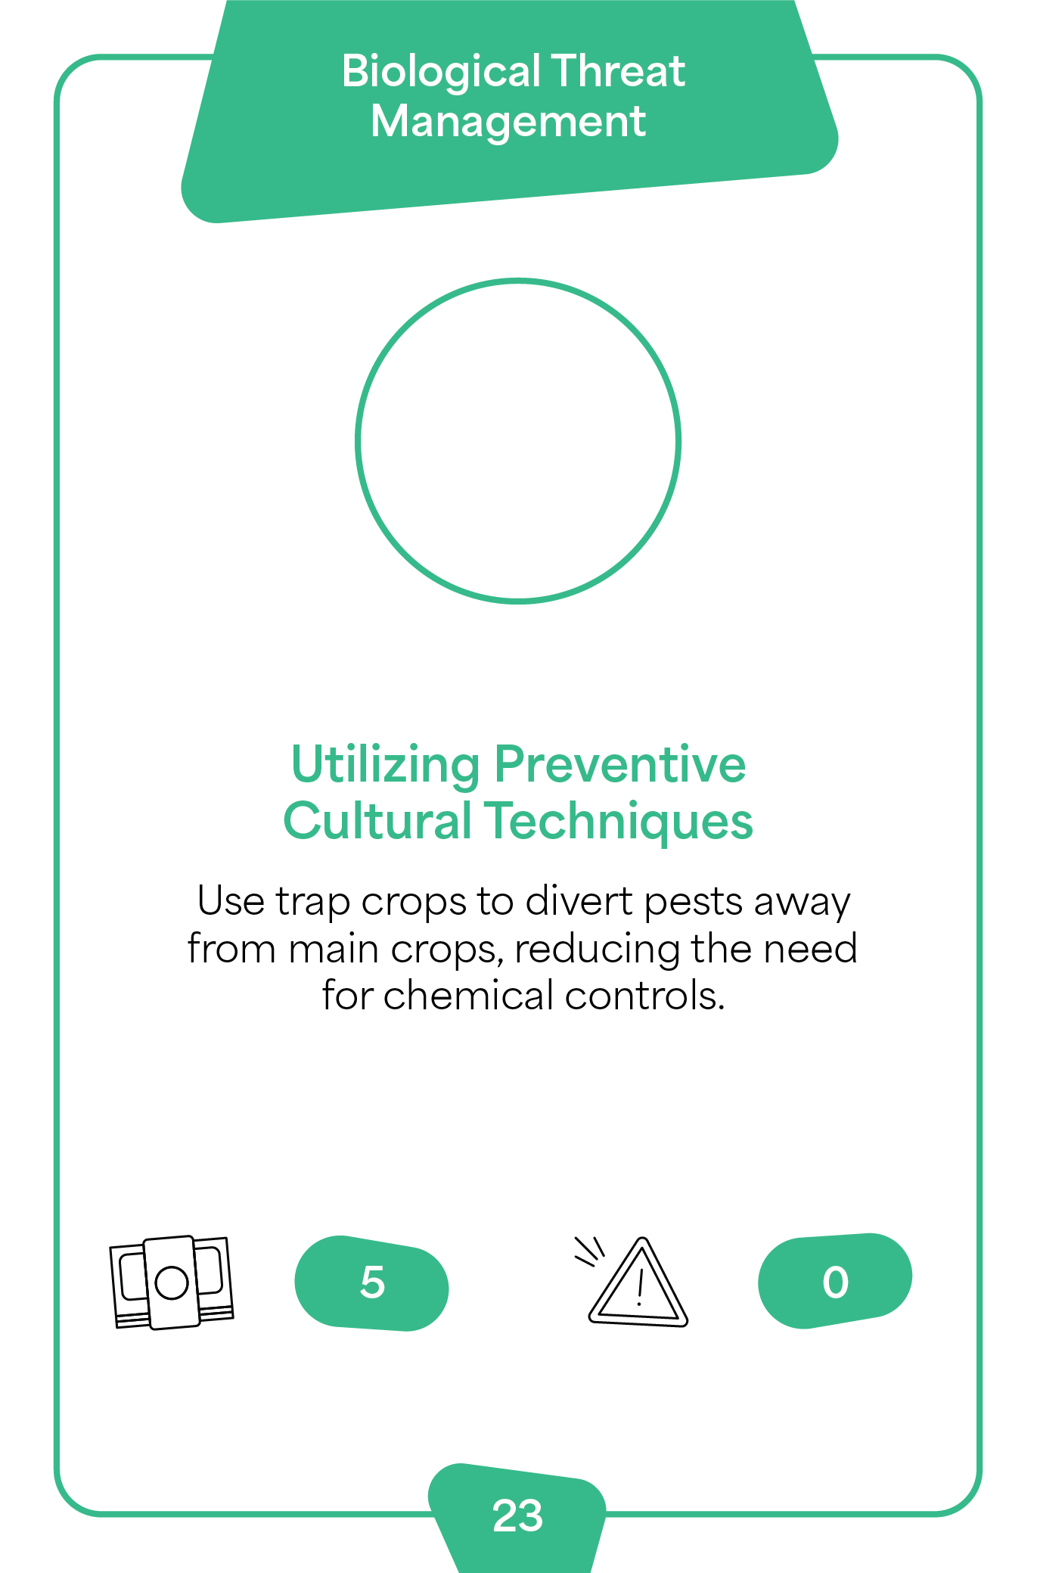
Farmer
Card 3
Index number 23

Slide 6
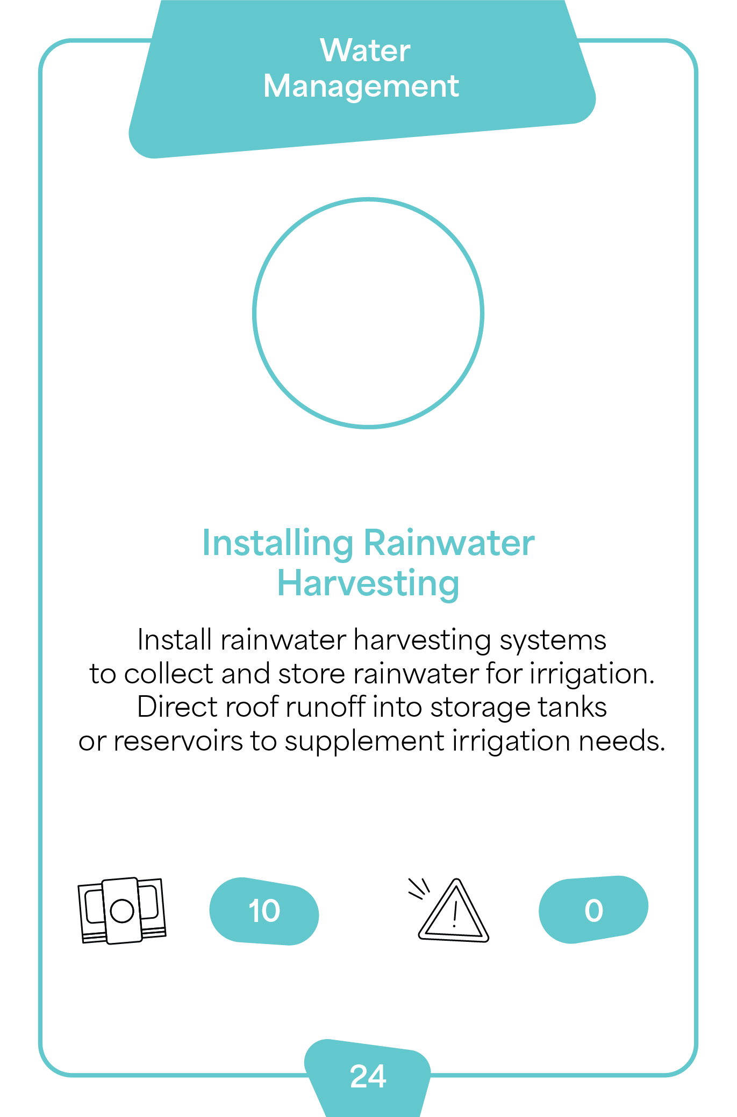
Farmer
Card 4
Index number 24

Slide 7

Farmer
Card 5
Index number 25

Slide 8
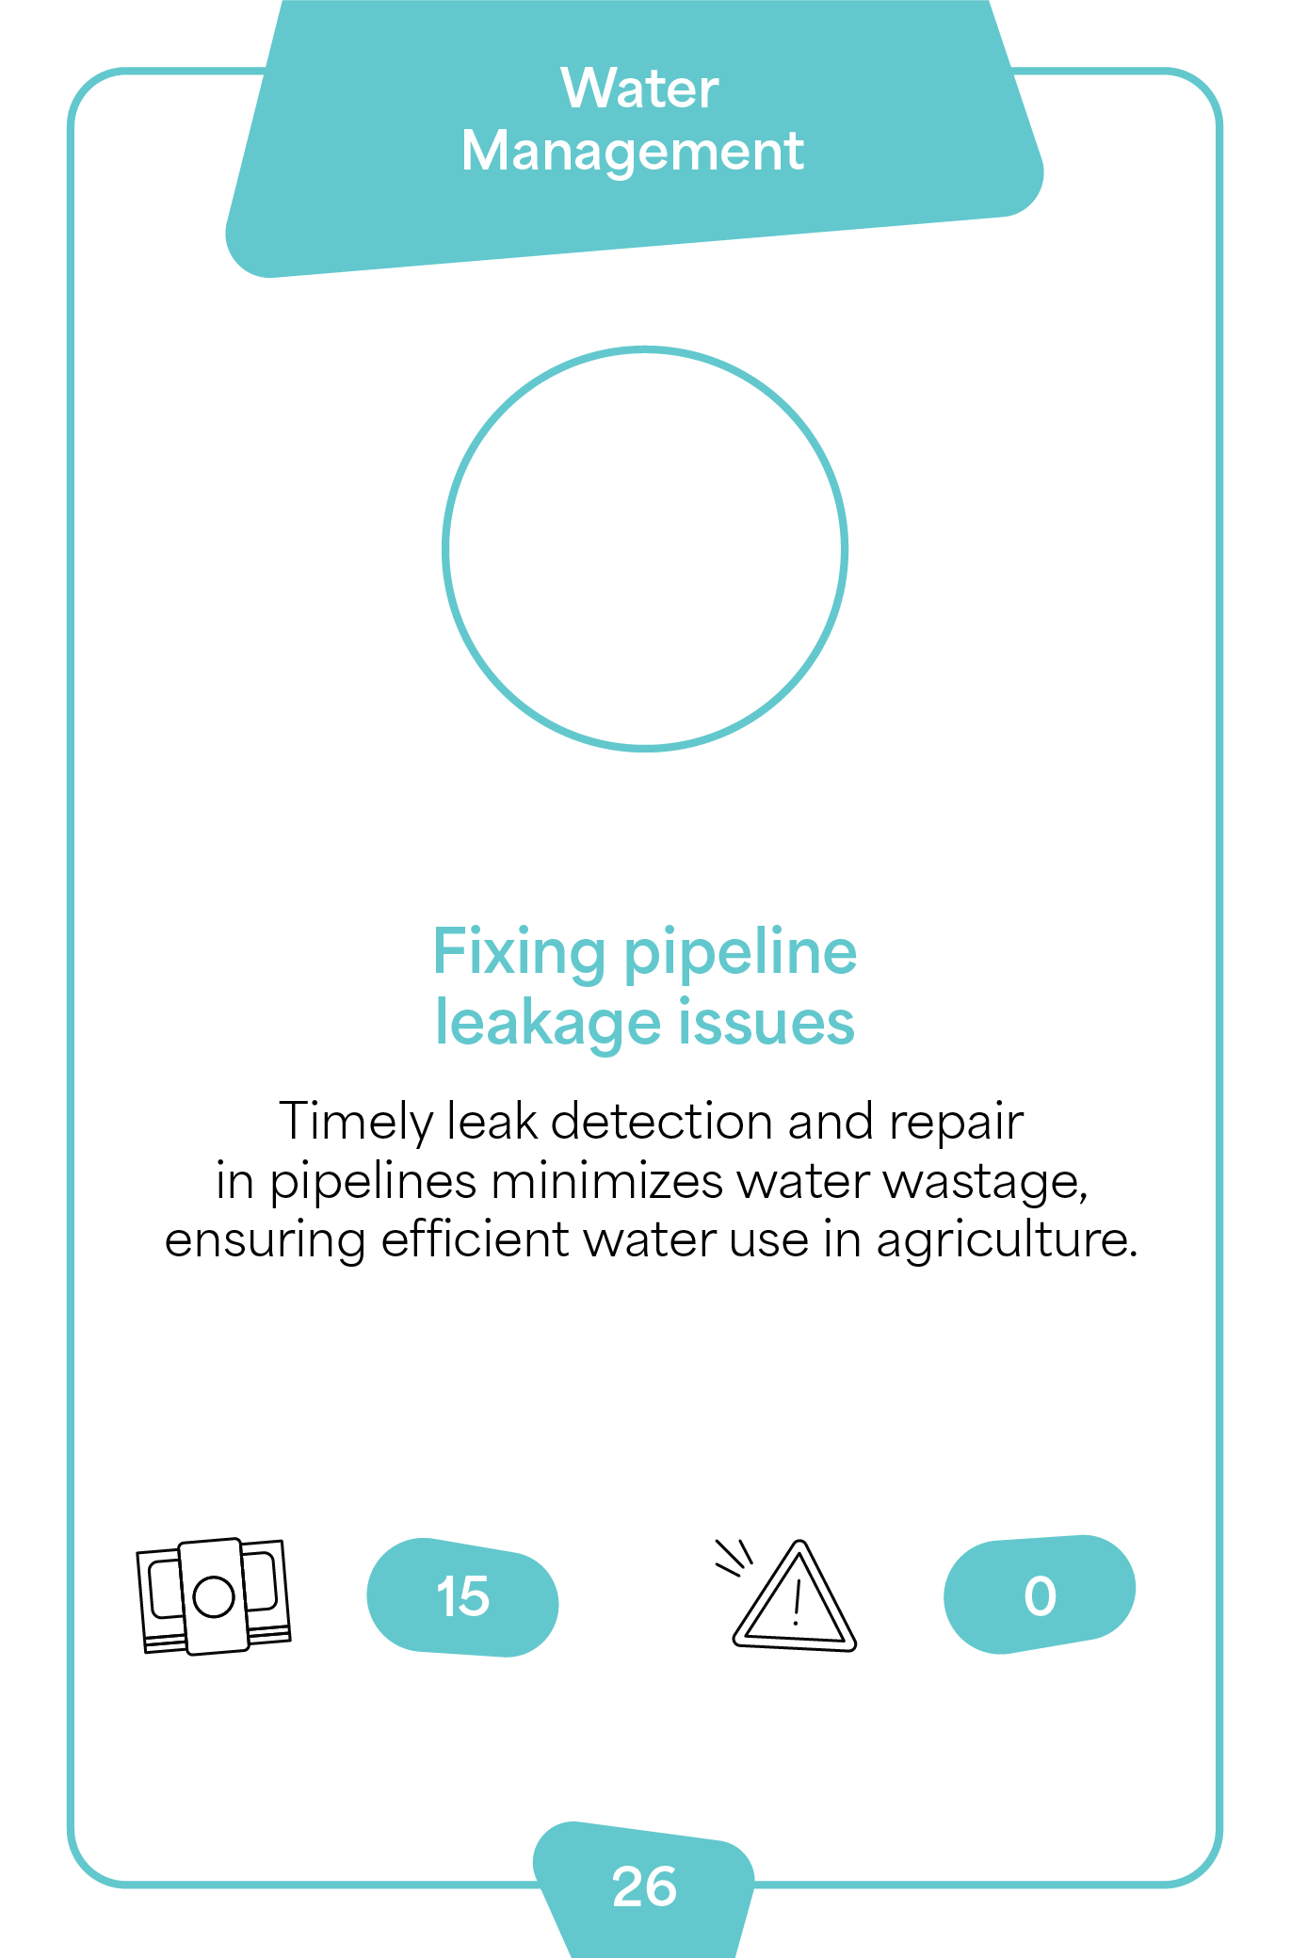
Farmer
Card 6
Index number 26

Slide 9
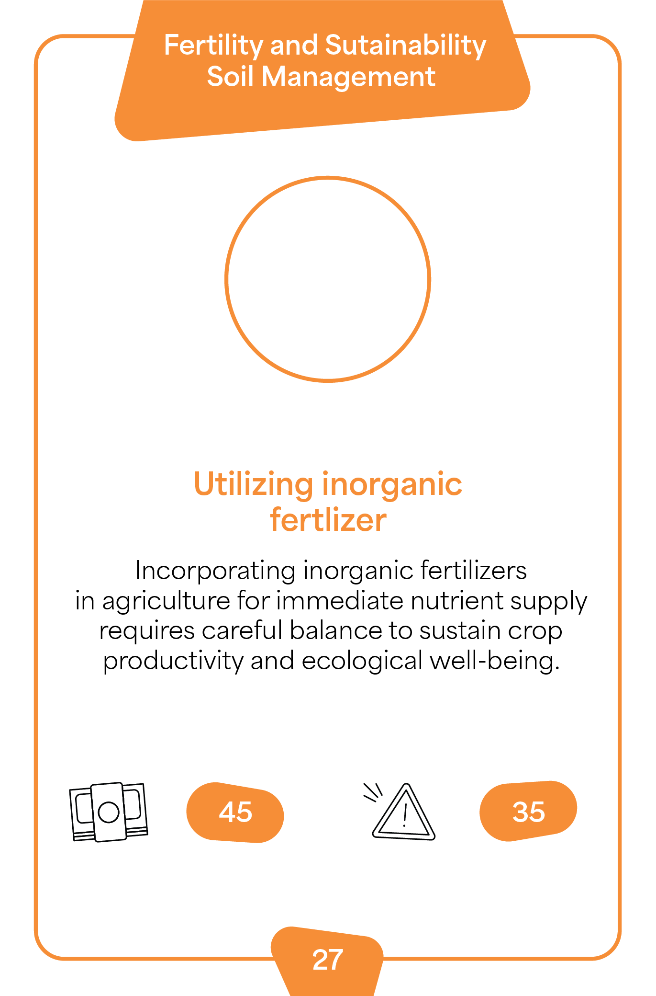
Farmer
Card 7
Index number 27

Slide 10
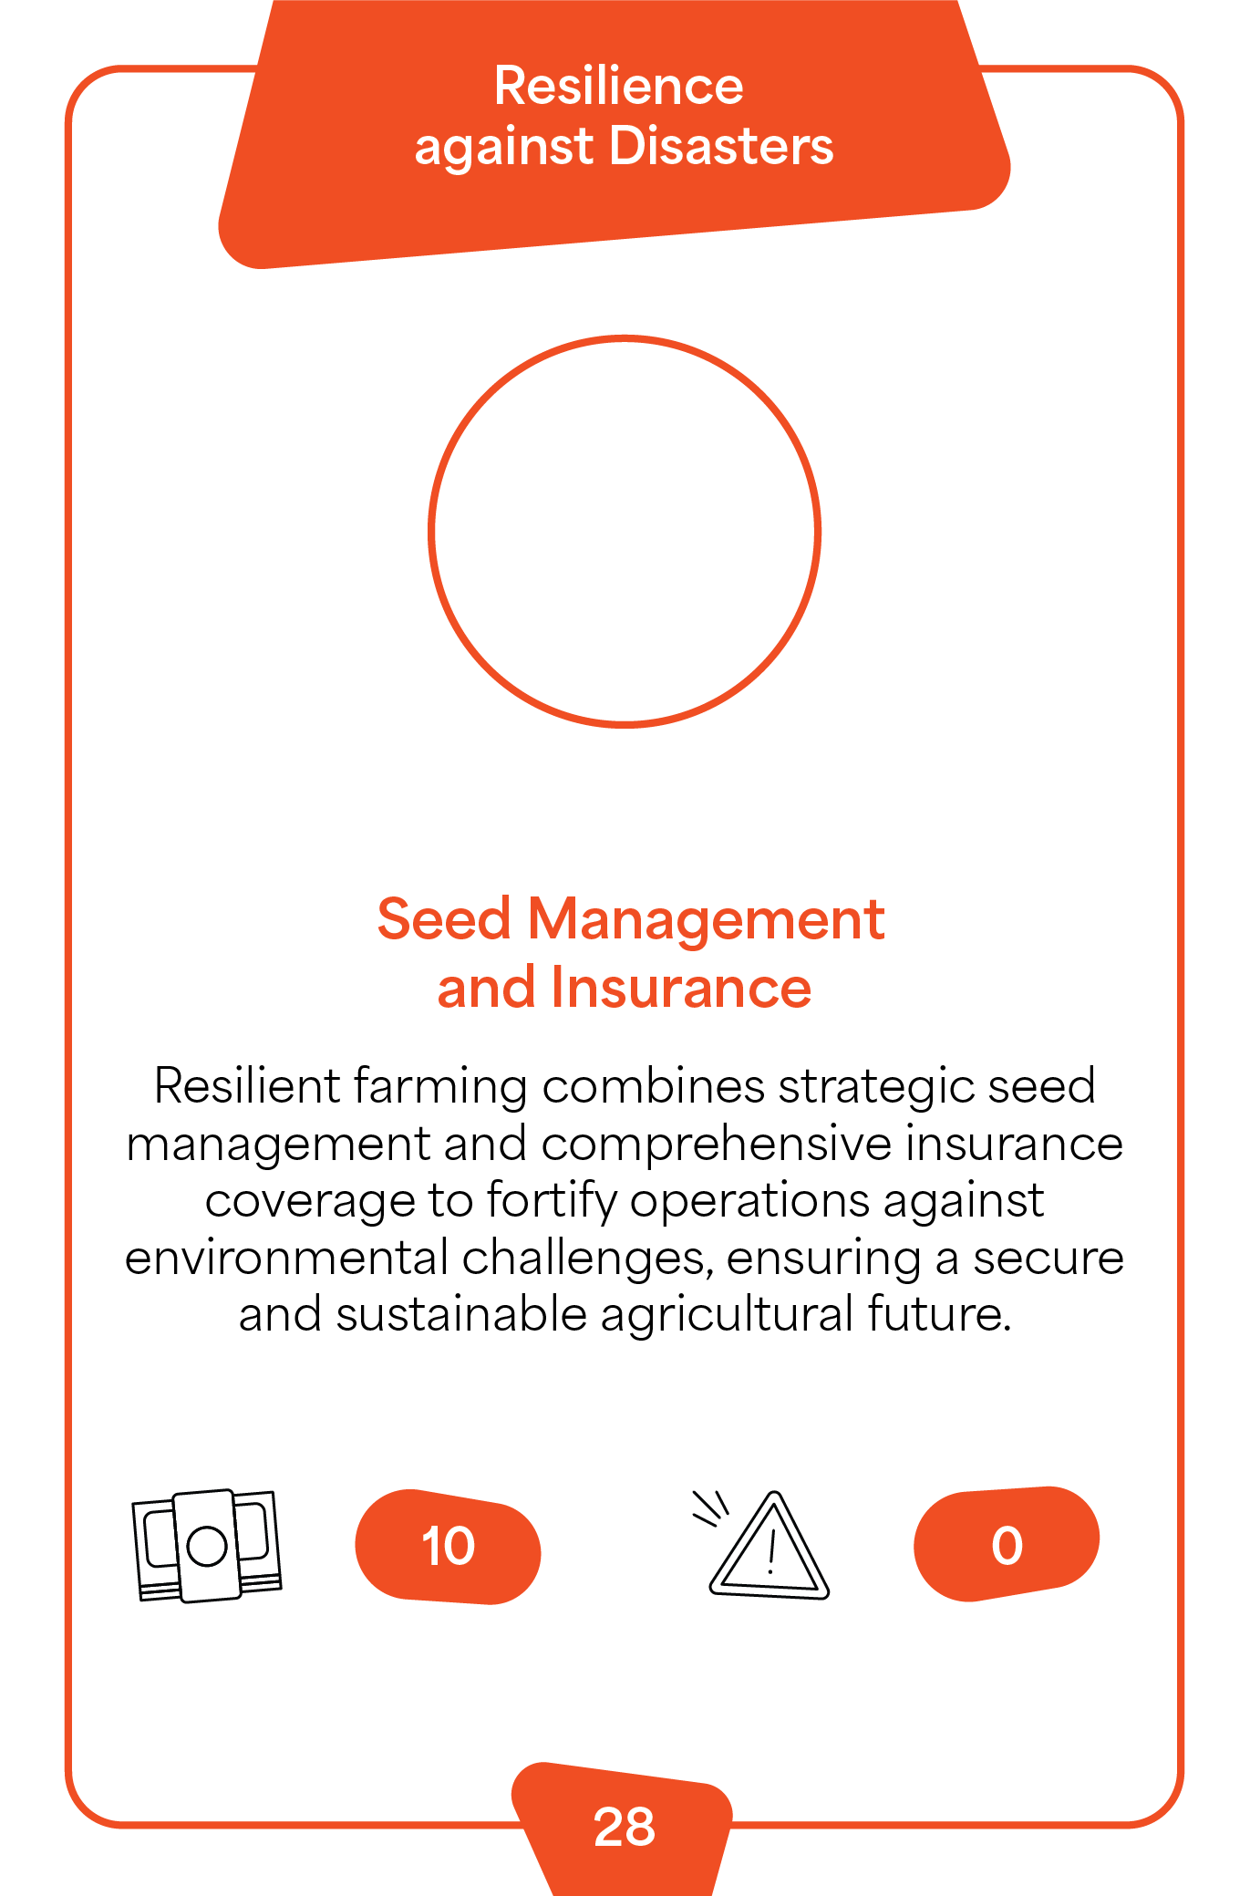
Farmer
Card 8
Index number 28

Slide 11

Farmer
Card 9
Index number 29

Slide 12
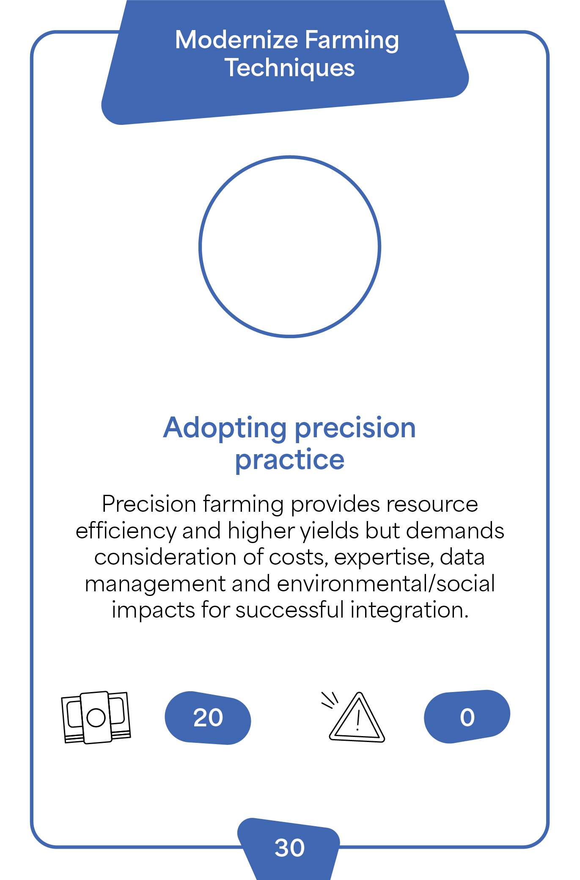
Farmer
Card 10
Index number 30

