Slide 1

Cultivate the Climate: A Game of Sustainable Agriculture​
FAO AGRIFOOD SIMULATION GAME
Policy marker cards

Slide 2

Policy Maker
The policymaker shapes farming policies, offering incentives, regulations, and training for better practices. They lack direct enforcement on farms, grapple with customizing policies, and face monitoring challenges due to practical constraints.
Player profile

Slide 3
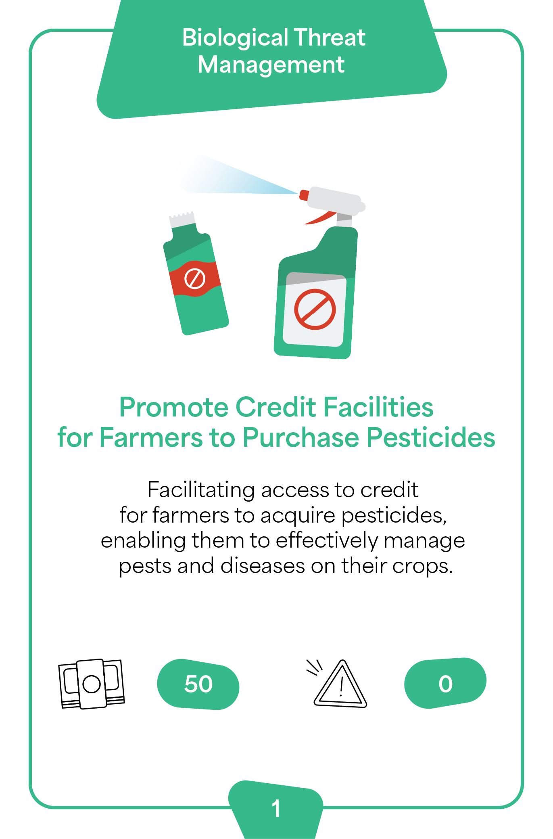
Policy Maker
Card 1
Index number 1

Slide 4

Policy Maker
Card 2
Index number 2

Slide 5
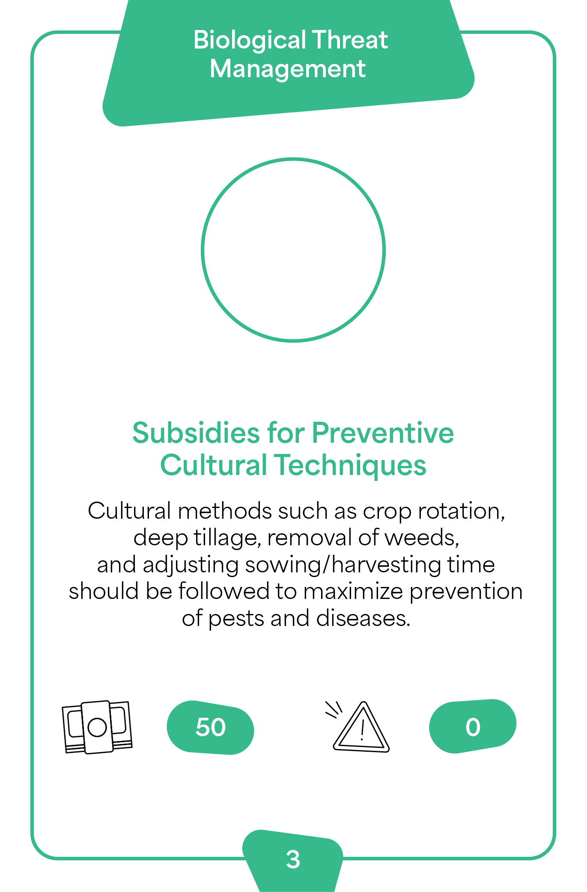
Policy Maker
Card 3
Index number 3

Slide 6
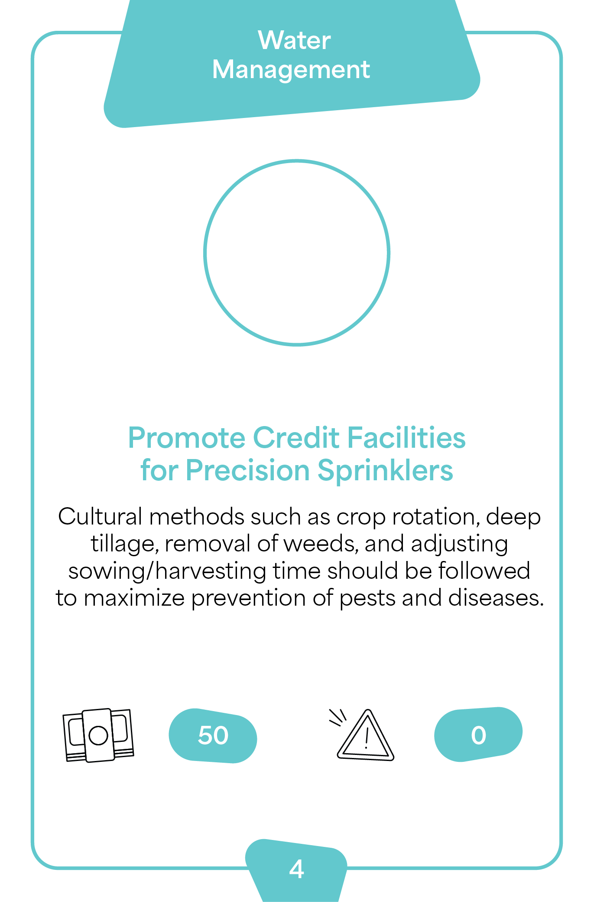
Policy Maker
Card 4
Index number 4

Slide 7
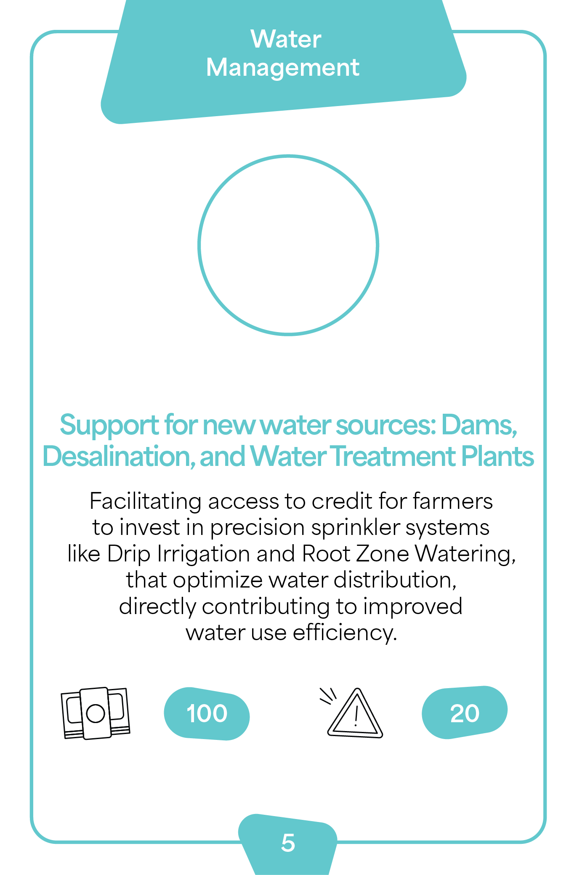
Policy Maker
Card 5
Index number 5

Slide 8
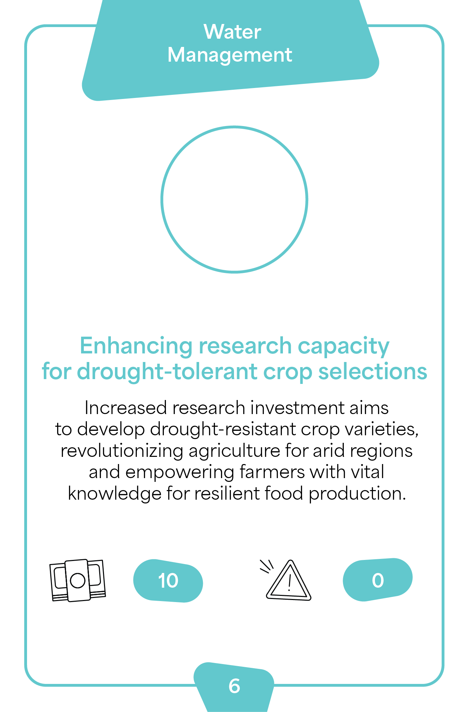
Policy Maker
Card 6
Index number 6

Slide 9
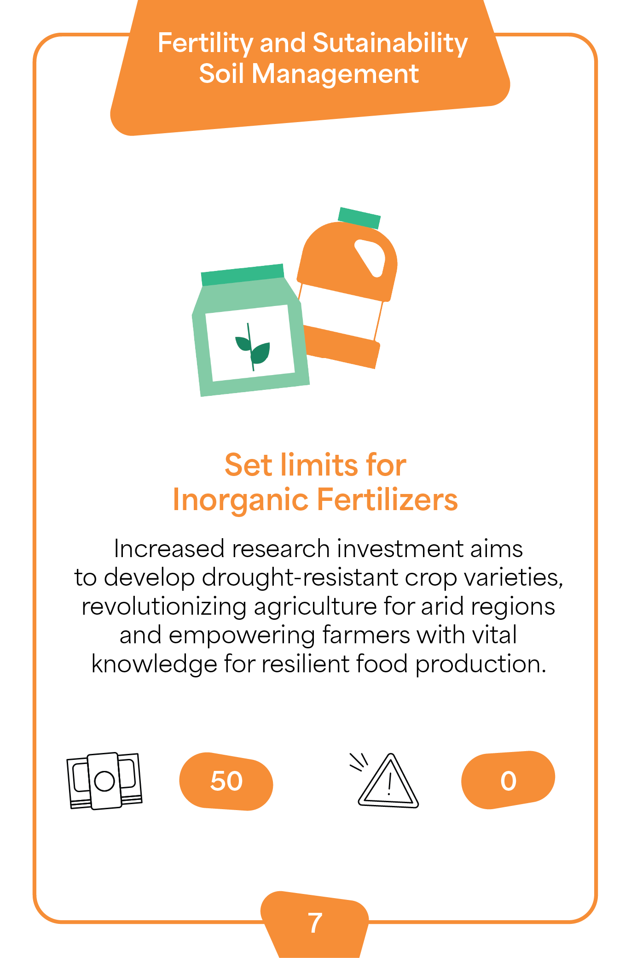
Policy Maker
Card 7
Index number 7

Slide 10
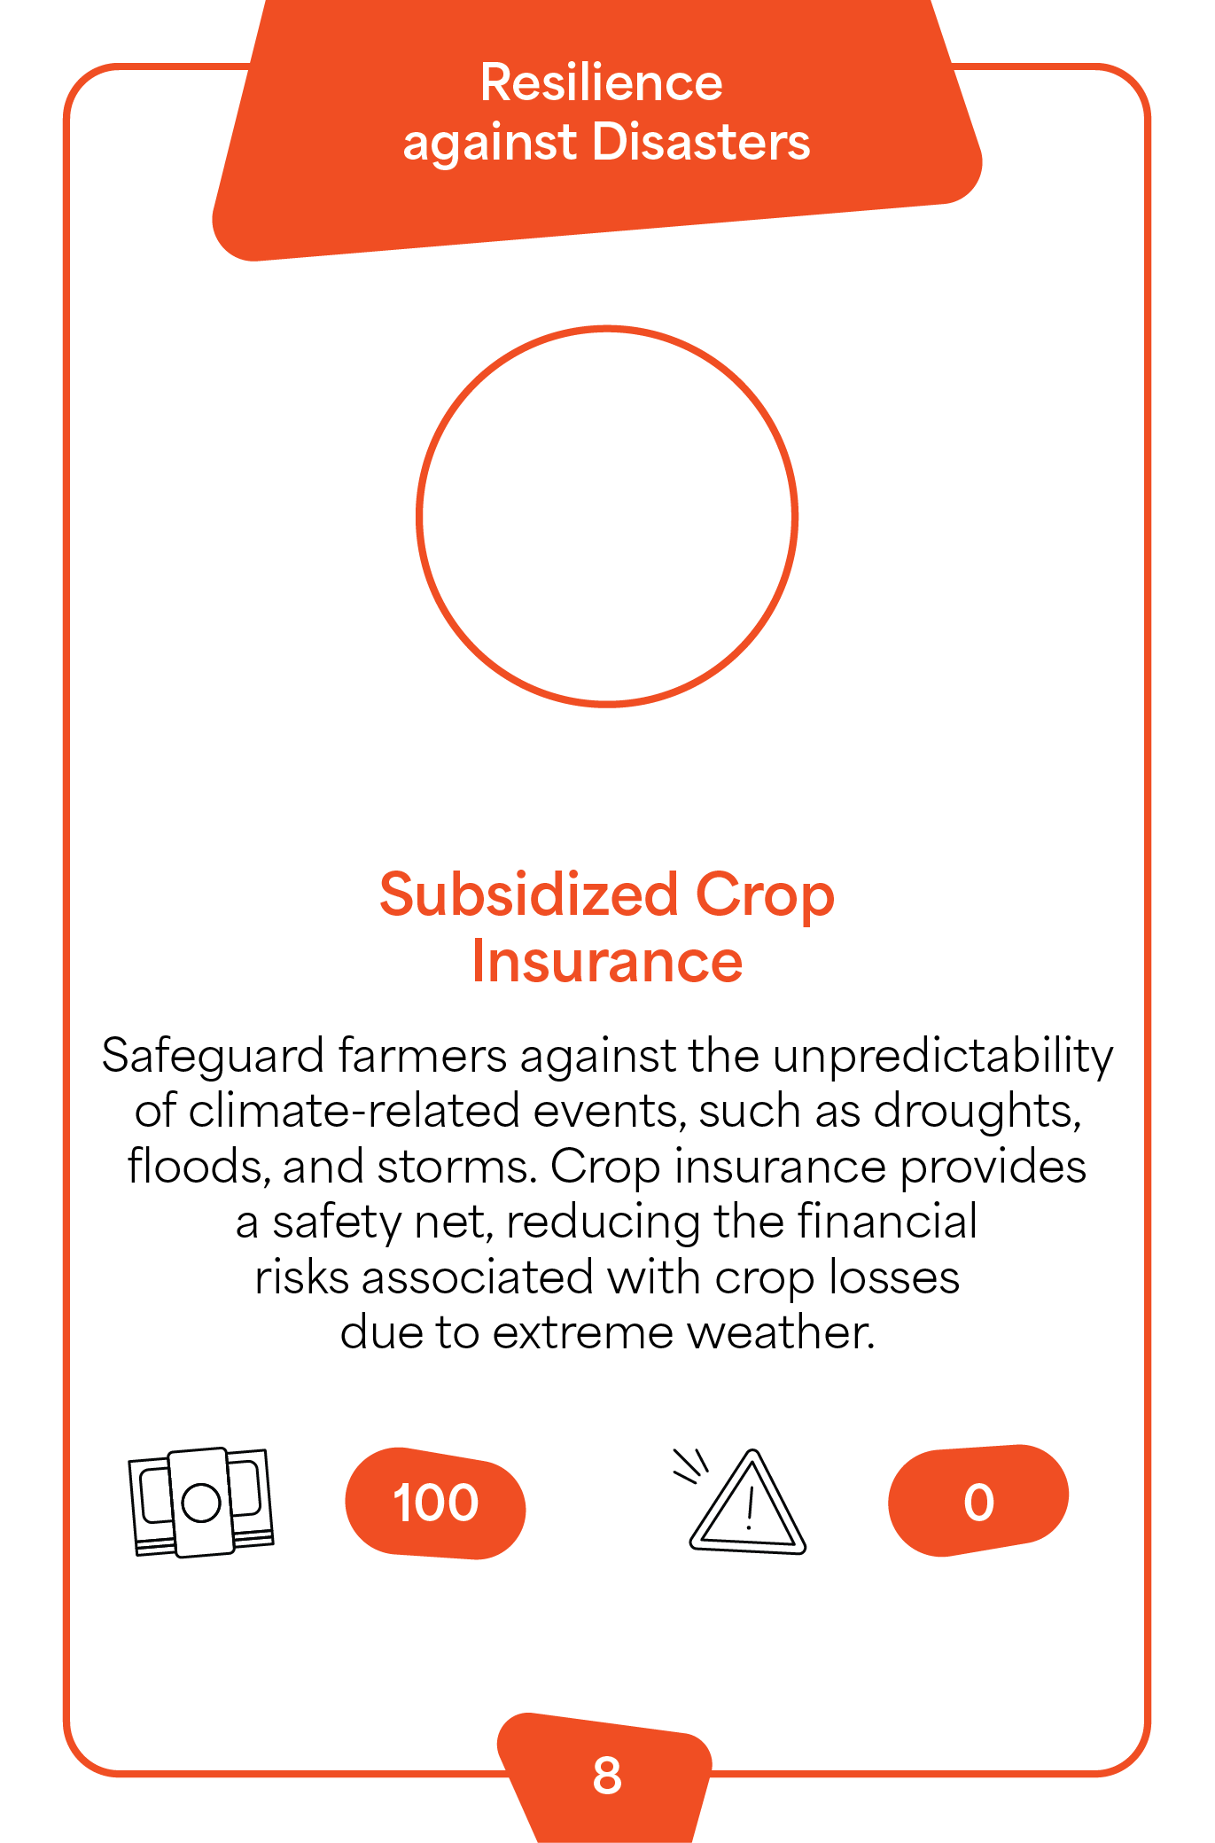
Policy Maker
Card 8
Index number 8

Slide 11
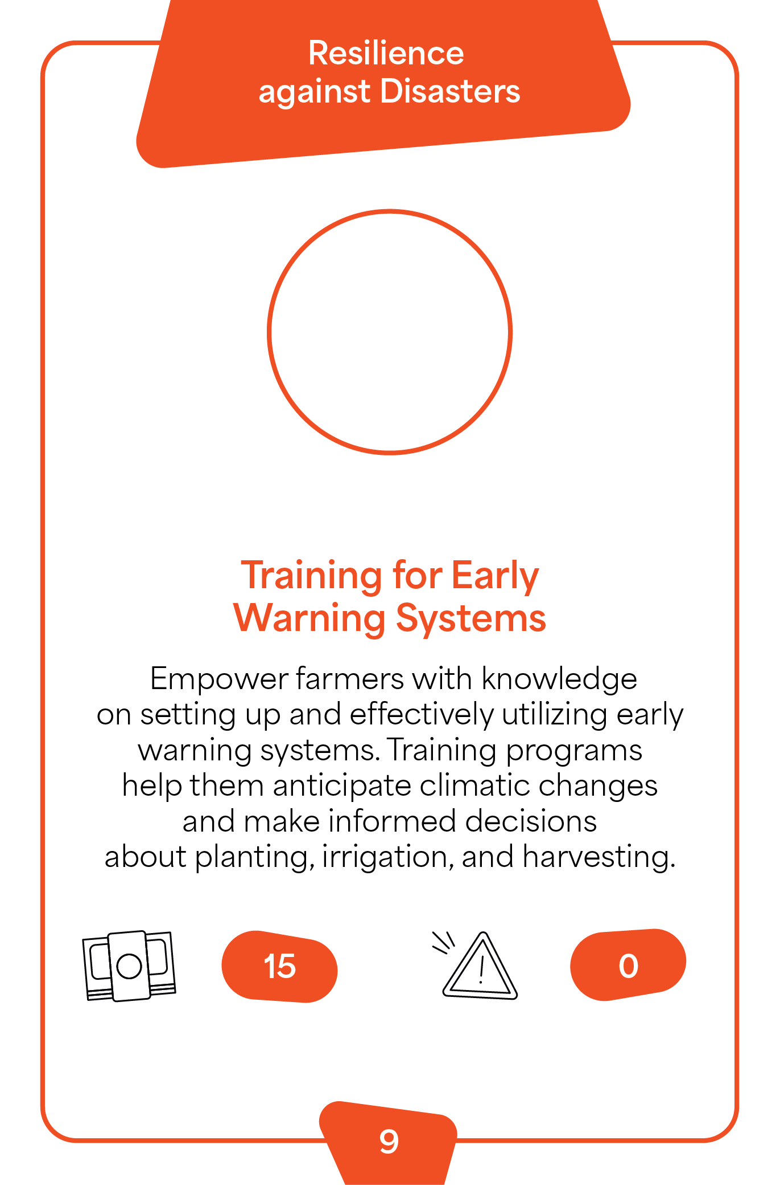
Policy Maker
Card 9
Index number 9

Slide 12
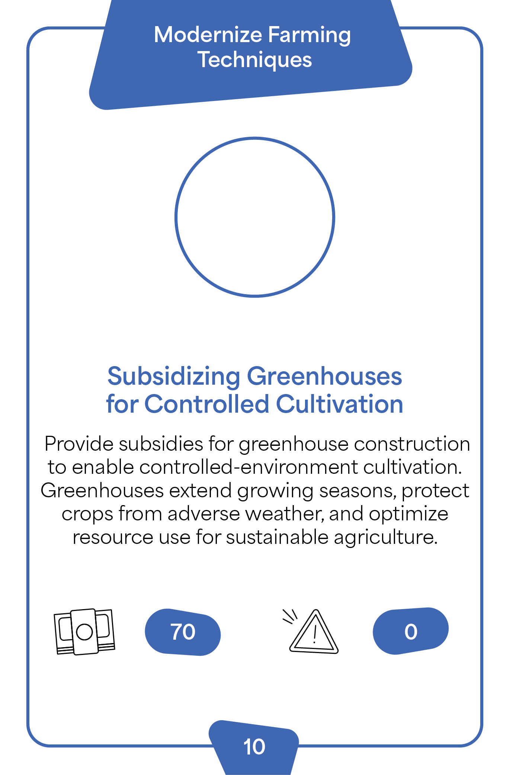
Policy Maker
Card 10
Index number 10

