Slide 1

Software Engineering
Restaurant Automation Project
Demo

Slide 2

Manager
Implemented Features:
Employee Management
Hire, Fire, Edit Employees
Inventory Management
Add, Remove, Update Stock
Financial Analysis
Determine and display food trends
Menu Management
Add, Remove, Update Menu Item

Slide 3

Customer
Implemented Features
Add Order
Place Order
Remove Order
Add / Remove Individual Items

Slide 4

Kitchen Staff
Implemented Features
Inventory
Can Access and Edit
Order Management
Display current order in organized window
Displays current waiter orders
Emergencies
Can send kitchen emergency signals

Slide 5

Waiter
Implemented Features
Payment Management
Accept Payment
Read Orders from different tables
Updates Table Balance
Messenger Between Employees
Assist Customer Window

Slide 6
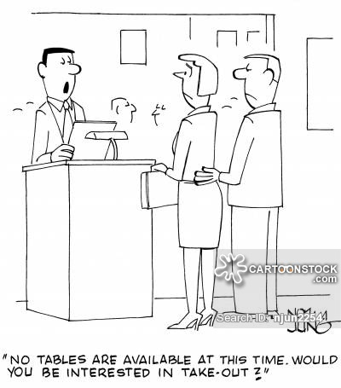
Host
Implemented Features
Communicates with Busboy
If table is declared as unclean by Busboy, it will be disabled for the host
Assigning waiters to tables
Declare multiple waiters to single table
Placing customers to tables
Declare table as occupied by customers
Declare table as unoccupied by customer

Slide 7
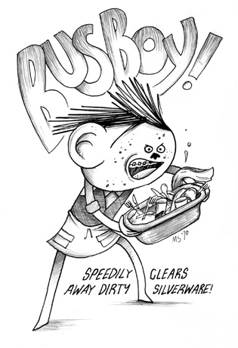
Busboy
Implemented Features
Table Status update
Clean and ready for customers
Unclean and not ready for customers
Will communicate with Host
If table is unclean, table will be disabled for Host’s use
If table is clean, table will be enabled for Host’s use

Slide 8
Future Work
Implementing Database
Synchronizing Software on multiple computers
Uniformity between interfaces
Code Optimizations
Trend Analysis with restaurant orders
Increased coupling between the different classes

