Slide 1

Agent-Based Model of Disinformation Spread
May 2024
Dr. Matthew Weber
Casey Randazzo

Slide 2
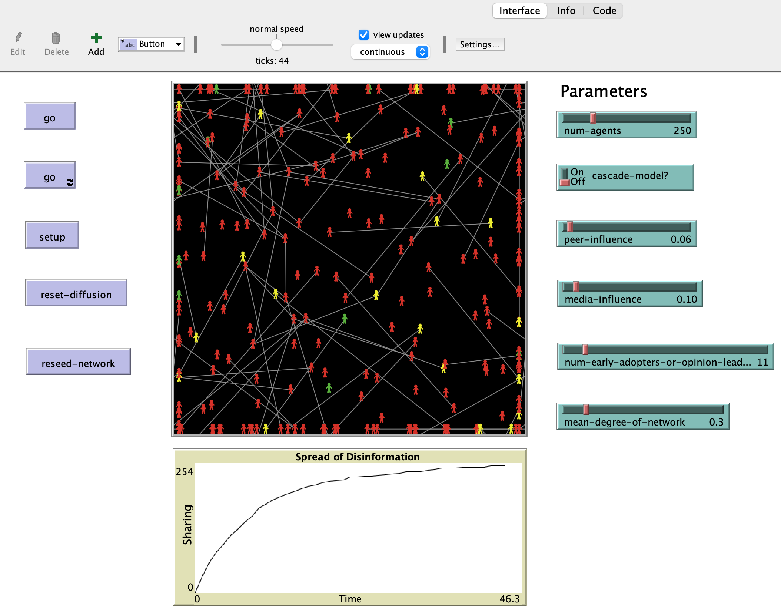
Model Development
A
Simulate disinformation spread
Developed in Netlogo
Information Cascade
& Bass Diffusion models
Main Assumption: Users adopt new information due to peer or media influence
Notes:
The purpose of the simulation is to model the spread of disinformation on social media. We developed the model in Netlogo. It considers the Information Cascade and Bass Diffusion models which we’ll discuss next. The main assumption of this simulation is that individuals adopt new information or behaviors due to peer or media influence.

Slide 3
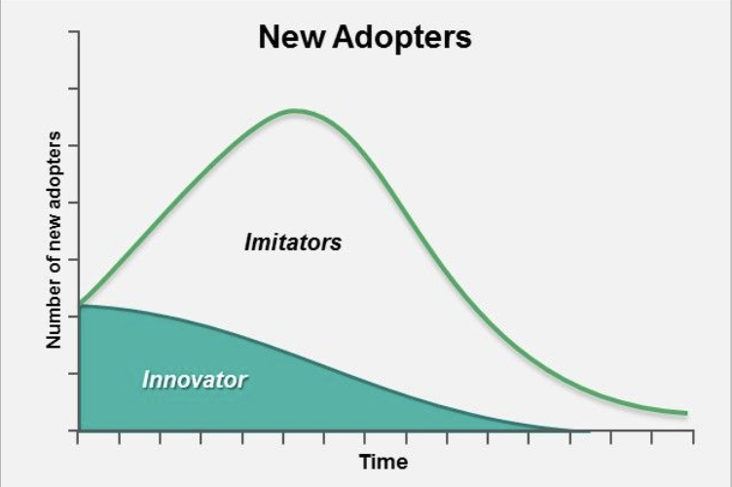
Diffusion Mechanism
A
Bass Diffusion Model
Operationalizes Diffusion of Innovations
Cumulative peer influence
Likelihood to share is proportional to % of neighbors who have shared
(Bass, 1969; Rogers, 1962)
Notes:
The bass diffusion model operationalizes aspects of Rogers’s diffusion of innovations theory which is often used to explain the adoption of new ideas, behaviors, or products. For example, an individual’s decision to purchase an iPhone might be influenced their friends also owning an iPhone, which is a peer pressure effect. In this bass model, as applied to this study, the likelihood to share disinformation is proportional to the percent of neighbors who have already shared.
This image illustrates the distribution of innovators (early adopters) and imitators (majority of others) over time. The plot declines after reaching market saturation.

Slide 4
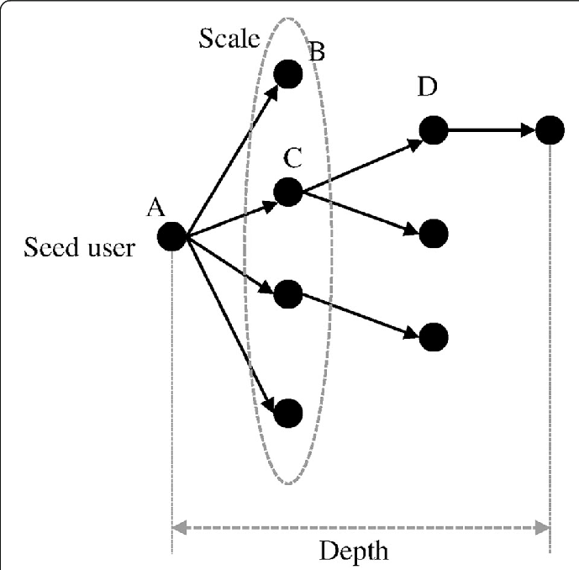
Diffusion Mechanism
A
Information Cascade Model
Direct peer influence
Snowball effect
Probability of subsequently sharing disinformation increases as others share
(Bikchandani et al., 1999)
Notes:
On social media platforms, information cascades describe users sequentially making the same decision. When applied to this study, the cascades model reveals how disinformation can rapidly spread or go viral within a network due to direct peer influence. Each user is influenced by the actions of those before them, leading to a snowball effect.
The image here visualizes the information cascade process. First, the model shows the propagation of information from the seed user (A) through multiple layers of users (B, C, D), indicating the flow and spread of information within a network.

Slide 5
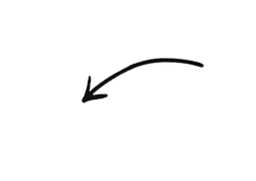
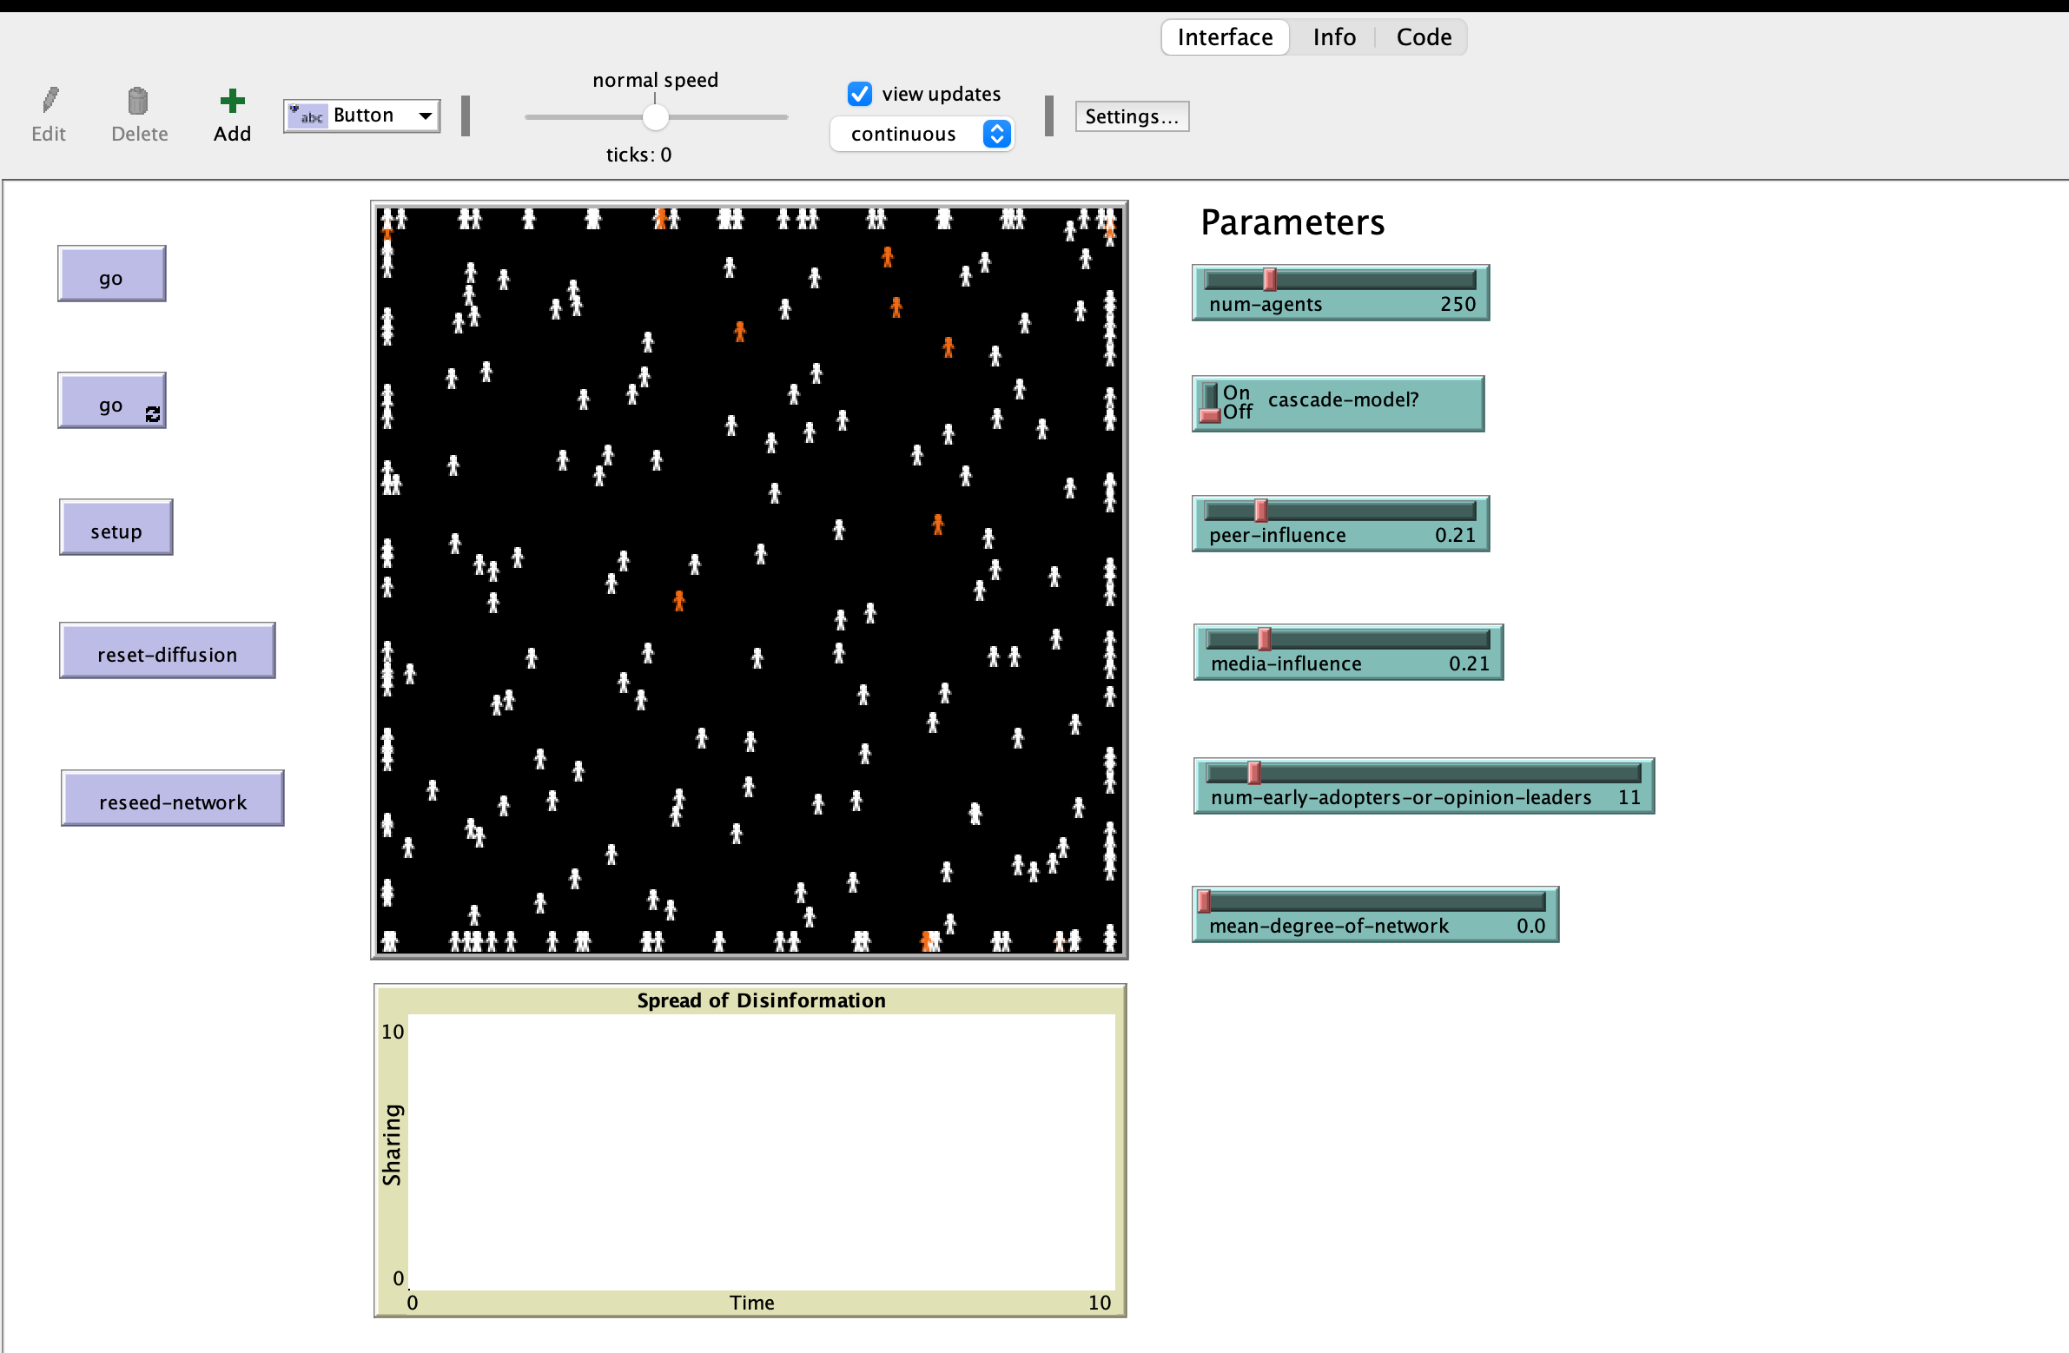
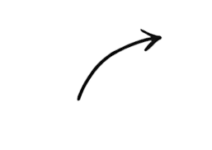
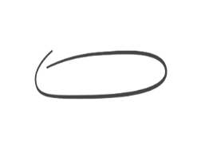



Step 1) Choose parameters
Model Setup
Step 2) Click ‘setup’
Number of users in the network.
Toggle to ‘on’ to test the Cascade Model and ‘off’ to test the Bass Model.
Base level of influence that peers have on each other.
Adjusts the influence of external media on sharing behavior
Sets the number of early adopters of the disinformation
Alters the average number of connections each agent has, influencing network density (level of connectivity)
KEY
Haven’t shared disinformation
Shared disinformation
Early adopters (first to share)
Notes:
First, choose the parameters of ineterst.

Slide 6
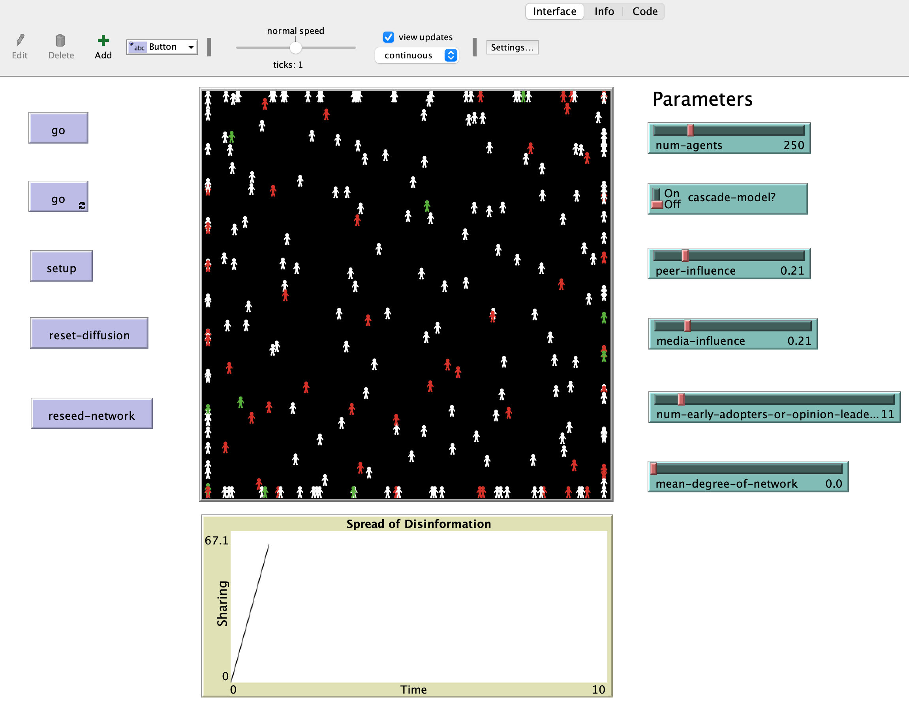
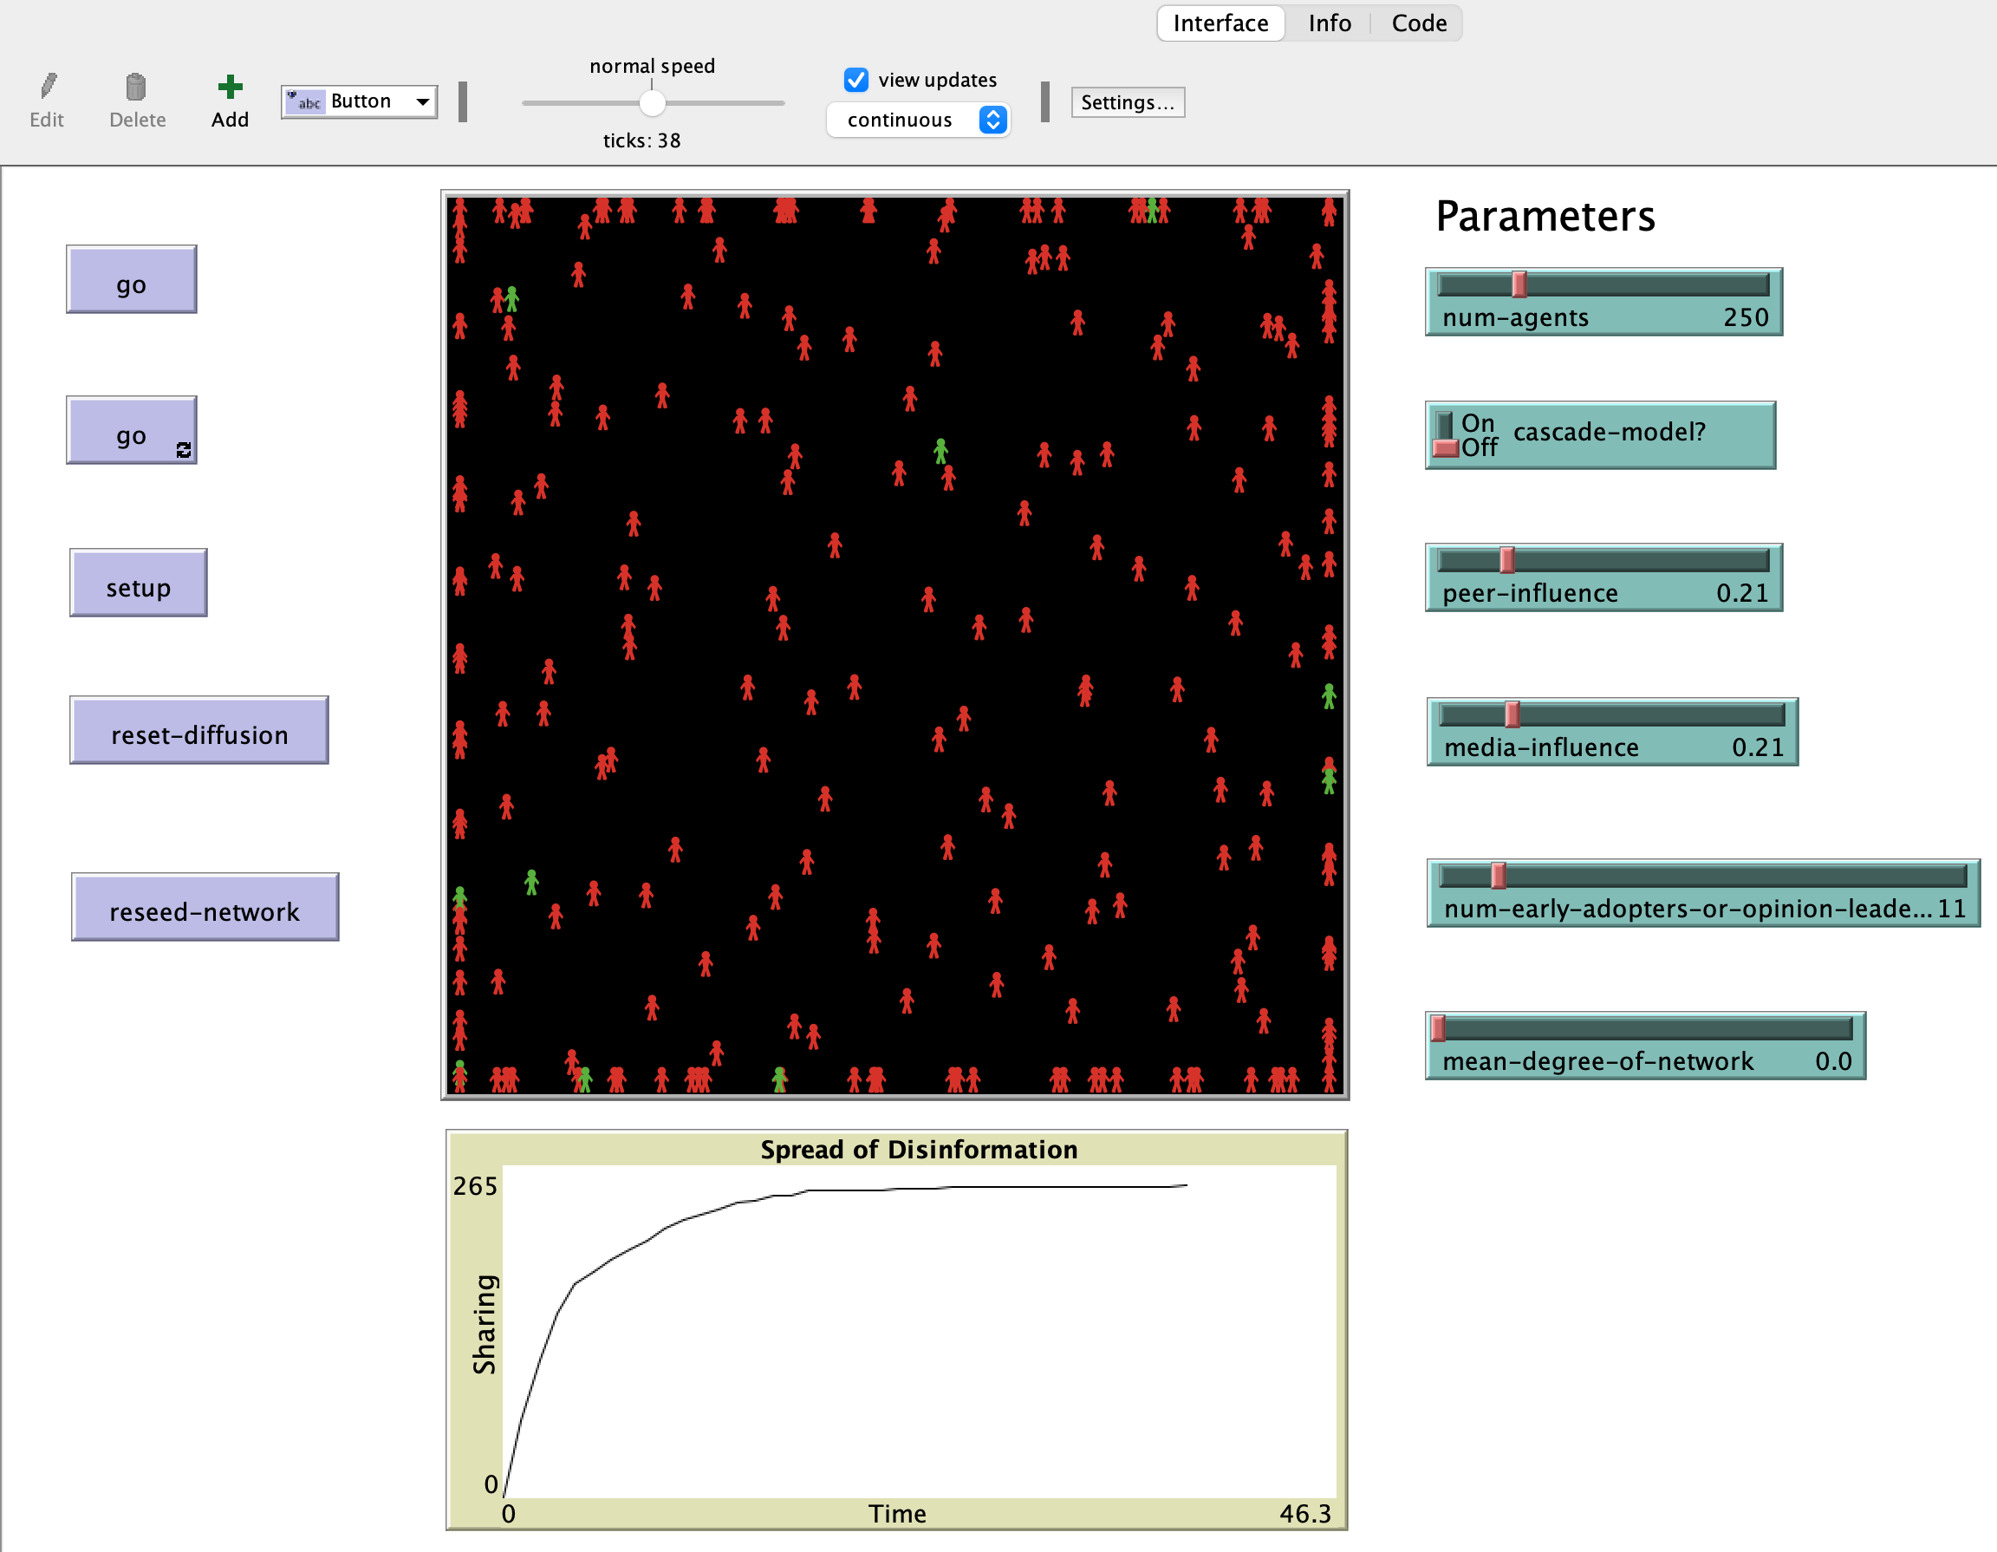
Initiate Simulation
Step 3) Run the model
Click ‘go’ to run a single iteration Or click ‘go ∞’ to run all possible iterations
Number of iterations
Notes:
We want to begin by setting up the model

Slide 7
Results
Resets the sharing status of all agents while
maintaining the same network structure
Resets which agents
are early adopters
Step 4) Review results
Tracks the spread of information over time. The X-axis likely represents time (ticks), and the Y-axis represents the number of agents sharing information
Notes:
The bottom plot tracks the spread of information over time. The X-axis likely represents time (ticks), and the Y-axis represents the number of agents sharing disinformation.

