Slide 1
Populization: An interactive population density analyzing, and visualizing application based on International Census data from 1950-2050
Presented by Group3,
Harshini Bonam (sdb202)
Nikhil Neroor (nn323)
Prathamesh Kulkarni (pmk107)
Under the guidance of,
Instructor: Prof. James Abello
TA: Fangda Han, Nishant Kumar

Slide 2
Data
Source - Kaggle
Size - 1.7 GB with 3 million+ records
Rest data
Time variant data
File type - a collection of .csv files exported to MySQL

Slide 3
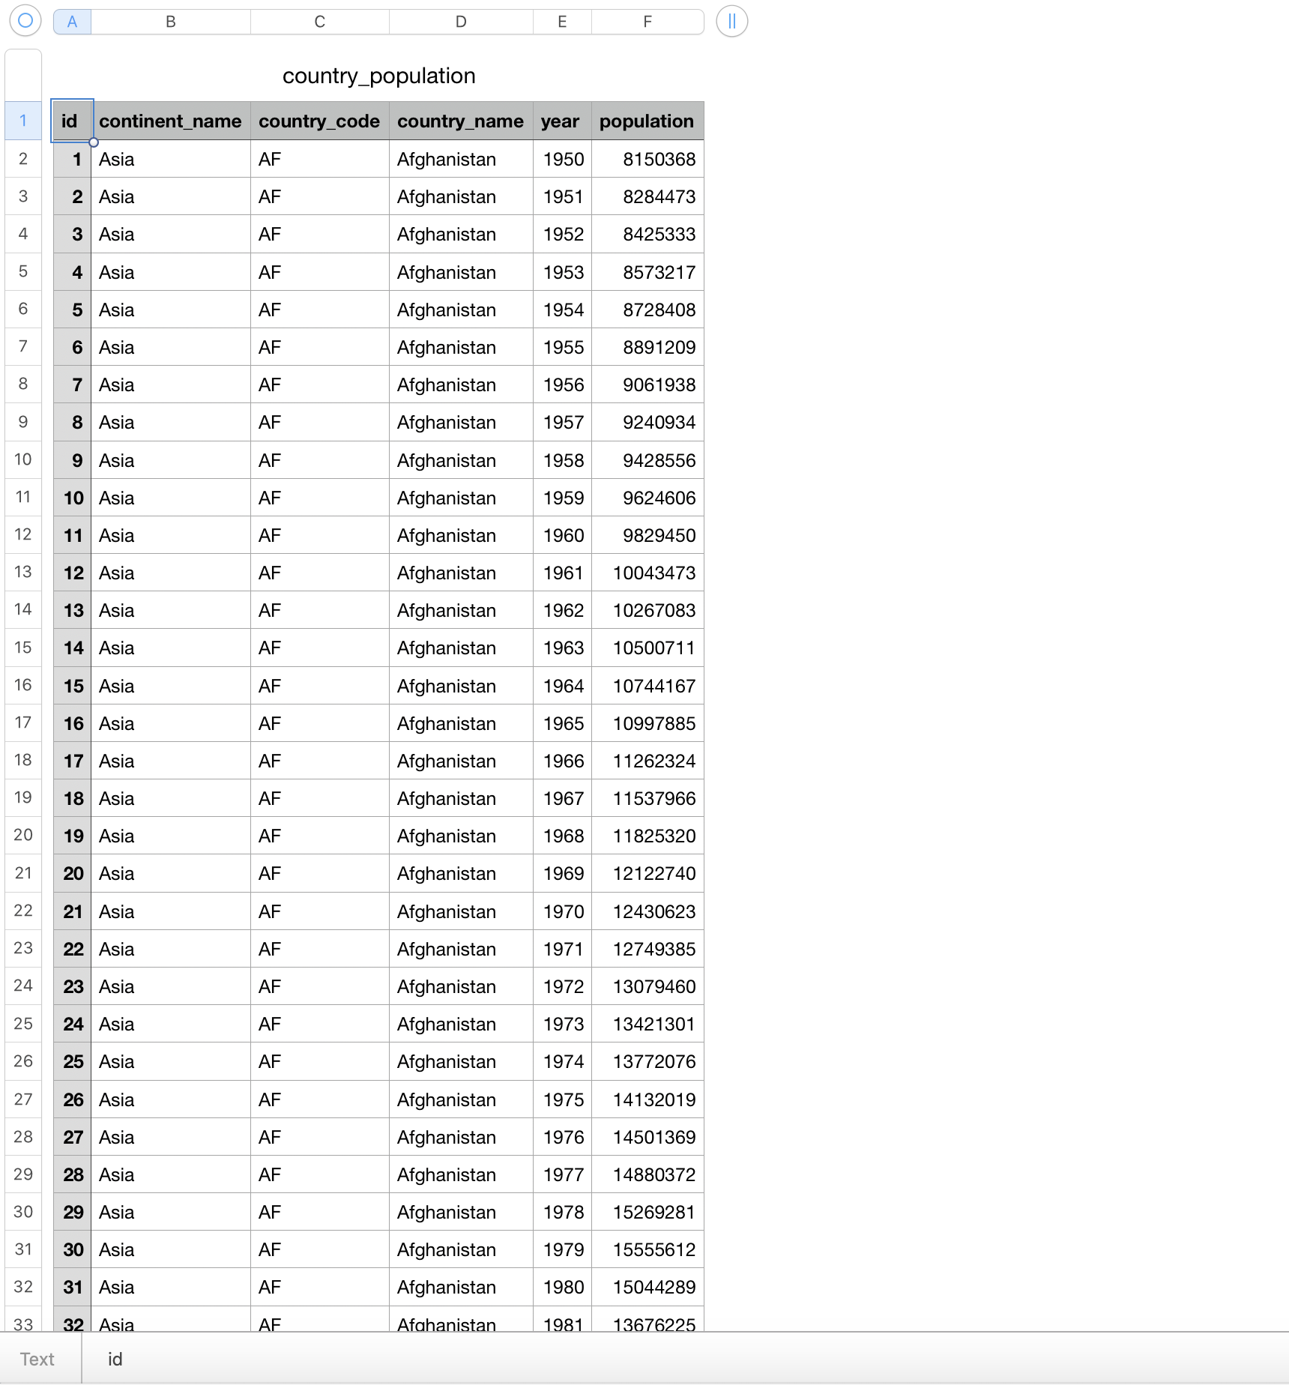
Snapshots of Data

Slide 4
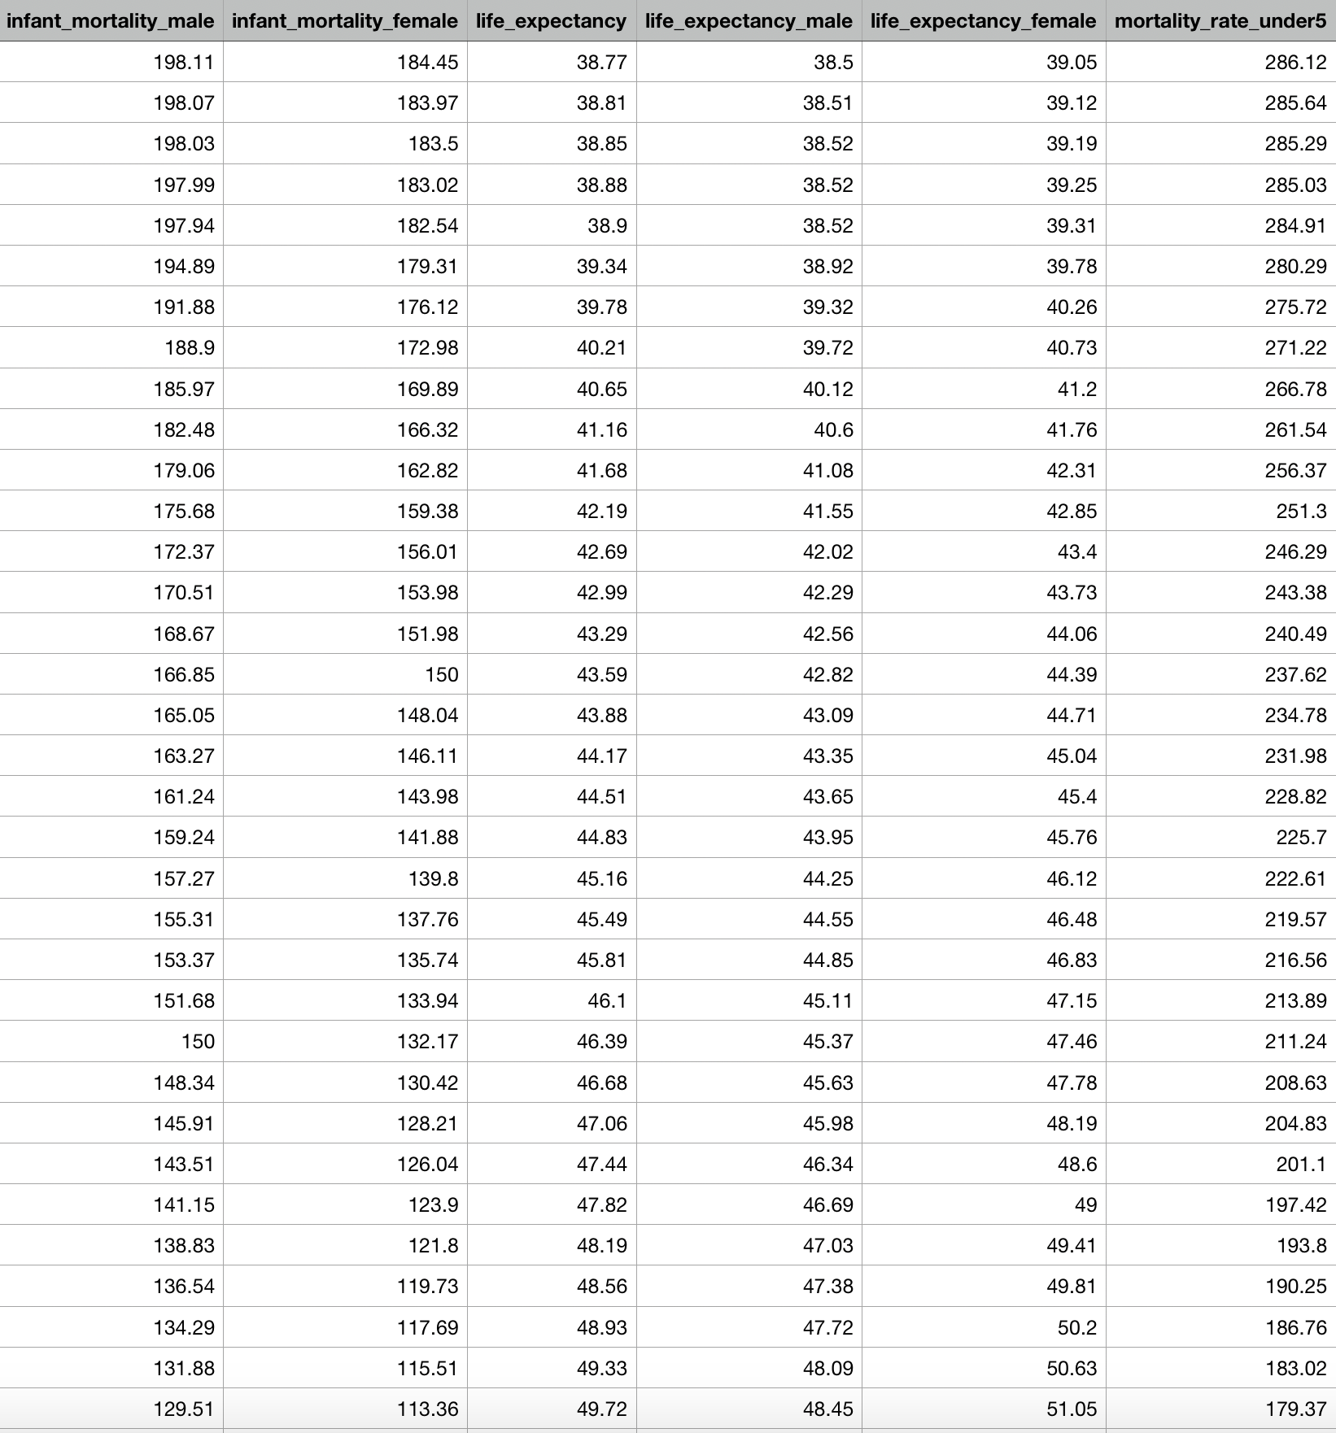

Slide 5
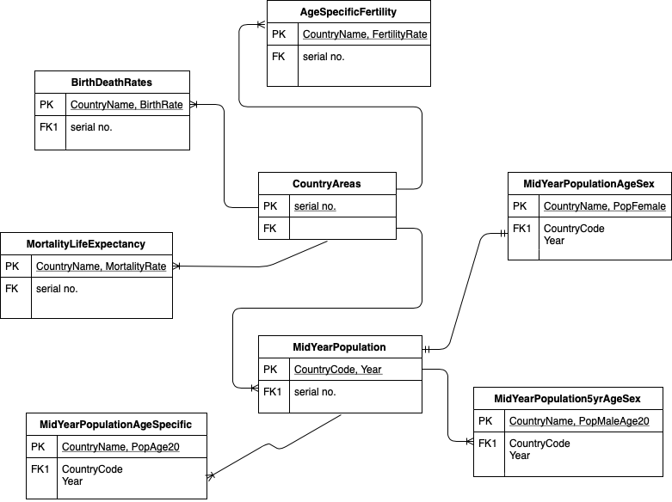
ER Diagram

Slide 6
Questions we would like to answer…
Some interesting population growth trends of 228 countries.
Some insights distinctions countries based on population density.
Which gender is better surviving under the age of 5?
Distribution of the ages of migrating people and the average age of a country.

Slide 7
Types of Users
Governments Organizations
Non-Government Organizations like:
The United Nations Organizations
Social Welfare Organizations
Research Teams

Slide 8
Mode of data processing
ARCHITECTURE: Model-View-Template Architecture using Django Framework
FRONTEND: HTML5, CSS, Javascript
D3 V5 library
AJAX
BACKEND: Python, MySql

Slide 9
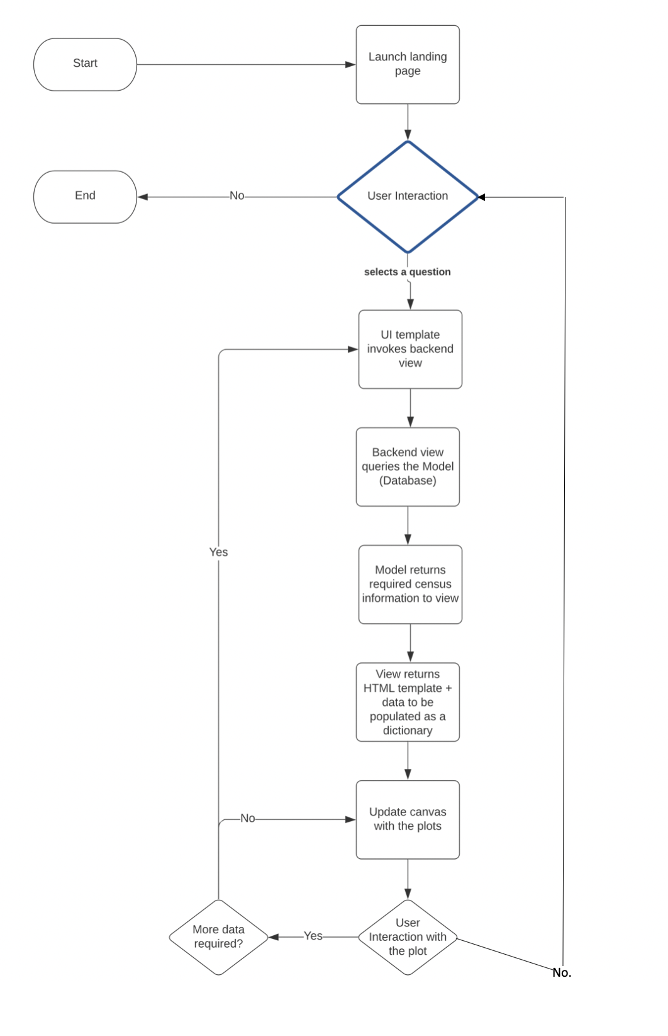
Flow Chart

Slide 10
Visual Representations
Scatter - Line Chart
Bar Chart
Choropleth
Pie Chart
Bubble Chart

Slide 13
Interaction
Zooming
Panning
Labels
Horizontal Sliders

Slide 14
DEMO

Slide 15
Interesting Findings

Slide 16
To be completed
Make changes based on feedback.
Enable bar and pie charts for remaining questions.
Add vertical line tooltip to canvas.
Get more interesting findings from the data.
Final report & video.

Slide 17
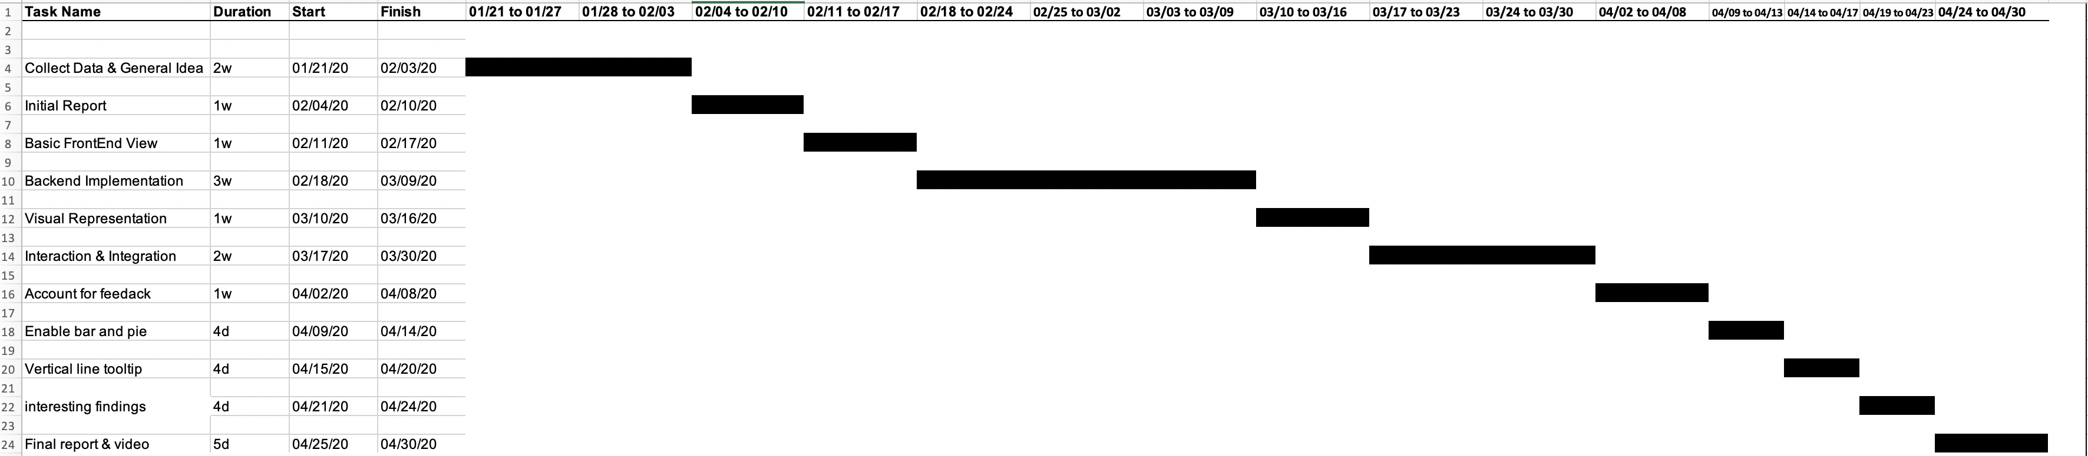
Timeline

