Slide 1
Populization: An interactive population density analyzing, and visualizing application based on International Census data from 1950-2050
Presented by Group3,
Harshini Bonam (sdb202)
Nikhil Neroor (nn323)
Prathamesh Kulkarni (pmk107)
Under the guidance of,
Instructor: Prof. James Abello
TA: Fangda Han, Nishant Kumar

Slide 2
Data
Source - Kaggle
Size - 1.7 GB with 3 million+ records
Rest data
Time variant data
File type - a collection of .csv files exported to MySQL

Slide 3
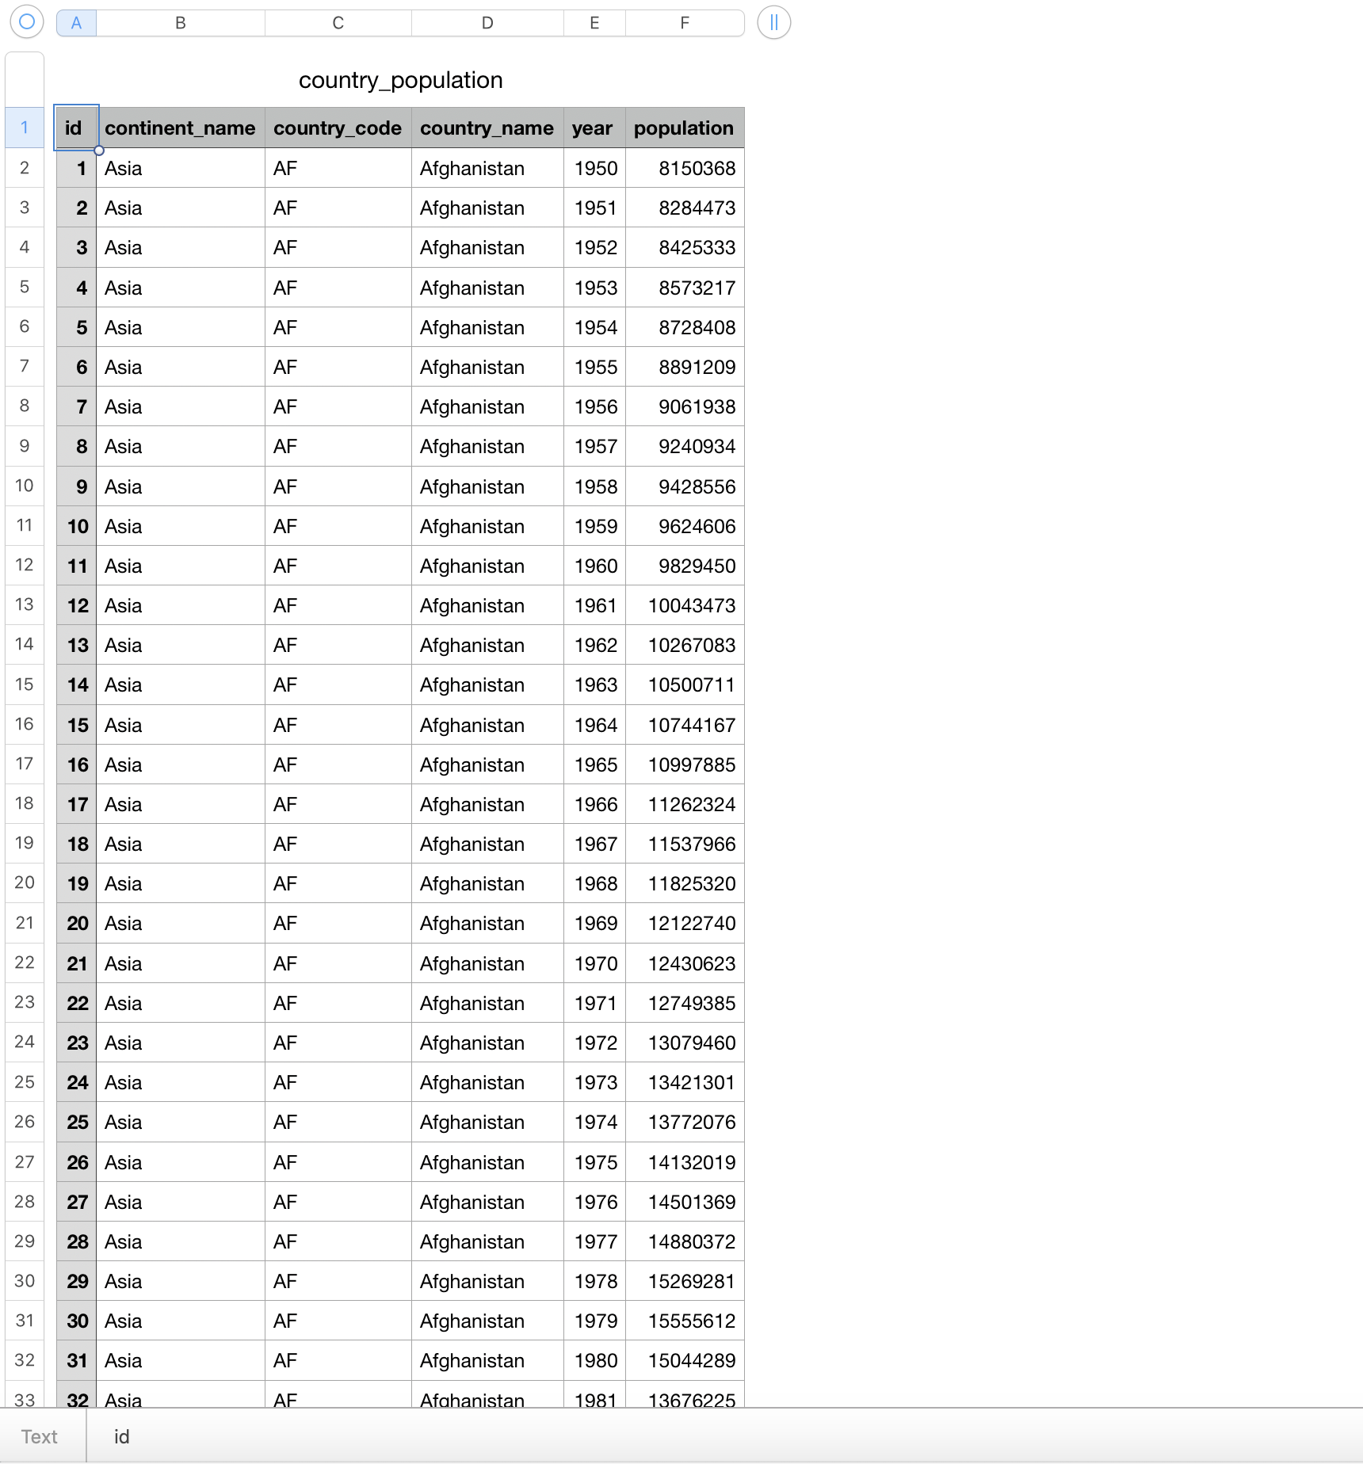
Snapshots of Data

Slide 4
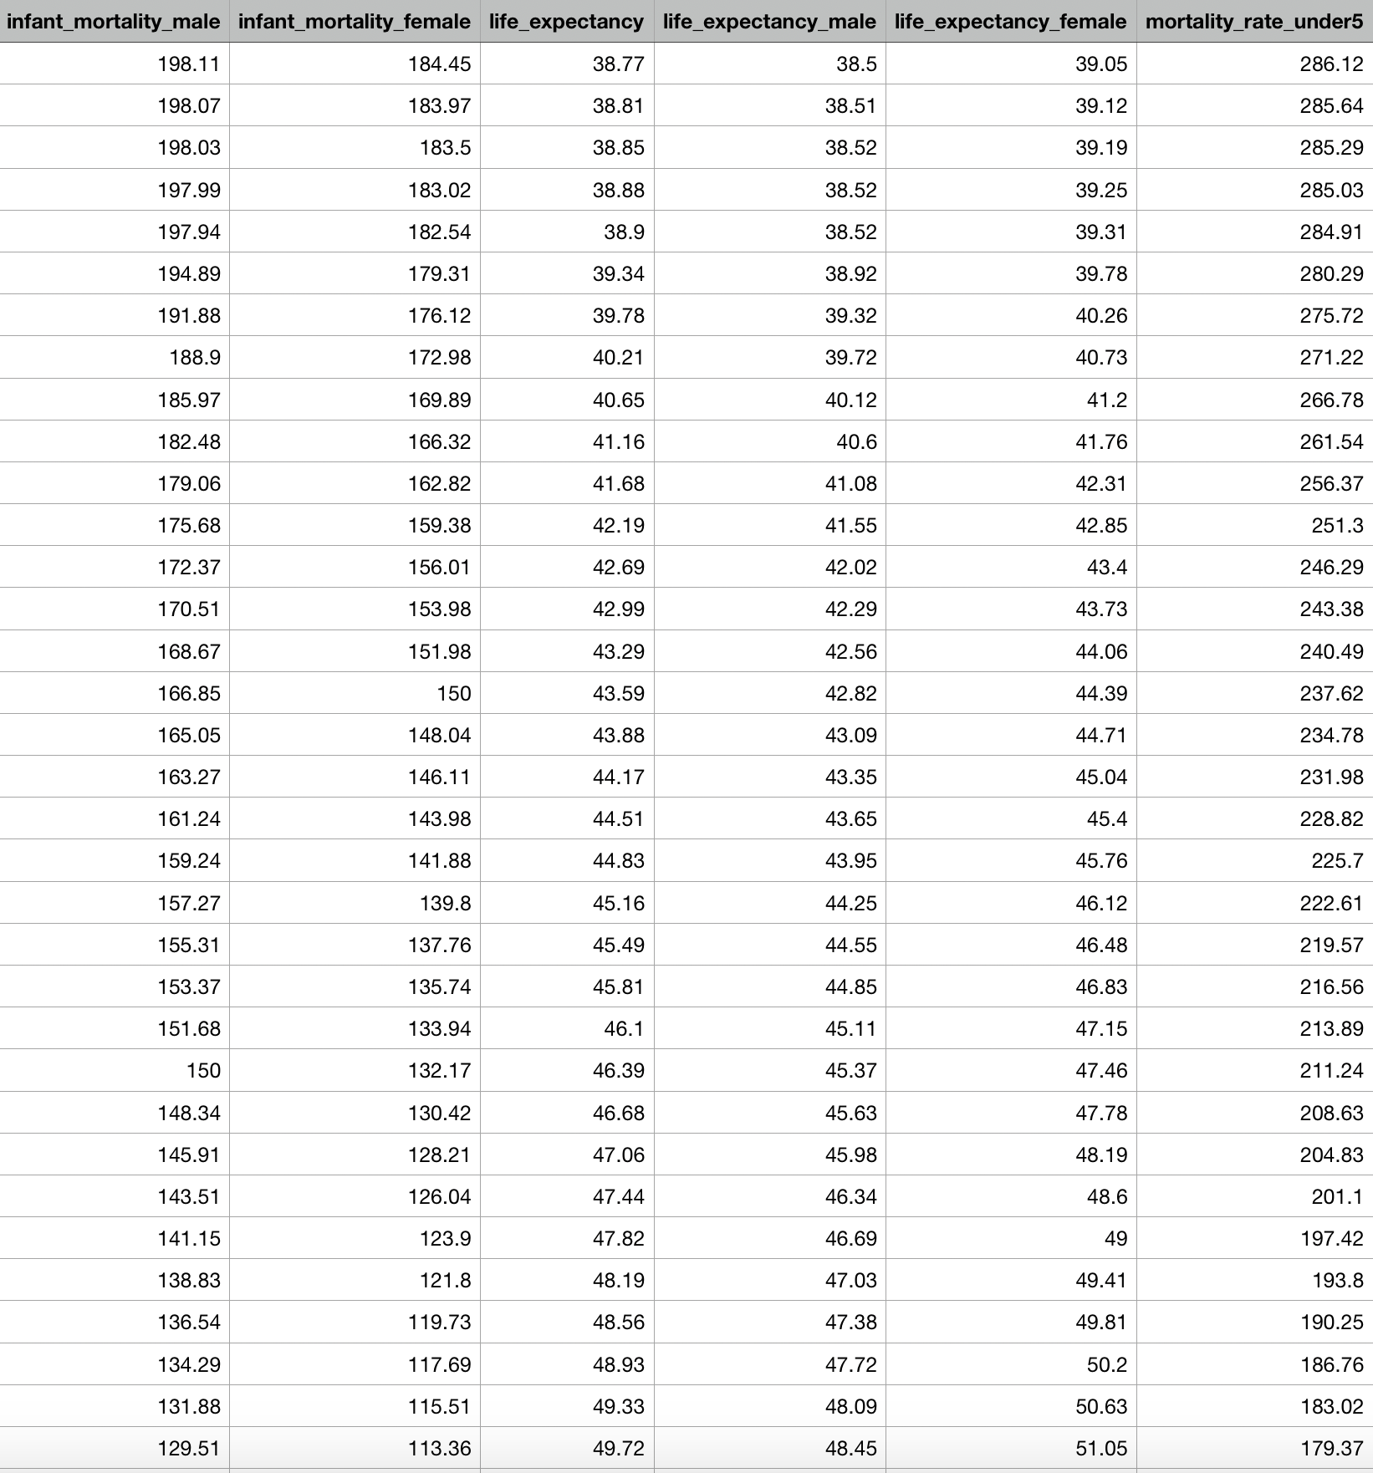

Slide 5
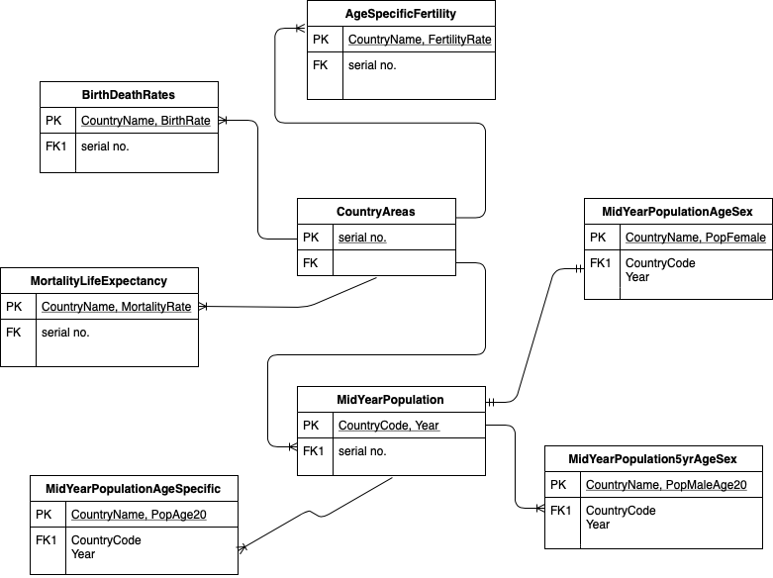
ER Diagram

Slide 6
Questions we would like to answer…
Some interesting population growth trends of 228 countries.
Some insights distinctions countries based on population density.
Is there a relationship between mother’s age and her child survival?
Which gender is better surviving under the age of 5?
Distribution of the ages of migrating people and the average age of a country.

Slide 7
Types of Users
Governments Organizations
Non-Government Organizations like:
The United Nations Organizations
Social Welfare Organizations
Research Teams

Slide 8
Mode of data processing
ARCHITECTURE: Model-View-Template Architecture using Django Framework
FRONTEND: HTML5, CSS, Javascript
D3 V5 library
AJAX
BACKEND: Python, MySql

Slide 9
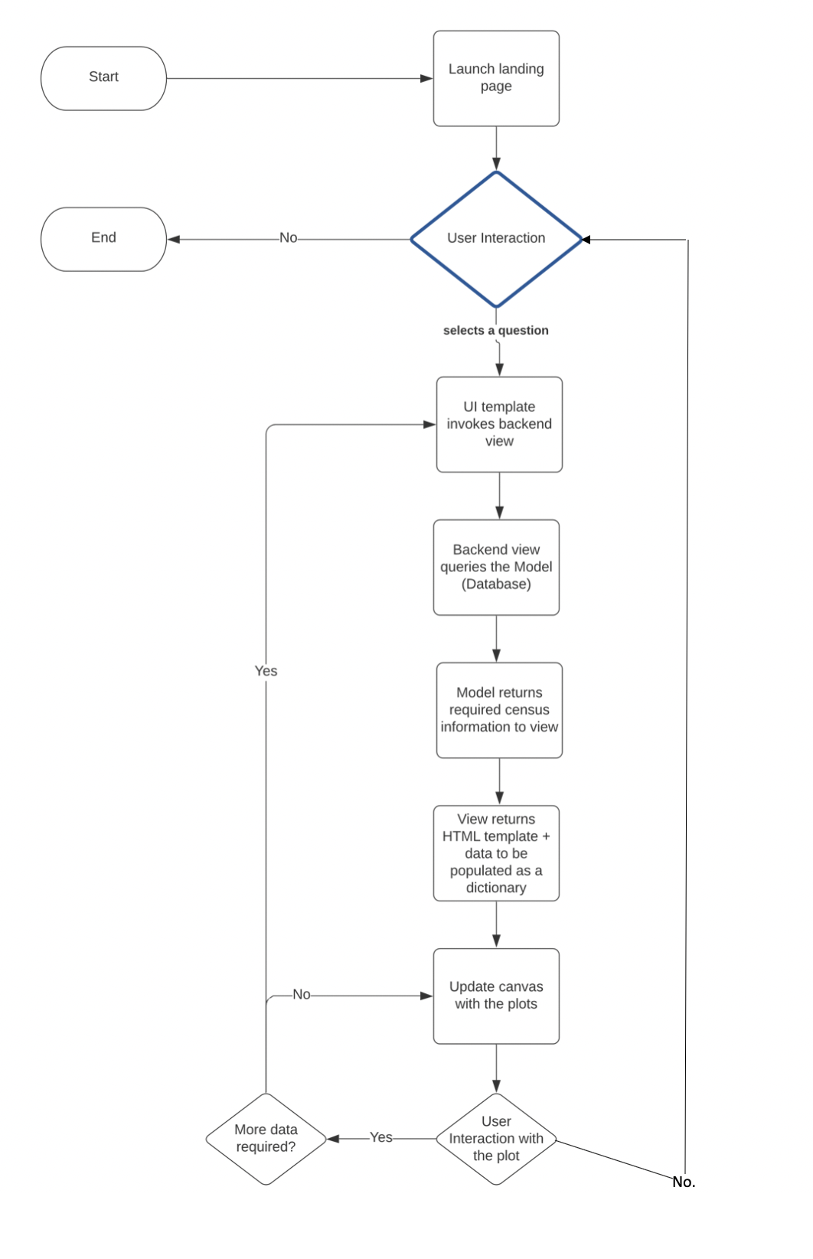
Flow Chart

Slide 10
Visual Representations
Scatter - Line Chart
Bar Chart
Choropleth
Pie Chart
Bubble Chart

Slide 13
Interaction
Zooming
Panning
Labels
Horizontal Sliders

Slide 14
DEMO

Slide 15
Interesting Findings

Slide 16
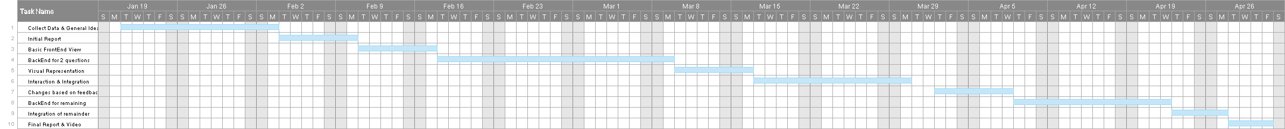
To be completed

