Slide 1
Tetwis
By: Jonathan Zelaya, Allen Tung, Fahad Mohammad, Prit Modi

Slide 2
Project Description
A Tetris-like game where you stack blocks and hope your newly built tower does not fall apart
Two modes
Time Attack - Stack blocks and built the biggest tower in 60 seconds
Standard - Build as high as you can! Lose lives if you lose blocks

Slide 3
Programming Goals and Challenges
From the beginning, we chose to use a new programming tool, Unity.
None of us had any familiarity with the IDE, which made the entire endeavor much more difficult
New Language: We’ve been using Java in class, but Unity uses C#.
Goals:
Implement the game UI transitions smoothly
Implement all the basic functionality necessary for the game
Manage physics of game objects
Manage user input with minimal error
Reduce effect of gravity and block shifting

Slide 4
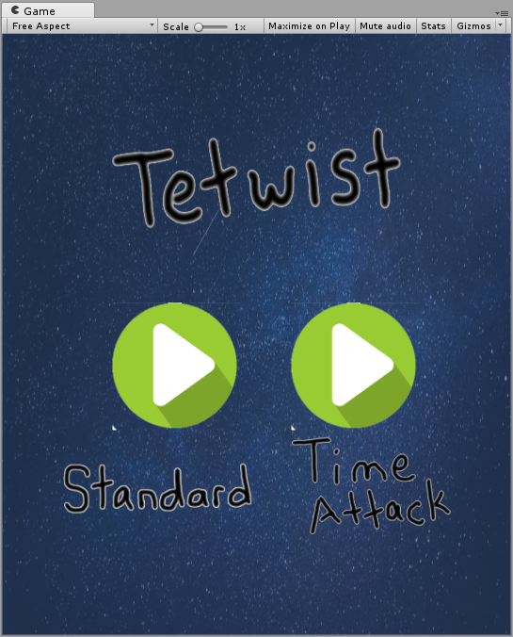
App Demonstration
Home Screen
Two Game Modes

Slide 5
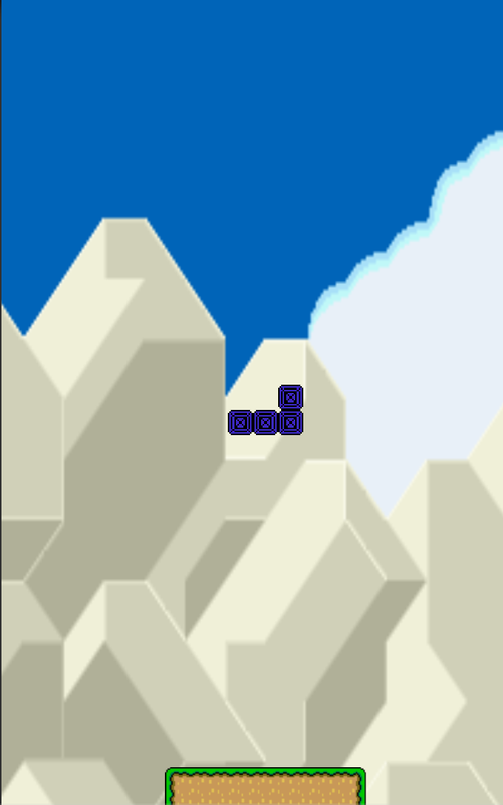
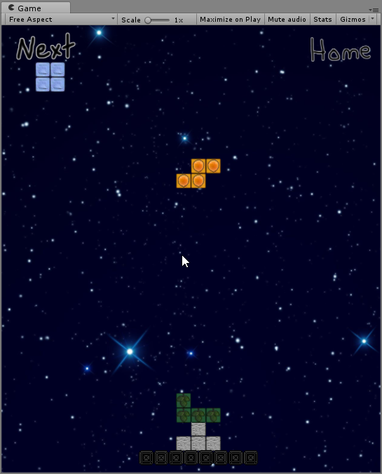
App Demonstration
The arrows shown to the left aren’t part of the UI but show how the controls work.
Tapping on the left moves the piece to the left, tapping on the right to the right, etc…
The image to the right shows a different background

Slide 6
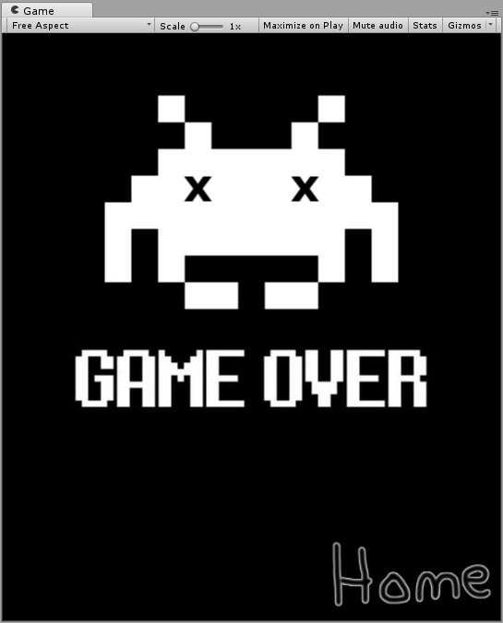
App Demonstration
Game Over:
Home button to return home

Slide 7

Questions and Answers

