Slide 1
Introduction to Linear Models
Irish Ecological Association Workshop 2019
GMIT and NUIG

Slide 2
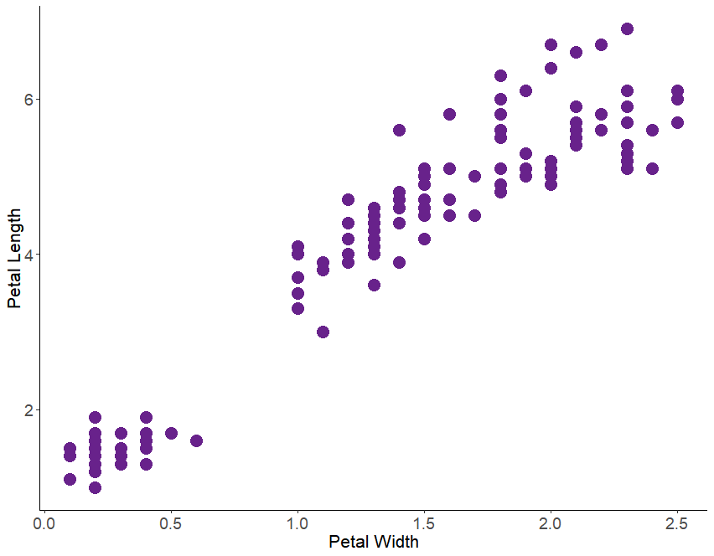
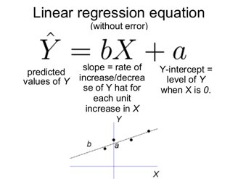
What is linear regression?

Slide 3
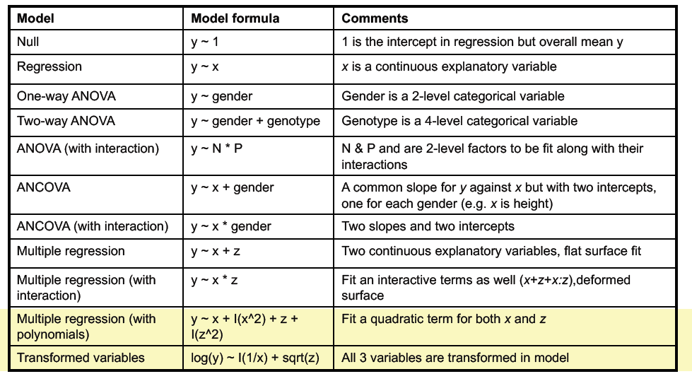

Slide 4
What are we modelling?
y ~ x
Test the null hypothesis: value of y is independent of value of x
Least squares regression

Slide 5
Model Assumptions
Explanatory variable measured without error
Errors (residuals) are normally distributed
Variances are constant
All unexplained variation is confined to the response variable

Slide 6
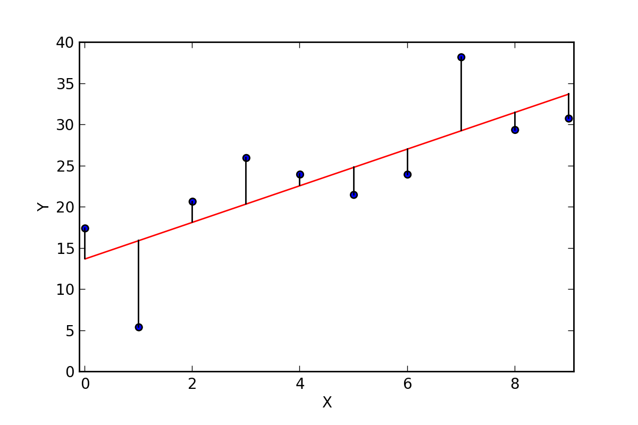
Residuals

Slide 7
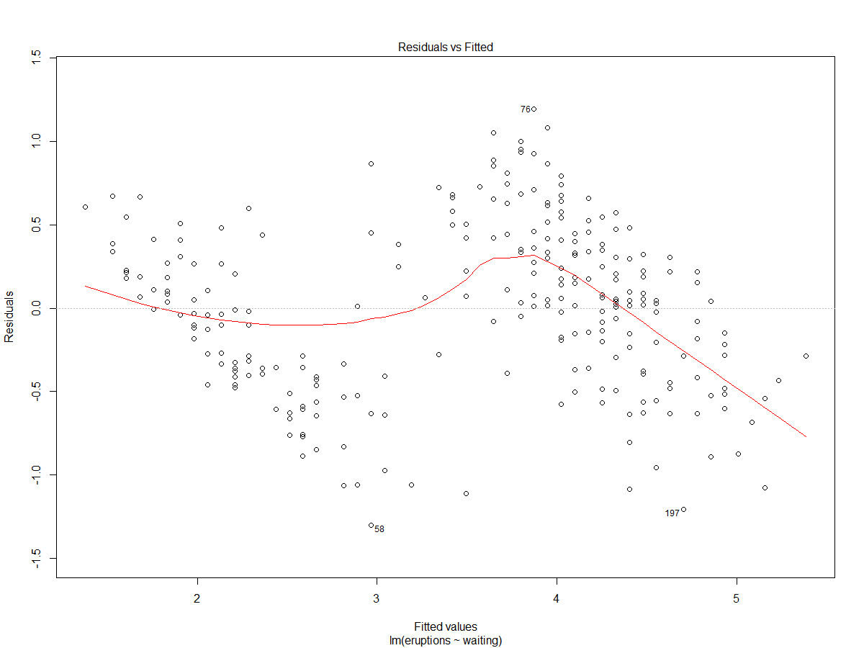
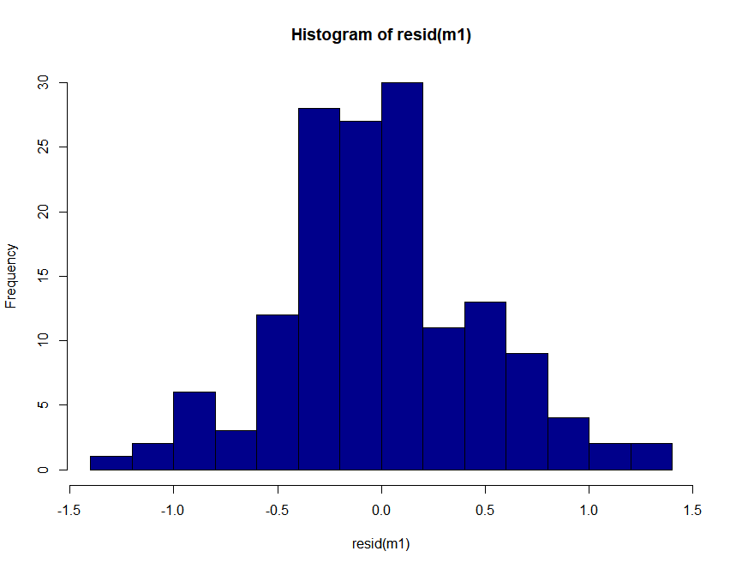
Checking the assumptions
Normally-distributed errors
Constant variance

Slide 8
Bad model = Untrustworthy Results

Slide 9

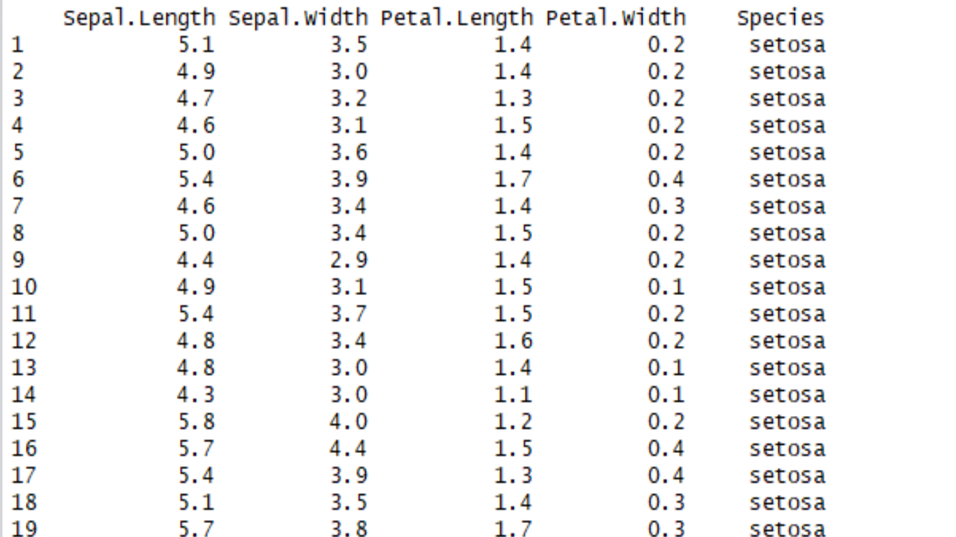
Let’s have a go……
Iris dataset

Slide 10
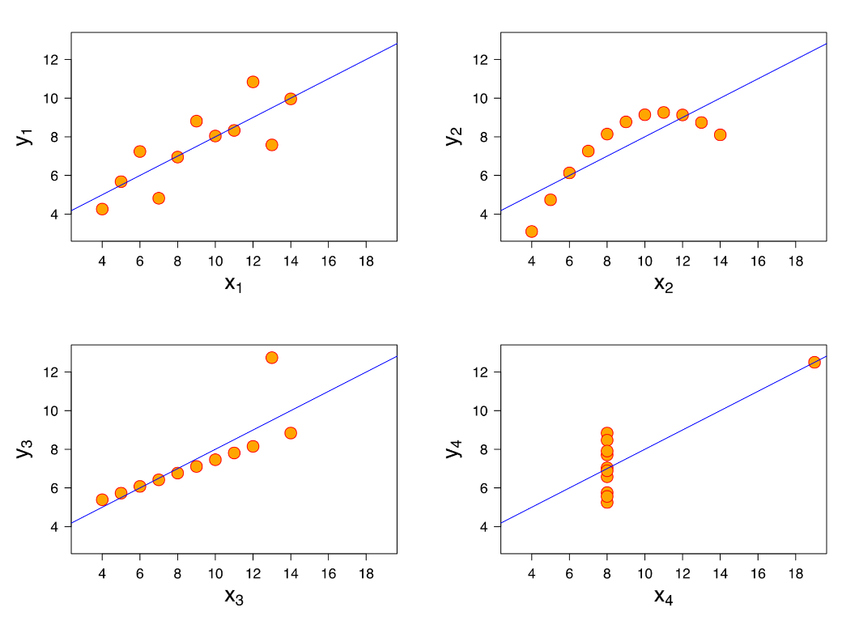
Step-by-step……
1. Simple plot
2. Run model
3. Check model assumptions
4. Interpret output

Slide 11
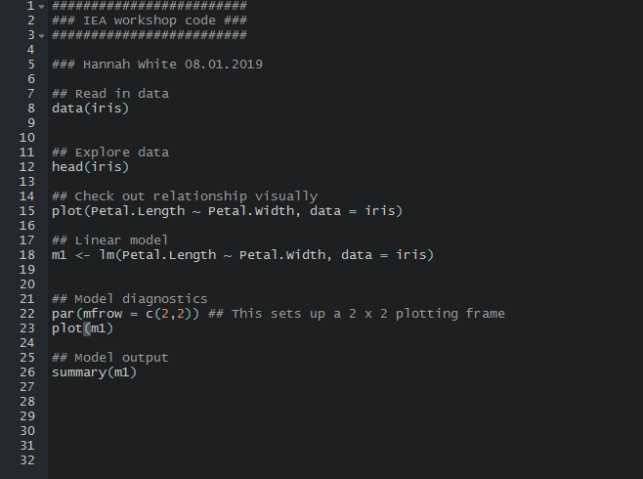
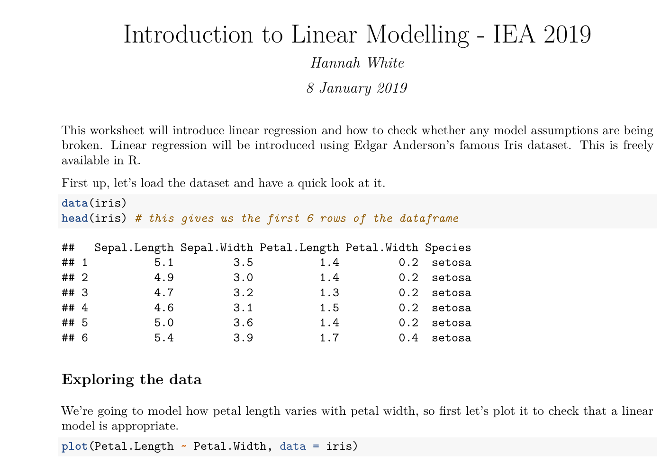
Linear regression in R

Slide 12
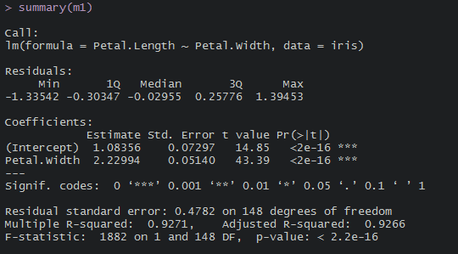

Slide 13
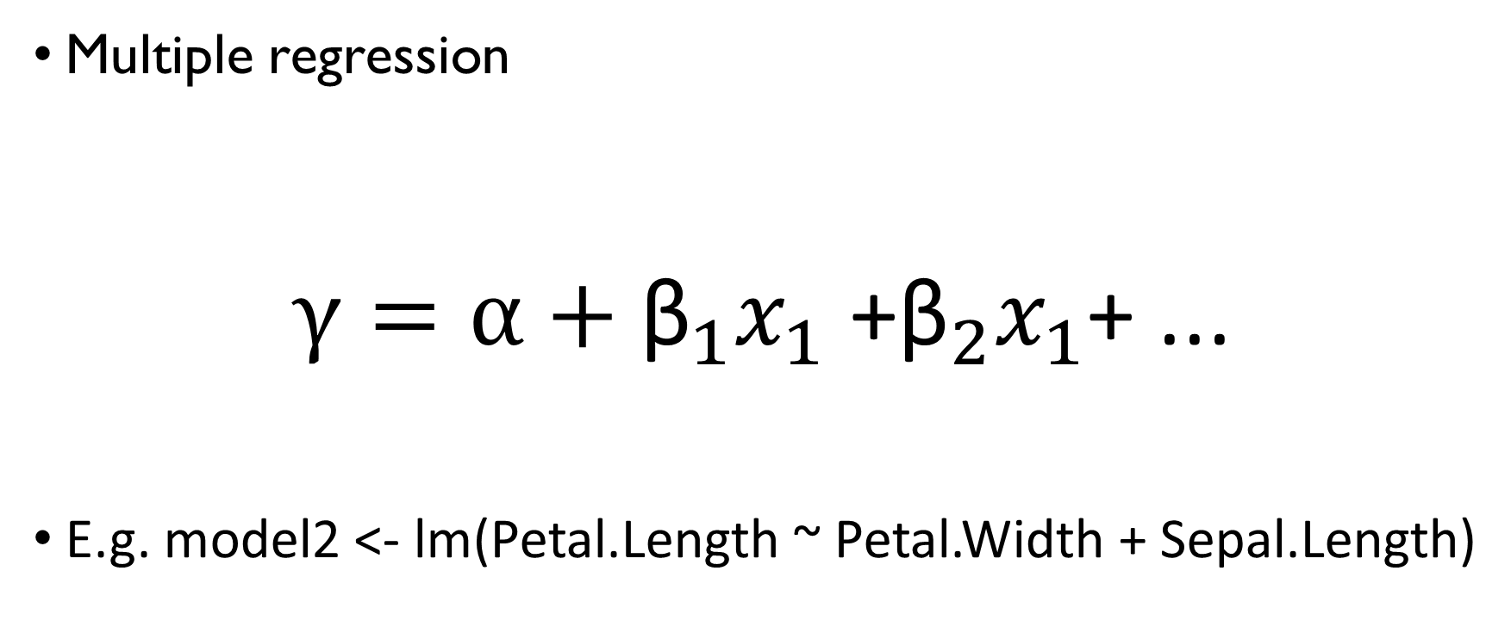
Adding more covariates….
Multiple regression
$γ=α\text{ + }{\text{β}}_{1}x_{1}\text{ +}{\text{β}}_{2}x_{1}$+ ...
E.g. model2 <- lm(Petal.Length ~ Petal.Width + Sepal.Length)

Slide 14

Next up
What to do if your errors are non-normally distributed?

