Slide 1
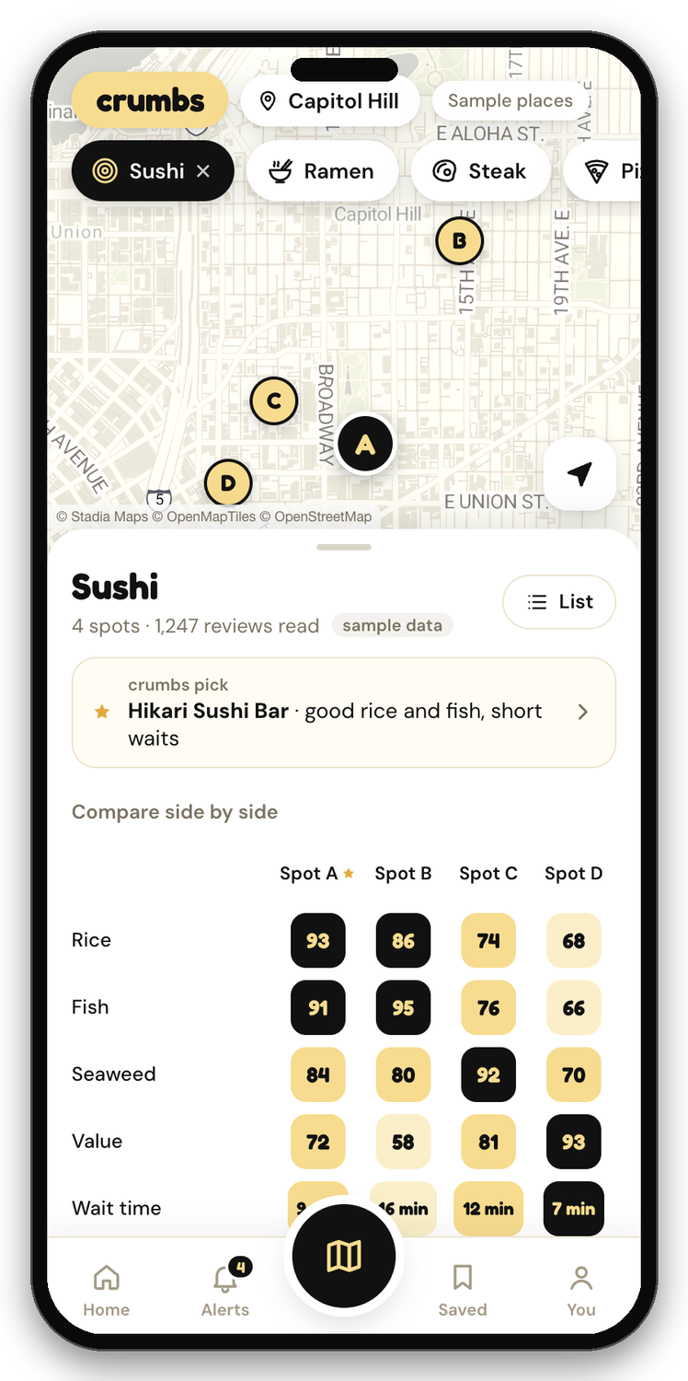
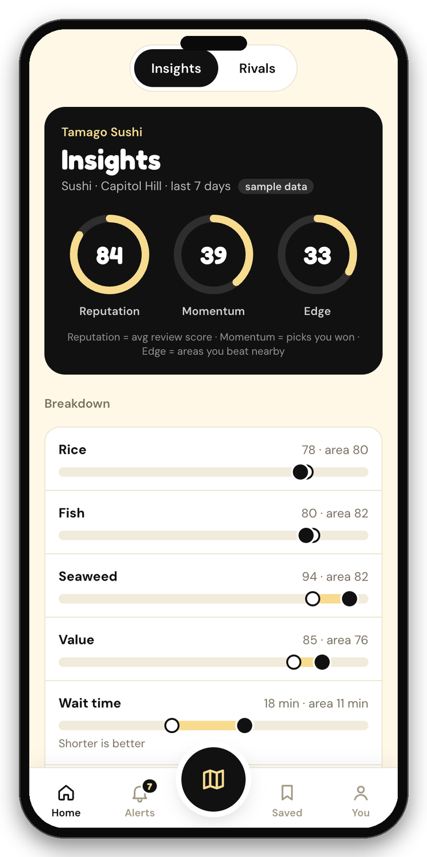
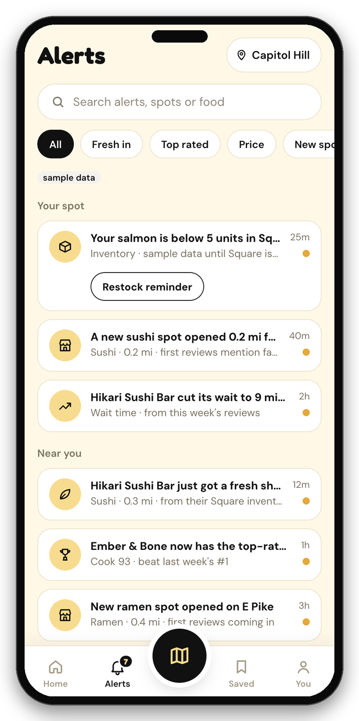
crumbs
CLAUDE IMPACT LAB · SEATTLE
AI for neighborhood food shops, and the neighbors who love them.
Every review leaves crumbs.
Notes:
[0:00-0:15] Hi, we're the crumbs team. Neighborhood food shops feed us every day, but they run on gut feel while chains run on data. crumbs fixes that: one product, two sides. Neighbors get an honest pick for tonight. Owners get to see the neighborhood the way a chain does. (Screens in this deck are the real app, running on sample data.)

Slide 2
Small food shops are flying blind
25 of 38
Where Washington owners lose time
Owners naming it a top time sink, out of 38
Washington owners surveyed name marketing a top time sink
16 of 38
worry about customer data and privacy when using AI
94.5 vs 98.5
Washington small-business optimism vs the U.S. (NFIB, winter 2026)
Sources: hackathon survey of 38 Washington owners (multi-select); NFIB Small Business Economic Trends, Washington, Winter 2026
Notes:
[0:15-0:45] We surveyed 38 Washington business owners through the hackathon. 25 of them said marketing is a top time sink, and 16 worry about data privacy, so they hesitate to hand their data to yet another tool. Zoom out: Washington small-business optimism is 94.5, below the national 98.5. These owners don't need another dashboard to learn. They need answers about the shop down the street.

Slide 3
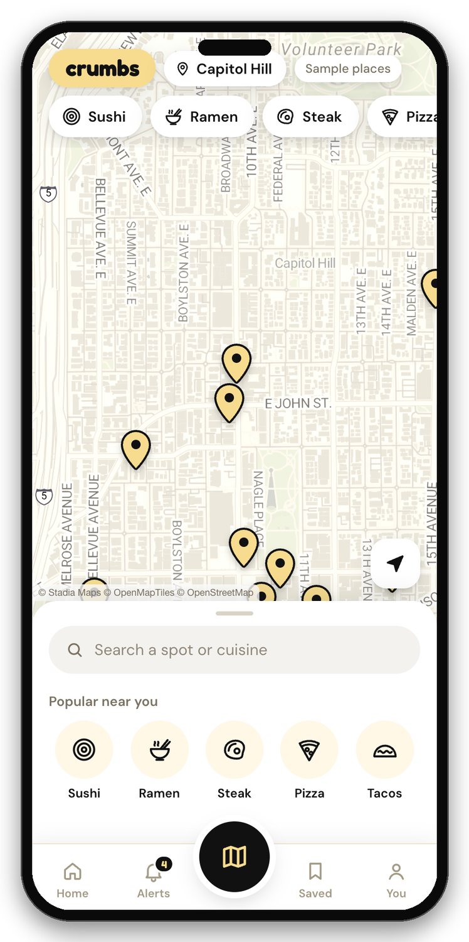
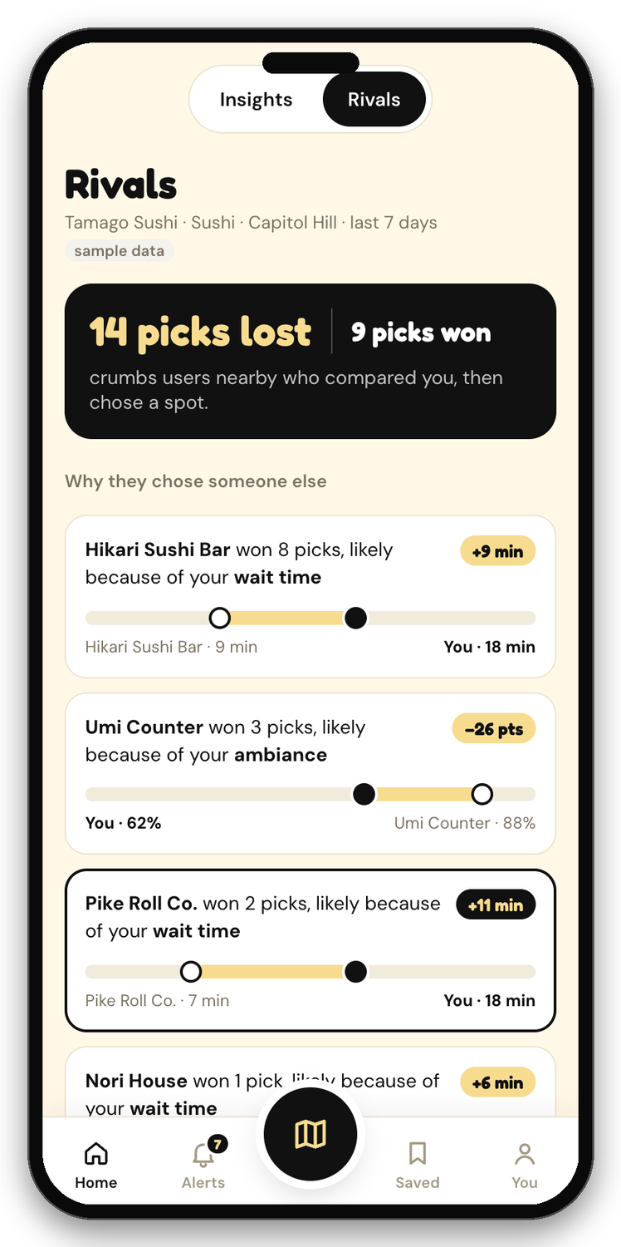


One product, two sides
For neighbors
For owners
Pick a food, see every nearby spot scored side by side, and get a walking route to the winner.
See how you stack up, which rivals diners pick over you and the likely reasons, and get alerts when something changes nearby.
Screens show sample data
Notes:
[0:45-1:20] LIVE DEMO CUE (about 25 seconds): open the app at the map, tap Sushi, show the compare sheet with the crumbs pick, then switch to Home (owner) and tap Rivals. On the neighbor side: choose a food and see nearby spots scored side by side with a walking route. On the owner side: Insights and Rivals show how you stack up and which rivals diners pick over you, with the likely reasons. A pick is an in-app selection, not a confirmed visit. Same data, two audiences. If the demo is flaky, stay on these screenshots.

Slide 4




Honest picks, built from real reviews
Claude reads the reviews
One call per spot scores each attribute from 0 to 100, from review text only.
Never guessed
If no review mentions it, the score stays blank. We do not invent a number.
Waits are real minutes
We take the minutes reviewers actually state, and compute the median in code, not with the model.
The pick is transparent
Highest average score wins. Ties go to the spot with more reviews read.
Notes:
[1:20-1:50] Where do the picks come from? Claude reads the reviews and scores each attribute from 0 to 100, one call per spot, from review text only. If nobody mentions something, the score stays blank: no made-up numbers. Waits are the minutes reviewers actually say, and the median is computed in plain code, not by the model. The winner is just the highest average, and ties go to the spot with more reviews read. Nothing hidden.

Slide 5
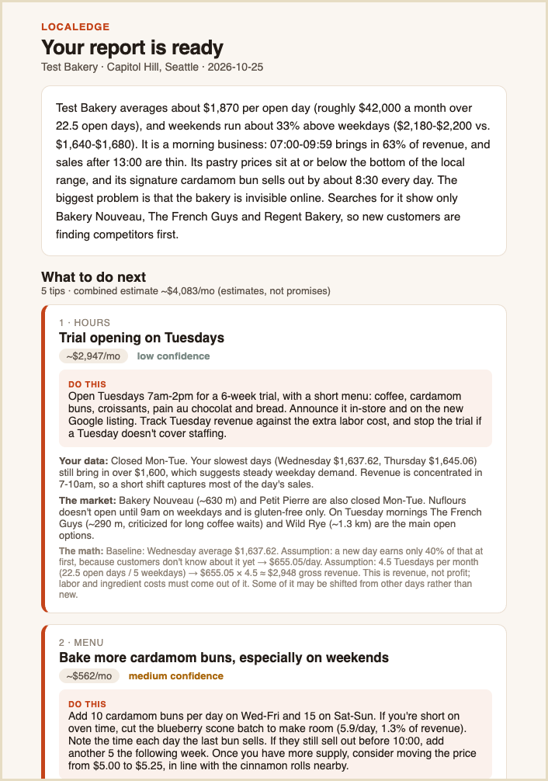
Owners get answers, not dashboards
Rivals
Picks lost, and the likely reasons
Alerts
Rival changes and low stock in one place
Report email
The full advice, in one inbox
Notes:
[1:50-2:25] For owners, three things. Rivals: how many diners compared you and picked someone else, and the likely reasons. These are possible factors, not proven causes. Alerts: rival changes come from public research, re-checked by our monitor three times a week, and low-stock alerts come from a Square sandbox connection. Owners are told by app, text or email. And the report email: the full advice, with the action, the evidence and the math for every tip, delivered to the owner's inbox. The owner never has to learn a new tool.

Slide 6



One practical step to test
From the shop's own sales
MENU · SAMPLE BAKERY REPORT
About 40 buns a day, with the last one sold around 8:30. The limit is what gets baked, not what customers want.
Bake more cardamom buns, especially on weekends
From the market
No nearby rival sells a cardamom bun. Comparable buns cost $5.25 to $7.86+.
Do this
Add 10 buns a day Wed–Fri and 15 on Sat–Sun. Note when the last one sells. If they still sell out before 10:00, add 5 more the next week.
Shown with its math
Assumes only 5 of the 10 extra buns sell: 5 × $5.00 × 22.5 days.
≈ $562 a month
estimated revenue, not profit · confidence: medium
From the sample bakery report (sample sales data). Illustrative estimates; we have not run this experiment.
Notes:
[2:25-3:00] This is what owners actually get: one specific step to test, not a dashboard. This one is from our sample bakery report. The advice: bake more cardamom buns, because they sell out around 8:30 and no nearby rival sells one. Every tip shows the owner's own numbers, the market evidence and the math, with a confidence level. The estimate is about 562 dollars a month in revenue, not profit, and it assumes only half of the extra buns sell. It's sample data and we have not run the experiment.

Slide 7
Under the hood: agents in parallel
Advisor · under a minute
Time to a full report
1 agent per competitor, up to 8, all at once
Owner
name, area, sales (optional)
Tailored advice
The owner's own online presence
Product gaps and review trends
Delivered as
App
Report email
Text or email alerts
About 4× faster
GitHub Actions monitor · Mon / Wed / Fri · re-check rivals, compare, alert
Measured on one sample bakery over a few runs: 172 s before, about 40 s now.
Notes:
[3:00-3:40] Under the hood: the owner gives a name and an area, and sales if they have them. Instead of one big agent doing everything in sequence, we run one small Claude agent per competitor, up to eight at once, plus one on the owner's own online presence. Then we find product gaps and write tailored advice. That took a full report from about three minutes to under one. A scheduled monitor on GitHub Actions re-checks rivals three times a week and alerts the owner to real changes, through the app, text or email.

Slide 8




Built to be trusted
Sources on every claim
Never guessed
Each competitor entry carries the links it came from, so owners can check the evidence.
Missing data stays blank and is listed as a caveat. Without sales data, dollar estimates are left out.
Private by design
Safe email
Picks are stored anonymously: no user id, IP or device. API keys stay on the server.
One recipient per report, HTML-escaped, rate-limited, with no tracking links.
Notes:
[3:40-4:05] Small shops are right to be careful with AI, and in our survey the top worries were privacy and wrong answers. So: every claim carries its sources. Anything we can't find stays blank and shows up as a caveat, and without sales data we don't make up dollar figures. Picks are stored anonymously. Our emails go to one recipient, are escaped, rate-limited, and have no tracking.

Slide 9
Why it matters, and what's next
696K
Next: a local-owner pilot
We will measure
1
Research time saved
small businesses in Washington, employing 1.5 million people
2
Recommendations owners act on
3
Outcomes of the experiments they choose
Their optimism trails the nation, 94.5 vs 98.5. Local shops need every edge they can get.
We're looking for Seattle food-business owners to help shape crumbs.
Proposed: a monthly subscription per location (price not set).
Source: NFIB Small Business Economic Trends, Washington, Winter 2026
Notes:
[4:05-4:35] Why it matters: Washington has about 696,000 small businesses employing 1.5 million people, and their optimism trails the nation. These shops need every edge. Next is a pilot with local owners. We'll measure research time saved, how many recommendations owners act on, and the outcomes of the experiments they choose. The model we're proposing is a monthly subscription per location, price not set. We're looking for Seattle food-business owners to help shape crumbs.

Slide 10
Thank you
crumbs is open source: github.com/RuthGajj05/crumbs
J
N
R
B
M
Jagger
Neha
Ruthwika
Boong
Manny
Front-end development, testing
API integration, web scraping, report emails, pitch deck, testing
Web scraping, connecting front-end and backend, testing
Web scraping, pitch deck, business solutions, testing
Back-end and scaffolding, testing
Every review leaves crumbs.
Notes:
[4:35-5:00] Built in one day by five of us: Jagger on the front end, Neha on API integration, web scraping with the four-times-faster research, report emails and the pitch deck, Ruthwika on web scraping and connecting the front end to the backend, Boong on scraping, the pitch deck and the business solutions, and Manny on the back end and scaffolding. Everyone tested. It's all open source. Every review leaves crumbs. Thank you, we'd love your questions.

