Slide 1
NLP with Disaster Tweets
資工三 許雱茹 108321015
資工四 黃琇筠 107321057

Slide 2
Topic – NLP with Disaster Tweets
Twitter has become an important communication channel.
Many people announce an emergency through smartphone.
-> More agencies are interested in programmatically monitoring Twitter. Ex disaster relief organization ,news agencies.

Slide 3
Goal
To predict which Tweets are about real disasters and which one’s aren’t. (1 for real ,0 for not a disaster.)
Submissions are evaluated using F1 between the predicted and expected answers.

Slide 4
Figure Eight
An open source training data which the industry needs for benchmarking and advancing machine learning deployments.
The dataset we used in this task is :
Multilingual Disaster Response Messages
A set of messages related to disaster response, covering multiple languages, suitable for text categorization and related natural language processing tasks.
Source:
https://www.prnewswire.com/news-releases/figure-eight-announces-datasets-video-object-tracking-and-smart-bounding-box-annotation-to-accelerate-the-adoption-of-ai-300646558.html

Slide 5
Dataset
資料集 | size | key(features)
Train | 7613 | id, text , location , keyword , target
Test | 3263 | id, text, location, keyword
columns
Id | 每個tweet的編號
Text | Tweets內容
Location | Tweet發送的地點(不一定每個都有)
Keyword | 災難分類(不一定每個都有)
Target | 只有train.csv有，為每則tweet的label , 1或0
最後test.csv的測試結果存至sample_submission.csv，再下載下來提交給kaggle。

Slide 6
Data Preprocess
將train set的資料shuffle後再訓練，以避免資料間的相依性。
針對text 使用 CountVectorizer建立字典，把所有的字收入字典，且根據每則推文出現的字產生word vector (length=dictionary size)。

Slide 7

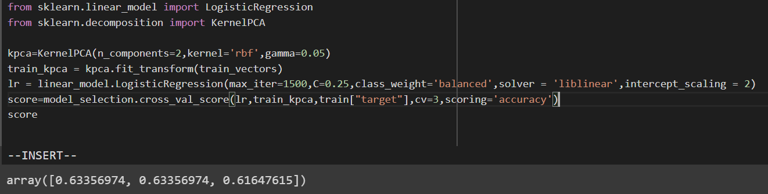
dimensionality reduction test
利用pca降低text的維度，配合LogisticRegression(c=0.25)
pca(n_components = 0.99) scoring=accuracy
Kpca(n_components = 2, kernel = rbf, gamma=0.05) accuracy 約為63%

Slide 8
Model (1/4)
text
shuffle
CountVectorizer
Train_vectors
RidgeClassifier
Cv=3 accuracy:

Slide 9
Model(2/4)
text
shuffle
Padding keyword to texts
CountVectorizer
Train_vectors
RidgeClassifier
Cv=3 accuracy:

Slide 10
Model(3/4)
text
shuffle
CountVectorizer
Train_vectors
Voting(hard) :
RidgeClassifier(alpha=6.5)
LogisticRegression(c=0.25)
SGDClassifier(alpha =0.1)
Cv=3 accuracy:

Slide 11
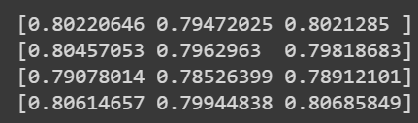
Model (4/4)
text
shuffle
CountVectorizer
Train_vectors
Voting(soft) :
RandomForestClassifier
(n_estimators=600)
LogisticRegression
(c=0.125, multi_class = ‘multinomial’)
SVC(propability = True, c=1.5)
Cv=3 accuracy:

Slide 12
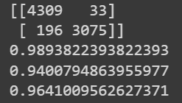
Confusion matrix
Confusion matrix:
Precision:
Recall:
F1 score:

Slide 13
Ranking and Score

Slide 14
Thank you for listening !

