Slide 1
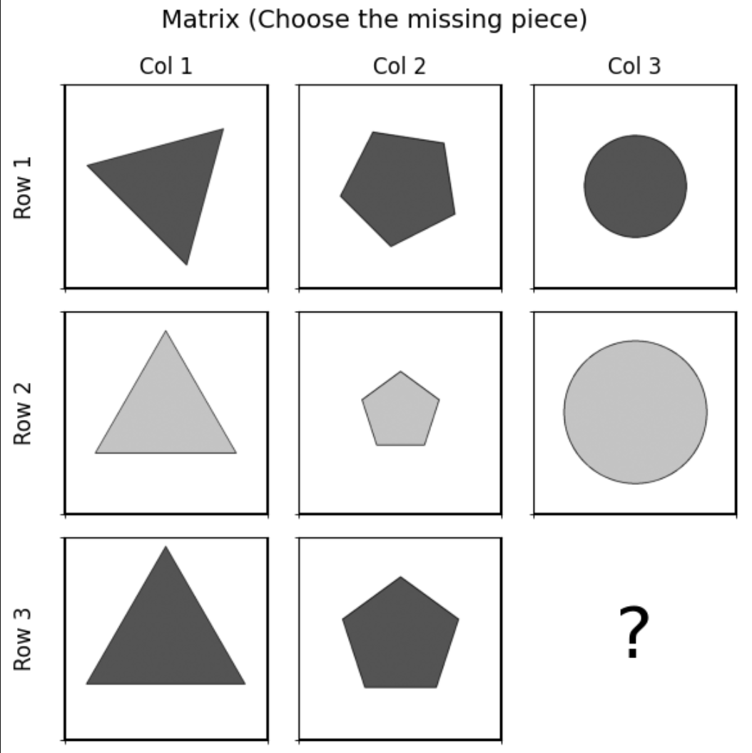
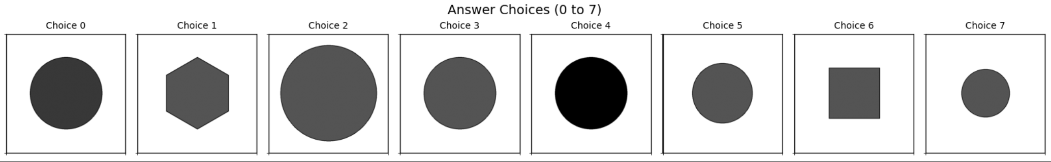
דוגמא שמופיעה לפני הניסוי
OS-1378
center_single
os pred: 5
llm pred: 0
true: 3

Slide 2
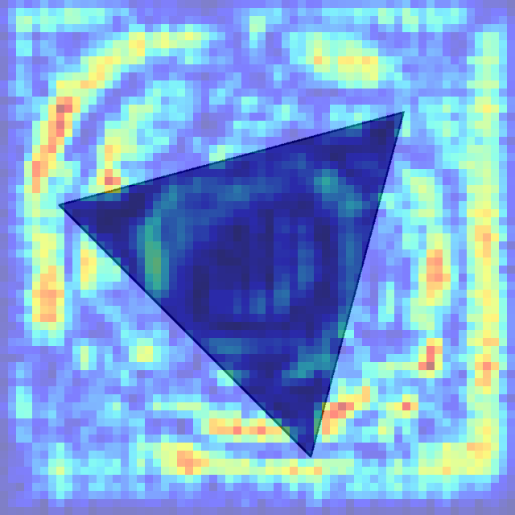
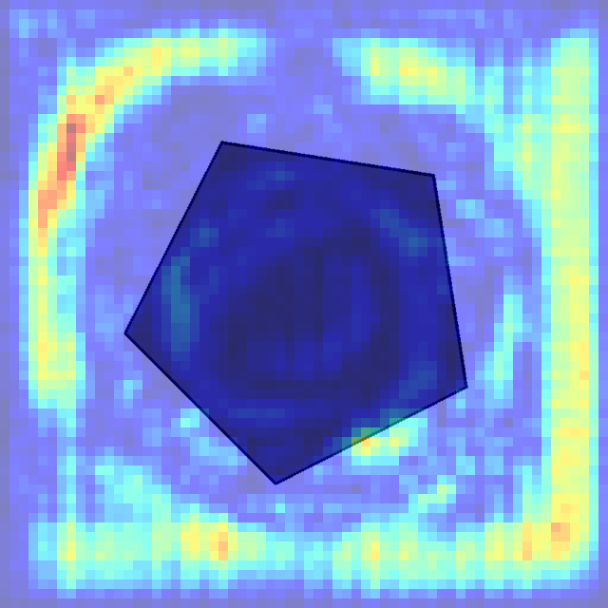
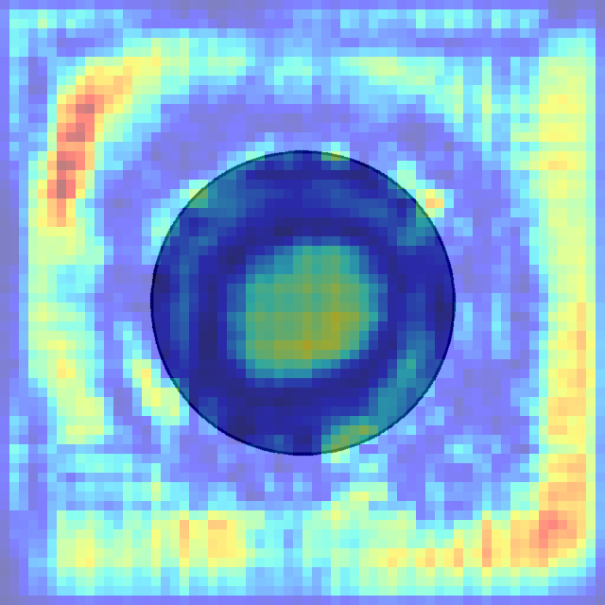
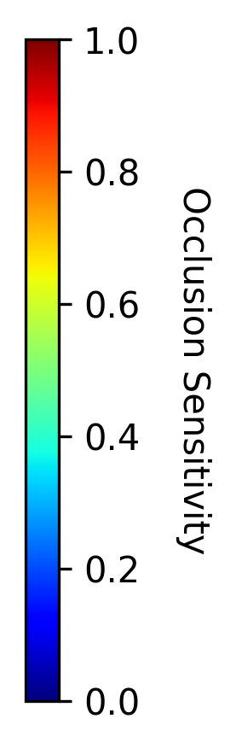
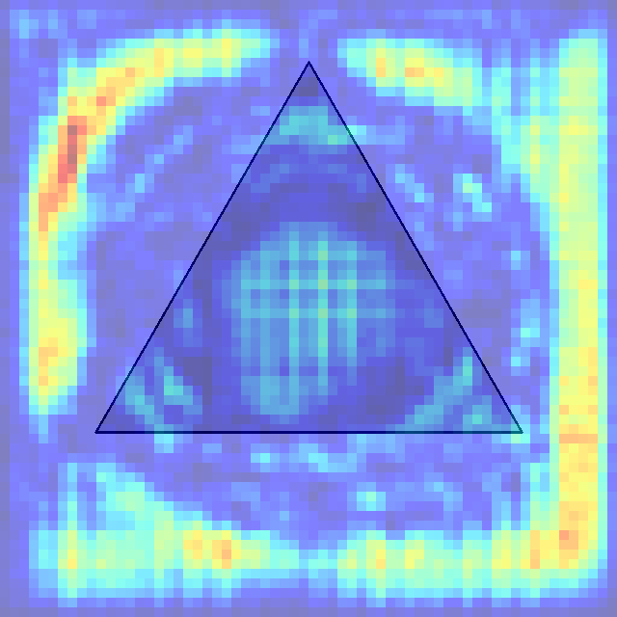
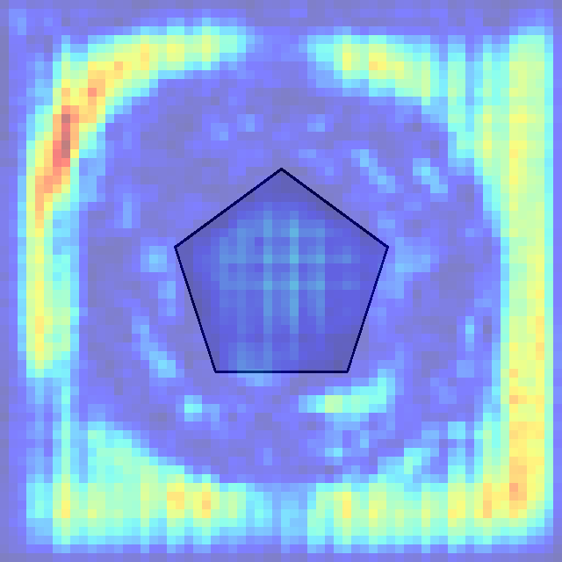
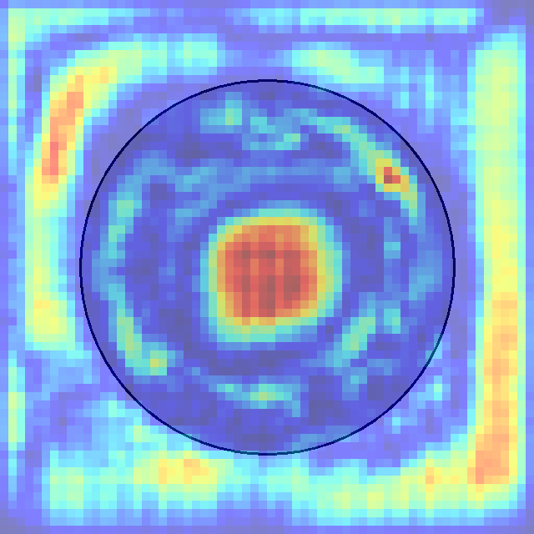
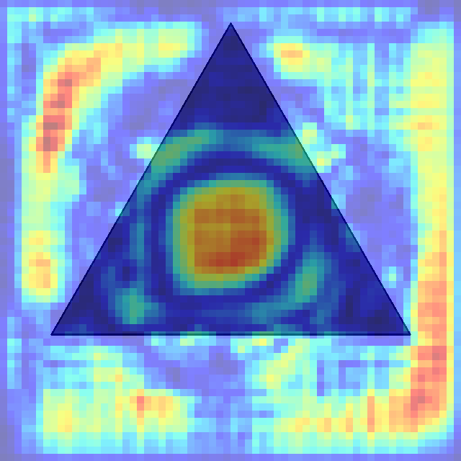
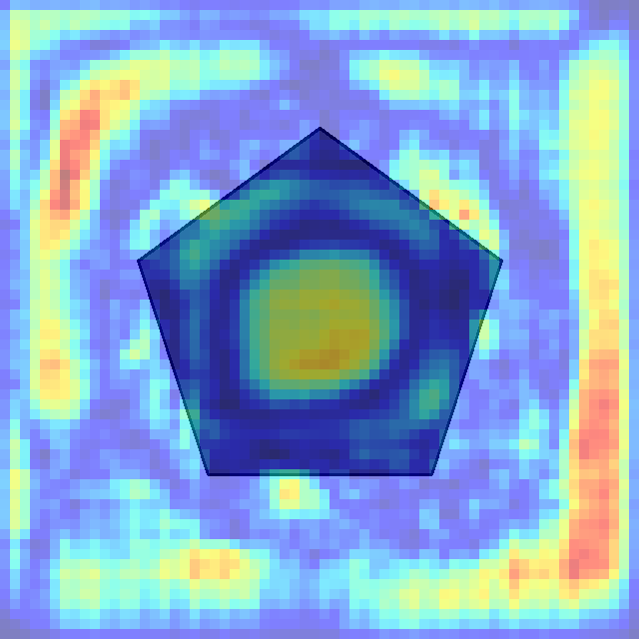

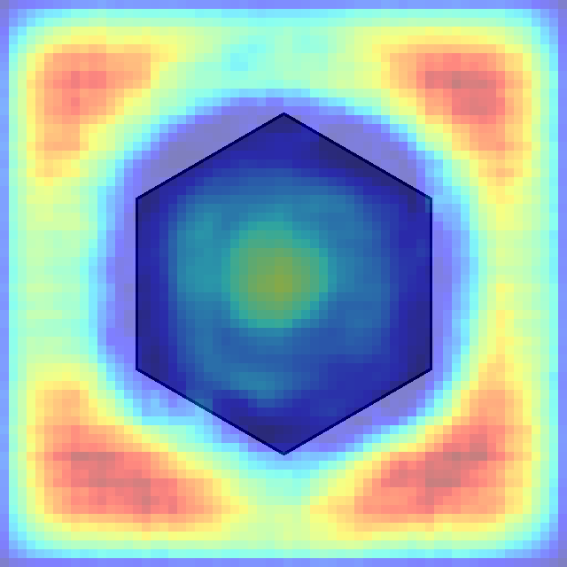
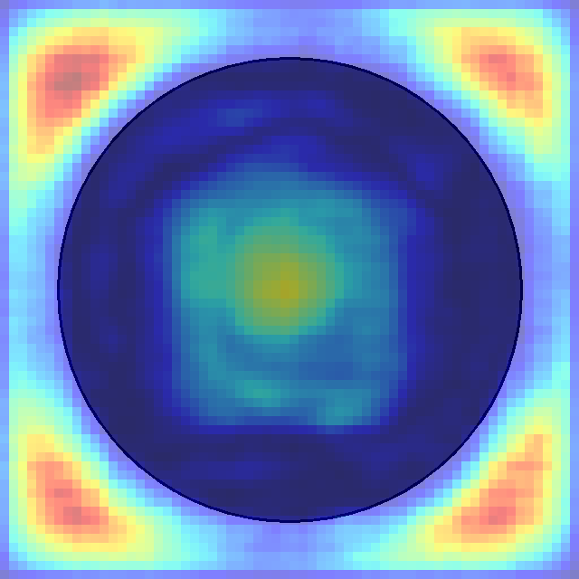





הסבר: אם ננתח את הפיקסלים האדומים בכל תשובה אפשרית לחידה ניתן לראות שהמודל מחפש צורת עיגול(בעיקר בולט בתשובה 1,6 שלכן נפסלות). מעבר לכך, ניתן להבחין כי הוא מחפש עיגול בגודל מסויים, ולכן תשובה 7 נפסלת.
לבסוף, ניתן להבחין כי תשובה 5 היא הנכונה לפי היגיון המודל כי הוא מצא בה הכי הרבה פיקסלים שחשובים לדעתו.
0 1 2 3 4 5 6 7

Slide 3
Row Pattern Analysis:
- Row 1: Dark triangle → Dark pentagon → Dark circle
- Row 2: Light triangle → Light pentagon → Light circle
- Row 3: Dark triangle → Dark pentagon → ?
Column Pattern Analysis:
- Column 1: Dark triangle → Light triangle → Dark triangle
- Column 2: Dark pentagon → Light pentagon → Dark pentagon
- Column 3: Dark circle → Light circle → ?
Logic:
1. Shape progression within rows: Each row follows the same sequence of shapes: triangle → pentagon → circle. Row 3 already has triangle and pentagon, so the missing piece must be a circle.
2. Color alternation within columns: Each column alternates between dark and light shades. Column 3 shows: dark circle (Row 1) → light circle (Row 2) → ? (Row 3). Following the alternating pattern, Row 3 should have a dark circle.
3. Consistency check: The pattern shows that odd-numbered rows (1 and 3) contain dark shapes, while even-numbered rows (2) contain light shapes. This confirms Row 3 should have a dark shape.
4. Shape and color convergence: Combining the shape requirement (circle) with the color requirement (dark), the answer must be a dark circle.
Answer: Choice 0 - The dark circle, which maintains both the shape progression within the row and the color alternation within the column.

Slide 4
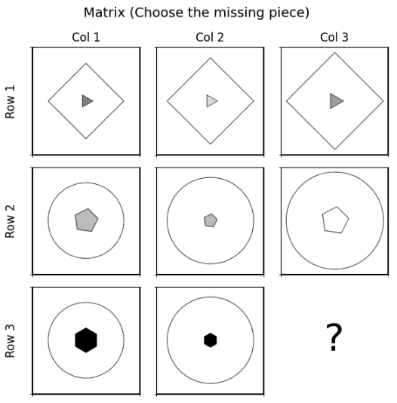
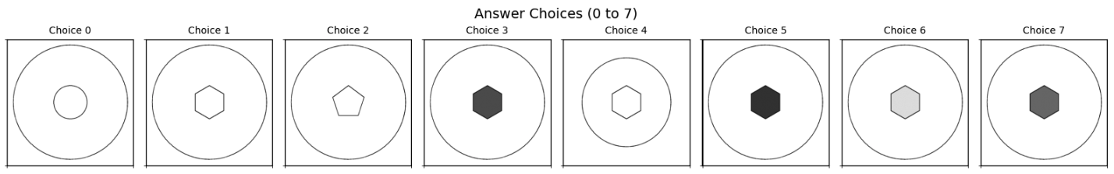
LLM-219
in_center_single_out_center_single
llm pred: 5
os pred: 1
true: 1

Slide 5
1. Outer shape pattern by row:
- Row 1: All cells contain diamonds
- Row 2: All cells contain circles
- Row 3: All cells contain circles (this pattern continues)
2. Inner shape pattern by row:
- Row 1: All cells contain triangles (pointing right)
- Row 2: All cells contain pentagons
- Row 3: All cells contain hexagons
3. Color/shading pattern by row:
- Row 1: Light gray and dark gray inner shapes
- Row 2: Light gray or white inner shapes
- Row 3: Black inner shapes (first cell), black inner shapes (second cell)
4. Size pattern by column:
- The size of the shapes seems to follow a pattern across columns, with the inner shapes in Column 2 being smaller\equal to those in Columns 1 and 3
Based on these patterns, the missing piece should have:
- A circle as its outer shape (following the row pattern)
- A hexagon as its inner shape (following the row pattern)
- A black inner shape (following the row pattern)
- The size of the outer and inner shapes should be consistent with Column 3
Looking at the answer choices:
- Choices 1-7 contain hexagons as inner shapes
- Among these, only Choices 3, 5, and 7 have dark/black hexagons
- Choice 5 appears to have the most appropriate size relationship between the outer circle and inner hexagon for Column 3
The most logical answer is Choice 5, which features a circle as the outer shape and a black hexagon as the inner shape. The size relationship between the outer circle and inner hexagon in Choice 5 appears to match the pattern observed in Row 3, where the inner shape in Column 3 should be similar in size to Column 1 (slightly larger than Column 2).
Therefore, Choice 5 with its circle outer shape and appropriately sized black hexagon inner shape is the best answer.

Slide 6
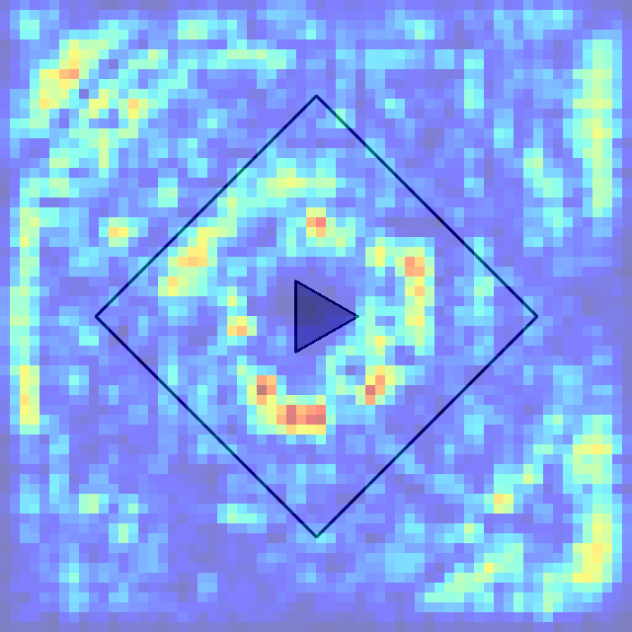
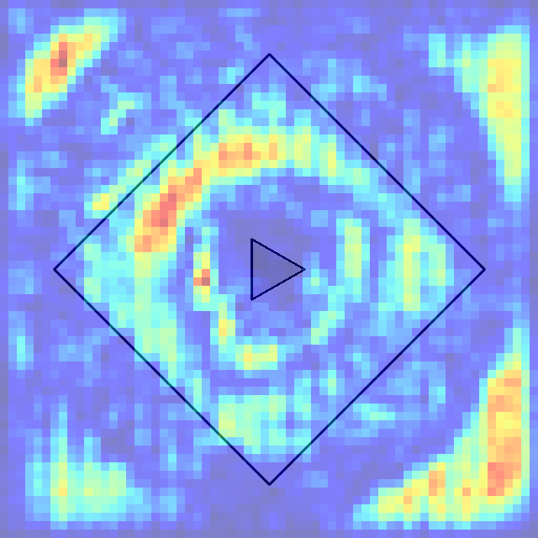
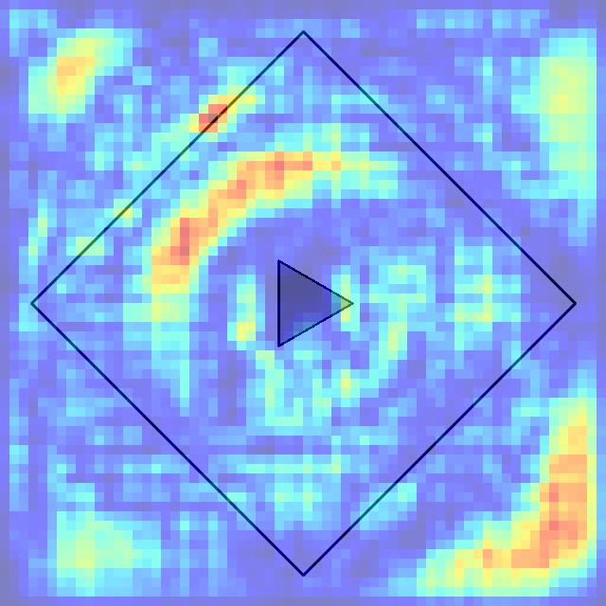
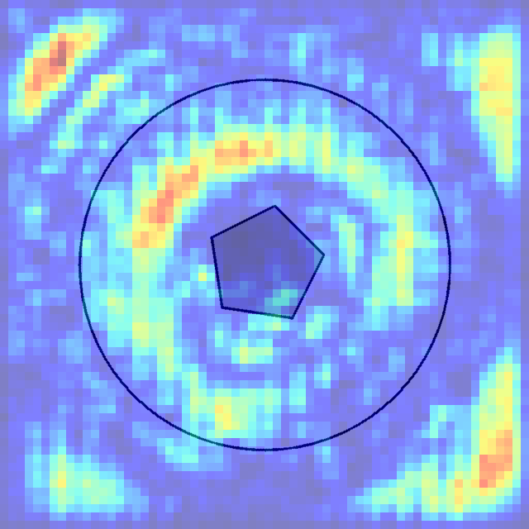
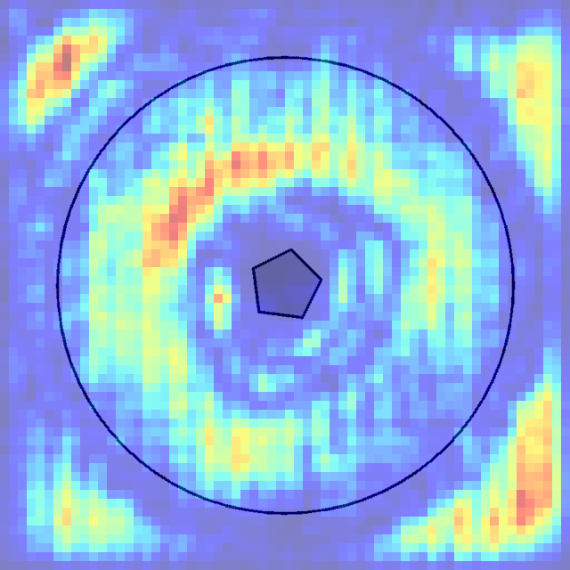
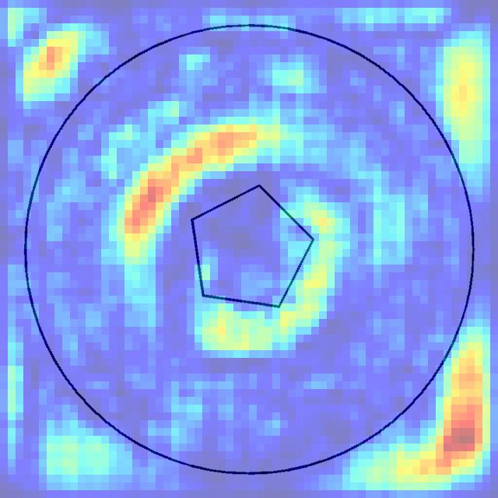
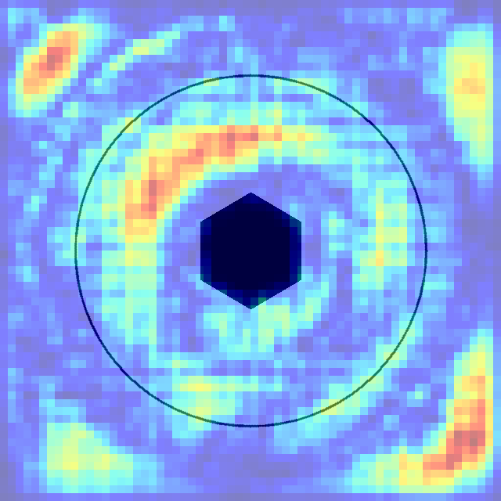
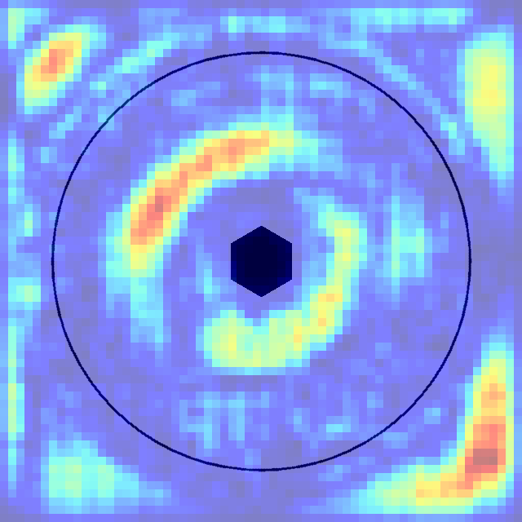
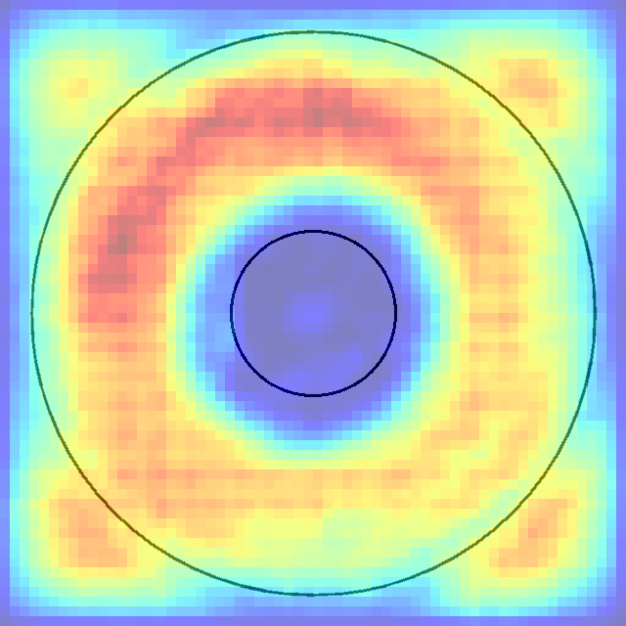
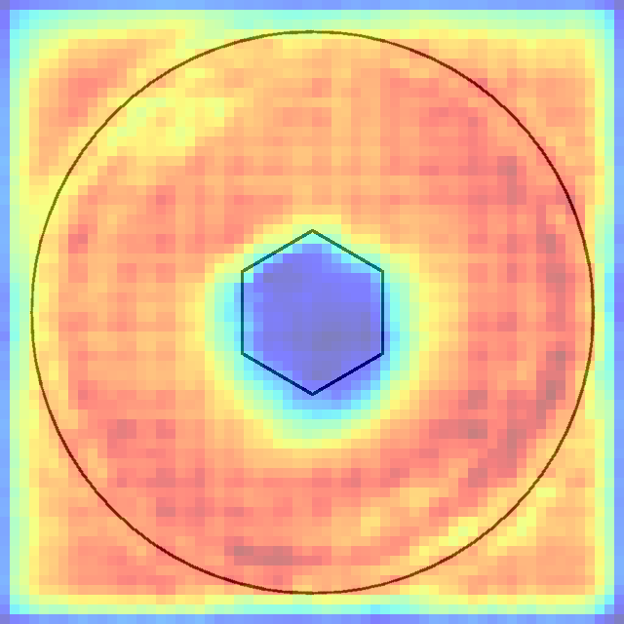
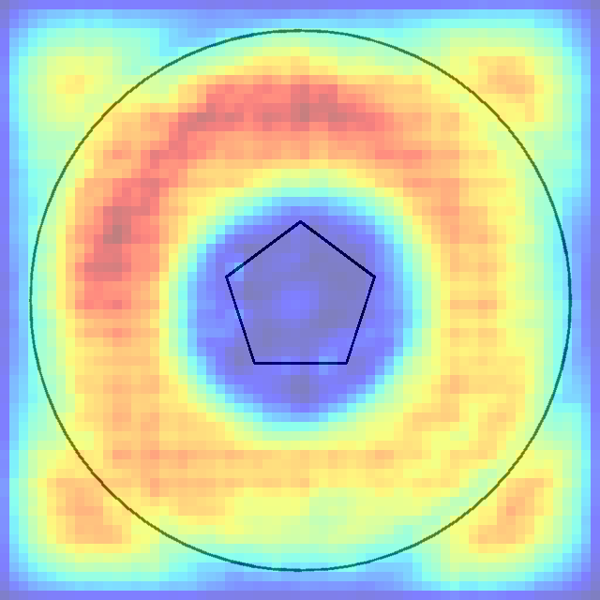
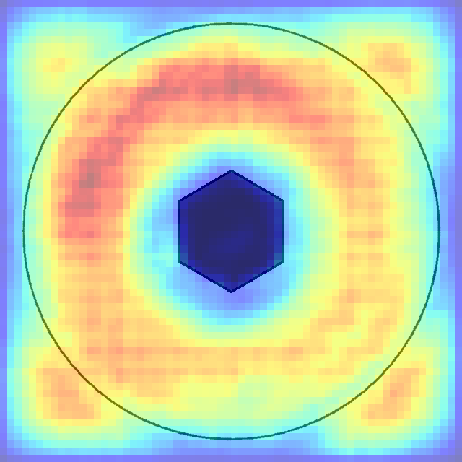
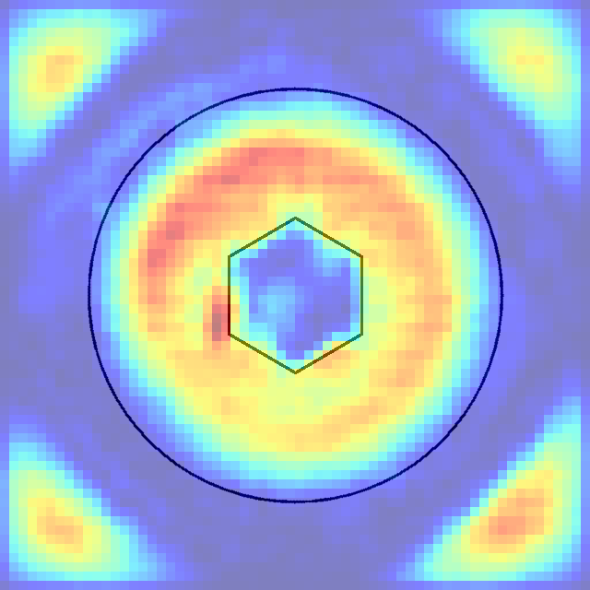
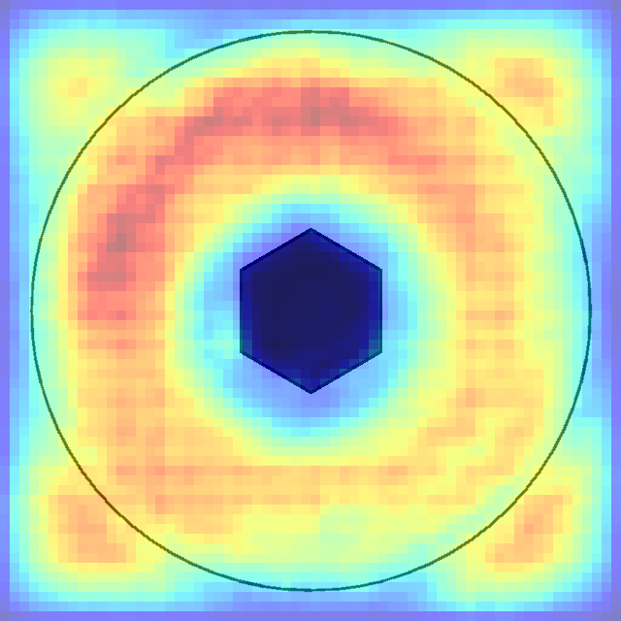
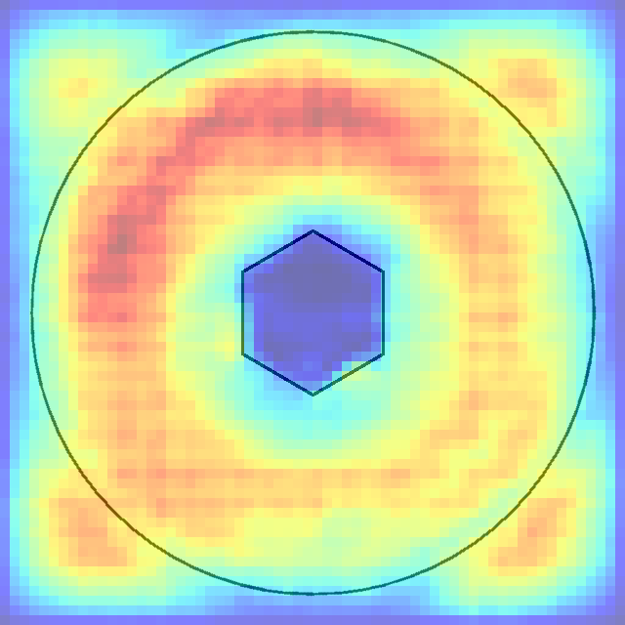
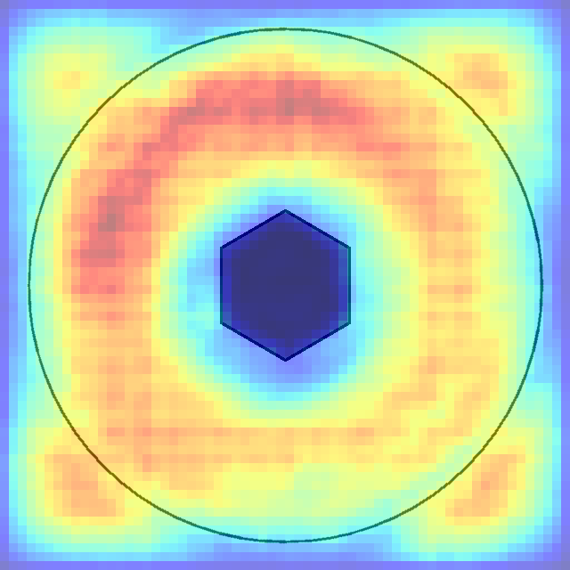
0 1 2 3 4 5 6 7

Slide 7
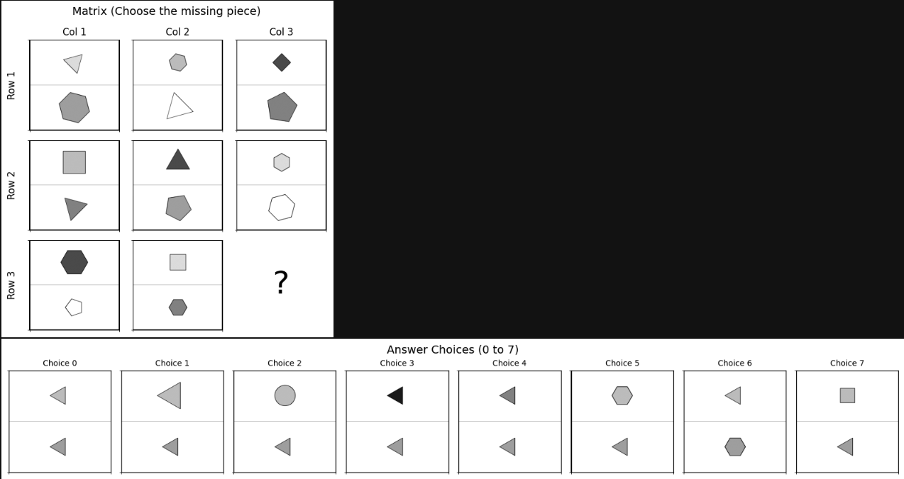
LLM_1228
up_center_single_down_center_single
llm pred: 0
os pred: 0
true: 0

Slide 8
Row Pattern Analysis:
- Row 1: (light triangle, gray hexagon) → (gray hexagon, white triangle) → (dark gray diamond, gray pentagon)
- Row 2: (gray square, gray triangle) → (dark gray triangle, gray pentagon) → (light hexagon, white hexagon)
- Row 3: (dark gray hexagon, white pentagon) → (gray square, gray hexagon) → ?
Column Pattern Analysis:
In each column, the top cell contains one of 3 colors: light, dark gray, gray, so I expect the top missing cell to be gray.
Logic:
1. Two shapes per cell consistency: Every cell in the matrix contains exactly 2 shapes. The missing cell in Row 3, Column 3 must also contain 2 shapes to maintain this fundamental pattern.
2. Shape variety within upper cells: Looking at the existing cells, each row in its upper cells contains 3 shapes: triangle, hexagon, square/diamond, so I expect the top cell in the missing cell to be a triangle.
3. Shape variety within bottom cells: Looking at the existing cells, each row in its bottom cells contains 3 shapes: triangle, hexagon, pentagon, so I expect the bottom cell in the missing cell to be a triangle.
Looking at the answer choices, only choices 0, 1 match both the shape and color requirements. However, answer 1 contains a triangle that is too big and not seen in the matrix, so the answer is choice 0.

Slide 9
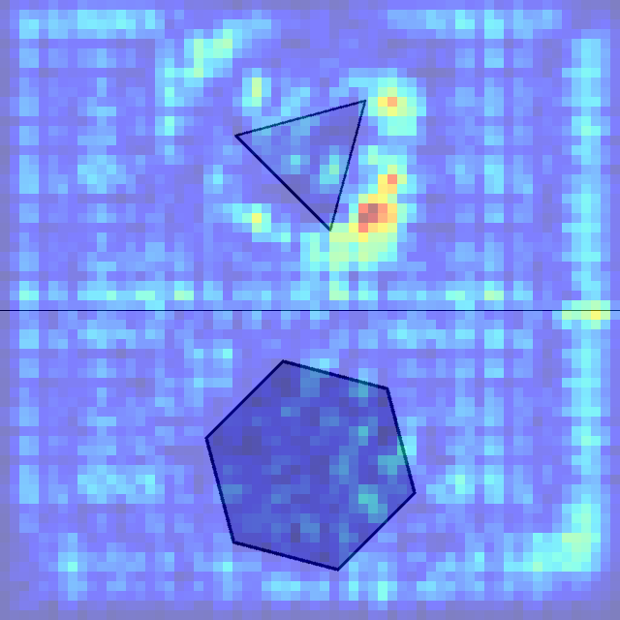
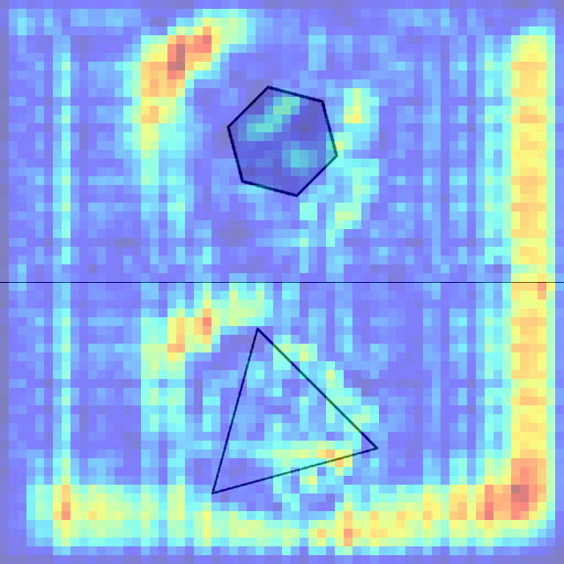
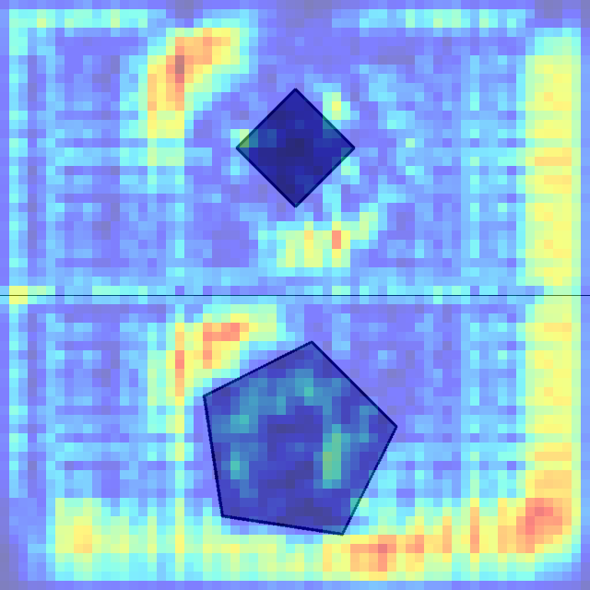
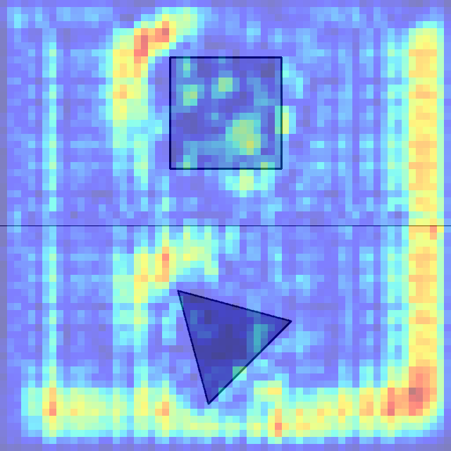
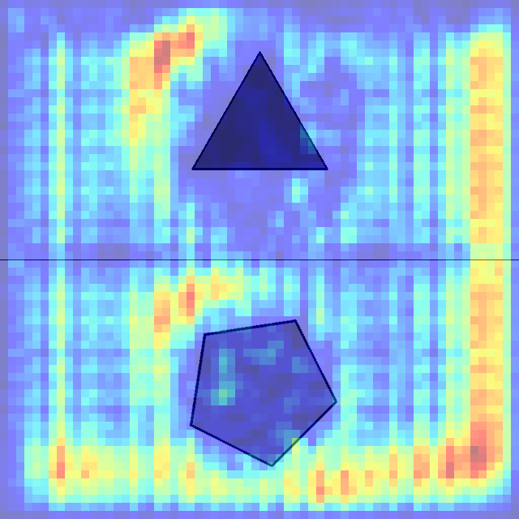
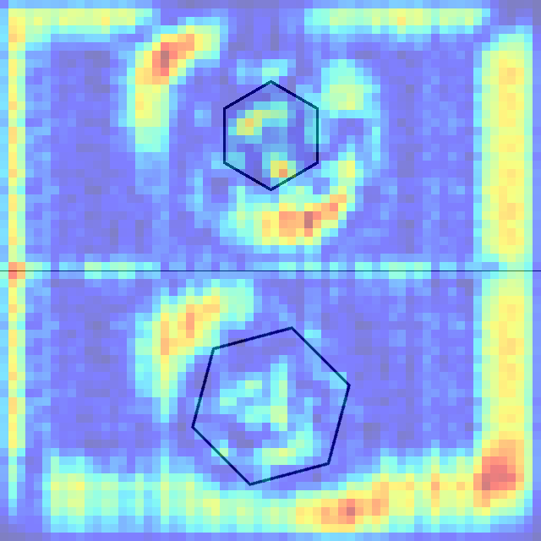
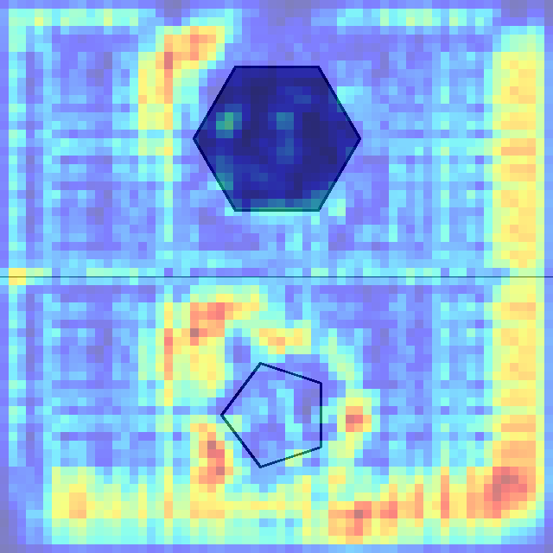
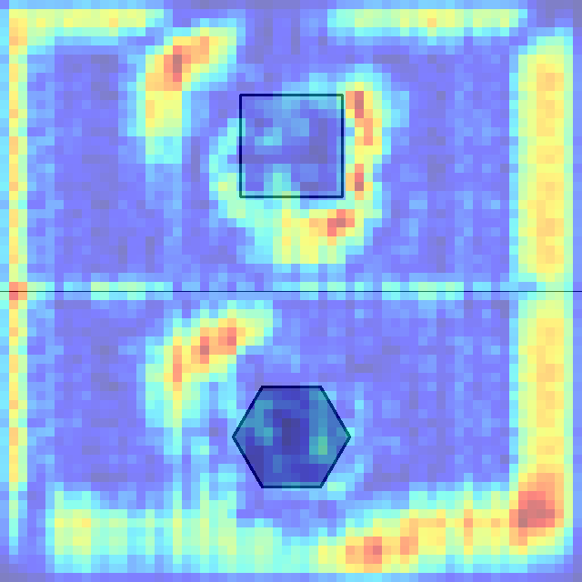
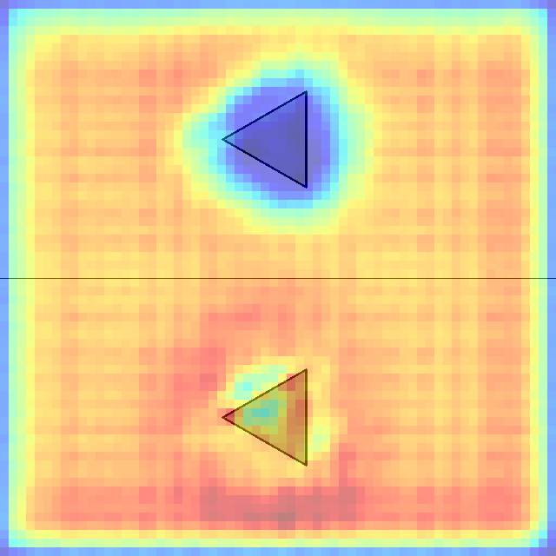
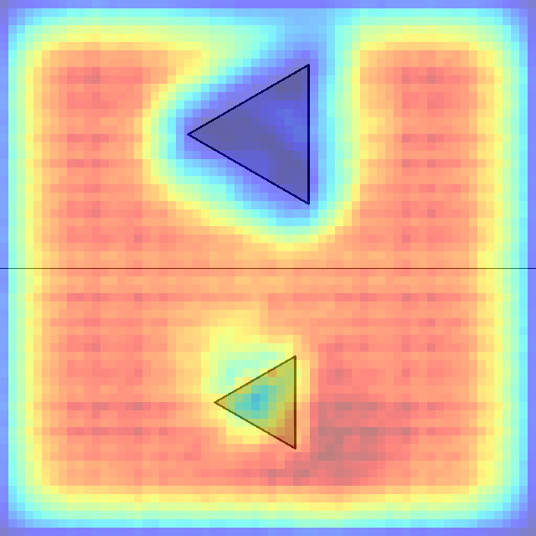
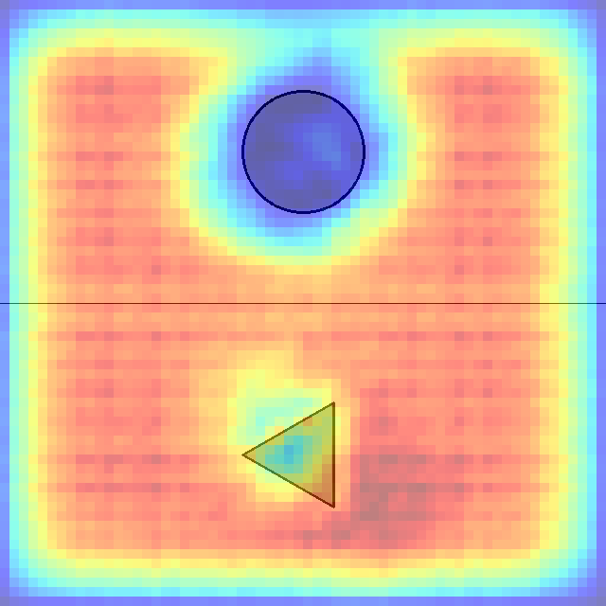
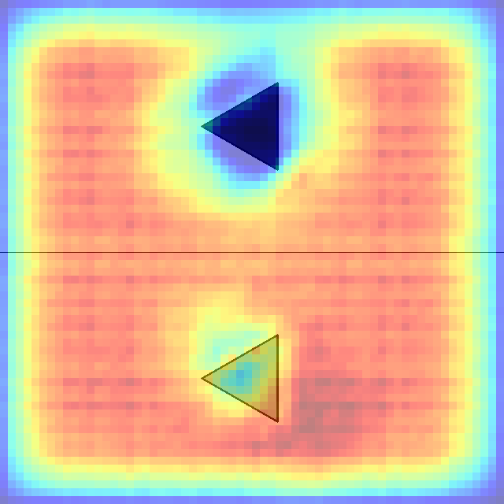
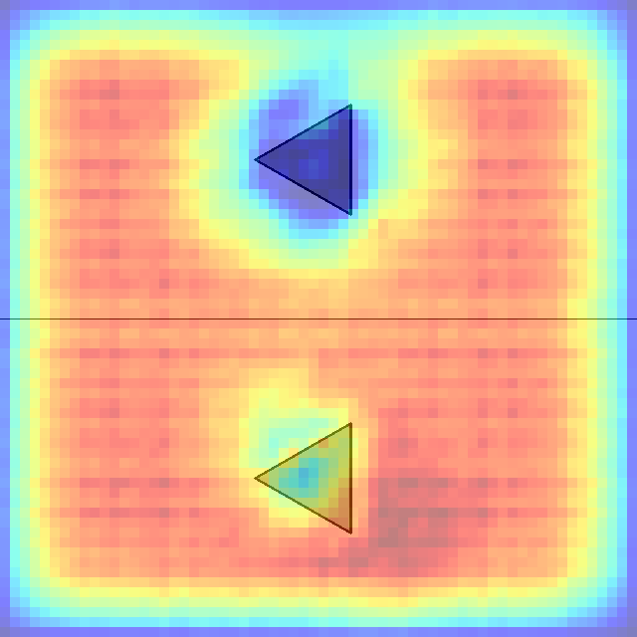
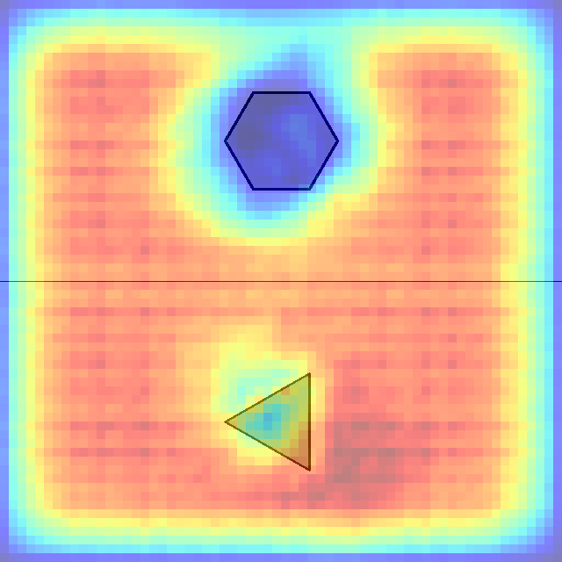
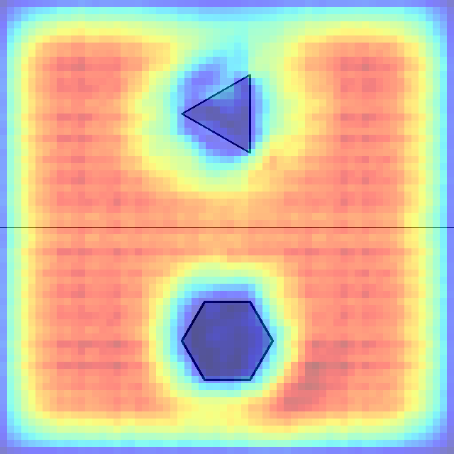
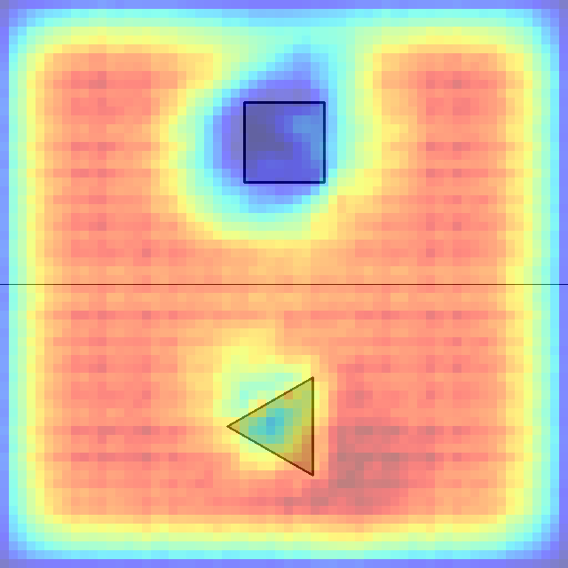
0 1 2 3 4 5 6 7

Slide 10
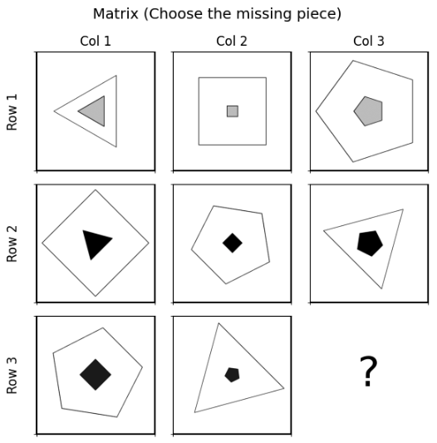
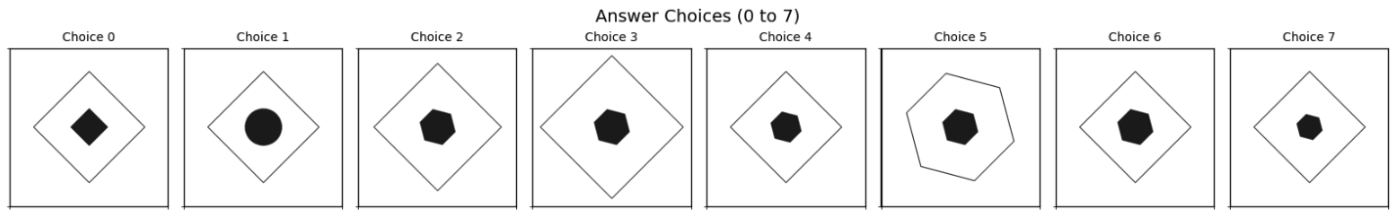
LLM-1229
in_center_single_out_center_single
llm pred: 6
os pred:6
true: 6

Slide 11
1. Outer shape pattern by column:
- Column 1: Triangle → Diamond/Square → Pentagon
- Column 2: Square/Diamond → Pentagon → Triangle
- Column 3: Pentagon → Triangle → Missing piece (should be a square or diamond)
2. Inner shape pattern by row:
- Row 1: Light gray shapes (triangle, square, pentagon)
- Row 2: Black shapes (triangle, diamond, pentagon)
- Row 3: Black shapes (diamond, pentagon, ?)
3. Size relationship:
- The inner shape is always smaller than the outer shape
- The inner shape's complexity appears to increase moving across Row 3 (diamond → pentagon → hexagon?)
4. Rotation pattern:
- There seems to be consistent rotation of the outer shapes in each row
Based on these patterns, the missing piece should have:
- A square or diamond as its outer shape (following the column pattern)
- A black inner shape (following the row pattern)
- The inner shape should be hexagon
Looking at the answer choices, we need a diamond or square outer shape with a black hexagon inner shape.
Choices 1, 2, 5 all show various polygons (hexagons, pentagons, circles) as the outer/inner shape, which don't follow the column/row pattern that we need.
Based on this analysis, Choice 6 appears to be the most logical answer
in terms of the size ratios seen in the matrix. It features a diamond outer shape (which follows the pattern of shapes in Column 3) and a black hexagon inner shape (which follows the pattern of black inner shapes in Row 3).

Slide 12
















0 1 2 3 4 5 6 7

Slide 13


LLM-6569
left_center_single_right_center_single
llm pred: 0
os pred: 1
true: 0

Slide 14
1. Left shape pattern across columns:
- Row 1: Circle (gray) → Circle(gray) → Circle (gray)
- Row 2: Pentagon (white) → Pentagon (white) → Pentagon (white)
- Row 3: Hexagon (dark gray) → Hexagon (dark gray) → Missing piece (should be a dark gray hexagon)
2. Right shape pattern across columns:
- Row 1: Hexagon (dark gray) → Triangle (black) → Square (black)
- Row 2: Triangle (dark gray) → Diamond (black) → Hexagon (black)
- Row 3: Square (gray) → Hexagon (dark gray) → Missing piece (should be a triangle based on the pattern)
3. Shape type pattern for right shapes:
- There appears to be a cycle of shapes: Hexagon → Triangle → Square/Diamond
- Shapes in the right cell increase from Col to Col in each row. (missing piece should be big triangle)
4. Shape type pattern for left shapes:
- Shapes in the left cell increase from Col to Col in each row. (missing piece should be big Hexagon)
Based on these patterns, the missing piece should have:
- A hexagon on the left (following the pattern in Row 3)
- A triangle on the right (following the cycle pattern for right shapes)
- The left hexagon should maintain the progression of shading and size seen in Row 3
- The right triangle should be black or very dark (following the darkening pattern)
Looking at the answer choices, all options show a configuration with a hexagon on the left and a triangle on the right, which matches our expected pattern. The differences are in the shading and exact shape details.
After examining all the choices, Choice 0 appears to be the most suitable answer. It shows:
1. A dark gray hexagon on the left that follows the shading progression seen in Row 3 .
2. A black triangle on the right that follows the darkening pattern across columns
3. The shapes maintain consistent proportions with what we see in the rest of the matrix

Slide 15
















0 1 2 3 4 5 6 7

Slide 16


LLM-7108
left_center_single_right_center_single
llm pred: 7
os pred:6
true: 5

Slide 17
Row 1:
- All cells contain light gray or white shapes
- Col 1: small light gray triangle pointing up, small white triangle pointing down
- Col 2: big white pentagon, medium white pentagon
- Col 3: big gray circle, big white circle
Row 2:
- All cells contain darker shapes
- Col 1: bit dark gray triangle pointing up, small black triangle pointing right
- Col 2: big dark gray pentagon, medium black pentagon
- Col 3: small gray circle, big black circle
Row 3 (incomplete):
- Col 1: big black triangle pointing down, small light gray triangle pointing left
- Col 2: small white pentagon, light gray pentagon
- Col 3: missing piece we need to identify
Column 3 pattern:
- Top cell: big light gray circle, big white circle
- Middle cell: small gray circle, big black circle
- Bottom cell (missing): should follow the pattern (should be 2 circles)
Based on these observations, I can identify several key patterns:
1. Each row follows a consistent color scheme
2. Row 3 alternates between black/white and light gray shapes
3. Shape types are consistent within columns (triangles in column 1, pentagons in column 2, circles in column 3)
4. There's a specific transformation happening with colors and sizes
The missing piece should contain circles (following column 3's pattern) with a black/white circle and a light gray circle (following row 3's pattern). Looking at the choices, this would be a small black circle and a larger light gray circle.
Examining the answer choices, Choice 7 appears to be the correct answer, as it shows a small black circle and a larger light gray circle, maintaining both the shape pattern of column 3 and the color pattern of row 3.

Slide 18
















0 1 2 3 4 5 6 7

Slide 19


OS-128
left_center_single_right_center_single
os pred: 6
llm pred: 1
true: 7

Slide 20
















0 1 2 3 4 5 6 7

Slide 21
Row Pattern Analysis:
- Row 1: (small light circle, large gray hexagon) → (medium black circle, small black triangle) → (large gray circle, medium black square)
- Row 2: (small black circle, medium black triangle) → (medium gray circle, large gray diamond) → (large light circle, small black hexagon)
- Row 3: (medium gray hexagon, small black square) → (medium light hexagon, medium black hexagon) → ?
Column Pattern Analysis:
- Column 1: Circle+hexagon → Circle+triangle → Hexagon+square
- Column 2: Circle+triangle → Circle+diamond → Hexagon+hexagon
- Column 3: Circle+square → Circle+hexagon → ?
Logic:
1. Left shape pattern in Column 3: Column 3 shows circle → circle → ? The pattern suggests the left shape should change from circles to something else. Looking at other columns, when circles appear twice, they're often followed by a hexagon (as seen in Column 1's progression). The missing piece should contain a hexagon in the left shape.
2. Right shape pattern in Column 3: Column 3 shows square → hexagon → ?. There's a progression from square/diamond to hexagon to triangle. Following geometric complexity in the other columns, the next shape should be a triangle.
3. Color alternation patterns: Looking at Row 3, there's a pattern of gray+black → light+black → ?. This suggests the missing cell should have a specific color combination. The left shape should be black, and the right shape should follow the established color pattern.
4. Shape size cycling in left-side rows: All left cells for each row show a gradual increase from small to medium to large. The missing part should contain a large hexagon.
5. Color alternation patterns in the right side: Looking at each row, there's a pattern in the right side of dark gray to light black to black. This suggests the missing cell should have a specific color combination. The right shape should be dark gray.
Answer: Choice 1 - This shows a black hexagon on the left and a dark gray triangle on the right. This maintains the hexagon pattern for the left shape in Row 3, provides the triangle as a logical geometric progression, and follows the color alternation patterns established in the matrix.

Slide 22


OS-218
in_center_single_out_center_single
os pred: 4
llm pred: 4
true: 4

Slide 23
















0 1 2 3 4 5 6 7

Slide 24
Row Pattern Analysis:
- Row 1: Square frame+diamond → Square frame+hexagon → Square frame+pentagon
- Row 2: Pentagon frame+pentagon → Pentagon frame+diamond → Pentagon frame+hexagon
- Row 3: Hexagon frame+hexagon → Hexagon frame+pentagon → ?
Column Pattern Analysis:
- Column 1: Square+diamond → Pentagon+pentagon → Hexagon+hexagon
- Column 2: Square+hexagon → Pentagon+diamond → Hexagon+pentagon
- Column 3: Square+pentagon → Pentagon+hexagon → ?
Logic:
1. Outer shape consistency within rows: Each row maintains the same outer frame shape throughout with the same size. Row 1 uses square frames, Row 2 uses pentagon frames, Row 3 uses hexagon frames. The missing piece must have a hexagon as the outer frame with the exact size of the shapes in Row 3.
2. Inner shape progression in Column 3: Column 3 shows pentagon → hexagon → ? Following the geometric progression in the columns (5 sides → 6 sides → 4 sides), the next logical shape would be a square (4 sides) to complete a cycle of basic polygons in the other columns.
3. Color pattern in Row 3: Row 3 shows gray hexagon inside → light pentagon inside → ? The color alternates between gray and light. Following this pattern, the inner shape should be gray to continue the alternation as seen in Choices 0, 4, 5.
4. Inner shape pattern within columns: Each column has 2 inner shapes of the same size. In column 1, the inner shapes in rows 1 and 3 are the same size. In column 2, the inner shapes in columns 1 and 2 are the same size. Therefore, the missing piece must contain an inner shape of the same size as one of the 2 shapes in rows 1 or 2.
Choice 4 meets this requirement.
Answer: Choice 4 - This shows a hexagon outer frame with a gray square inside. This maintains the hexagon outer shape for Row 3, follows the color alternation pattern (gray inner shape), and completes the geometric progression.

Slide 25


OS-429
up_center_single_down_center_single
os pred: 7
llm pred: 6
true: 6

Slide 26
















0 1 2 3 4 5 6 7

Slide 27
Row Analysis:
Row 1: Top shapes progress from dark gray pentagon → light gray pentagon → very light gray pentagon (getting lighter)
Row 1: Bottom shapes progress from black hexagon → black pentagon → black diamond (changing shape, staying black)
Row 2: Top shapes progress from light black diamond → llight black diamond → white diamond
Row 2: Bottom shapes progress from black square → light black hexagon → dark gray pentagon (changing shape and color)
Row 3: Top shapes are gray diamonds (consistent)
Row 3: Bottom shapes progress from black pentagon → light black square → ?
Column Analysis:
Column 1: Bottom shapes are hexagon → square → pentagon
Column 2: Bottom shapes are pentagon → hexagon → square
Column 3: Bottom shapes are diamond → pentagon → ? (pattern suggests continuation)
Logic:
1. Top shapes consistency within rows: The top shapes follow color progression patterns (Rows 1-2 get lighter). The top shapes are the same shape. The top shape in the missing piece should contain a light diamond.
2. Bottom shapes consistency within rows: The bottom shapes maintain specific shape sequences within each row structure of hexagon → square → pentagon. The bottom shape in the missing piece should contain a hexagon to complete the sequence.
3. Top shapes consistency within columns: The top shapes in each column get smaller as you go down row by row. The top of the missing piece should contain a diamond that is smaller in size than the one seen at the top of row 2.
4. Bottom shapes consistency within columns: Each column has one small bottom shape and 2 larger shapes. In column 1, the bottom shapes in rows 2 and 3 are larger than those in row 1. In column 2, the bottom shapes in rows 1 and 2 are larger than those in row 3.
The bottom missing part in column 3 should be a larger part than the one seen in row 1, so answer 6 is the most appropriate
The answer is Choice 6.

Slide 28


OS-1228
center_single
os pred: 1
llm pred: 1
true: 1

Slide 29
















0 1 2 3 4 5 6 7

Slide 30
Row Analysis:
- Row 1: Gray hexagon → Light Gray circle → White triangle
- Row 2: Dark Gray circle → Gray triangle → Light gray hexagon
- Row 3: Dark Gray triangle → Gray hexagon → ?
Column Analysis:
- Column 1: Gray hexagon → Gray circle → Gray triangle
- Column 2: Gray circle → Gray triangle → Gray hexagon
- Column 3: White triangle → Light gray hexagon → ?
Logic:
1. Shape Cycling Pattern: Each row and column contains three different shapes (hexagon, circle, triangle) that appear to cycle through systematically. The missing piece should be a circle.
2. Column 3 Consistency: Column 3 shows outline/unfilled versions, so the missing piece should be an outline circle to maintain this pattern.
3. Shape size consistency within rows: For each row, there are 3 sizes, large, medium, and small. Row 3 has a triangle (large) and a hexagon (medium), the missing part should contain a circle (small)
Looking at the answer choices, Choice 1 shows a light gray circle (outline), which perfectly fits the established patterns.
The answer is Choice 1.

Slide 31


OS-6999
in_distribute_four_out_center_single
os pred: 3
llm pred: 0
true: 3

Slide 32
















0 1 2 3 4 5 6 7

Slide 33
Row Analysis:
Row 1: All triangles as outer shapes, with inner elements progressing from circles (outline) → pentagons (filled) → squares and diamonds (filled)
Row 2: All triangles as outer shapes, with inner elements showing diamonds (filled) → circles (outline) → pentagons (filled)
Row 3: All circles as outer shapes, with inner elements showing pentagons (filled) → diamonds (filled) → ?
Column Analysis:
Column 1: Triangle → Triangle → Circle (outer shapes), with circles → diamonds → pentagons (inner elements)
Column 2: Triangle → Triangle → Circle (outer shapes), with pentagons → circles → diamonds (inner elements)
Column 3: Triangle → Triangle → Circle (outer shapes), with squares/diamonds → pentagons → ?
Logic:
1. Outer Shape Pattern: Each row maintains consistent outer shapes (Row 1 and 2: triangles, Row 3: circles), and columns show a transition from triangles to circles in the third row. The missing piece is a circle.
2. Inner Element Cycling: The inner shapes cycle through circles, diamonds/squares, pentagons in various fill states (outline vs filled).
3. Fill State Pattern: There's an alternating pattern between outline (unfilled) and filled shapes across the matrix.
- All inner circles are white
- All inner diamonds/squares are gray
- All inner pentagons are black
Missing piece should contain inner circles in white color
Outer shape consistency: Row 3 uses circles as containers throughout
Inner shape cycling: The pattern suggests circles should appear in position (3,3)
Fill state alternation: Based on the pattern, the circles should be outline/unfilled
Systematic completion: This maintains both row and column logical sequences
Looking at the answer choices, Choice 0 shows a circle (outer shape) containing outline circles (inner elements), which perfectly fits the established patterns.
The answer is Choice 0.

