Slide 1
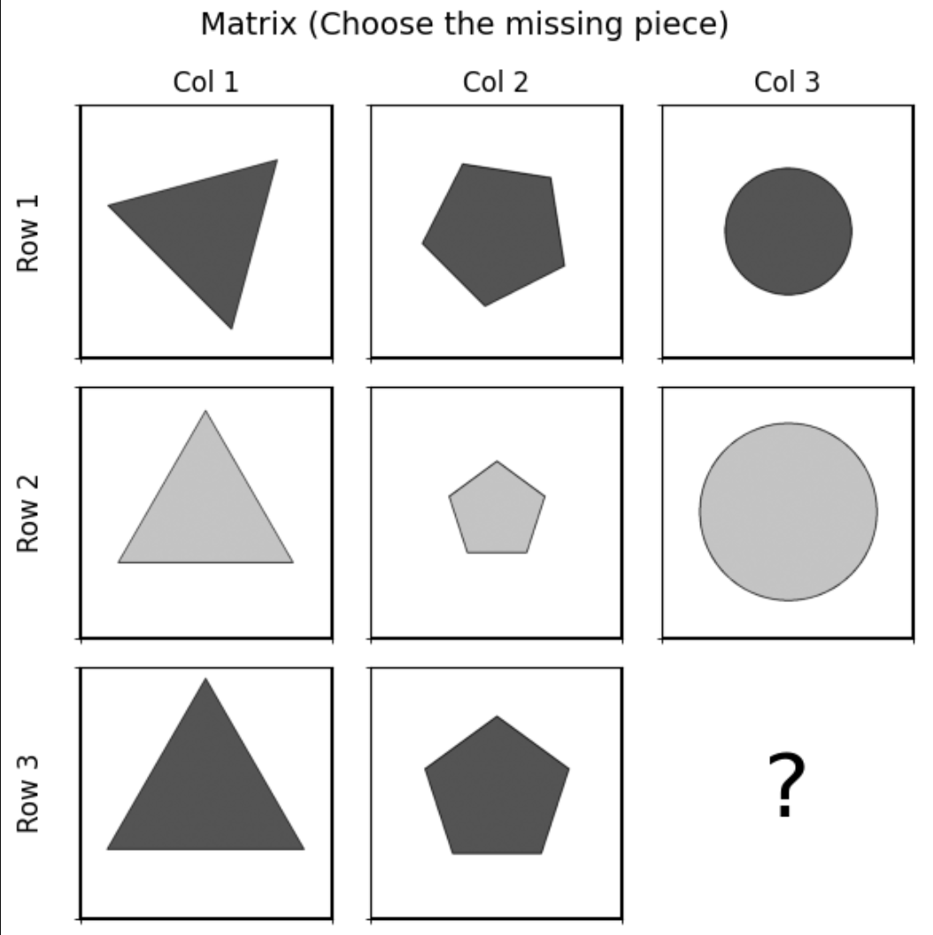
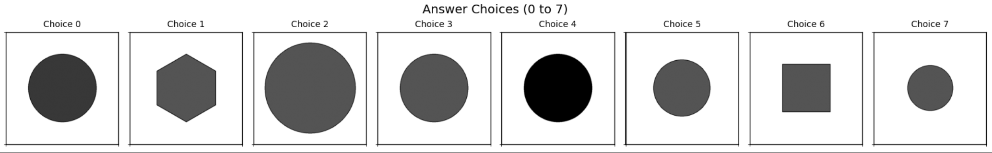
דוגמא שמופיעה לפני הניסוי
OS-1378
center_single
pred: 5
true: 3

Slide 2
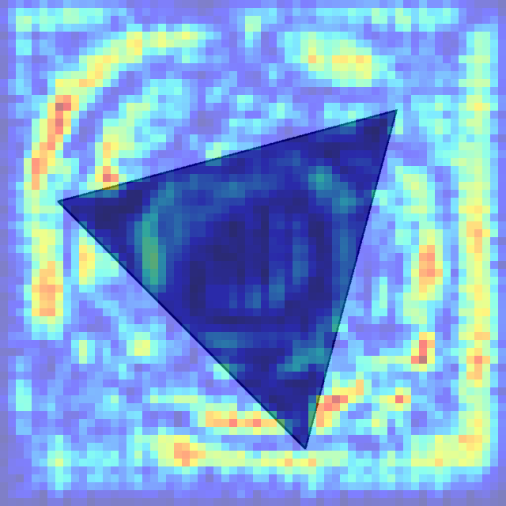
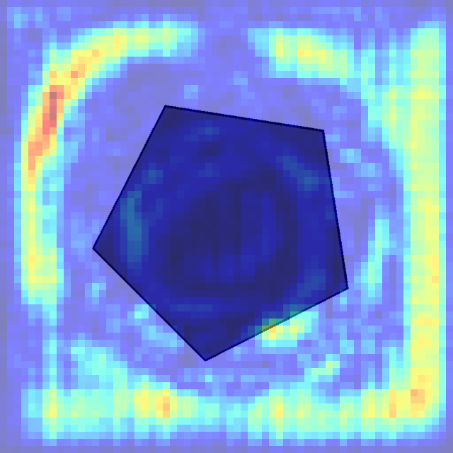
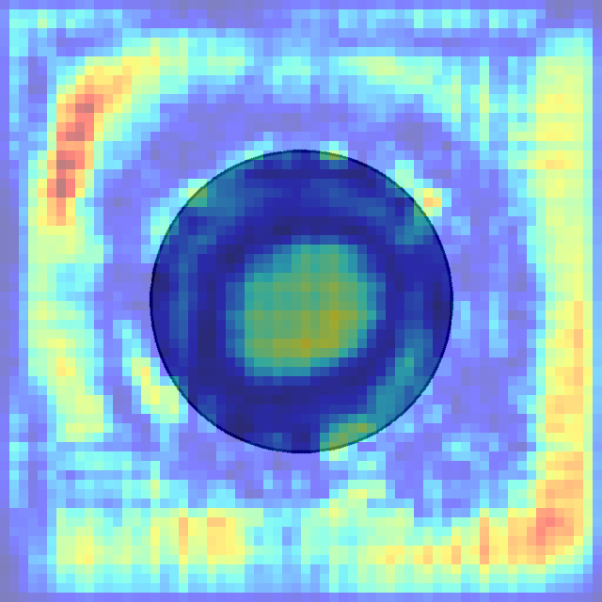
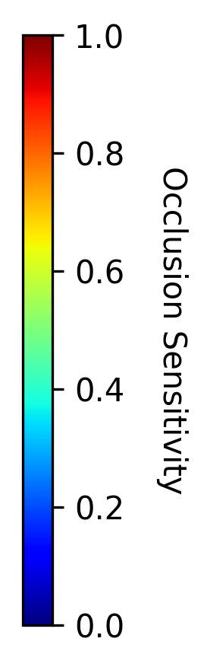
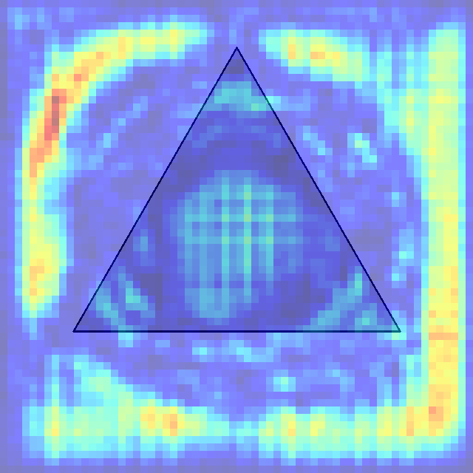
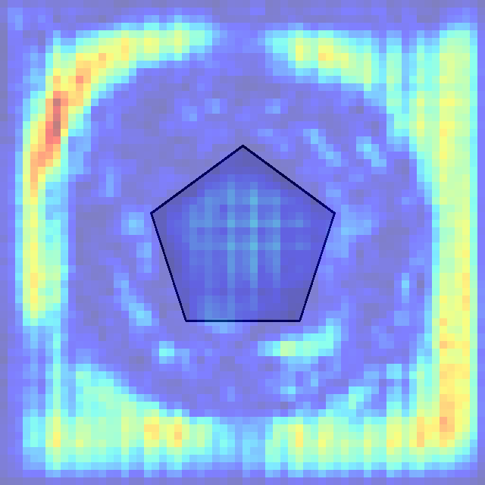
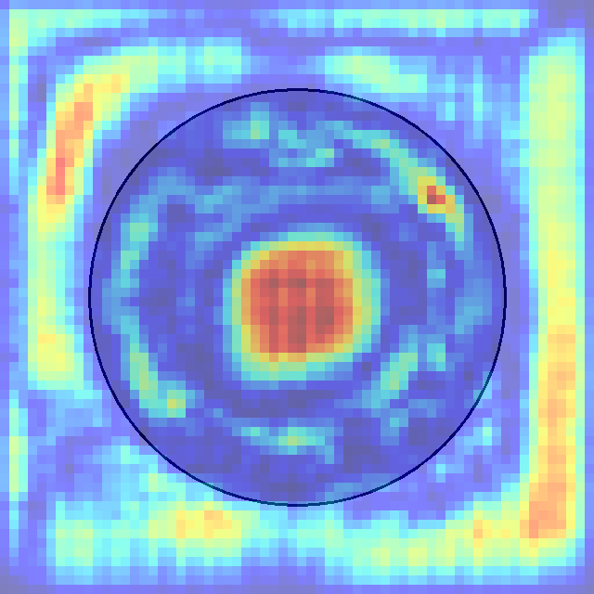
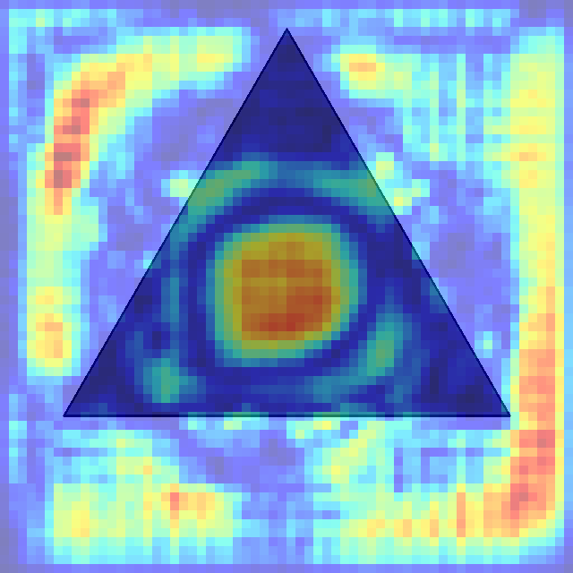
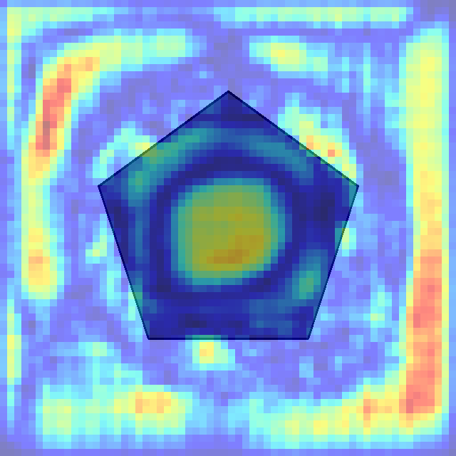
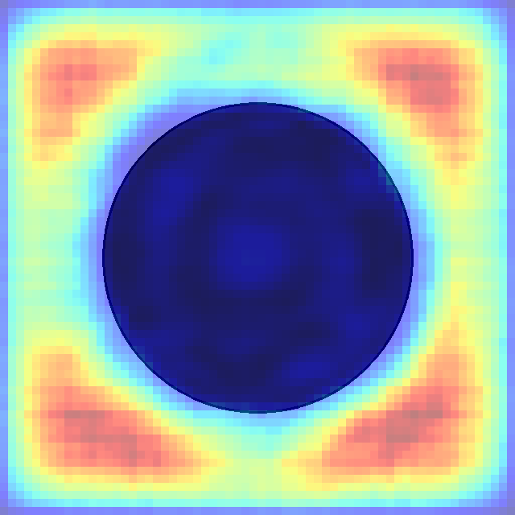
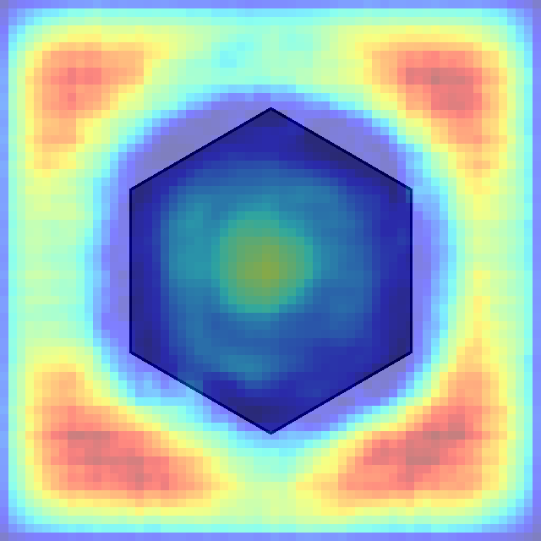
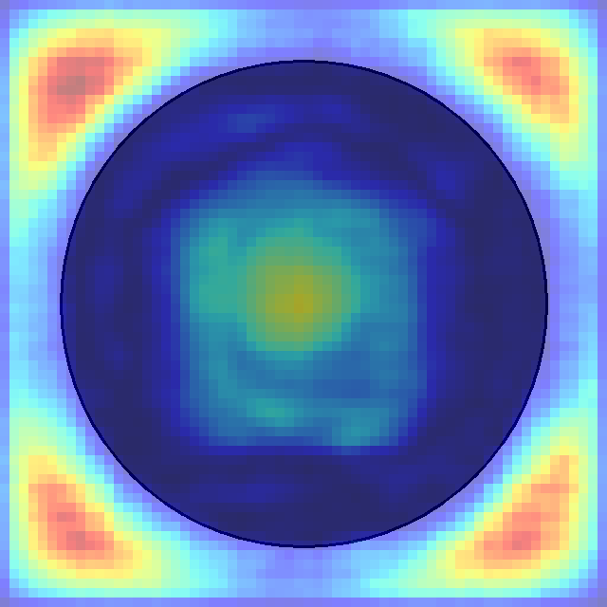
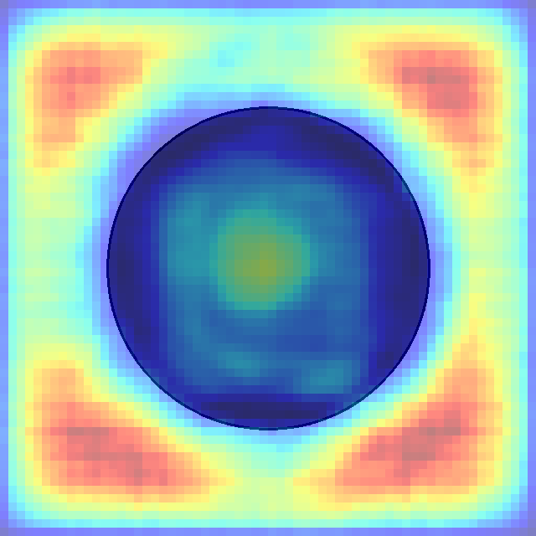



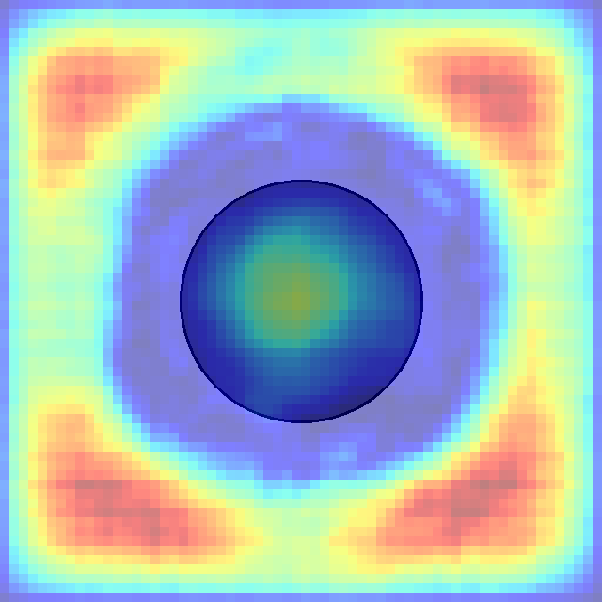
הסבר: אם ננתח את הפיקסלים האדומים בכל תשובה אפשרית לחידה ניתן לראות שהמודל מחפש צורת עיגול(בעיקר בולט בתשובה 1,6 שלכן נפסלות). מעבר לכך, ניתן להבחין כי הוא מחפש עיגול בגודל מסויים, ולכן תשובה 7 נפסלת.
לבסוף, ניתן להבחין כי תשובה 5 היא הנכונה לפי היגיון המודל כי הוא מצא בה הכי הרבה פיקסלים שחשובים לדעתו.
0 1 2 3 4 5 6 7

Slide 3
Row Pattern Analysis:
- Row 1: Dark triangle → Dark pentagon → Dark circle
- Row 2: Light triangle → Light pentagon → Light circle
- Row 3: Dark triangle → Dark pentagon → ?
Column Pattern Analysis:
- Column 1: Dark triangle → Light triangle → Dark triangle
- Column 2: Dark pentagon → Light pentagon → Dark pentagon
- Column 3: Dark circle → Light circle → ?
Logic:
1. Shape progression within rows: Each row follows the same sequence of shapes: triangle → pentagon → circle. Row 3 already has triangle and pentagon, so the missing piece must be a circle.
2. Color alternation within columns: Each column alternates between dark and light shades. Column 3 shows: dark circle (Row 1) → light circle (Row 2) → ? (Row 3). Following the alternating pattern, Row 3 should have a dark circle.
3. Consistency check: The pattern shows that odd-numbered rows (1 and 3) contain dark shapes, while even-numbered rows (2) contain light shapes. This confirms Row 3 should have a dark shape.
4. Shape and color convergence: Combining the shape requirement (circle) with the color requirement (dark), the answer must be a dark circle.
Answer: Choice 0 - The dark circle, which maintains both the shape progression within the row and the color alternation within the column.

Slide 4
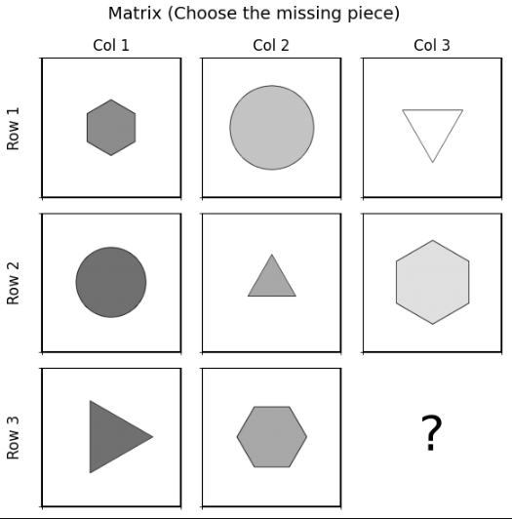
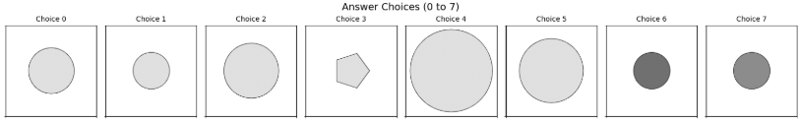
OS-1228
center_single
pred: 1
true: 1

Slide 5
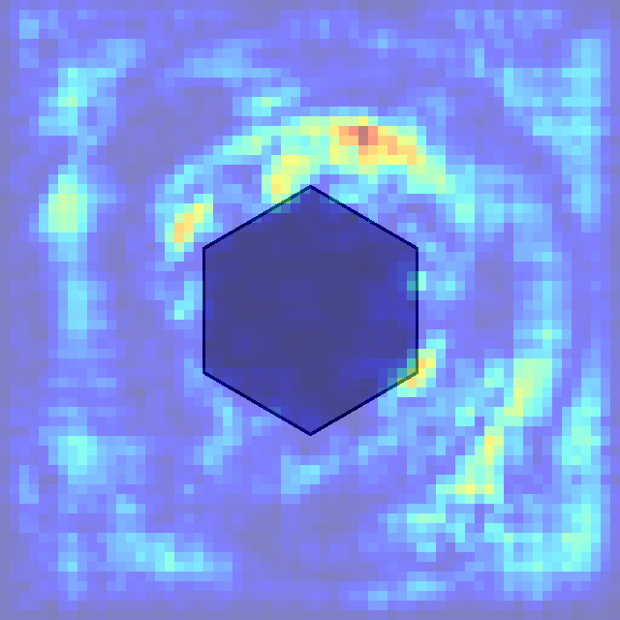
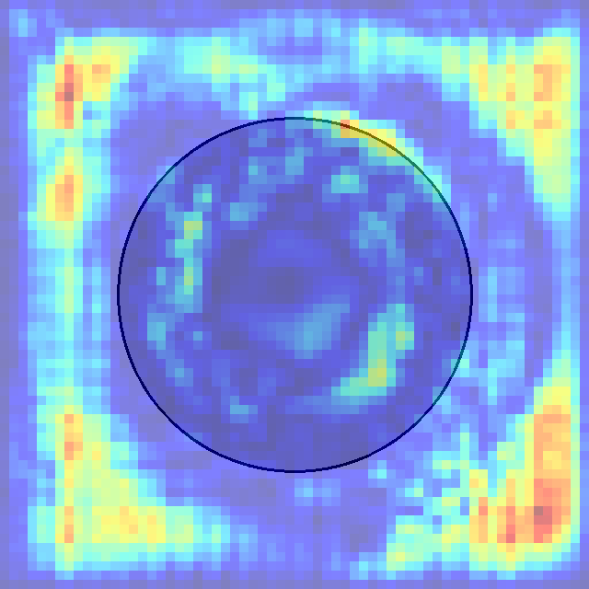
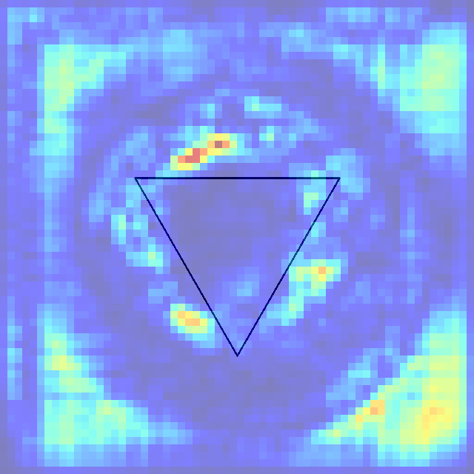
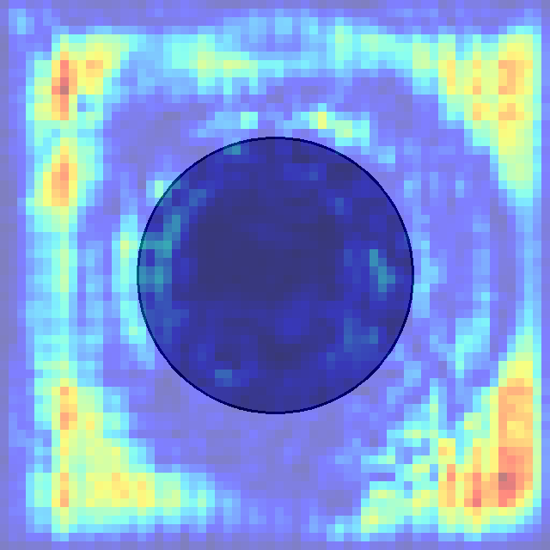
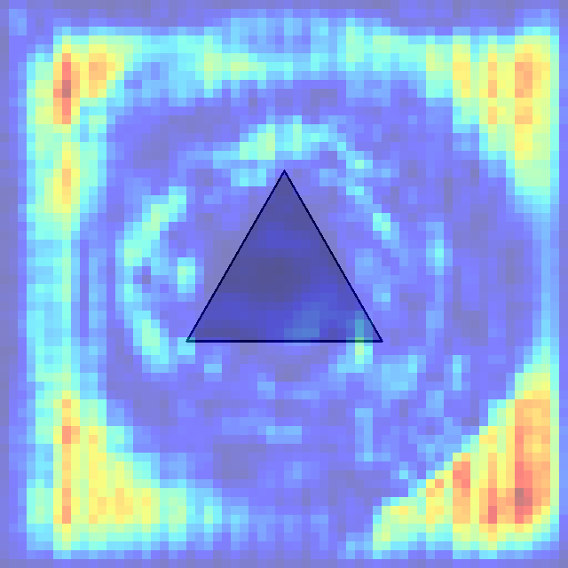
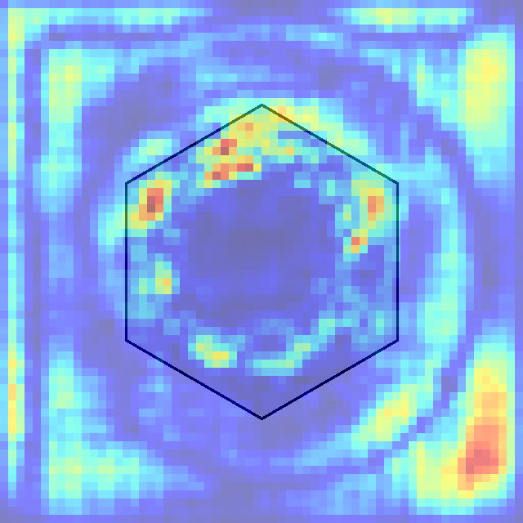
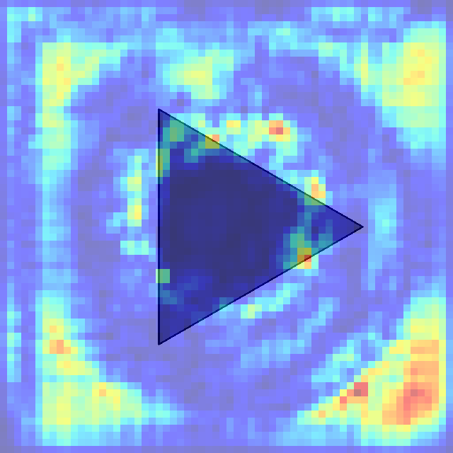
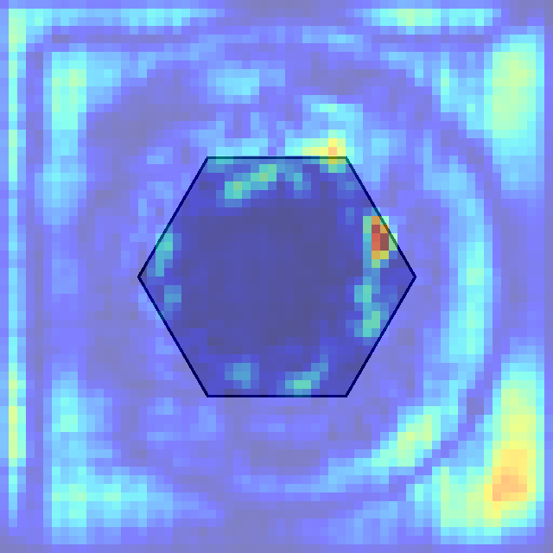
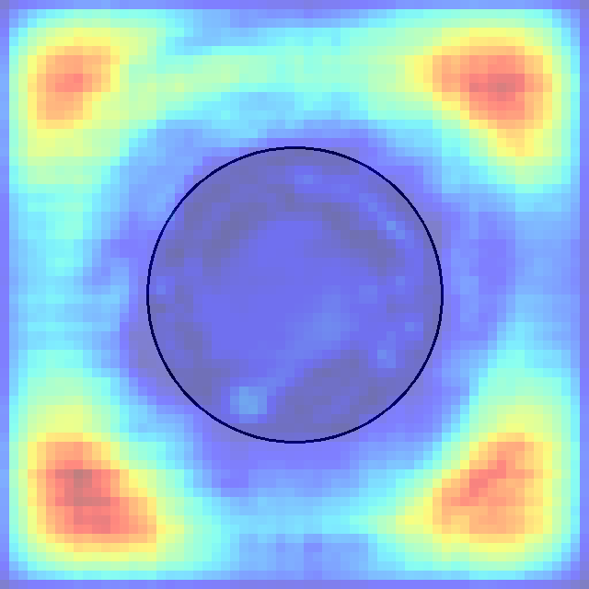
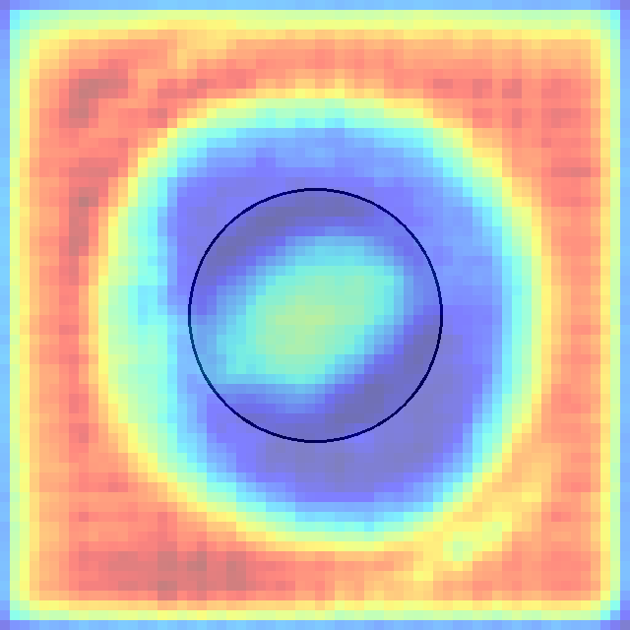
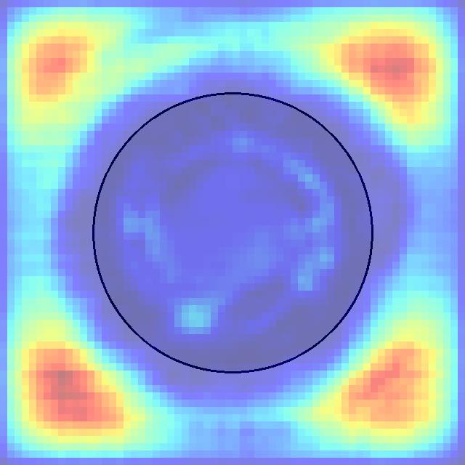
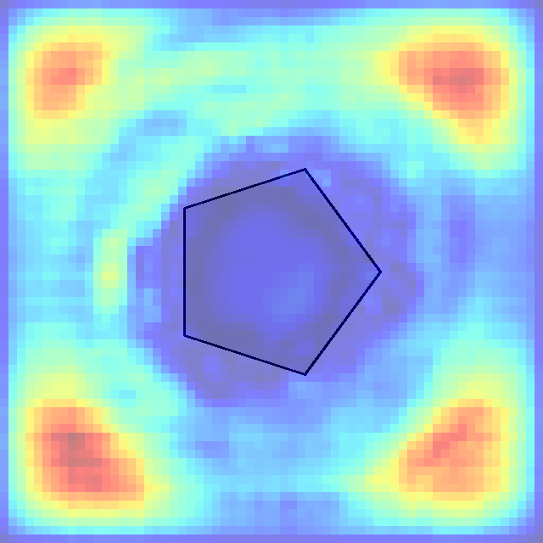
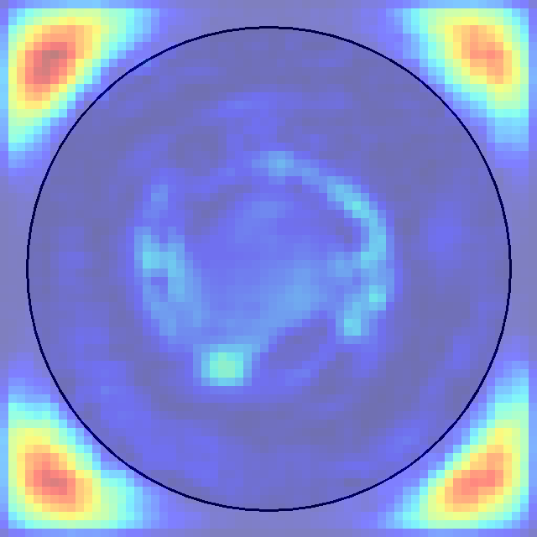
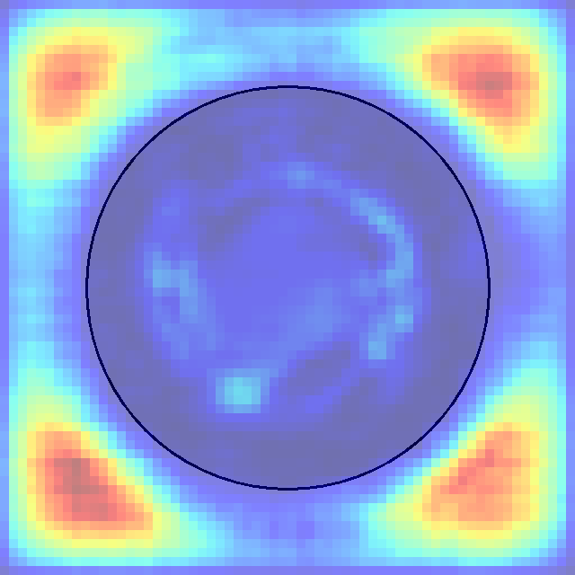
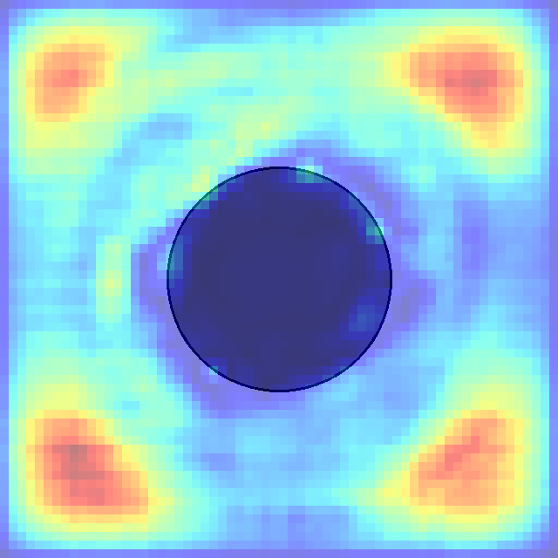
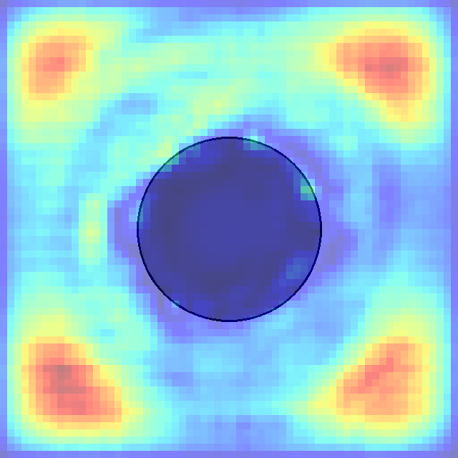
0 1 2 3 4 5 6 7

Slide 6
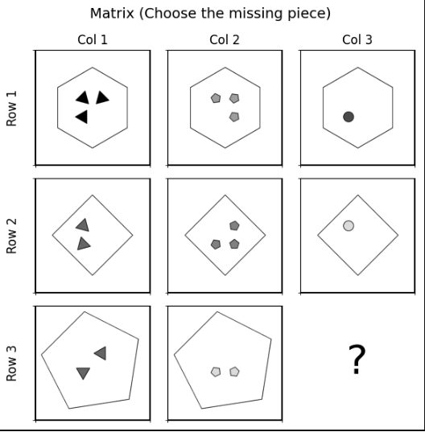
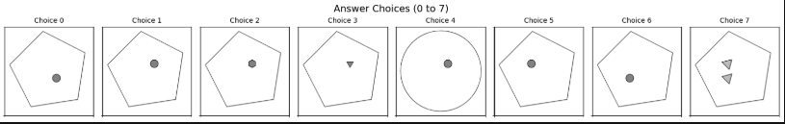
OS-2739
in_distribute_four_out_center_single
pred: 3
true: 1

Slide 7
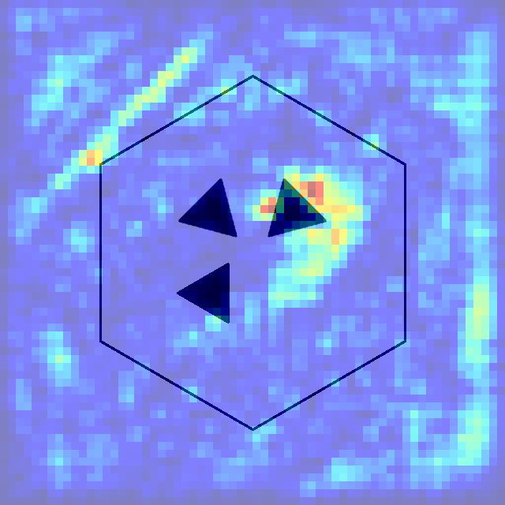
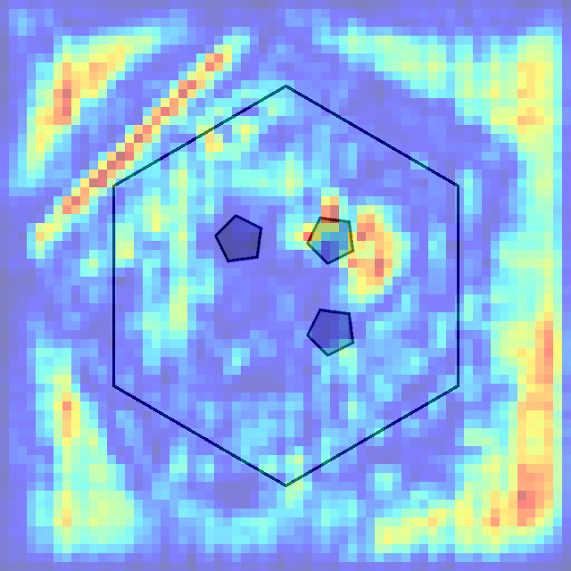
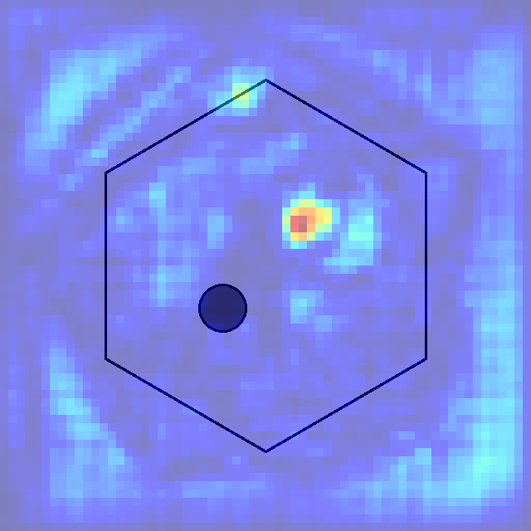
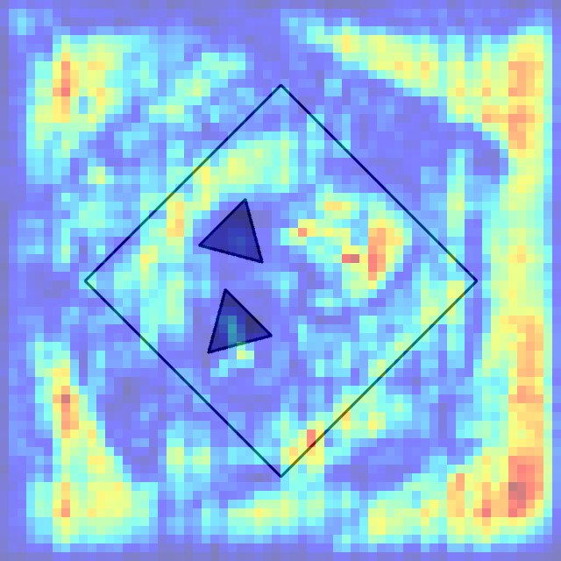
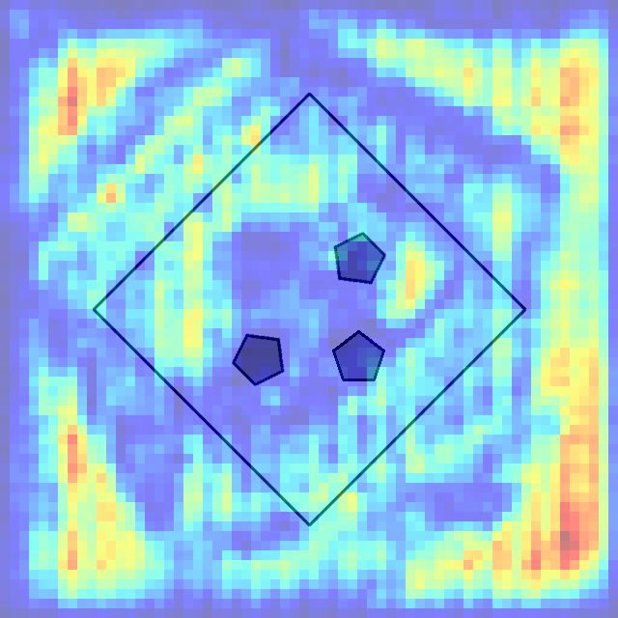
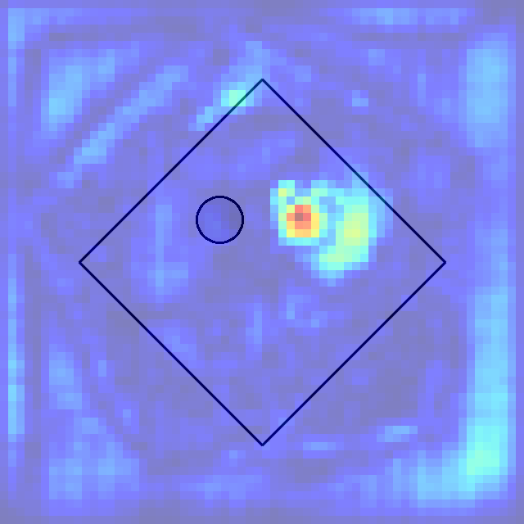
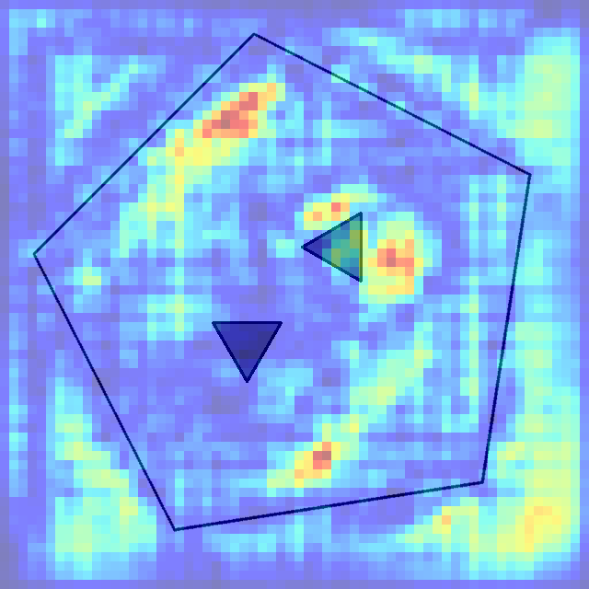
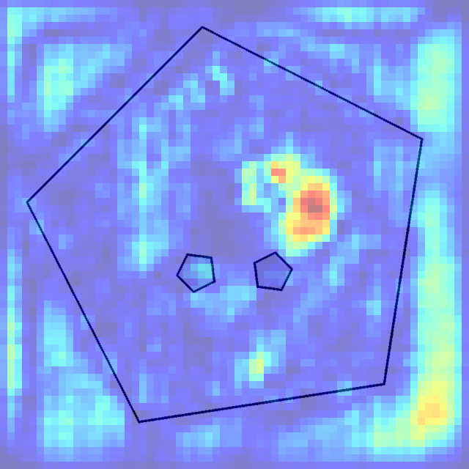
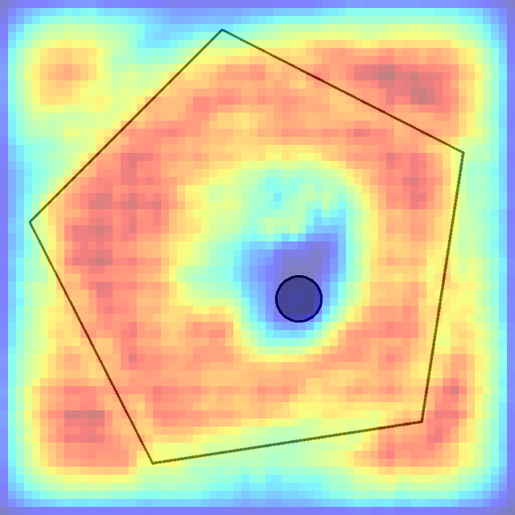
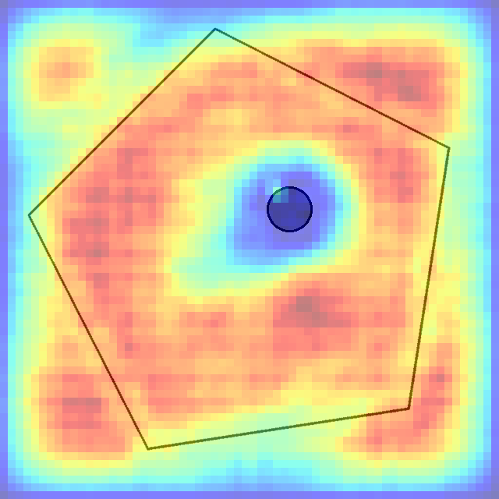
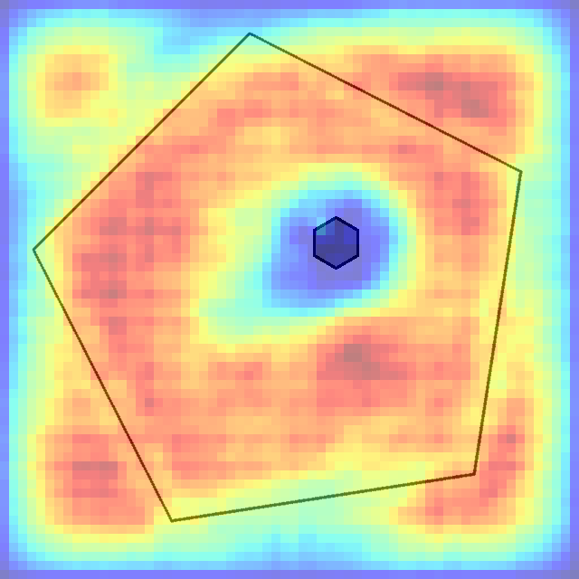
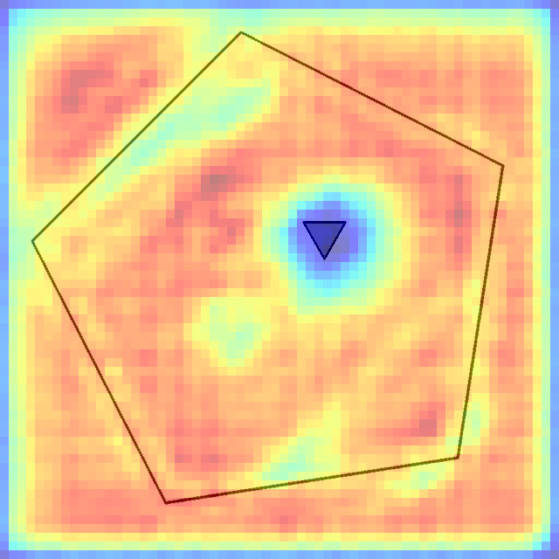
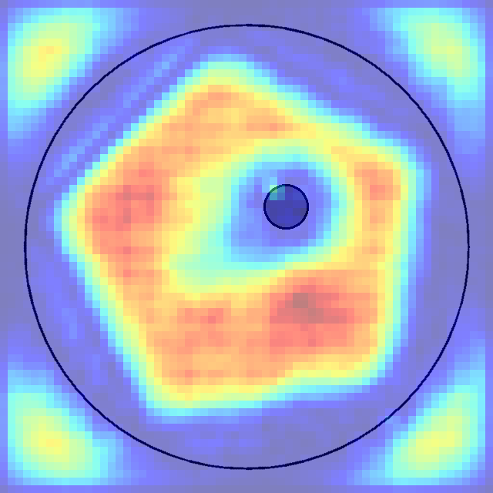
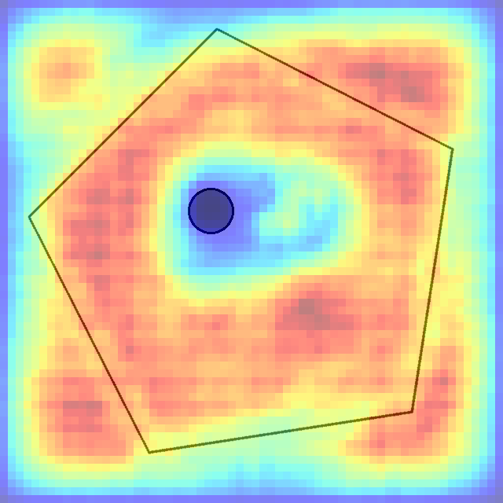


הסבר: בתמונה זאת ניתן לראות כי המודל מחפש תבנית של מחומש גדול(תשובה 4 נפסלת).
הסיבה שיש כ״כ הרבה פיקסלים אדומים בכל תשובה אפשרית היא בגלל שכמעט כולן מכילות מחומש גדול שמבחינת המודל זה חלק מהתשובה שהוא מחפש ולכן זה פיקסלים חשובים מבחינתו.
לבסוף, ניתן לראות שיש הכי הרבה פיקסלים שצבועים באדום בתשובה 3 שזאת בחירת המודל.
0 1 2 3 4 5 6 7

Slide 8


OS-7029
in_distribute_four_out_center_single
pred: 7
true: 7

Slide 9
















הסבר: גם כאן ניתן לראות שהמודל מחפש משולש
כצורה חיצונית
0 1 2 3 4 5 6 7

Slide 10


OS-429
up_center_single_down_center_single
pred: 7
true: 6

Slide 11
















0 1 2 3 4 5 6 7

Slide 12


OS-128
left_center_single_right_center_single
pred: 6
true: 7

Slide 13
















0 1 2 3 4 5 6 7

Slide 14


OS-218
in_center_single_out_center_single
pred: 4
true: 4

Slide 15
















0 1 2 3 4 5 6 7

Slide 16


OS-869
in_distribute_four_out_center_single
pred: 5
true: 5

Slide 17
















0 1 2 3 4 5 6 7

Slide 18


OS-6999
in_distribute_four_out_center_single
pred: 3
true: 3

Slide 19
















0 1 2 3 4 5 6 7

Slide 20

LLM-4088
distribute_9
pred: 5
true: 5

Slide 21
Row Pattern Analysis:
- Row 1: 4 black pentagons → 4 gray squares/diamonds → 6 light gray triangles
- Row 2: 1 gray pentagon → 3 gray diamonds → 4 black triangles (1 up, 3 down)
- Row 3: 3 gray hexagons → 7 black pentagons → ?
Column Pattern Analysis:
- In each column, the top two cells contain the same shape type
- In each column, the shape in the bottom cell has a greater number of sides than the shapes in the top cells
Column 1: Top cells contain a pentagon (5 sides), bottom cell contains a hexagon (6 sides)
Column 2: Top cells contain a square (4 sides), bottom cell contains a pentagon (5 sides)
Column 3: Top cells contain a triangle (3 sides), bottom cell must contain a square (4 sides) to maintain the consistency seen in the matrix.
Logic:
1. Color progression and alternation: In Column 3, we see light → black → ? The pattern suggests returning to a gray shade. Looking at the overall matrix, there's often a cycling between light, dark, and gray.
2. Quantity and size variation: Each row contains shapes of uniform colors and sizes in each cell. The missing cell should maintain this pattern.
3. Mixed orientations and arrangements: Row 2 Col 3 shows triangles in different orientations (up and down). Row 3 Col 3 should likely continue this pattern of varied orientations and positions.
Answer: Choice 5 - This shows multiple squares/diamonds in different orientations and positions, maintaining the triangle theme of Column 3, providing the color progression (returning to lighter/gray tones), and offering the size and positional variety consistent with Row 3's increasing complexity pattern.

Slide 22


LLM-6569
left_center_single_right_center_single
pred: 0
true: 0

Slide 23
1. Left shape pattern across columns:
- Row 1: Circle (gray) → Circle(gray) → Circle (gray)
- Row 2: Pentagon (white) → Pentagon (white) → Pentagon (white)
- Row 3: Hexagon (dark gray) → Hexagon (dark gray) → Missing piece (should be a dark gray hexagon)
2. Right shape pattern across columns:
- Row 1: Hexagon (dark gray) → Triangle (black) → Square (black)
- Row 2: Triangle (dark gray) → Diamond (black) → Hexagon (black)
- Row 3: Square (gray) → Hexagon (dark gray) → Missing piece (should be a triangle based on the pattern)
3. Shape type pattern for right shapes:
- There appears to be a cycle of shapes: Hexagon → Triangle → Square/Diamond
- Shapes in the right cell increase from Col to Col in each row. (missing piece should be big triangle)
4. Shape type pattern for left shapes:
- Shapes in the left cell increase from Col to Col in each row. (missing piece should be big Hexagon)
Based on these patterns, the missing piece should have:
- A hexagon on the left (following the pattern in Row 3)
- A triangle on the right (following the cycle pattern for right shapes)
- The left hexagon should maintain the progression of shading and size seen in Row 3
- The right triangle should be black or very dark (following the darkening pattern)
Looking at the answer choices, all options show a configuration with a hexagon on the left and a triangle on the right, which matches our expected pattern. The differences are in the shading and exact shape details.
After examining all the choices, Choice 0 appears to be the most suitable answer. It shows:
1. A dark gray hexagon on the left that follows the shading progression seen in Row 3 .
2. A black triangle on the right that follows the darkening pattern across columns
3. The shapes maintain consistent proportions with what we see in the rest of the matrix

Slide 24


LLM-7108
left_center_single_right_center_single
pred: 7
true: 5

Slide 25
Row 1:
- All cells contain light gray or white shapes
- Col 1: small light gray triangle pointing up, small white triangle pointing down
- Col 2: big white pentagon, medium white pentagon
- Col 3: big gray circle, big white circle
Row 2:
- All cells contain darker shapes
- Col 1: bit dark gray triangle pointing up, small black triangle pointing right
- Col 2: big dark gray pentagon, medium black pentagon
- Col 3: small gray circle, big black circle
Row 3 (incomplete):
- Col 1: big black triangle pointing down, small light gray triangle pointing left
- Col 2: small white pentagon, light gray pentagon
- Col 3: missing piece we need to identify
Column 3 pattern:
- Top cell: big light gray circle, big white circle
- Middle cell: small gray circle, big black circle
- Bottom cell (missing): should follow the pattern (should be 2 circles)
Based on these observations, I can identify several key patterns:
1. Each row follows a consistent color scheme
2. Row 3 alternates between black/white and light gray shapes
3. Shape types are consistent within columns (triangles in column 1, pentagons in column 2, circles in column 3)
4. There's a specific transformation happening with colors and sizes
The missing piece should contain circles (following column 3's pattern) with a black/white circle and a light gray circle (following row 3's pattern). Looking at the choices, this would be a small black circle and a larger light gray circle.
Examining the answer choices, Choice 7 appears to be the correct answer, as it shows a small black circle and a larger light gray circle, maintaining both the shape pattern of column 3 and the color pattern of row 3.

Slide 26


LLM-1229
in_center_single_out_center_single
pred: 6
true: 6

Slide 27
1. Outer shape pattern by column:
- Column 1: Triangle → Diamond/Square → Pentagon
- Column 2: Square/Diamond → Pentagon → Triangle
- Column 3: Pentagon → Triangle → Missing piece (should be a square or diamond)
2. Inner shape pattern by row:
- Row 1: Light gray shapes (triangle, square, pentagon)
- Row 2: Black shapes (triangle, diamond, pentagon)
- Row 3: Black shapes (diamond, pentagon, ?)
3. Size relationship:
- The inner shape is always smaller than the outer shape
- The inner shape's complexity appears to increase moving across Row 3 (diamond → pentagon → hexagon?)
4. Rotation pattern:
- There seems to be consistent rotation of the outer shapes in each row
Based on these patterns, the missing piece should have:
- A square or diamond as its outer shape (following the column pattern)
- A black inner shape (following the row pattern)
- The inner shape should be hexagon
Looking at the answer choices, we need a diamond or square outer shape with a black hexagon inner shape.
Choices 1, 2, 5 all show various polygons (hexagons, pentagons, circles) as the outer/inner shape, which don't follow the column/row pattern that we need.
Based on this analysis, Choice 6 appears to be the most logical answer
in terms of the size ratios seen in the matrix. It features a diamond outer shape (which follows the pattern of shapes in Column 3) and a black hexagon inner shape (which follows the pattern of black inner shapes in Row 3).

Slide 28


LLM-219
in_center_single_out_center_single
pred: 5
true: 1

Slide 29
1. Outer shape pattern by row:
- Row 1: All cells contain diamonds
- Row 2: All cells contain circles
- Row 3: All cells contain circles (this pattern continues)
2. Inner shape pattern by row:
- Row 1: All cells contain triangles (pointing right)
- Row 2: All cells contain pentagons
- Row 3: All cells contain hexagons
3. Color/shading pattern by row:
- Row 1: Light gray and dark gray inner shapes
- Row 2: Light gray or white inner shapes
- Row 3: Black inner shapes (first cell), black inner shapes (second cell)
4. Size pattern by column:
- The size of the shapes seems to follow a pattern across columns, with the inner shapes in Column 2 being smaller\equal to those in Columns 1 and 3
Based on these patterns, the missing piece should have:
- A circle as its outer shape (following the row pattern)
- A hexagon as its inner shape (following the row pattern)
- A black inner shape (following the row pattern)
- The size of the outer and inner shapes should be consistent with Column 3
Looking at the answer choices:
- Choices 1-7 contain hexagons as inner shapes
- Among these, only Choices 3, 5, and 7 have dark/black hexagons
- Choice 5 appears to have the most appropriate size relationship between the outer circle and inner hexagon for Column 3
The most logical answer is Choice 5, which features a circle as the outer shape and a black hexagon as the inner shape. The size relationship between the outer circle and inner hexagon in Choice 5 appears to match the pattern observed in Row 3, where the inner shape in Column 3 should be similar in size to Column 1 (slightly larger than Column 2).
Therefore, Choice 5 with its circle outer shape and appropriately sized black hexagon inner shape is the best answer.

Slide 30

LLM_1228
up_center_single_down_center_single
pred: 0
true: 0

Slide 31
Row Pattern Analysis:
- Row 1: (light triangle, gray hexagon) → (gray hexagon, white triangle) → (dark gray diamond, gray pentagon)
- Row 2: (gray square, gray triangle) → (dark gray triangle, gray pentagon) → (light hexagon, white hexagon)
- Row 3: (dark gray hexagon, white pentagon) → (gray square, gray hexagon) → ?
Column Pattern Analysis:
In each column, the top cell contains one of 3 colors: light, dark gray, gray, so I expect the top missing cell to be gray.
Logic:
1. Two shapes per cell consistency: Every cell in the matrix contains exactly 2 shapes. The missing cell in Row 3, Column 3 must also contain 2 shapes to maintain this fundamental pattern.
2. Shape variety within upper cells: Looking at the existing cells, each row in its upper cells contains 3 shapes: triangle, hexagon, square/diamond, so I expect the top cell in the missing cell to be a triangle.
3. Shape variety within bottom cells: Looking at the existing cells, each row in its bottom cells contains 3 shapes: triangle, hexagon, pentagon, so I expect the bottom cell in the missing cell to be a triangle.
Looking at the answer choices, only choices 0, 1 match both the shape and color requirements. However, answer 1 contains a triangle that is too big and not seen in the matrix, so the answer is choice 0.

Slide 32

LLM_5349
distribute_nine
pred: 6
true: 6

Slide 33
Row Pattern Analysis:
- Row 1: 7 Multiple mixed shapes → 8 Multiple mixed shapes → Single light pentagon
- Row 2: 5 Multiple mixed shapes → 6 Multiple mixed shapes → Single light triangle
- Row 3: 5 Multiple mixed shapes → 7 Multiple mixed shapes → ?
Column Pattern Analysis:
- Column 3: Light pentagon → Light triangle → ?
Logic:
1. Column 3 simplification pattern: Column 3 consistently shows single, simple shapes while Columns 1 and 2 contain multiple complex arrangements. Row 1 has a single light pentagon, Row 2 has a single light triangle. This establishes that Column 3 contains individual shapes rather than collections.
2. Positioning pattern: The shape in column 3 of rows 1 and 2 appears in the position resulting from subtracting the shapes in column 2 from the shapes in column 1.
Answer 6 best fits the positional pattern in row 3 based on this logic.
Answer: Choice 6 - This shows a single gray pentagon that preserves the simplicity, color consistency, and positioning pattern established in Row 3.

Slide 34

LLM_7788
distribute_nine
pred: 3
true: 2

Slide 35
Row Pattern Analysis:
- Row 1: 2 light circles → 2 light pentagons → 2 light triangles
- Row 2: 7 dark circles → 7 dark pentagons → 7 dark triangles
- Row 3: 1 large dark circle → 1 small dark pentagon → ?
Column Pattern Analysis:
- Column 1: 2 shapes → 7 shapes → 1 shape
- Column 2: 2 shapes → 7 shapes → 1 shape
- Column 3: 2 shapes → 7 shapes → ?, missing piece shoud contain 1 shape
Logic:
1. Shape progression within rows: Each row maintains the same shape cycle, circle → pentagon → triangle.
Missing piece should contain a triangle.
2. Color consistency within rows: Row 1 uses light colors throughout, Row 2 uses dark colors throughout, Row 3 uses dark colors in Columns 1 and 2, so Column 3 should also use a dark color.
3. Size and position pattern: Row 3 shows a progression from a large dark circle to a small dark pentagon, suggesting the triangle should be appropriately sized and positioned, likely as a medium single dark triangle seen in Choices 2, 3.
Choice 3 presents a more logical position that has been seen in Row 3.
Answer: Choice 3 - This shows a single dark triangle, which maintains the quantity pattern (1 shape), follows the shape logic (triangle to complete the row pattern), uses the correct color (dark to match Row 3), and provides the appropriate size and positioning consistent with the established matrix structure.

