Slide 1

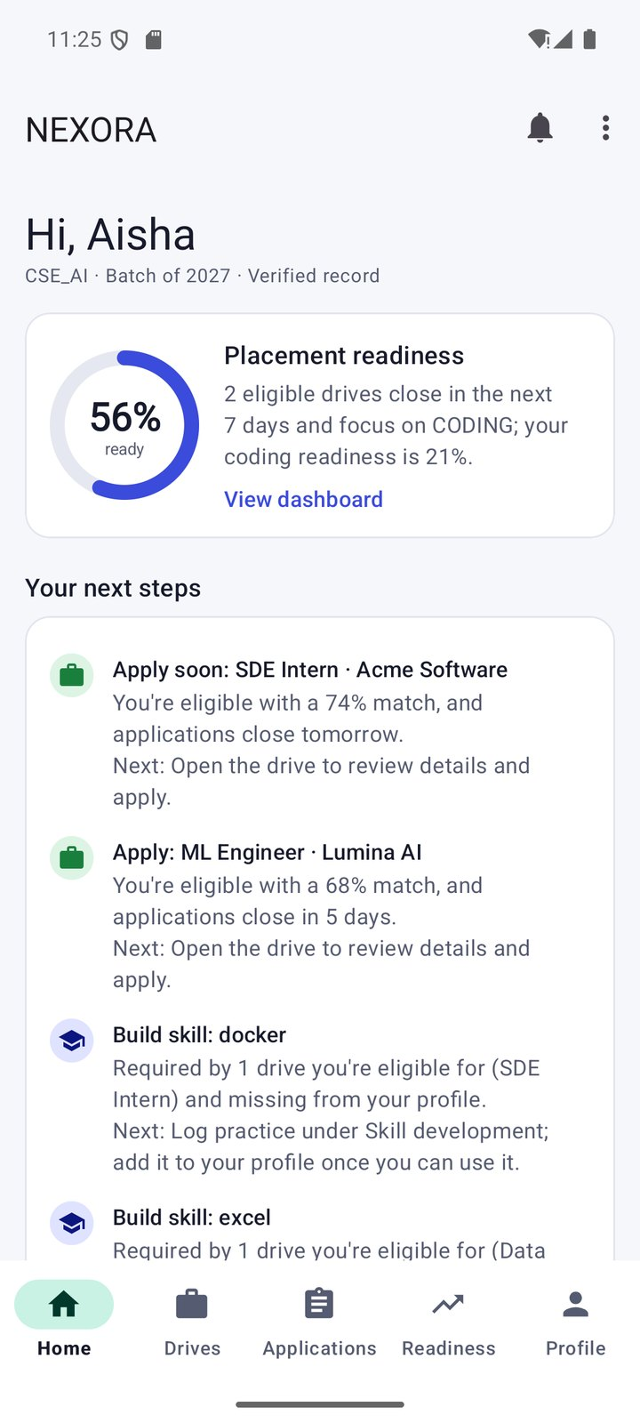
NEXORA
Campus Placement Recruitment System
Explainable eligibility · match scoring · readiness analytics · Career Action Engine
22AIE458 — Mobile Application Development · Amrita Vishwa Vidyapeetham
Student
Student
Guide
Mandala Ruthik Reddy
Hasthi Naresh
Rahul Varma U
AM.SC.U4AIE23129
AM.SC.U4AIE23113
Faculty Guide

Slide 2





Problem statement and motivation
Eligibility is opaque
Students cannot tell which drives they qualify for, or why they are rejected.
Self-reported data is untrustworthy
Motivation
Freely editable CGPA and backlogs make any client-side check meaningless.
One app in which eligibility is explained criterion by criterion, trust-critical rules are enforced on the server, and every student always sees a concrete next step — while the placement office gets verified data and live analytics.
Deadlines and rounds are missed
Updates are scattered across notice boards, spreadsheets and chat groups.
No guidance on preparation
Students don't know what to practise; officers lack an overview of progress.

Slide 3



Objectives and proposed solution
Objectives
Explainable
Role-based student and placement-officer portals in one APK
Explain eligibility for every criterion
Rank drives with a transparent, documented match score
Track preparation with a readiness score
Connect everything through a Career Action Engine
Enforce roles, verification and outcomes on the server
Work offline and stay on the free Firebase Spark plan
Per-criterion eligibility with reasons; match = 0.60·S + 0.25·P + 0.15·R with matched and missing skills.
Trusted
Officer-verified academic records; Firestore Security Rules re-check eligibility, deadlines, duplicates and outcomes.
Guided
Readiness dashboard and a ranked Career Action Plan linking preparation to real drives and rounds.

Slide 4








Technology stack
Java 17 + XML
Material Components
MVVM + Repository
Firebase Authentication
Android Studio · Gradle 9.4.1 · minSdk 26, target SDK 36
Version 1.14 · Material 3 theme, light and dark
ViewModel and LiveData (Lifecycle 2.10), manual DI container
Email and password; Emulator Suite in debug
Cloud Firestore
Room 2.8.5
WorkManager 2.11
Testing
7 collections, Security Rules, offline persistence
Bookmarks, activity log and offline cache
Background sync and local notifications
JUnit 4, JaCoCo, Espresso, rules-unit-testing

Slide 5
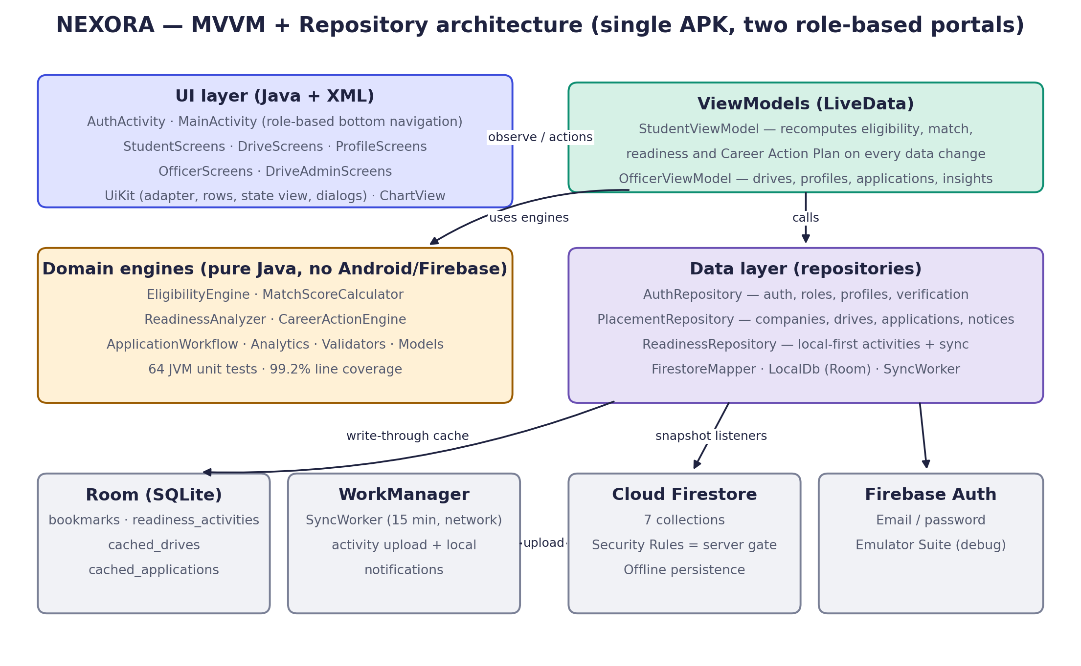



System architecture
Pure-Java domain
Engines import no Android or Firebase classes, so 64 unit tests run on the JVM.
Reactive ViewModels
Every derived result is recomputed whenever any input LiveData changes.
Repositories
Hide Firestore and Room; snapshot listeners detach automatically when screens stop.

Slide 6
Implemented modules and components
EligibilityEngine
MatchScoreCalculator
CGPA, branch, backlogs, graduation year → PASS / FAIL / UNKNOWN with explanations
Weighted skills, role-preference and readiness score with reasons and bands
ReadinessAnalyzer
CareerActionEngine
Five weighted components over 30 days, weekly trend, suggestions
Ranked, explained next steps built from the other engines' results
ApplicationWorkflow
Analytics
Apply decision; advance and reject transitions; immutable final states
Dashboard, funnel, branch selections, preparation insights (aggregate only)
Repositories
SyncWorker + Room
Auth, Placement, Readiness — Firestore and Room behind LiveData
Idempotent activity upload, notification fetch, offline cache
28 Java source files (~6,500 lines) · 22 XML layouts · 7 Firestore collections · 4 Room tables

Slide 7
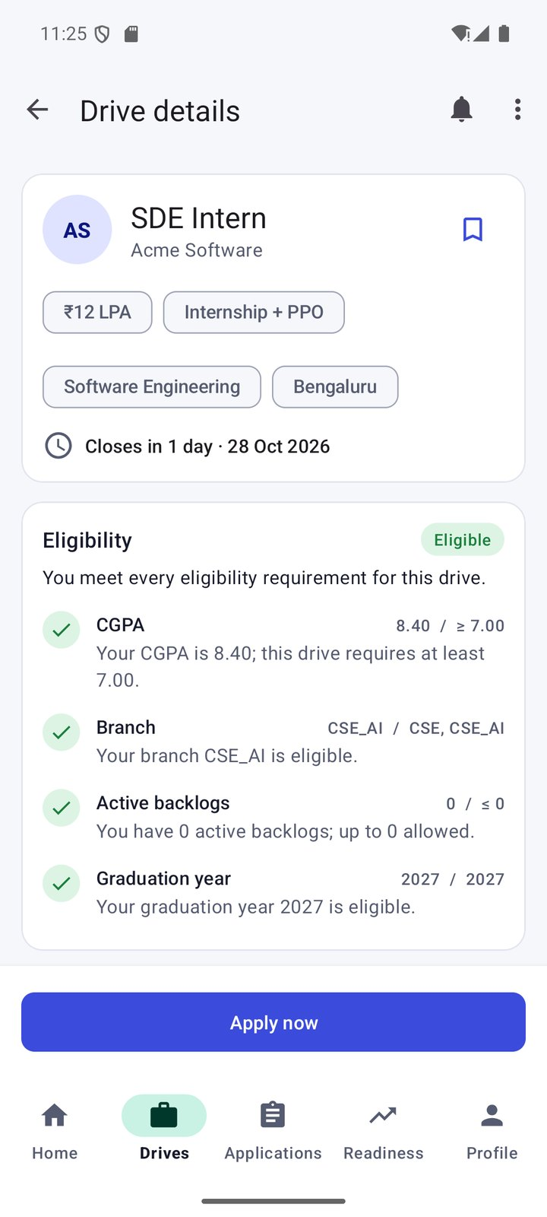
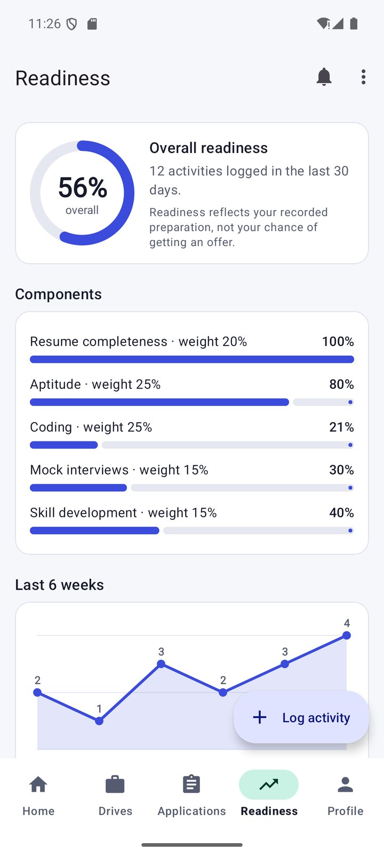
Student portal
Onboarding, registration (always STUDENT), login, password reset
Home: readiness ring, Career Action Plan, eligible and closing-soon drives
Drives: search, quick filters, filter and sort sheet, bookmarks
Drive detail: explainable eligibility and match; Apply with reason when blocked
Applications and recruitment journey timeline
Readiness dashboard with activity logging (works offline)
Profile: academic record locked after verification
Home
Explainable eligibility
Readiness

Slide 8
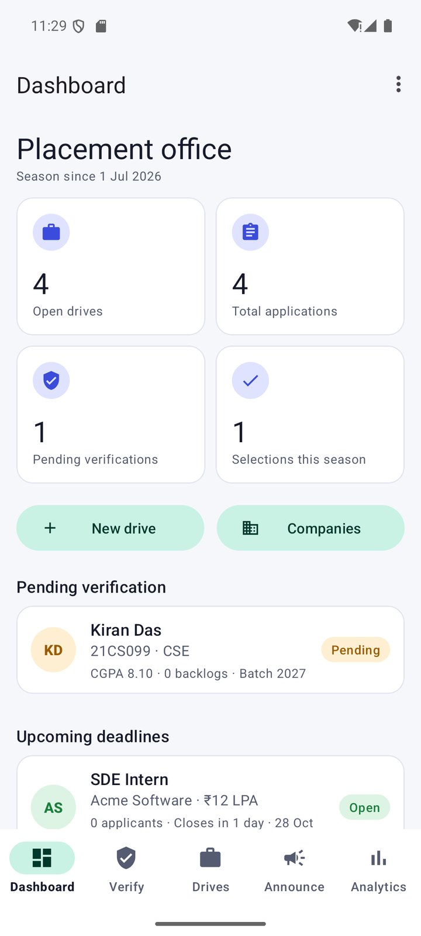
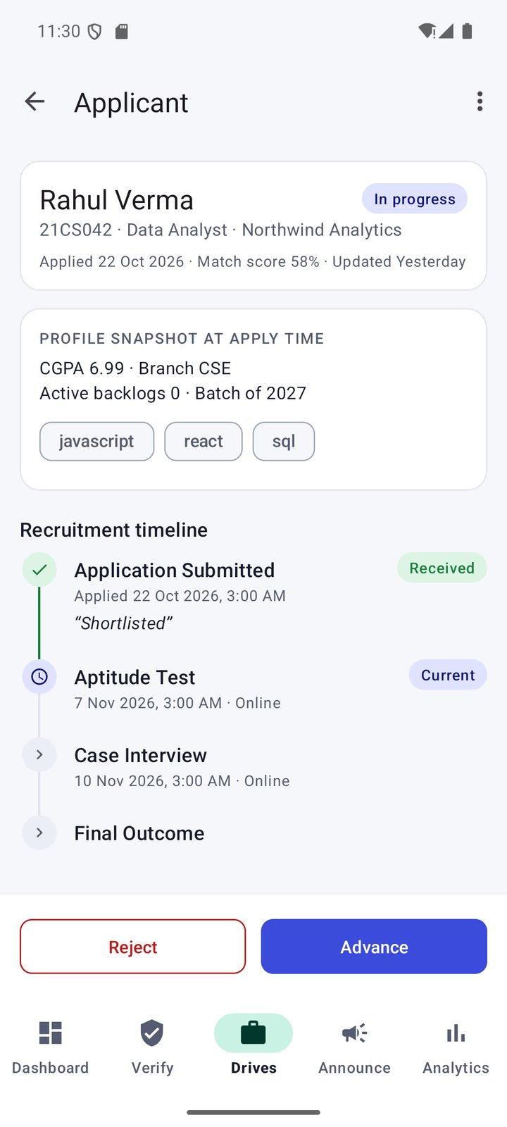
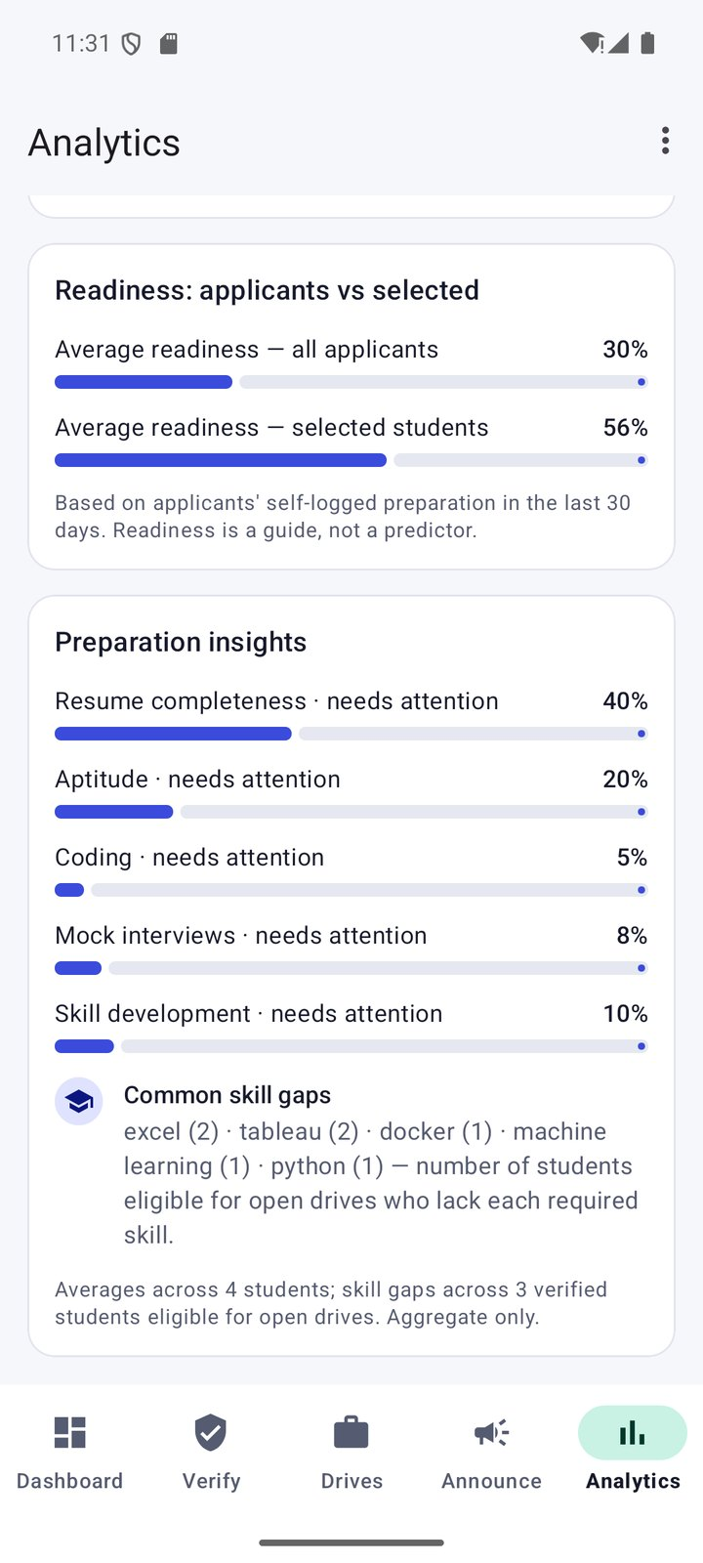
Placement officer portal
Separate role-based navigation; officer accounts provisioned only by the admin seed script
Verification queue: verify complete records or un-verify for correction
Companies and drives: criteria, skills, prep focus, deadline, ordered stages; draft, publish, close
Applicants: filter, review snapshot and links, advance or reject with notes (batched with a notification)
Announcements and analytics: per-drive counts, funnel, branch selections, readiness and preparation insights
Dashboard
Advance / reject
Insights

Slide 9
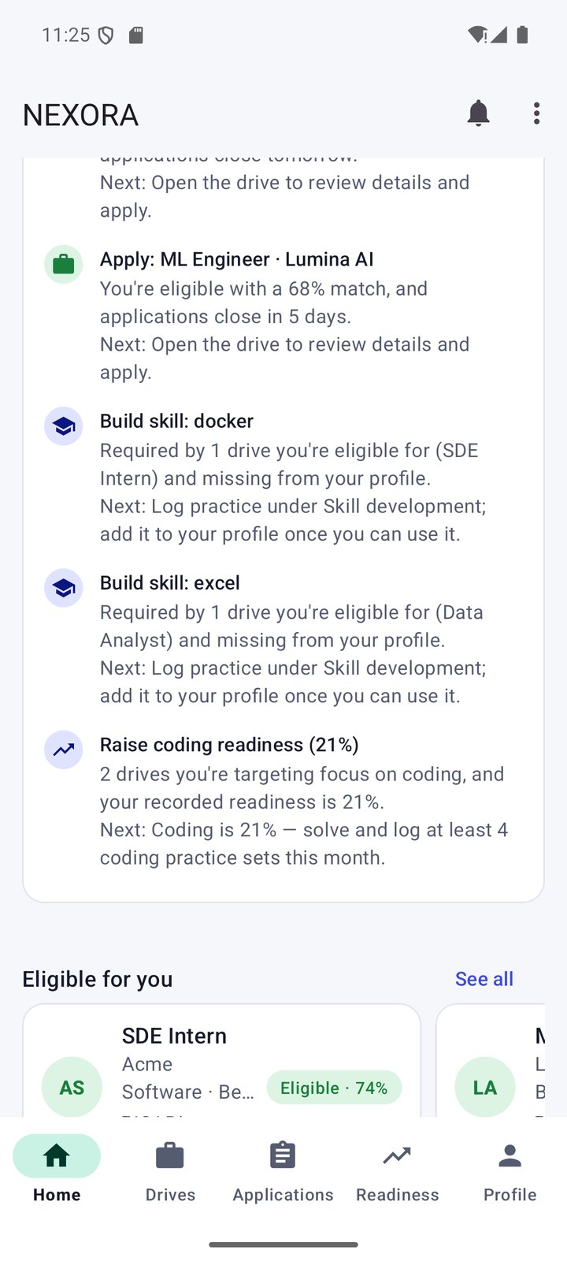
Career Action Engine and feature integration
Student profile
Eligibility
Ranking
Action plan
Preparation
Journey
Officer analytics
verified data
per criterion
match score
next steps
readiness
stages
insights
Feedback loop: a new activity, drive, verification or stage change recomputes the plan
Ranking rules
Action | Rule (higher ranks first) | Opens
VERIFY | 1000 — record unverified or incomplete | Profile
STAGE | 900 − 10 × days to a scheduled round (≤ 14 days) | Journey
APPLY | 800 − hours / 6 if ≤ 3 days, else 500 + match − days | Drive detail
SKILL | 300 + 10 × eligible drives needing the skill | Readiness
READINESS / PROFILE | 200 + (60 − weakest %) · 150 if resume < 100% | Readiness / Profile
Your next steps

Slide 10
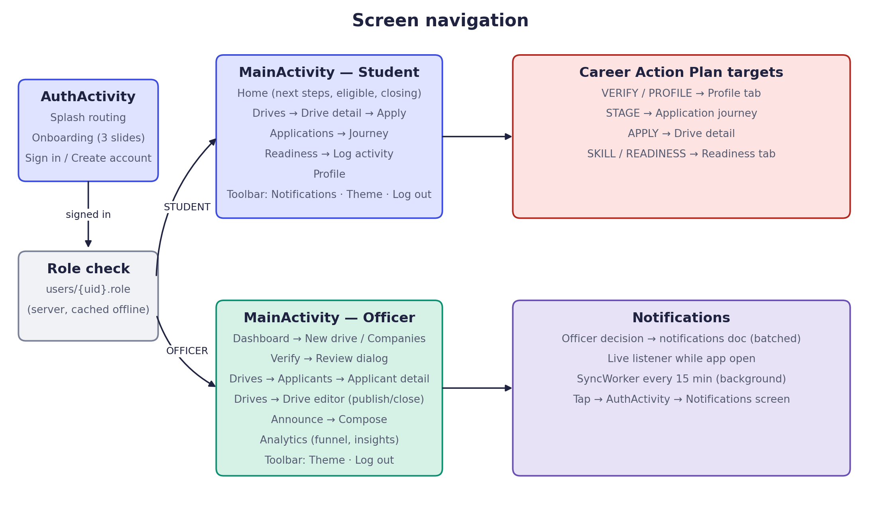
Application workflow and navigation
Application status
SUBMITTED
stage 0
IN_PROGRESS
one stage per update
SELECTED
final
REJECTED
final, from any active stage
Id {driveId}_{uid}: a second apply is rejected by the server
Each decision updates the application and notifies the student in one batch

Slide 11
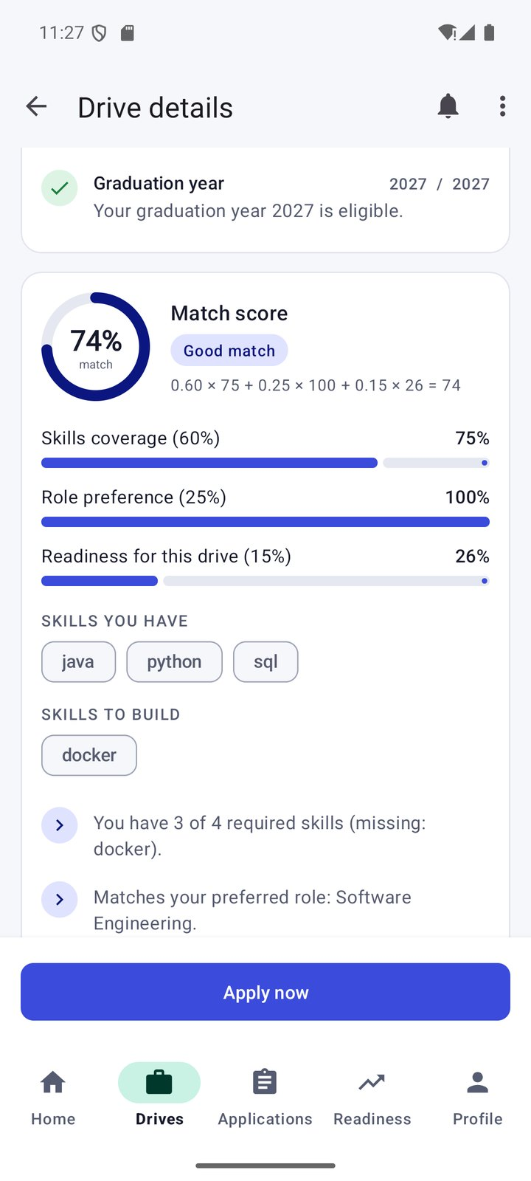
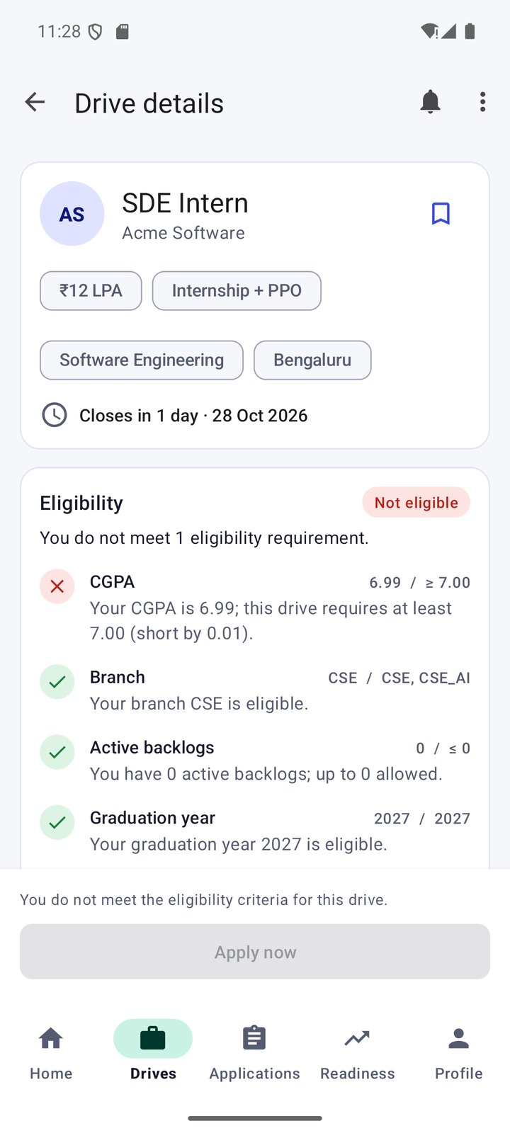
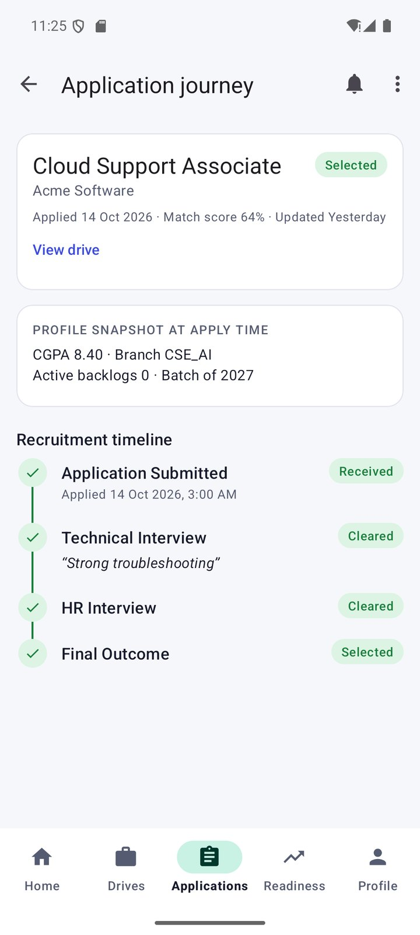
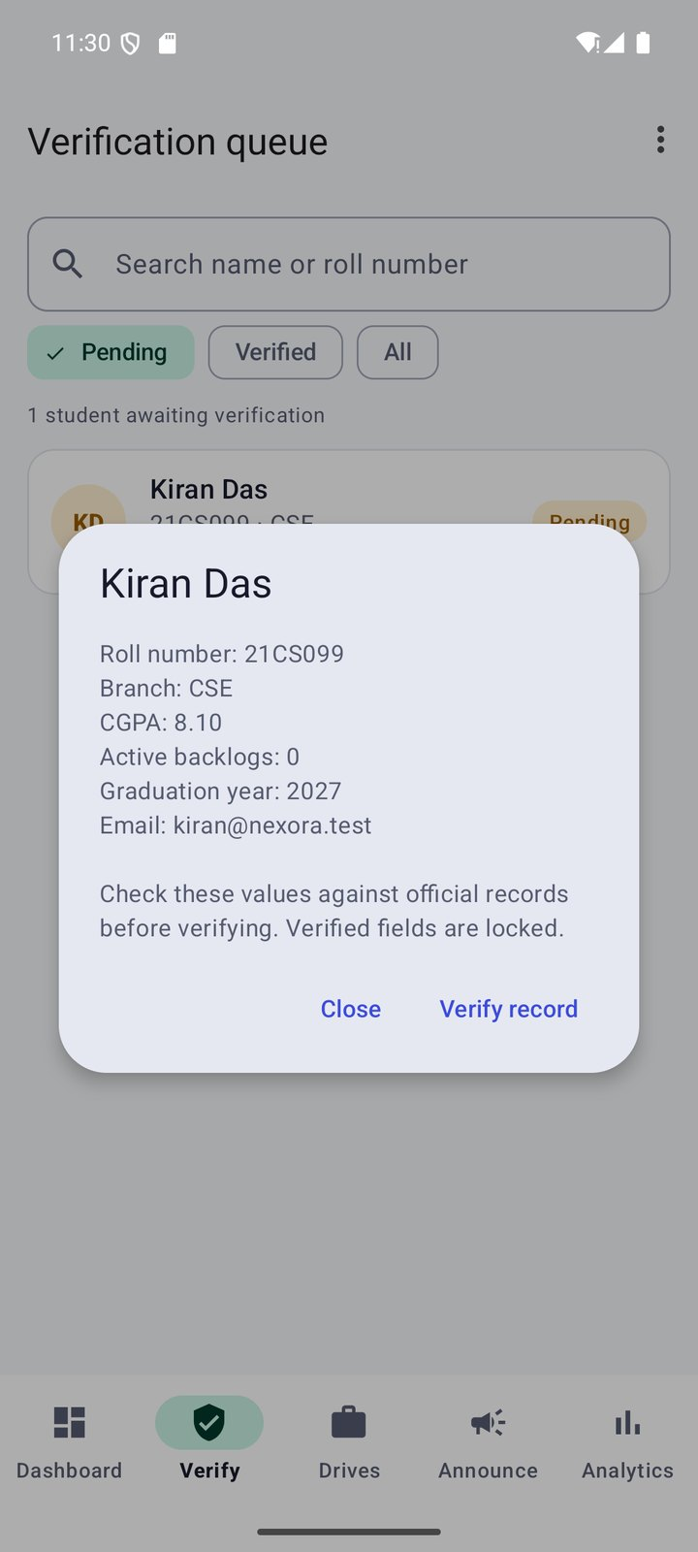
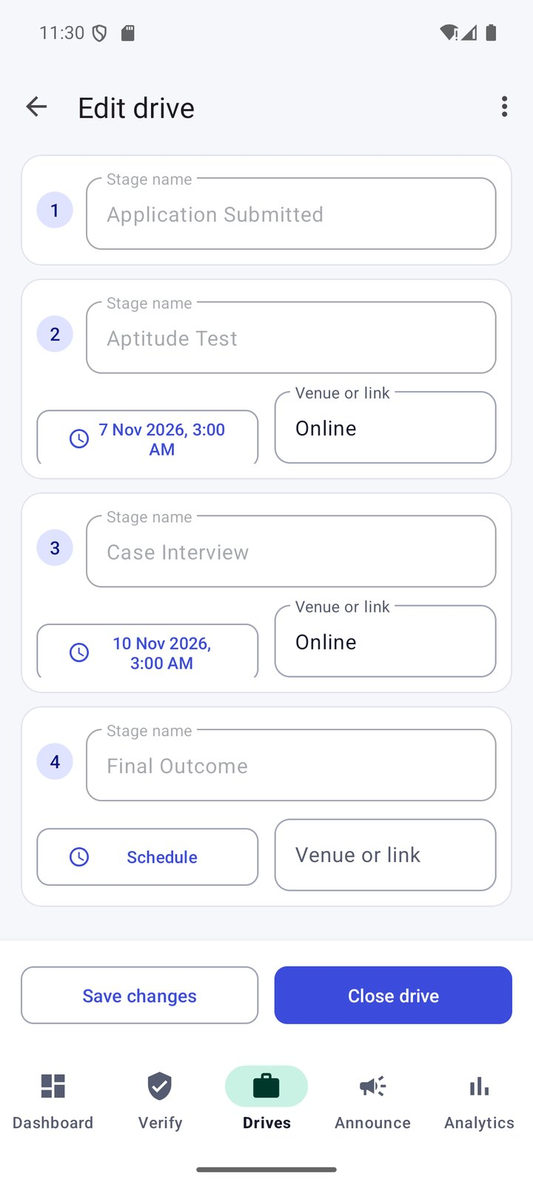
Application screenshots
Match score breakdown
Not eligible: 6.99 vs 7.00
Recruitment journey
Officer verification
Drive stage schedules

Slide 12
Testing and results
64 / 64
99.2%
47 / 47
6 / 6
JVM unit tests passed
domain line coverage (JaCoCo)
Firestore Security Rules tests
instrumented tests passed
Automated
Manual (emulator + Firebase Emulator Suite)
Eligibility boundaries: 7.00 vs 7.00 passes, 6.99 fails
Match weights, aliases, bands; readiness formulas and windows
Career Action Engine: ineligible, applied, closed and expired drives excluded
Rules: role escalation, verification lock, duplicates, deadlines, outcomes
Room DAO, Espresso onboarding, field validation
Login errors and role-based routing
Verification unlocks eligibility; officer-created drive reaches students
Application accepted, duplicate blocked, advance updates timeline + notification
Offline activity synced exactly once after reconnecting
Analytics and insights match hand-calculated seed values

Slide 13


Conclusion and future scope
Conclusion
Future scope
Complete student and officer placement workflow in Java and XML
Explainability with server-side trust: students see why; the rules decide
Career Action Engine links eligibility, ranking, readiness and the journey
Tested domain logic, offline support, free Firebase Spark plan
Officer-configurable match weights and readiness targets
Instant push through a trusted server (paid plan)
Resume upload, parsing and verified skill assessments
Automated end-to-end UI journeys and a usability study
Calendar integration and a web dashboard for officers

Slide 14
References
[1] Android Developers — Guide to app architecture: developer.android.com/topic/architecture
[2] Android Developers — ViewModel and LiveData: developer.android.com/topic/libraries/architecture
[3] Android Developers — Room: developer.android.com/training/data-storage/room
[4] Android Developers — WorkManager: developer.android.com/topic/libraries/architecture/workmanager
[5] Android Developers — Espresso: developer.android.com/training/testing/espresso
[6] Material Design 3: m3.material.io
[7] Material Components for Android: github.com/material-components/material-components-android
[8] Firebase Authentication (Android): firebase.google.com/docs/auth/android/start
[9] Cloud Firestore: firebase.google.com/docs/firestore
[10] Firestore Security Rules: firebase.google.com/docs/firestore/security/get-started
[11] Firebase Emulator Suite: firebase.google.com/docs/emulator-suite
[12] Security Rules unit tests: firebase.google.com/docs/rules/unit-tests
[13] JUnit 4: junit.org/junit4 · JaCoCo: jacoco.org/jacoco
[14] Amrita Vishwa Vidyapeetham (official logo): amrita.edu

