Slide 1

Swiggy Mumbai (EDA)

Slide 2
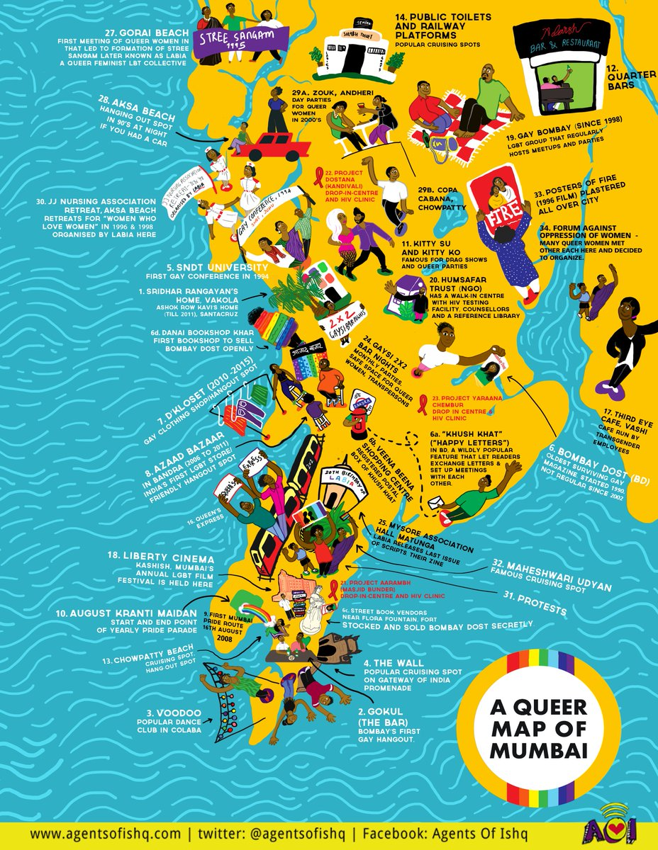

Content slide
Total Data available for 42 Locations in Mumbai
11987 Restaurants listed.
We have mention top 10 locations having great protentional to carry out our expansion.
We have also mentioned bottom 10 locations.

Slide 3
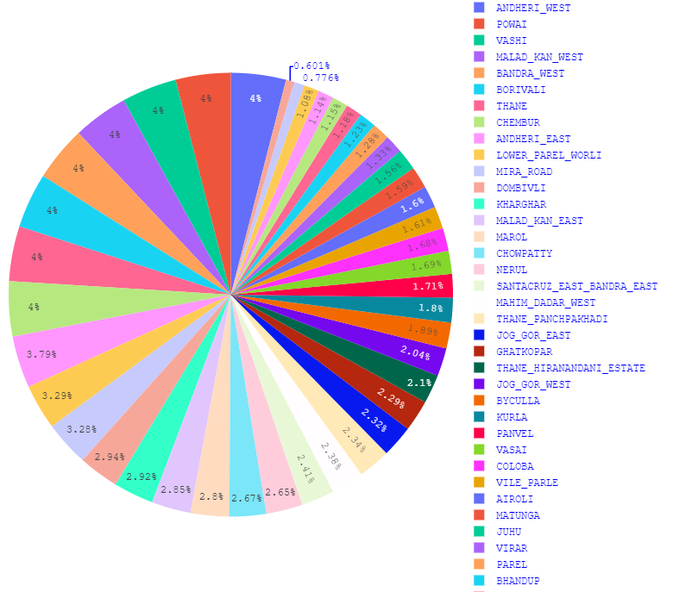
LOCATIONS “42
Cbd Belapur | Kamothe
Kharghar | Kurla
Marol | Lower Parel Worli
Thane Panchpakhadi | Mahalaxmi Malabar Hill
Vashi | Mahim Dadar West
Airoli | Malad Kan East
Andheri East | Malad Kan West
Andheri West | Matunga
Bandra West | Mira Road
Bhandup | Nerul
Bhayandar | Panvel
Borivali | Parel
Byculla | Powai
Chembur | Santacruz East
Chowpatty | Bandra East
Dahisar East | Sion Bhakti Park
Dombivli | Thane Hiranandani State
Coloba | Thane
Ghatkopar | Vasai
Jog Gor West | Vile Parle
Jog Gor East | Virar
Juhu

Slide 4
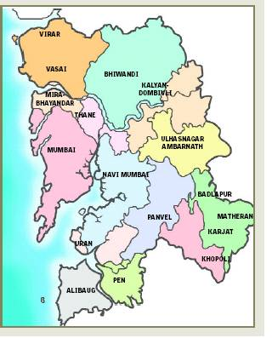

TOP “10 LOCATIONS
Locality | Number of Restaurants
Vashi | 480
Powai | 480
Chembur | 480
Malad Kandivali West | 480
Andheri West | 480
Borivali | 480
Bandra West | 480
Thane | 480
Andheri East | 454
Lower Parel Waroli | 394

Slide 5
BOTTOM “10 LOCATIONS
Locality | Number of Restaurants
Sion Bhakti Park | 72
CBD Belapur | 93
Bhayandar | 130
Mahalaxmi Malabar Hill | 137
Kamothe | 138
Dahisar East | 141
Bhandup | 148
Parel | 154
Virar | 159
Juhu | 187

Slide 6
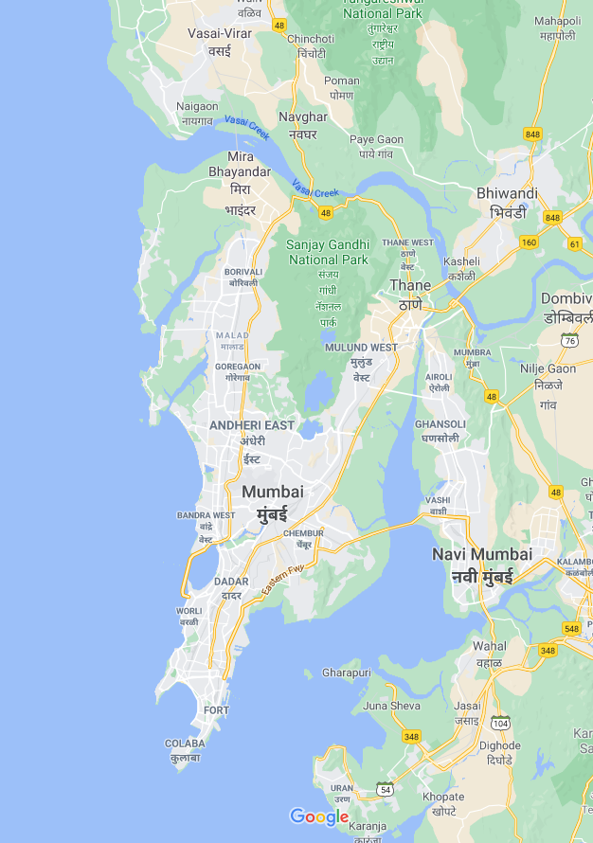
Top 10 Locations:
470 restaurants per Location.
Clearing out the competition from 42 mentioned locations.
The route from Dahisar East to Lower Parel will be more beneficial for covering most of the restaurants.
This Route will cover Andheri East, Bandra, Borivali, Andheri West, Malad Kandivali West and also few parts of Powai.
This route covers 30km of road route.
Covering minimum 4 locations would be enough(1 location = 5km) to get maximum benefit.

Slide 7
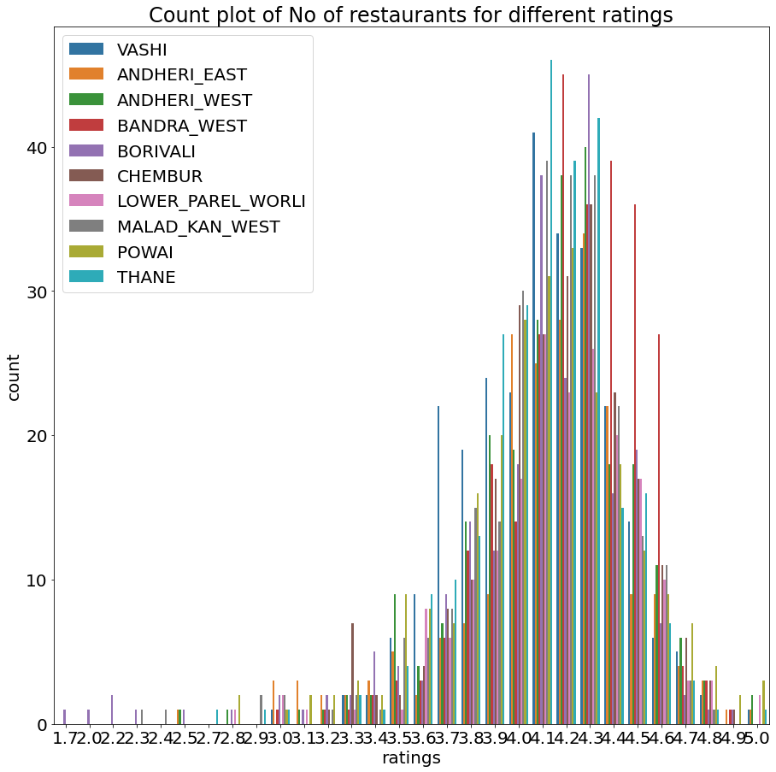
Pumped Ratings:
Same as Pune, we can see most no of restaurants are rated between 3 to 5.
Here we have considered the top 10
Locations as mentioned earlier.

Slide 8
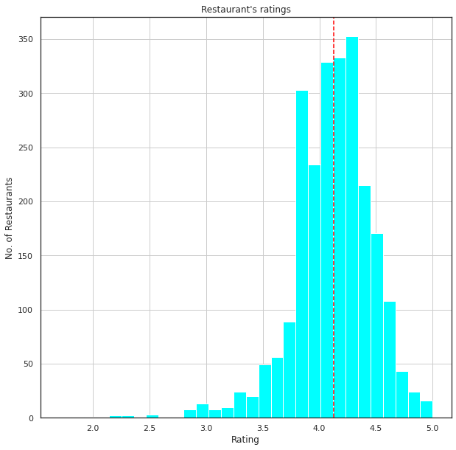
An average of 4.1 ratings are given to most of the restaurants.
These creates a positive image of the restaurants, for the customers.

Slide 9
Pricing for two given by Rest.
200/-
778
300/-
977
400/-
653
250/-
481
350/-
267
500/-
443
600/-
205
150/-
172
The Data shows, most of number of restaurants have an approximate pricing between “100 - 500” for a meal of two.
997 restaurants have 300/-
778 restaurants have 200/-
…

Slide 10
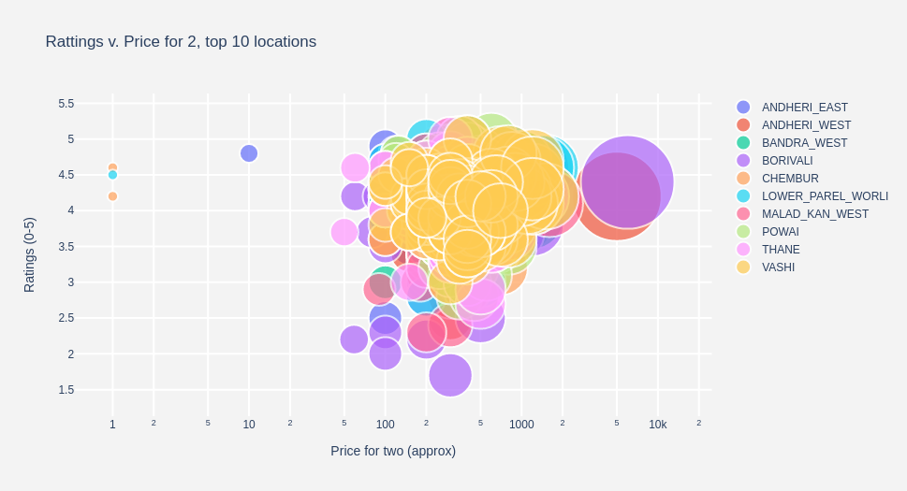
Corelation between Ratings and Price for Two:
The Visualization shows the relation between Ratings and Pricing for two of the top 10 locations.
We can observe more dense grouping of restaurants for ratings between 3 – 5,
Also the same for pricing between 100 – 1000.

Slide 11
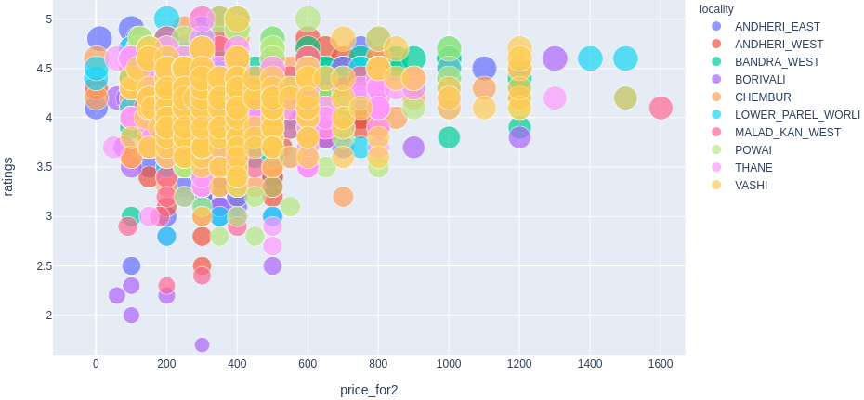
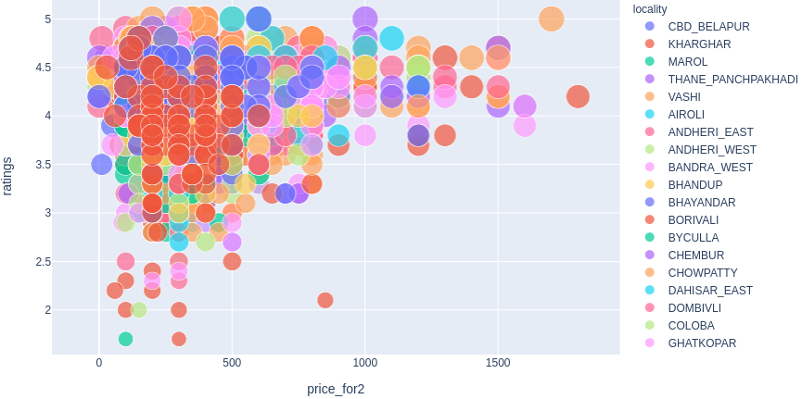
Visualization for top 10 locations
Both visualization has a common area having dense grouping for ratings between 3 to 5, and pricing between 200 to 700.
Visualization for all 42 locations

Slide 12
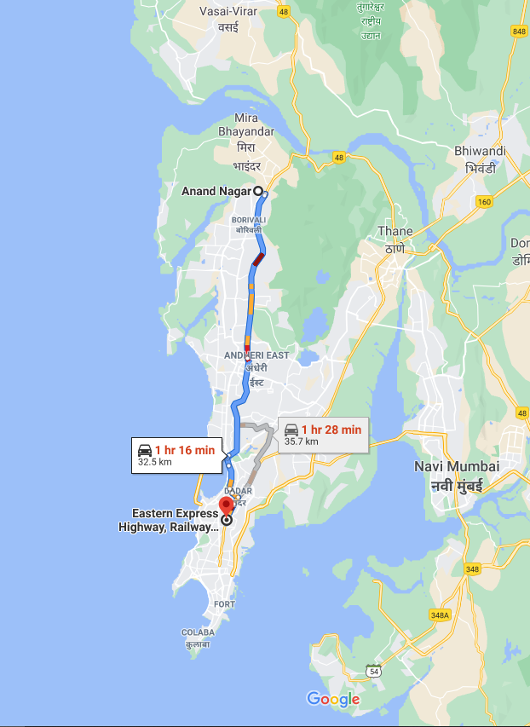
INSIGHTS
The route from Dahisar East to Lower Parel will be more beneficial for covering most of the restaurants.
Covering minimum 4 locations would be enough(1 location = 5km) to get maximum benefit.
Most Restaurants have an average rating of 4.1
Also most of number of restaurants have an approximate pricing between “100 - 500” for a meal of two.
ruthikkale27@gmail.com

