Slide 1
Campaigns & Marketing REPORT
Ruthik Kale
ruthikkale27@gmail.com

Slide 2

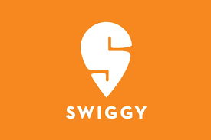

Expansion in Other Categories
All In One BRO SERVICES
Restaurant Food
Homemade Food
Pickup & Drop
Electronic Gadgets
Supplements
Gifts and Lifestyles
Hardware Products
Packages / Parcels
Medicines
Groceries
Meat & Seafood
Restaurant Food
Nutrition Supplements
Restaurant Food
Pickup and Drop
Meat and Seafood
Buy form Store:
Medicines, Groceries,
Homemade Food
Restaurant Food
Packages
Pet Foods
Meat and Seafood
Gifts and Lifestyles

Slide 3
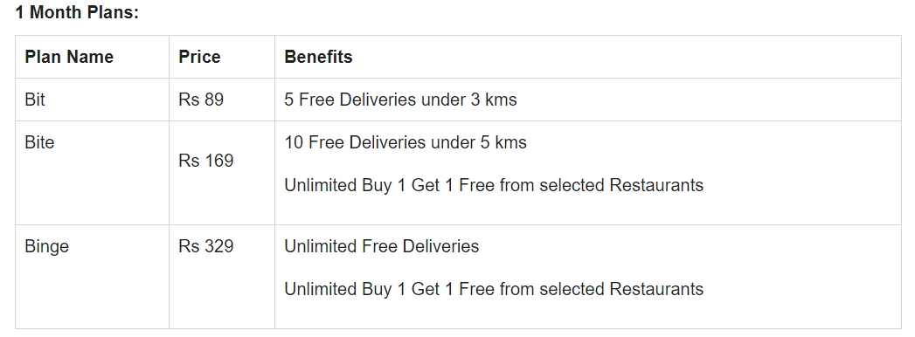
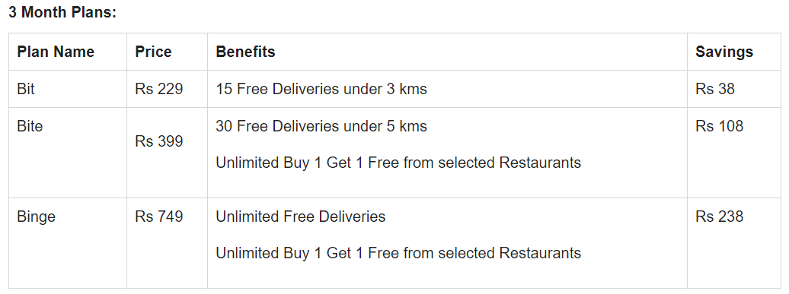
Swiggy Membership
NEW SWIGGY MEMBERSHIP PLANS 2021
The new Subscription Plans of Swiggy Super will be out on 10th March 2021 exclusively on the Swiggy App.
Subscription starts from 10th march.
It will be available on a first cum first serve basis

Slide 4
MARKETING REVIEWS
“TOP CATEGORIES WITH NEGATIVE RESPONSES”
Laundry
Stationeries
Paan Shops
Chicken Shops
Medicals
Marketing Team Field Response
“Zero Trust for new company
Problems with membership price”
“ONLY CATEGORY WITH POSITIVE RESPONSE”
“Restaurants”

Slide 5
MARKETING TECHS
ZOMATO
Search Engine Optimization
Paid : Google Ads
Social Media Marketing's
Twitter Trends
Sponsorships
Marketing Campaigns:
“Zomato Premier League – Indian Premier League
On Time Or Free Delivery (Dec 2019)
Zomato Gold / Pro Membership
Zomaland – Food Carnival”

Slide 6
MARKETING TECHS
DUNZO
Commercial Campaigns
Meme Marketing
Social Media Marketing
Hyper-local Communication
Content In The Mundane
Twitter
Campaigns And Consistency

Slide 7
MARKETING TECHS
SWIGGY
Social Media Campaigns
Search Engine Optimization
Content Strategy
Influencer Marketing Strategy
Online Reputation Management
Social Media & Google Ads

Slide 8
NEGATIVITY
Negative effect of Zomato Swiggy on Owners:
Promotion Charges:
Swiggy & Zomato charges the restaurants for promotion.
Approx (8 -10/-) per clicks.
Safety & Securities:
No proper responsibility taken about the delivery.
Mismanagement of packages.
Higher Charges for Delivery:
More hidden charges behind delivery.
Max (28-30%) under each delivery
No options to Switch:
Only option for delivery.
Full control of package delivery is not under the owner.
Limited Delivery Categories:

