Slide 3
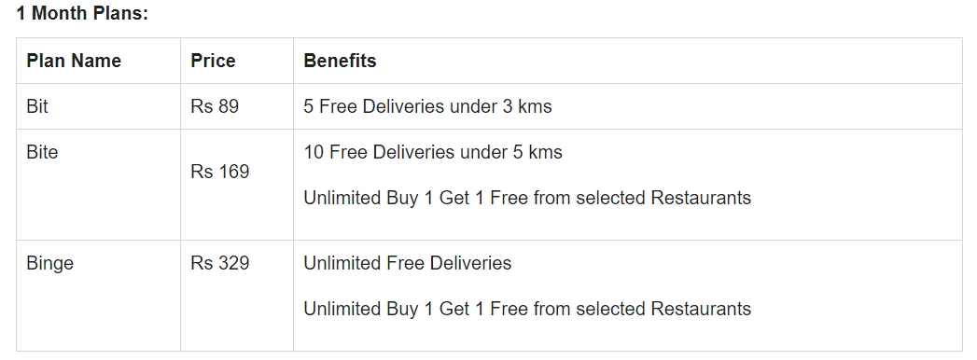
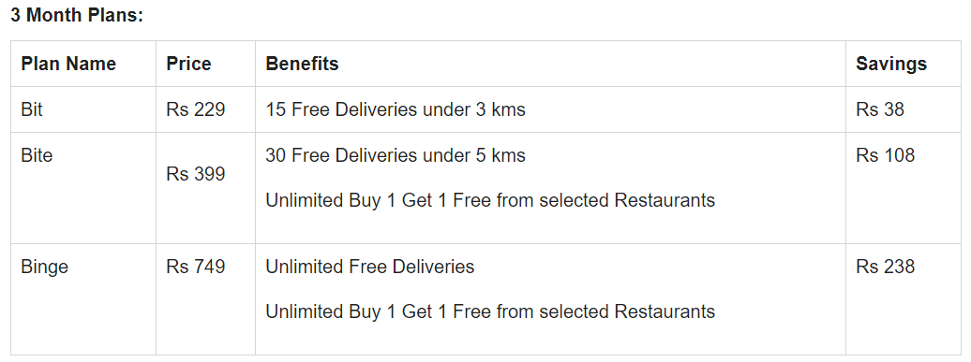
Swiggy Super New Subscription Plans

Slide 4



Restaurant Food
Nutrition Supplements
Restaurant Food
Pickup and Drop
Meat and SeaFood
Buy form Store:
Medicines, Groceries,
Homemade Food
Restaurant Food
Packages
Pet Foods
Meat and SeaFood
Gifts and Lifestyles

