Slide 1

Swiggy Mumbai (EDA)

Slide 2
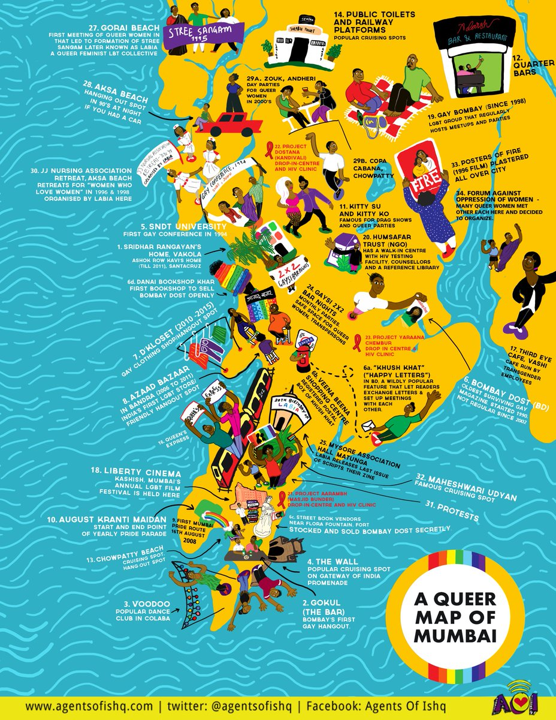
Content slide
Total Data available for 42 Locations in Mumbai
11987 Restaurants listed.
We have mention top 10 locations having great protentional to carry out our expansion.
We have also mention bottom 10 locations.

Slide 3
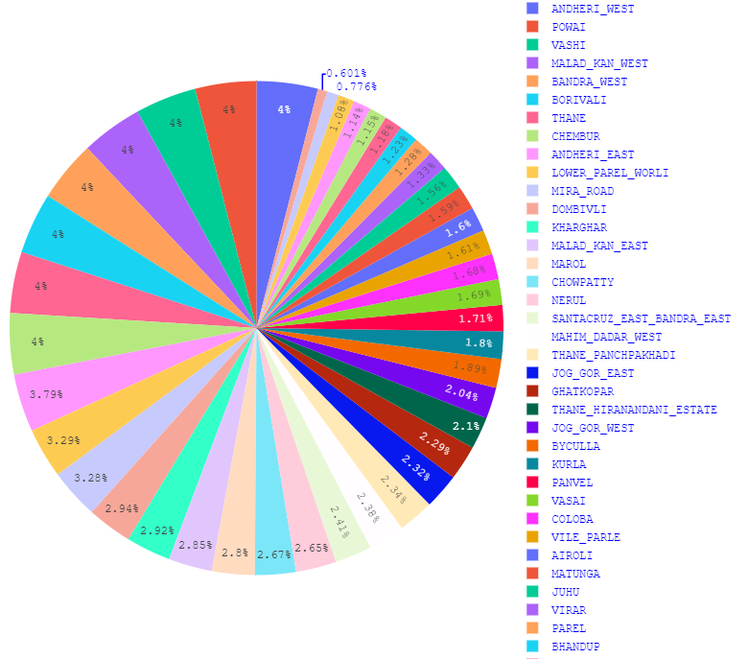
LOCATIONS “42
Cbd Belapur | Kamothe
Kharghar | Kurla
Marol | Lower Parel Worli
Thane Panchpakhadi | Mahalaxmi Malabar Hill
Vashi | Mahim Dadar West
Airoli | Malad Kan East
Andheri East | Malad Kan West
Andheri West | Matunga
Bandra West | Mira Road
Bhandup | Nerul
Bhayandar | Panvel
Borivali | Parel
Byculla | Powai
Chembur | Santacruz East
Chowpatty | Bandra East
Dahisar East | Sion Bhakti Park
Dombivli | Thane Hiranandani State
Coloba | Thane
Ghatkopar | Vasai
Jog Gor West | Vile Parle
Jog Gor East | Virar
Juhu

Slide 4
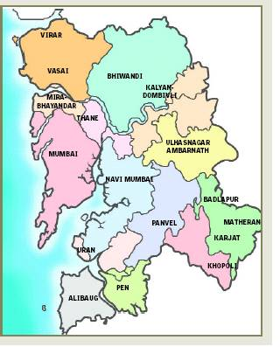
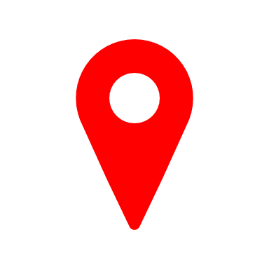
TOP “10 LOCATIONS
Locality | Number of Restaurants
Vashi | 480
Powai | 480
Chembur | 480
Malad Kandivali West | 480
Andheri West | 480
Borivali | 480
Bandra West | 480
Thane | 480
Andheri East | 454
Lower Parel Waroli | 394

Slide 5
BOTTOM “10 LOCATIONS
Locality | Number of Restaurants
Sion Bhakti Park | 72
CBD Belapur | 93
Bhayandar | 130
Mahalaxmi Malabar Hill | 137
Kamothe | 138
Dahisar East | 141
Bhandup | 148
Parel | 154
Virar | 159
Juhu | 187

Slide 6
overview

