Slide 1

TINY OWL
How TinyOwl, the blue-eyed startup kid lost its Nest and Ground
0

Slide 2
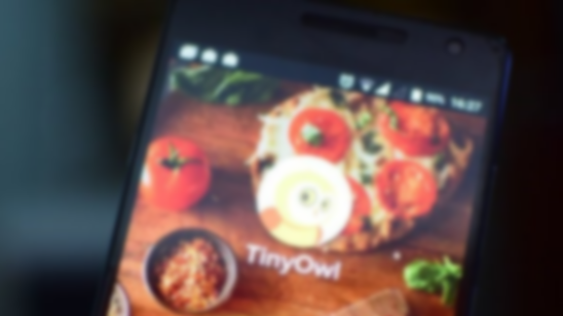
TABLE OF CONTENTS
THE BEGINNING
RICH KID
OBJECTIVE
WORKING
FUNCTIONS
THE FALL
TIMELINE FUNDINGS
ENDING
1

Slide 3
THE BEGINNING
TinyOwl was founded by five IIT alumni in the year 2014.
The capital investment was the 25 million raised by renowned VC (Venture Capital) firms like Sequoia Capital, Nexus Venture Partners and Matrix Partners in their series ‘A’ funding. Hence the food delivery startup faced no issues when it came to funding.
2

Slide 4
OBJECTIVE
The main idea behind TinyOwl was to create value for all stakeholders in the restaurant and food ecosystem that includes the “restaurant owners, staffs, suppliers and of course, the consumers”.
The restaurant owners’ benefit, making the app a potent marketing tool for them as they can target users based on location and preferences.
3

Slide 5
FUNCTIONS
When you open the app, it detects your location and gives you a list of nearby restaurants.
You can then choose your dishes/cuisine from the menu and place the order by providing details on where to find you.
The app provided not just the food menus, it describes each dishes and provides you with the chef’s profile.
Suggestions based on your past choices were also provided.
You have options to pay via card/cash. It also gives you the convenience of tracking the delivery.
It’s a simple and friendly user interface, the constantly updated menus and prices, everything made the app easy, convenient and reliable to use.
4

Slide 6
TIMELINE FUNDINGS
TinyOwl ran 4 total rounds of funding between 2014 to 2015 and big investors pitched in. Companies like Sequoia Capital India and Matrix Partners were vying for a piece of the pie.”
These investors together raised a whopping “$27.7 million in total over just two short years ”, which set a very successful financial benchmark for the company.
Angel Funding
Founded in 2014
₹ 6 Cr
Aug ‘14
₹ 20 Cr
Series - B
Dec ‘14
₹ 107 Cr
Feb ‘15
Series - A
₹ 52 Cr
Oct ‘15
Merged with Roadrunner
Bridge
5

Slide 7
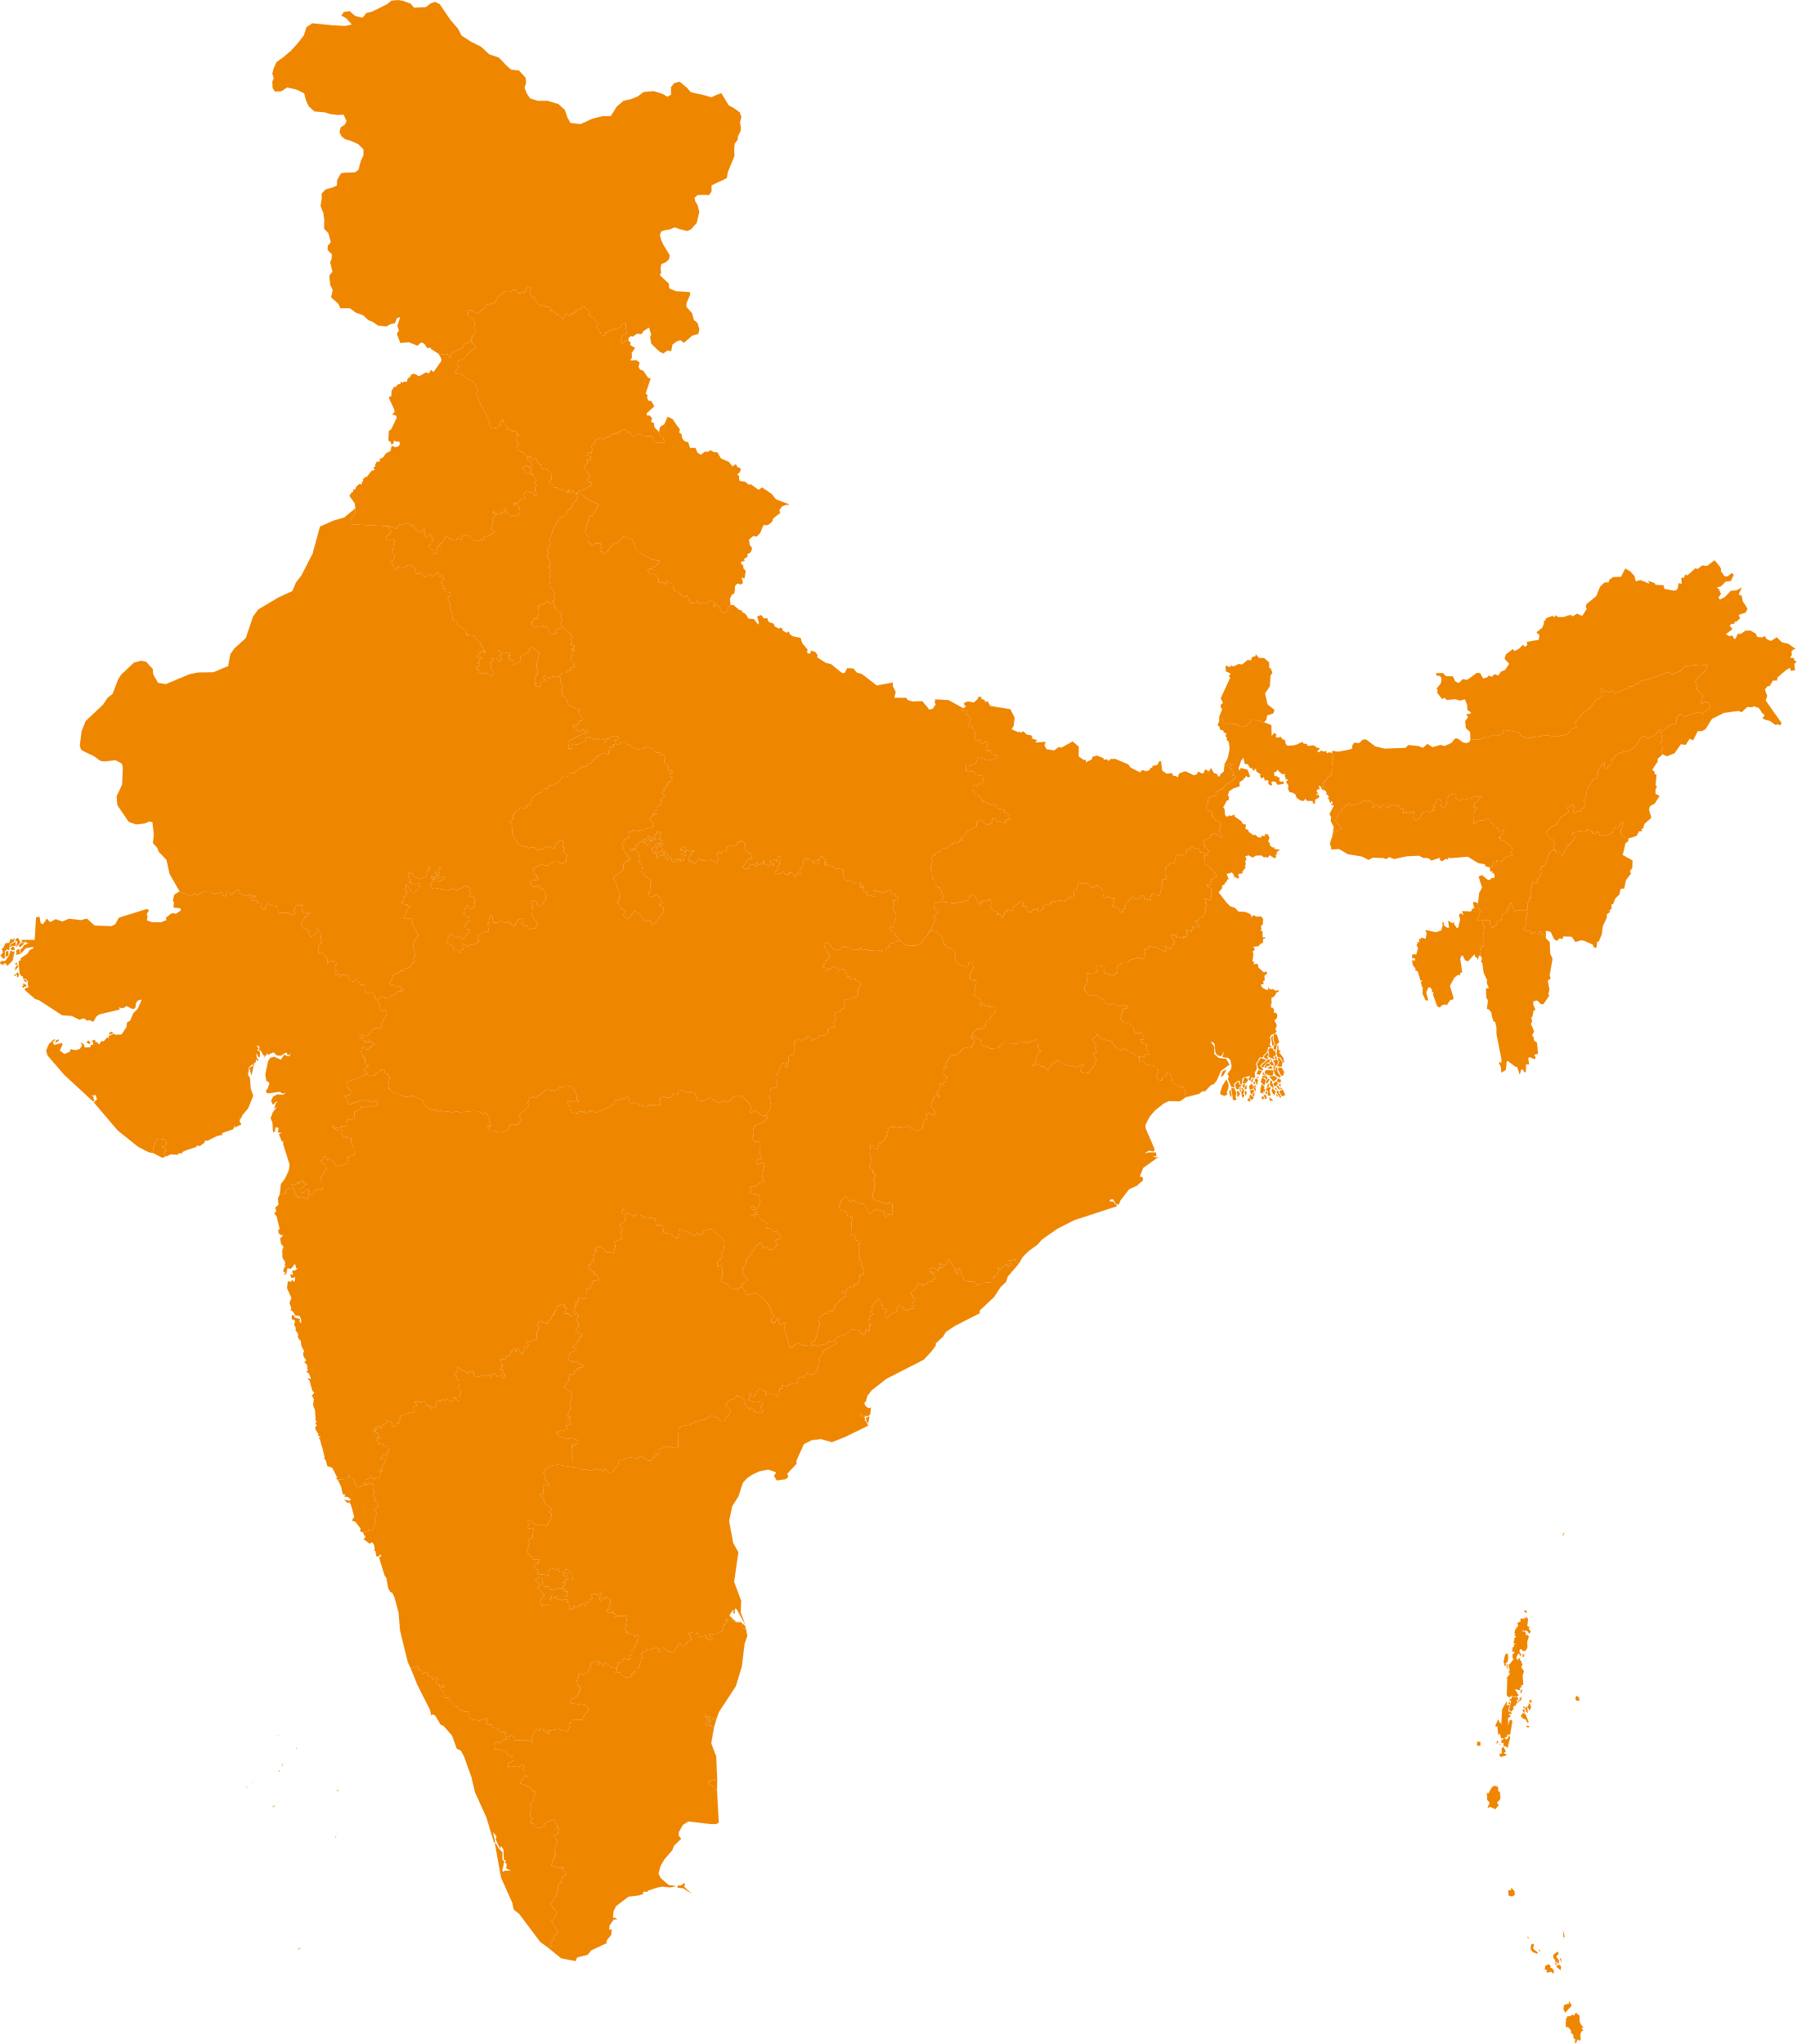
RICH KID, TINY OWL
They decided to hire, scale, expand in whatever capacity they could.
Soon, the company was open and
“operating in 11 cities in India and had a strength of 600 employees”.
App Downloads: 500,000+
App Ratings: 3.7/5
Number of Restaurants : 4000
Minimum Order : Depends On Restaurants
Web/App Based : App Only
Order Tracking : Yes
Modes OF Payment : COD, online
6

Slide 8
WORKING
50 people for data collection making menus of hotels more visual and functions.
40 engineers and design team, 15 working on improving the app.
A senior management team for smooth functioning of all departments.
Focused on Field/ Office campaigns on weekends and brochure distribution during weekdays.
Analyse effectiveness of different campaigns and modify future strategies accordingly.
Team looked after the popularity of the Owl via brochures and filers.
As operations increased, the focus increased on social media platforms.
7

Slide 9
STEPPING TOWARDS THE FALL
BAD PRESS
Careless management
INCORRECT ASSESSMENT
Dissolving Homemade, the only arm that breaks even
WRONG PIVOTS
Introduced dish & area based aggregation system
Limited use of data analytics
UNCOORDINATED HIRING
HR failure
Over-hiring
UNSUSTAINABLE MODEL
Weak advertising appeal
High acquisition price
Reckless layoffs
Expensive CTO at poor time
Unregulated discounting
8

Slide 10
DOWNFALL
1
“OVER-HIRING” Tiny Owl started its destruction by over hiring and careless management. An incident took place in Sep ‘14 where the co-founders where held as hostages by employees when the company refused to pay salaries.
2
“A dish-based aggregation system” it was like if you open the app — it will tell you what’s today’s dish, and would give you options on where you could order it from.
The idea turned wrong due to lack of technical aspects. There was hardly any artificial intelligence used, no data analytics were there and the pivot tanked with just less than five orders a day.
3
“Hired a CTO for Rs1.5 Crores” and a joining bonus of Rs 50 lakhs.
“area-based food aggregation” In this model, TinyOwl had to pay for the logistics of gathering the food from various restaurants. That cost too much for the poor kid.
For the area-based food aggregation plan, more cash was required and all head of the departments were told to find new jobs. Thus Homemade, the only arm of TinyOwl broke and dissolved.
4
9

Slide 11

THE ENDING
Only the Mumbai division was kept alive
With a negative profit margin, high costs of delivery and customer acquisition, the overstaffed and lavish offices began mass layoffs. It soon had to shut down operations in every city except Mumbai.
June 2016 Roadrunner acquired Tiny Owl, then rebranded itself as “Runnr”.
September 2017 Zomato acquired Runner for $40 million.
TINYOWL
RUNNR
ZOMATO
“Tiny Owl and Runner two of the most well funded on-demand startups in 2015 having collectively raised more than $50 million from investors like Sequoia Capital, Nexus Venture Partners and Matrix Partners.”
10

Slide 12
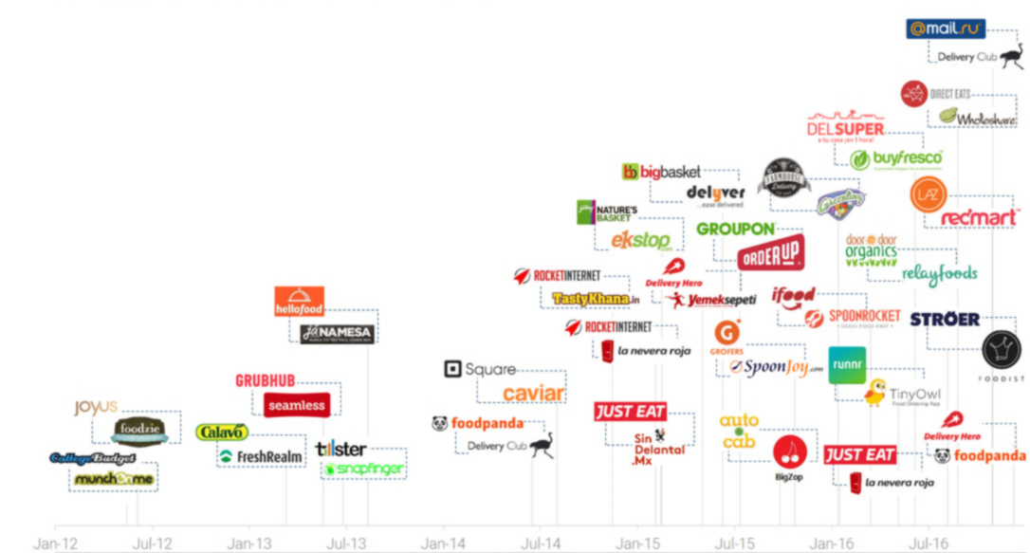
THANKS
11
“There may be many who are not aware, but Tiny Owl’s sad demise was a lesson to be learned from one of the biggest startups in the Indian economy. The company shut down in 2016 when it was acquired by Roadrunnr. However, unlike many other companies, it’s failures cannot be credited to external factors. TinyOwl was eaten from the inside.”
Ruthik Kale
Source : Research Papers, News Articles and Blog posts
ruthikkale27@gmail.com

