Slide 1

REACTJS
Ruthran.kumar@gmail.com
+44 7405708980
+91 9715531887

Slide 2
Agenda
Overview
Environment Setup
Component
Parent to Child data communication
Form
Validation
Routing
Flux (Unidirectional Design Pattern)

Slide 3
Overview
React is a UI library developed at Facebook to facilitate the creation of interactive, stateful & reusable UI components.
JSX is JavaScript syntax extension. It isn't necessary to use JSX in React development, but it is recommended.
React is all about components. You need to think of everything as a component. This will help you maintain the code when working on larger scale projects.
React implements one-way data flow which makes it easy to reason about your app. Flux is a pattern that helps keeping your data unidirectional.
Uses virtual DOM JavaScript virtual DOM is faster than the regular DOM.

Slide 4
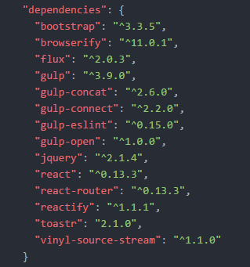
Environment Setup
By Starter Kit https://github.com/coryhouse/react-flux-starter-kit
npm install
Package JSON

Slide 5
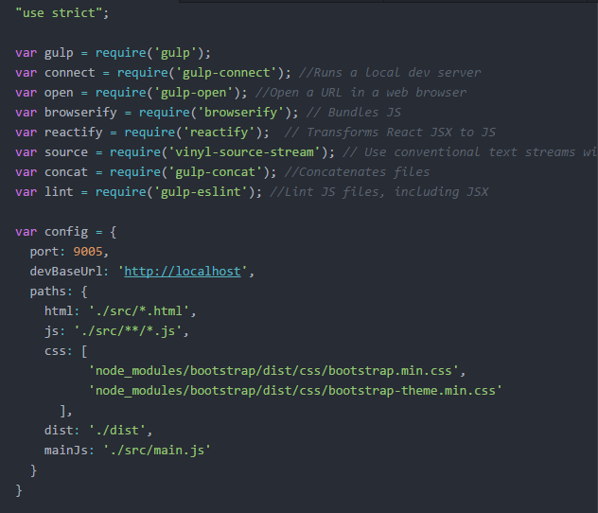
Environment Setup
Gulp.js

Slide 6
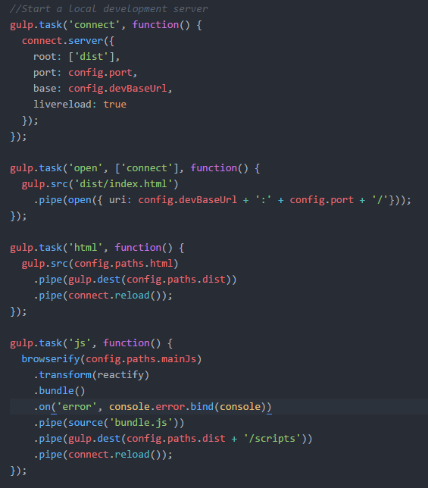
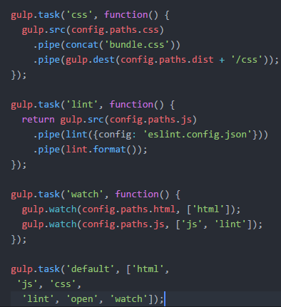
Gulp.js Cont.

Slide 7
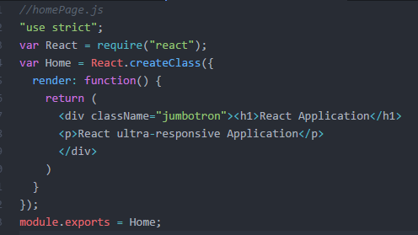
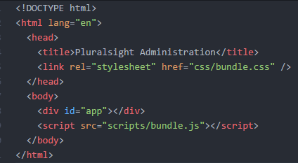
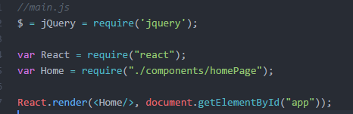
Component

Slide 8
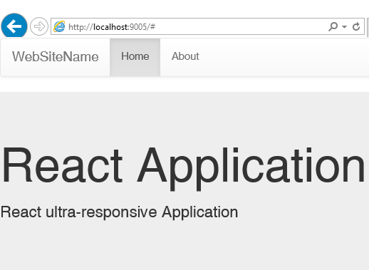
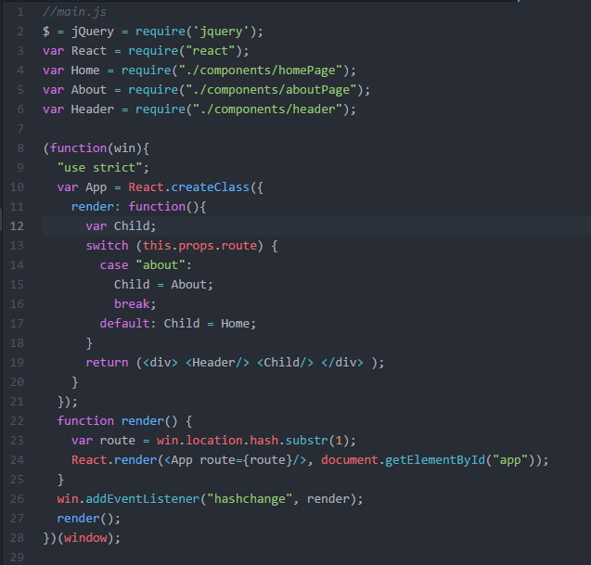
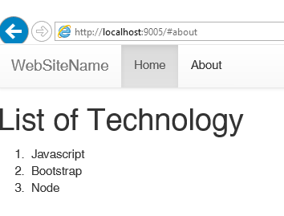
Basic Routing

Slide 9
Props State Key
Props →Immutable, To pass data to child
getDefaultProps
State →Mutable, To Pass data from controller to view
getInitialState
Key → <div key={unique key}></div>

Slide 10
Lifecycle Methods
componentWillMount
componentDidMount
componentWillReceiveProps
shouldComponentUpdate
componentWillUpdate
componentDidUpdate
componentWillUnmount

Slide 11
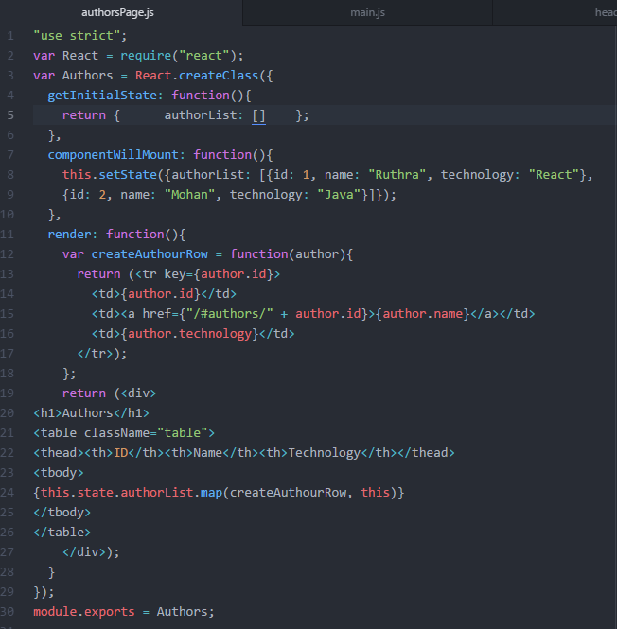
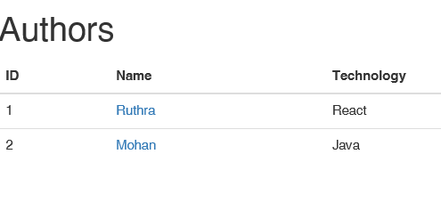

Slide 12
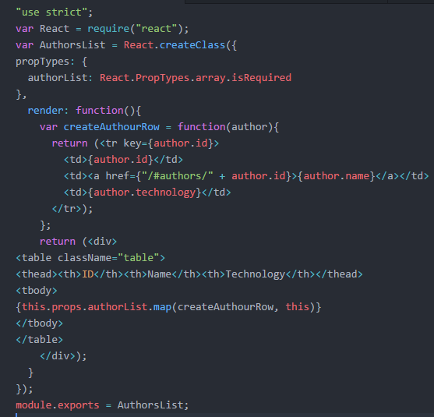
Props Validation

Slide 13
Route
Route
DefaultRoute
NotFoundRoute
Redirect
Params (Passing data to targeted state)
Link
Transition

Slide 14
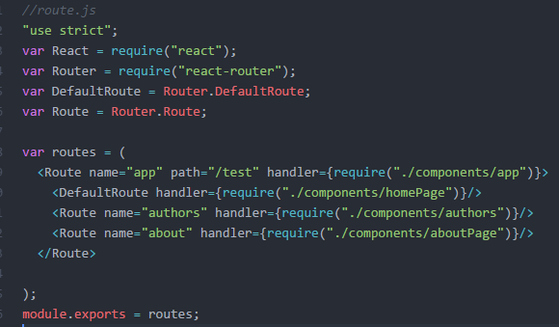
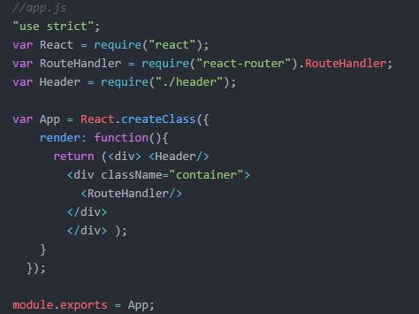
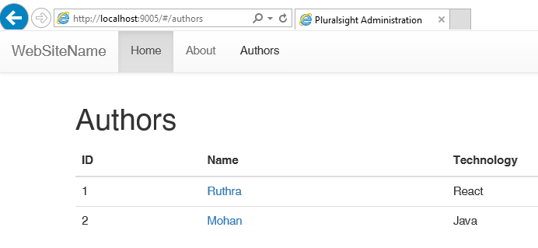
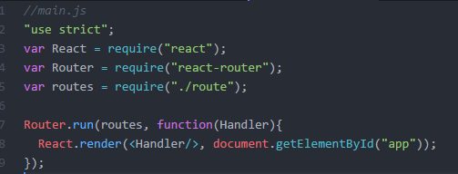
Route

Slide 15
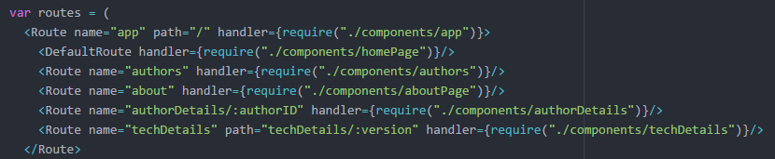
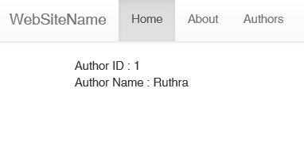
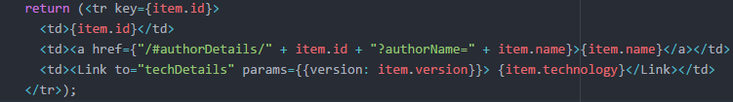
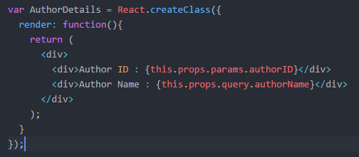
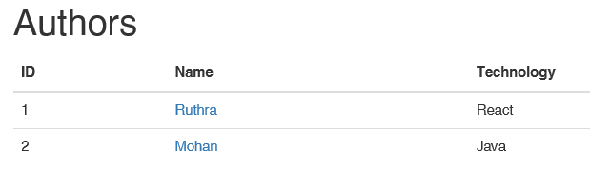
Query / Path Params / Link

Slide 16
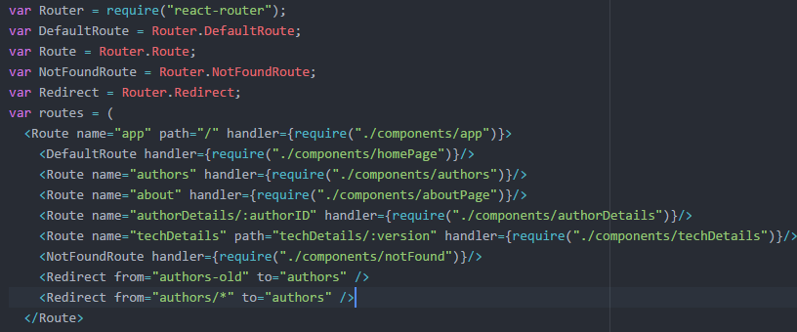
NotFound, Redirect

Slide 17
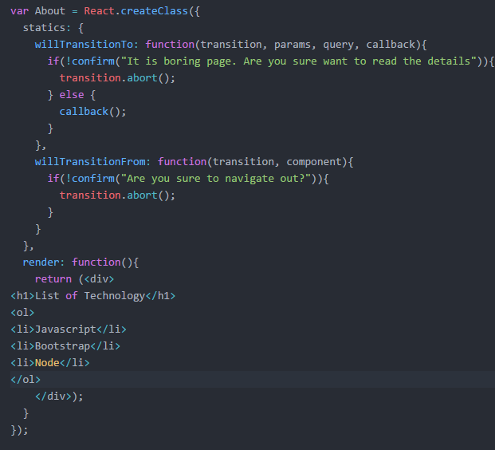
Transition

Slide 18
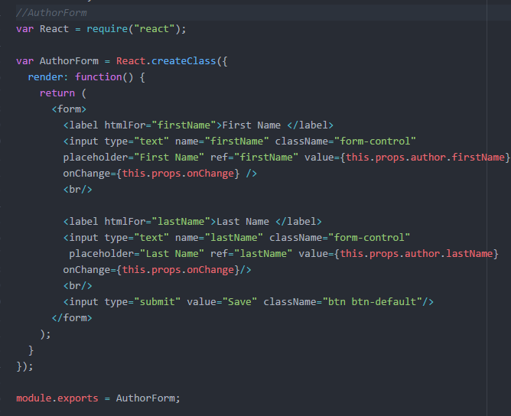
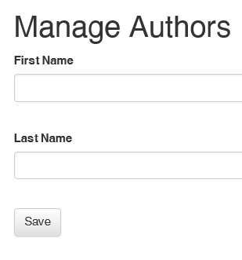
Form

Slide 19
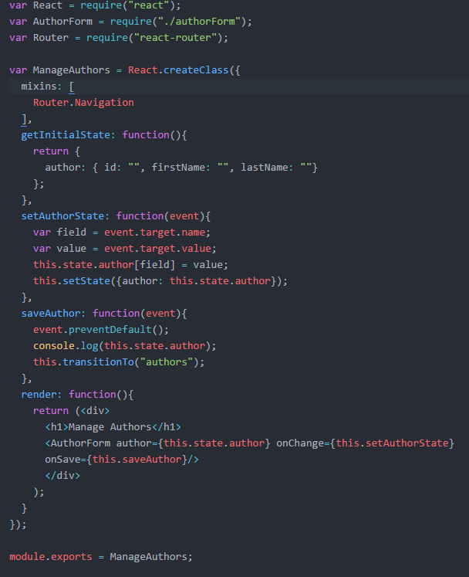
Consume Form

Slide 20
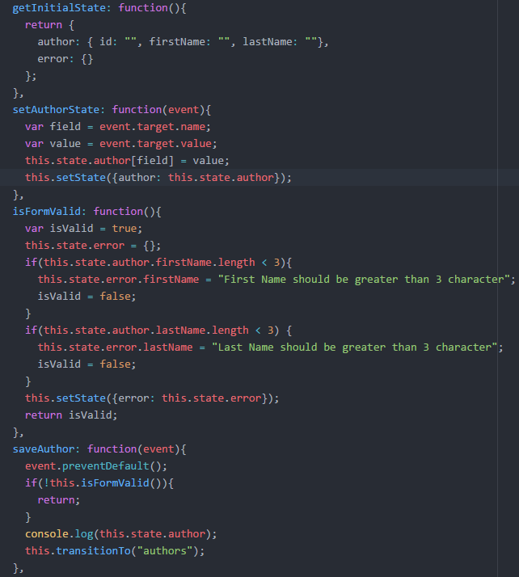
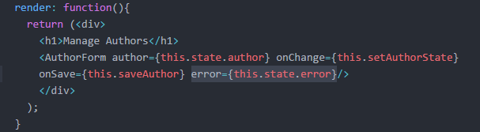
Form Validation

Slide 21
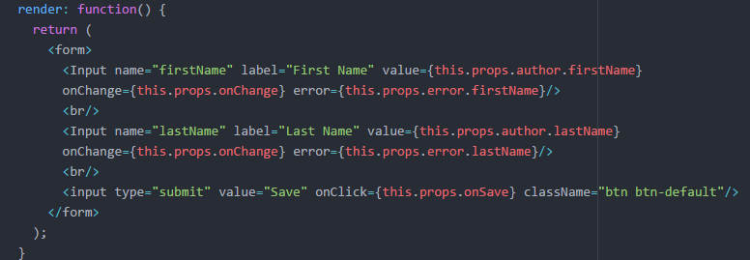
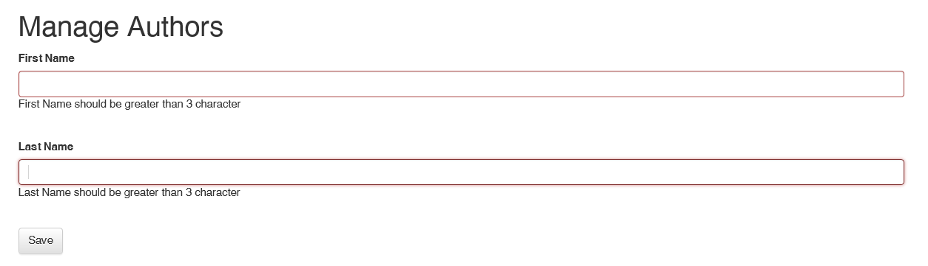
Form Validation

Slide 22
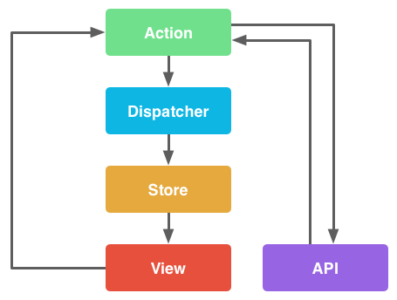
Flux
Design pattern for Unidirectional data flow

Slide 23
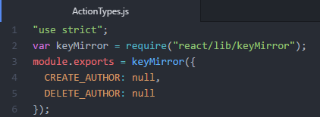
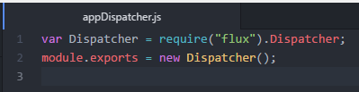
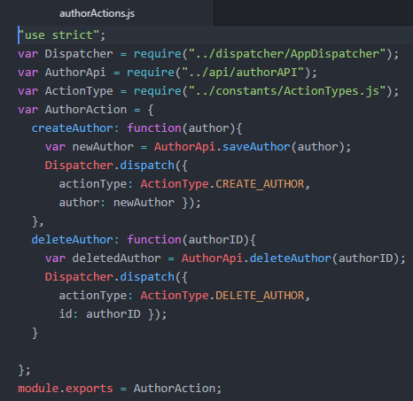
Flux(Constants,Dispatcher, Action)

Slide 24
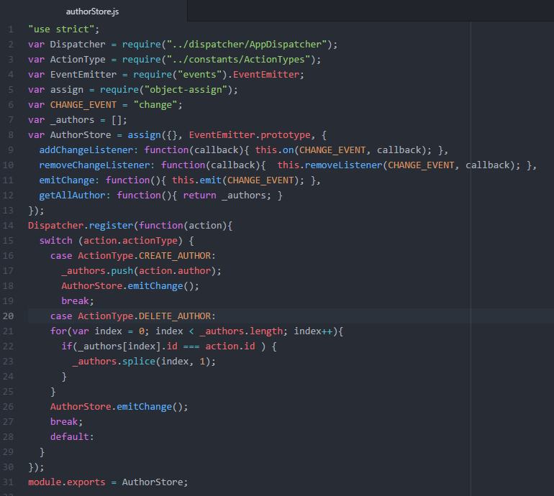
Store

Slide 25
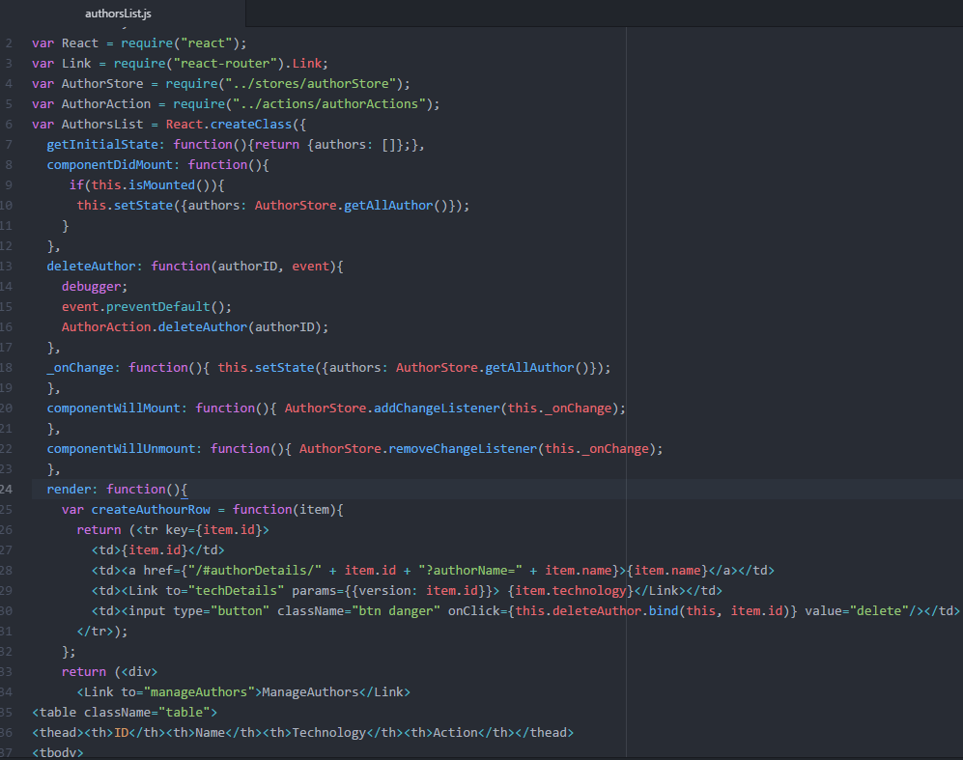
Flux (Component)

Slide 26
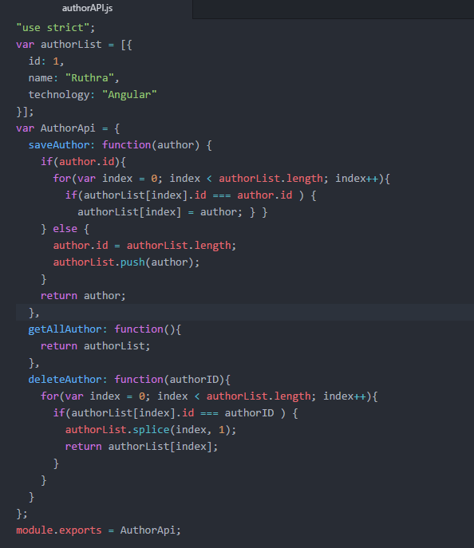
Mock Api

Slide 27
Thank you!!!
Ruthran.kumar@gmail.com
+44 7405708980
+91 9715531887

