Slide 1


TLS Handshake Visualizer and Vulnerability Scanner
CAPSTONE PROJECT
Presented by:
P. Ruthish 192224283
Devanarayanan J 192524314

Slide 2
INTRODUCTION
TLS (Transport Layer Security) is widely used to provide secure communication between web browsers, servers, and other network applications.
The TLS handshake establishes a secure connection by negotiating protocol versions, cipher suites, certificates, and cryptographic parameters.
Weak TLS configurations, outdated protocol versions, insecure cipher suites, and invalid certificates can create security risks.
The TLS Handshake Visualizer and Vulnerability Scanner analyzes TLS connections, visually presents the handshake process, detects security weaknesses, and generates security assessment results.

Slide 3
PROBLEM STATEMENT
Problem
TLS handshakes involve multiple cryptographic operations and message exchanges that can be difficult to understand and analyze.
Servers may also use outdated TLS versions, weak cipher suites, expired certificates, or insecure configurations.
Existing System
Existing TLS analysis and vulnerability scanning tools often provide highly technical results.
Understanding handshake operations and interpreting TLS security problems may require networking and cybersecurity expertise.
Proposed Solution
Develop a TLS Handshake Visualizer and Vulnerability Scanner to analyze TLS-enabled servers.

Slide 4
OBJECTIVES
To develop a TLS handshake analysis system that connects to a target server and identifies important TLS parameters such as protocol version, cipher suite, certificate details, and handshake information.
To develop a vulnerability scanner that identifies weak TLS versions, insecure cipher suites, certificate-related problems, and configuration weaknesses while providing severity classification, security scores, and remediation recommendations.

Slide 5
Literature Review / Background
Author | Title | Advantage | Disadvantage | Year
Research Paper 1 | TLS Security Analysis | Identifies TLS configuration weaknesses | Requires technical knowledge | 2024
Research Paper 2 | TLS Vulnerability Detection | Detects insecure TLS configurations | May require multiple scanning tools | 2024
Research Paper 3 | SSL/TLS Certificate Security Analysis | Identifies certificate security problems | Mainly focuses on certificates | 2023
Research Paper 4 | Analysis of TLS Handshake Security | Provides detailed handshake analysis | Complex for non-technical users | 2022

Slide 6
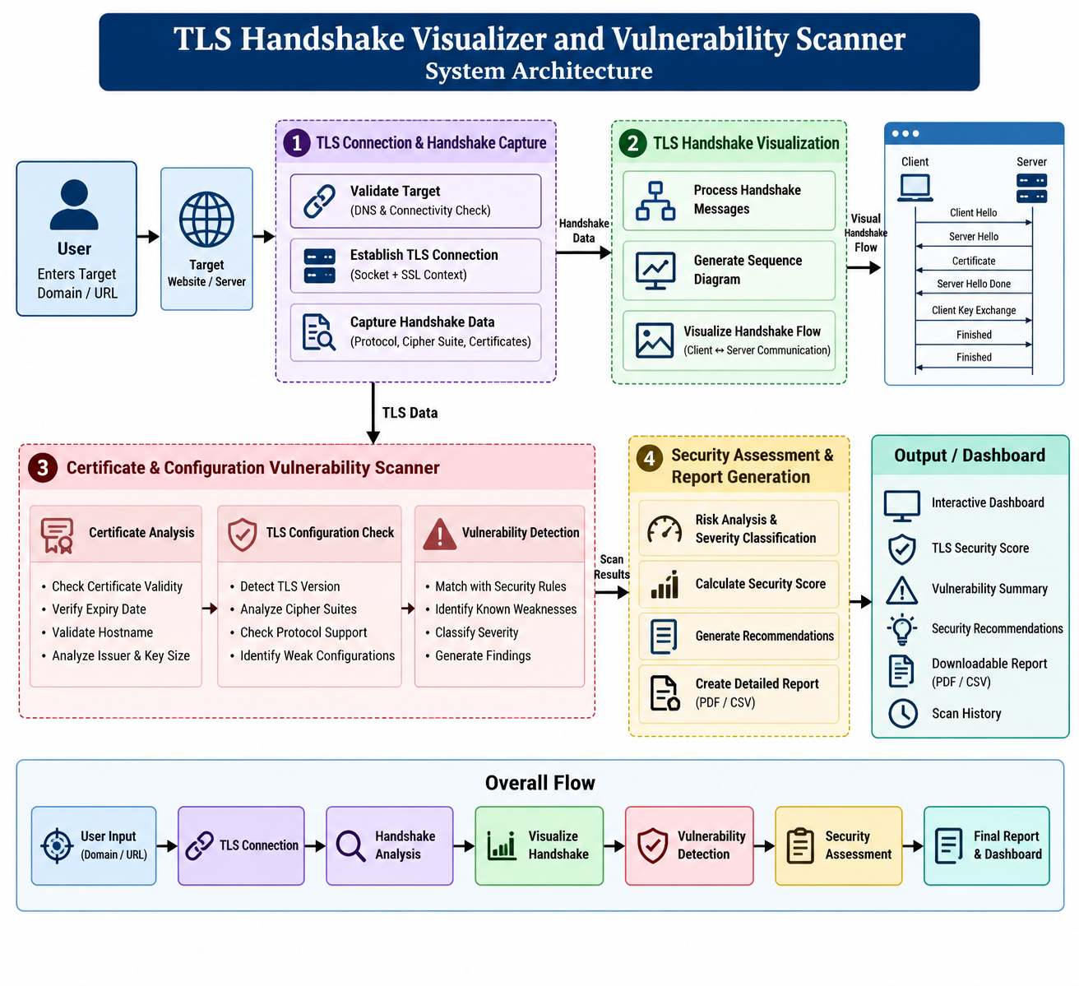
SYSTEM ARCHITECTURE

Slide 7
MODULE 1
Objective
Establish a TLS connection with the target server and collect important TLS handshake information.
Functions
Accept domain name or server address from the user.
Validate target hostname and connection availability.
Establish a TLS connection with the target server.
Capture TLS protocol and handshake information.
Identify the negotiated TLS version.
Identify the selected cipher suite.
Collect handshake timing and connection information.
Output
TLS connection status
TLS protocol version
Negotiated cipher suite

Slide 8
MODULE 2
Objective
Present the TLS handshake process in an easy-to-understand visual format.
Functions
Process the collected TLS handshake information.
Identify important stages of the handshake.
Display communication between client and server.
Visualize certificate exchange and cryptographic negotiation.
Display negotiated protocol version and cipher suite.
Show successful and failed handshake stages.
Output
TLS handshake flow visualization Client-server message sequence Protocol and cipher information Handshake status

Slide 9
MODULE 3
Objective
Analyze TLS configuration and identify potential security vulnerabilities.
Functions
Detect outdated or insecure TLS versions.
Identify weak or insecure cipher suites.
Analyze server certificate information.
Check certificate validity and expiration.
Check certificate hostname information.
Analyze cryptographic key parameters.
Classify identified vulnerabilities based on severity.
Output
List of TLS vulnerabilities Certificate security status Severity levels – Low, Medium, High, Critical TLS configuration assessment
TLS security score
Security recommendations
Security assessment report
Scan history

Slide 10
CONCLUSION
The TLS Handshake Visualizer and Vulnerability Scanner provides an automated and user-friendly approach for understanding and analyzing TLS connections.
It helps identify security risks such as outdated TLS versions, weak cipher suites, certificate problems, and insecure server configurations.
The system combines TLS handshake visualization and vulnerability scanning, helping users understand secure communication while identifying potential TLS security weaknesses.
This follows the presentation style of your reference, whose modules are structured using Objective → Functions → Output and conclude with the project's overall security benefit.

Slide 11
THANK YOU

