Slide 1

Heart Disease Prediction
BANA 6350 Quantitative Methods
Ruth Kebede

Slide 2
Heart Disease in the United States
Heart disease is the leading cause of death in both men and women.
About 695,000 people died from heart disease in 2021.
Coronary heart disease is the most common type of heart disease, killing 375,476 people in 2021.
It cost the U.S. about $239.9 Billion each year from 2018 to 2019 including the cost of health care services, medicines and lost productivity due to death.

Slide 3
Heart health Dataset Overview
Independent Dependent Variable
Age: Age of the patient. HeartDisease: Presence or absence of heart disease
Sex: Gender of the patient (Male/Female).
ChestPainType: Type of chest pain experienced.
RestingBP: Resting blood pressure.
Cholesterol: Serum cholesterol level.
FastingBS: Fasting blood sugar level.
RestingECG: Resting electrocardiogram results.
MaxHR: Maximum heart rate achieved.
ExerciseAngina: Exercise-induced angina (Yes/No).
Oldpeak: ST depression induced by exercise relative to rest.
ST_Slope: Slope of the peak exercise ST segment.

Slide 4
Important steps before analysis
Loaded the heart dataset and explored the data. It had 918 rows and 12 columns.
Defined the independent and dependent variables.
Identified the categorical data and converted them to numerical type using one-hot encoder. E.g., Sex, Chest pain type, ST slope
Split the dataset into training and testing set to evaluate how the model works.
The dependent variable was in binary format so there was no need to change the data type.

Slide 5
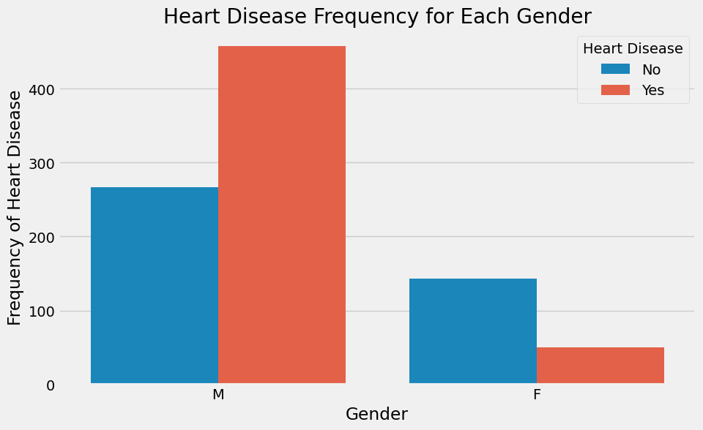
Men are most likely to get heart disease compared to women

Slide 6
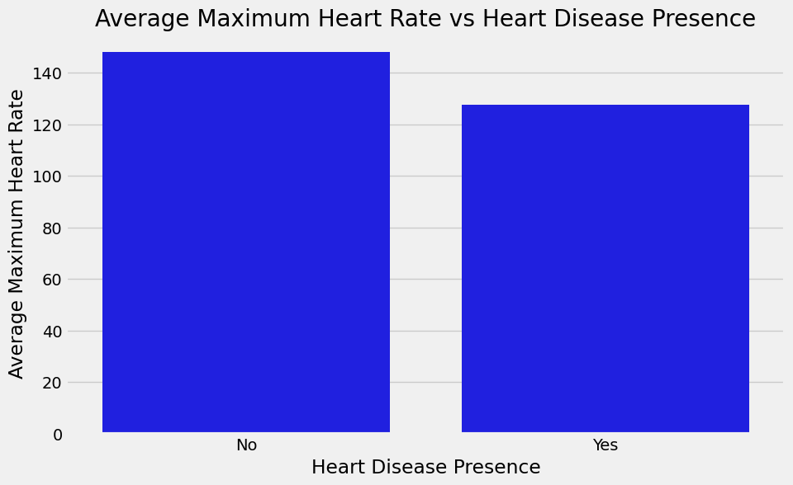
The relationship between maximum heart rate and heart disease

Slide 7
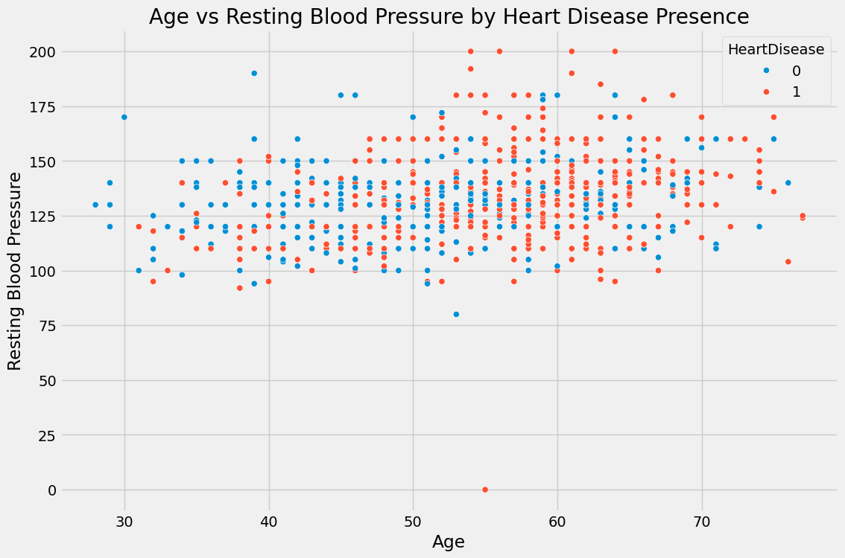
High resting blood pressure for older people increases the risk of heart disease

Slide 8
Predictive Models
Logistic regression: is an analysis technique used to predict the probability that the outcome will happen as a function of unit changes in the Independent variable.
In the context of the heart dataset, the dependent variable is binary, 1 if heart disease occurred and 0 if it did not occur.
The test accuracy for this model was approximately 84%
The train accuracy was about 88%
The precision was 83%.

Slide 9
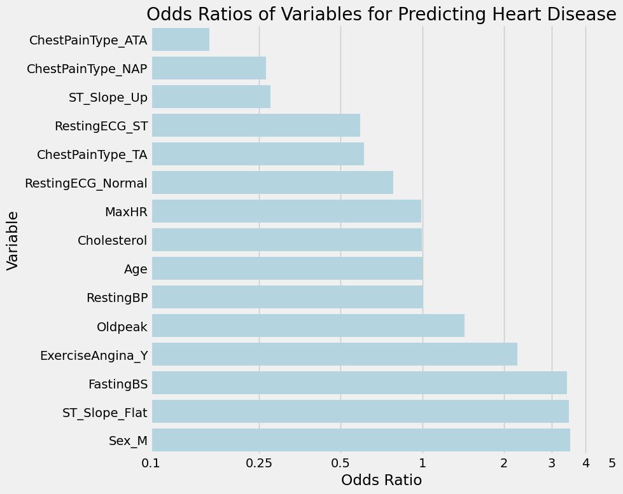
Odds Ratio

Slide 10
Random Forest
This is a technique that involves in creating multiple decision trees to make predictions.
Results:
The test accuracy was approximately 86%, and the training accuracy was 100%.
The precision of the model was 85%
The model does not perform as well with new data as it shows a drop from the training accuracy. Although a precision of 85% might not be bad it still might show false negatives for heart disease as it is not 100 %

Slide 11
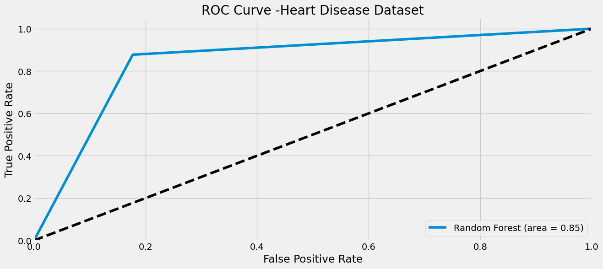
ROC Curve

Slide 12
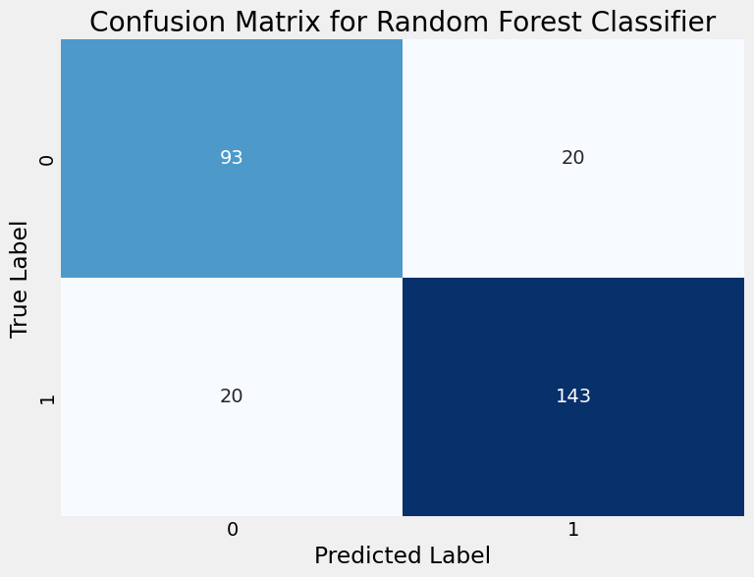
Confusion Matrix

Slide 13
XGBoost Model
This model implements decision trees designed for speed and performance. It's a powerful approach that works well on a wide range of problems, including binary classification like heart disease prediction.
The training accuracy was 100%
Test Accuracy was approximately 86% and the precision was 86%
The model has learned the training data perfectly however the test data shows a drop meaning the data doesn’t perform as well to new data. A precision of 86% indicates the model can predict heart disease 86% of the time but doesn’t account for false negatives or where model predicts no heart disease, but the disease is present.

Slide 14
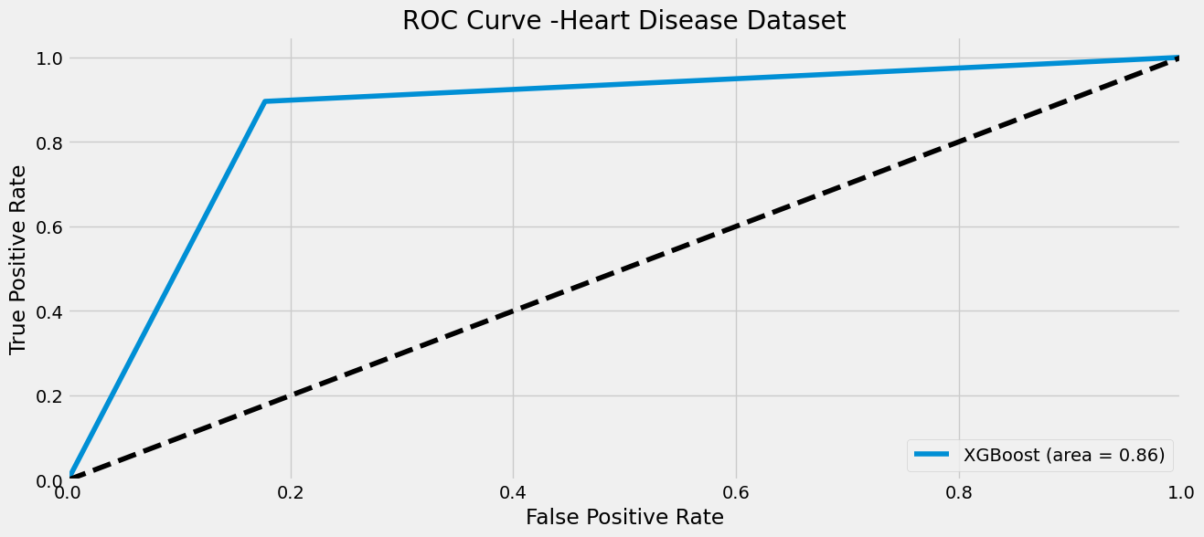
ROC Curve

Slide 15
Conclusion
Best result: XGBoost was over all the highest performing model with the highest test accuracy (86%) and highest precision (86%)
It is important to watch out for these major factors to predict heart disease :
Gender: Male
ST_Slope: When it is flat
High Fasting Blood sugar
Exercise Angina
Other factors such as Age, cholesterol, Maximum heartrate play moderate role but it is important not to ignore all the signs so the person can get the appropriate treatment.

Slide 16
Resources
Centers of Disease Control and Prevention. (2023, May 15). Heart Disease Facts.
Pythonafroz. (2022, October 1). Eda-heart-disease-prediction-roc & PR curve. Kaggle. https://www.kaggle.com/code/pythonafroz/eda-heart-disease-prediction-roc-pr-curve/input

