Slide 1
AWS
Learning Account Creation

Slide 2
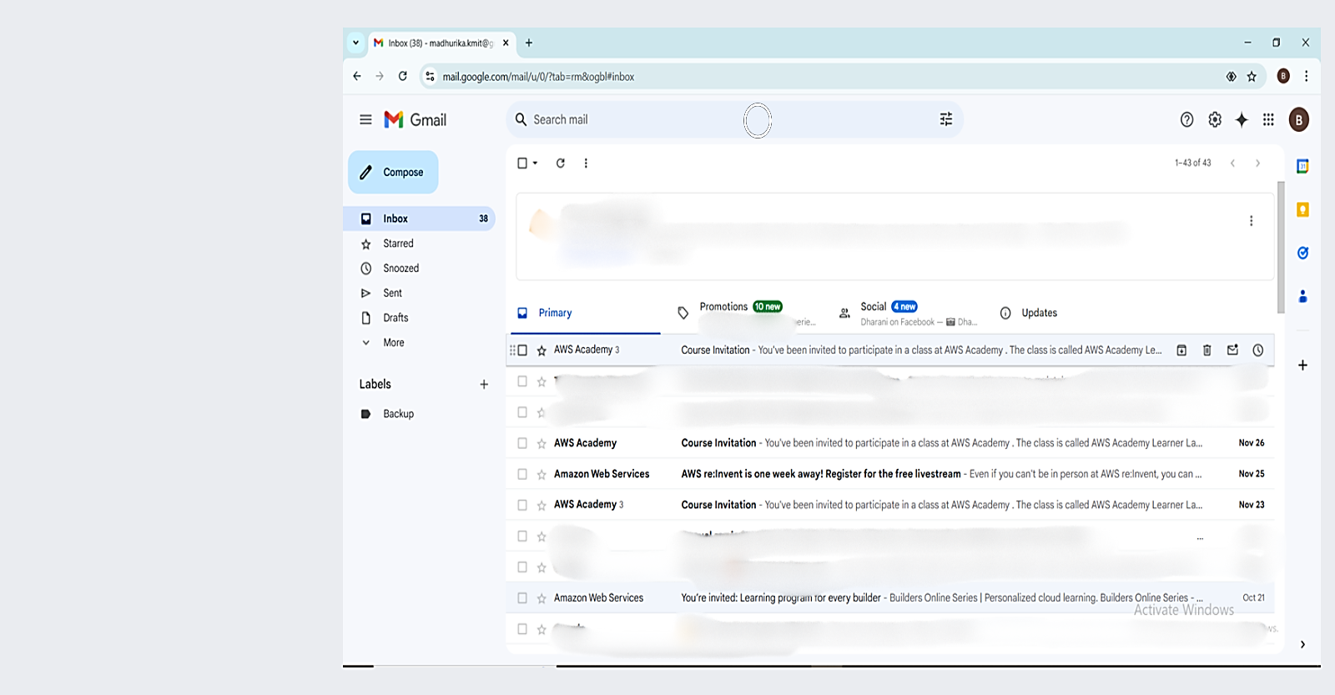
Go to your Email and Check for AWS Academy course invitation

Slide 3
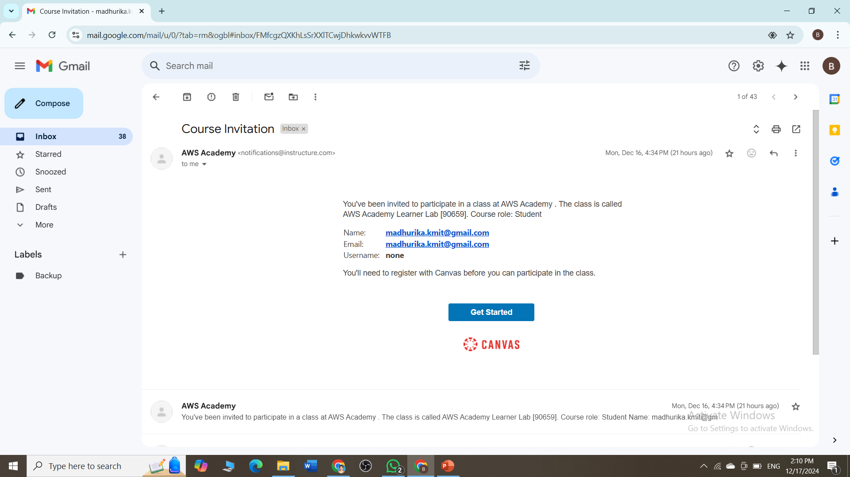
Click on Get Started

Slide 4
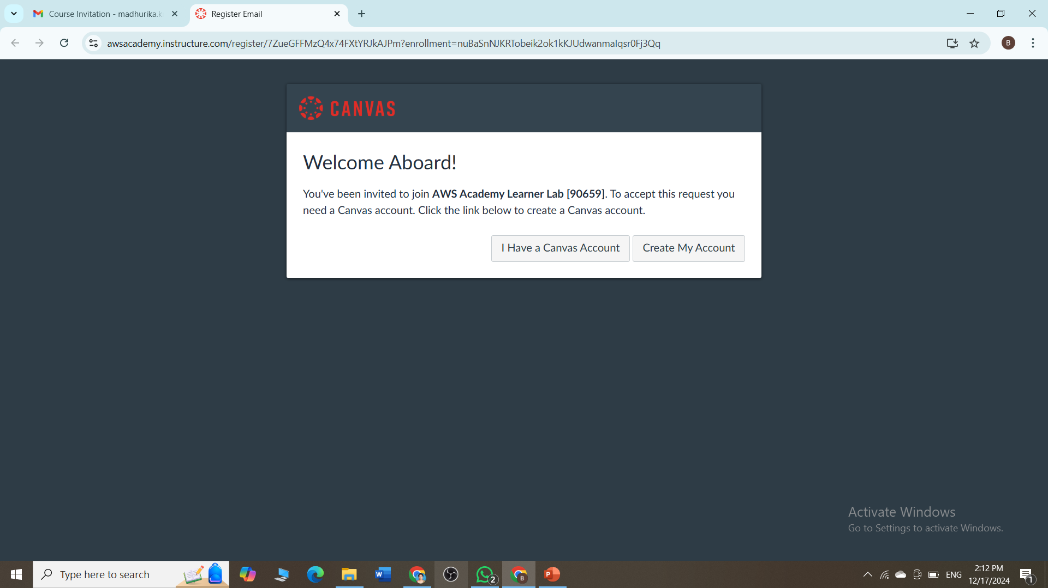
Click on Create My Account

Slide 5
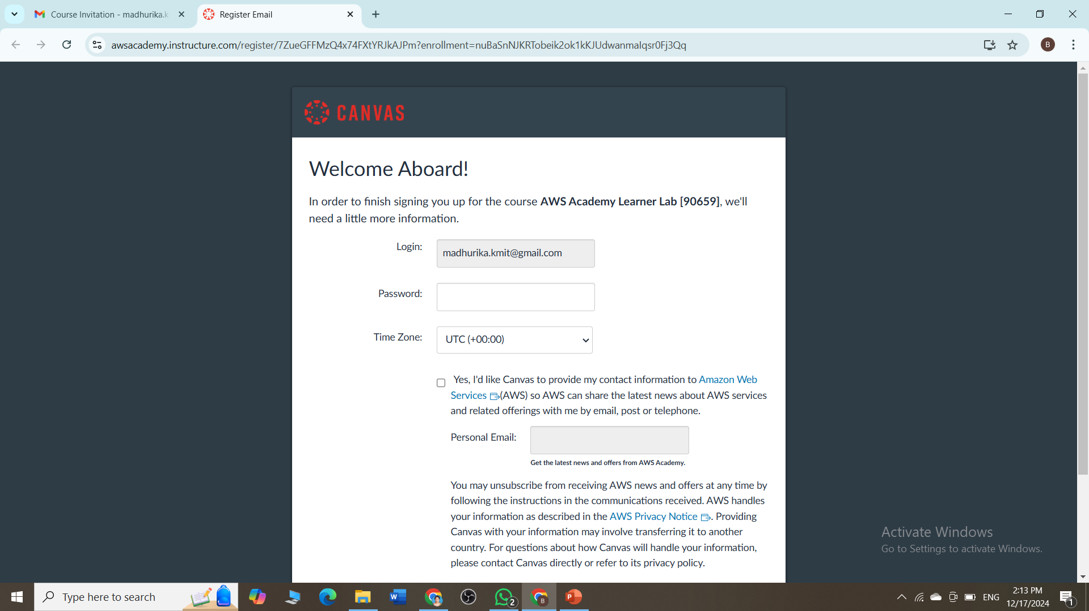
Provide a password

Slide 6
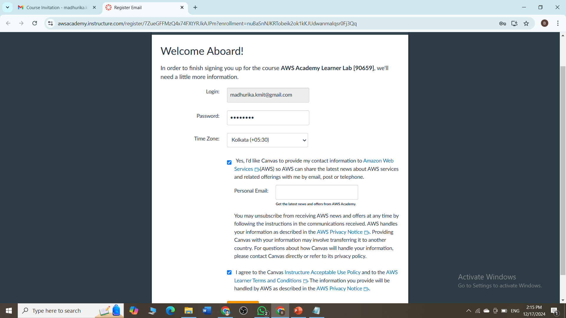
Select time zone(any Indian time zone), Check all the boxes

Slide 7
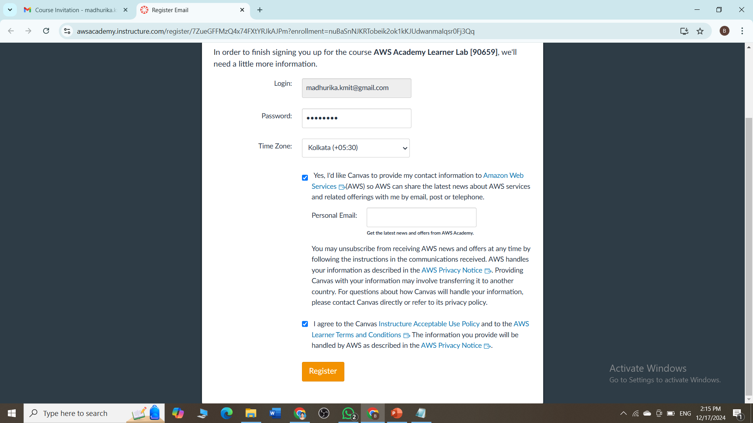
Scroll down and Click on Register

Slide 8
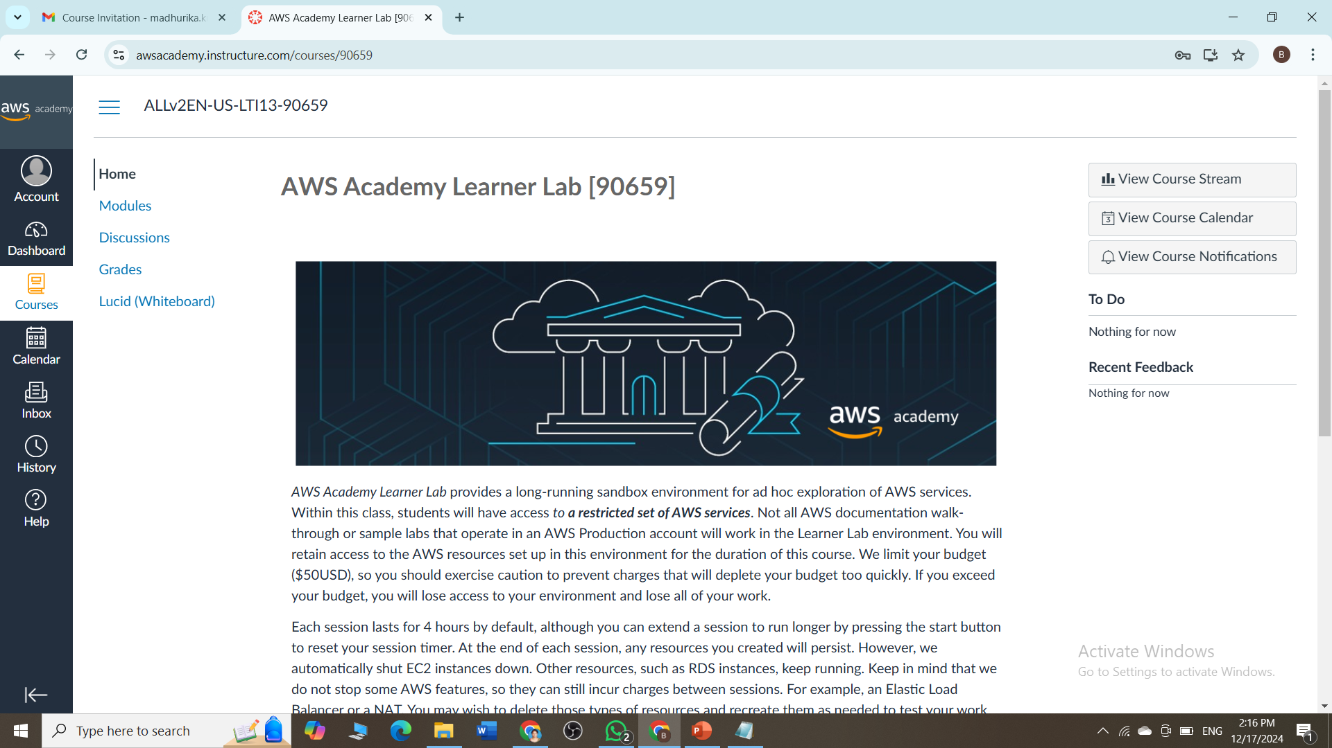
on this window click on account

Slide 9
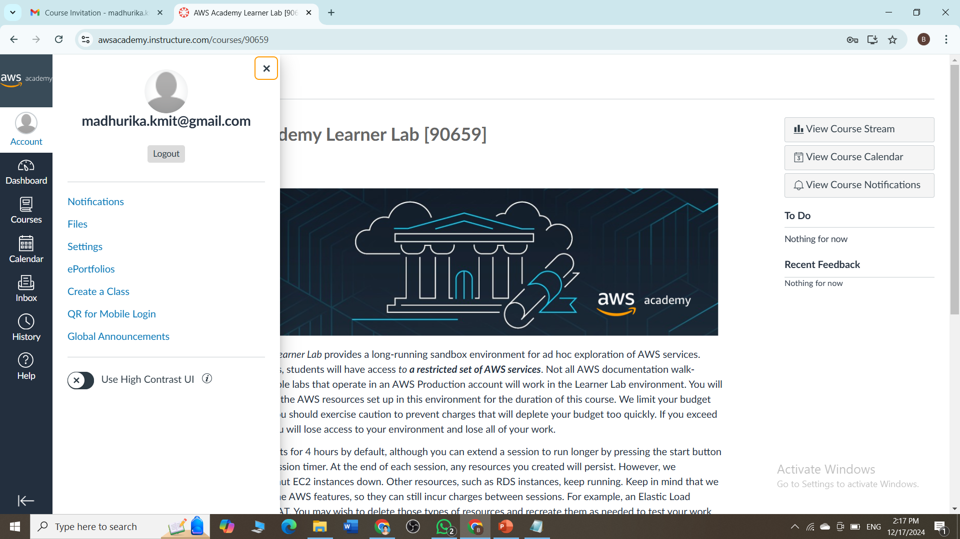
Let's see how to logout and login again →CLICK on logout

Slide 10
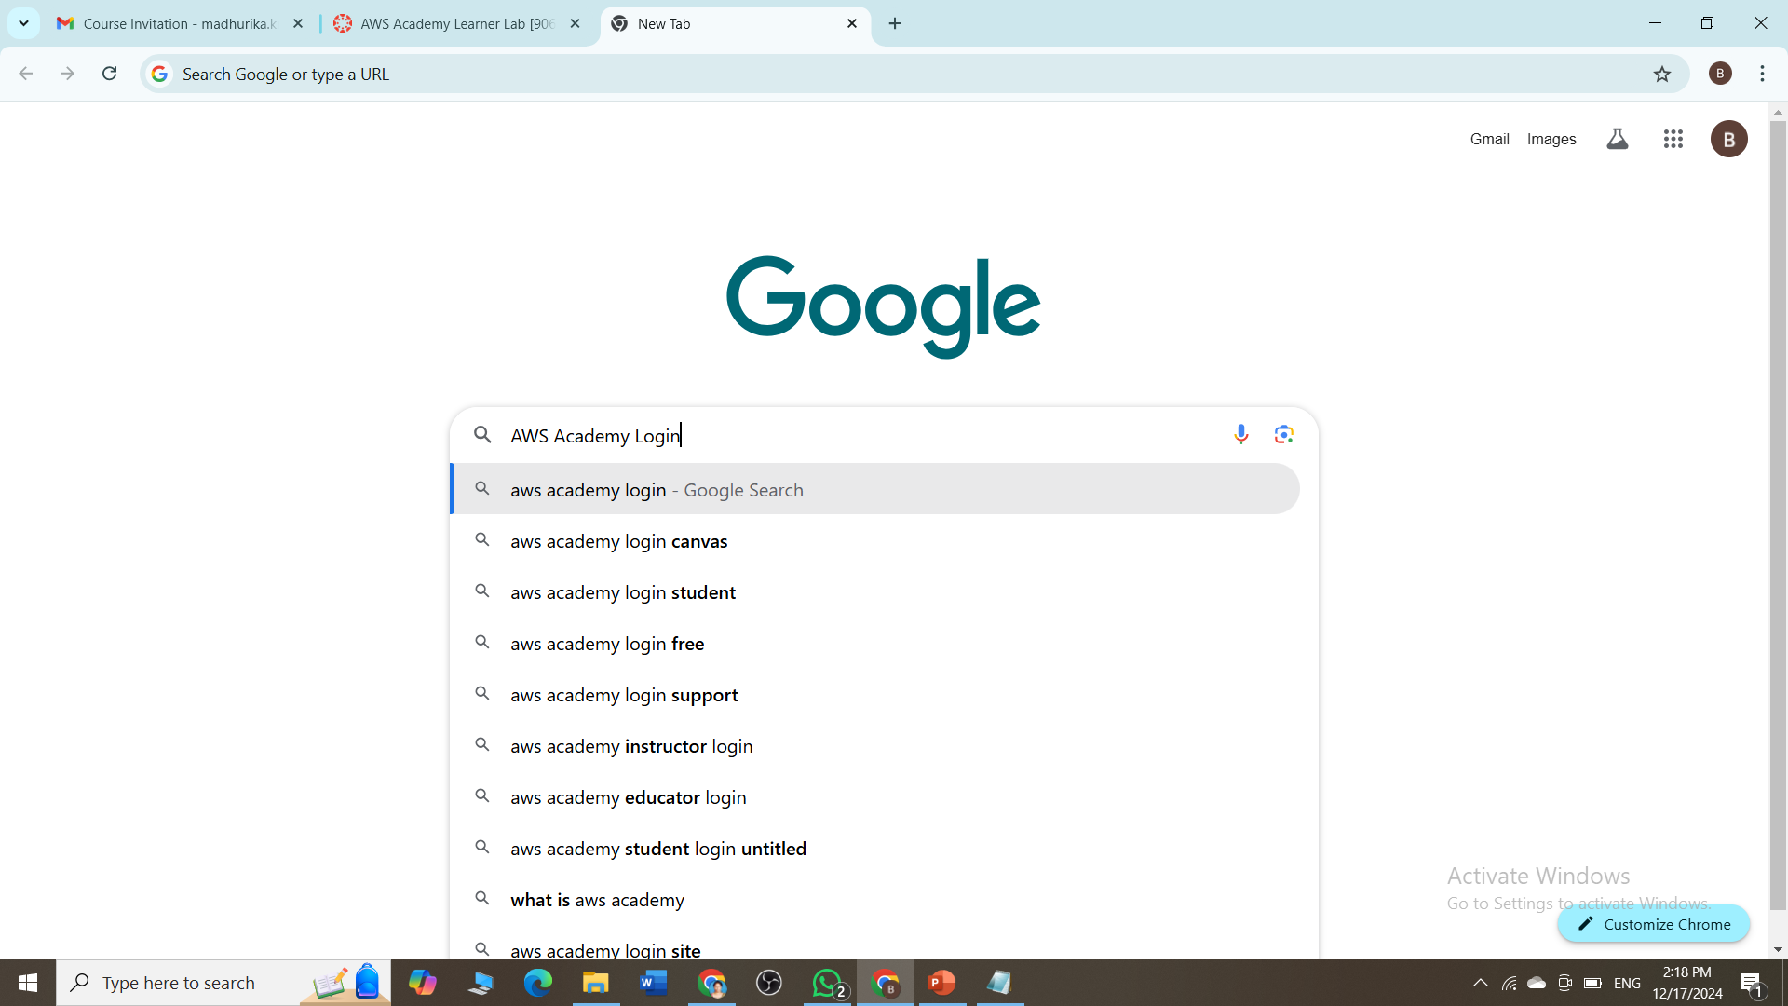
Go to google search for aws academy login

Slide 11
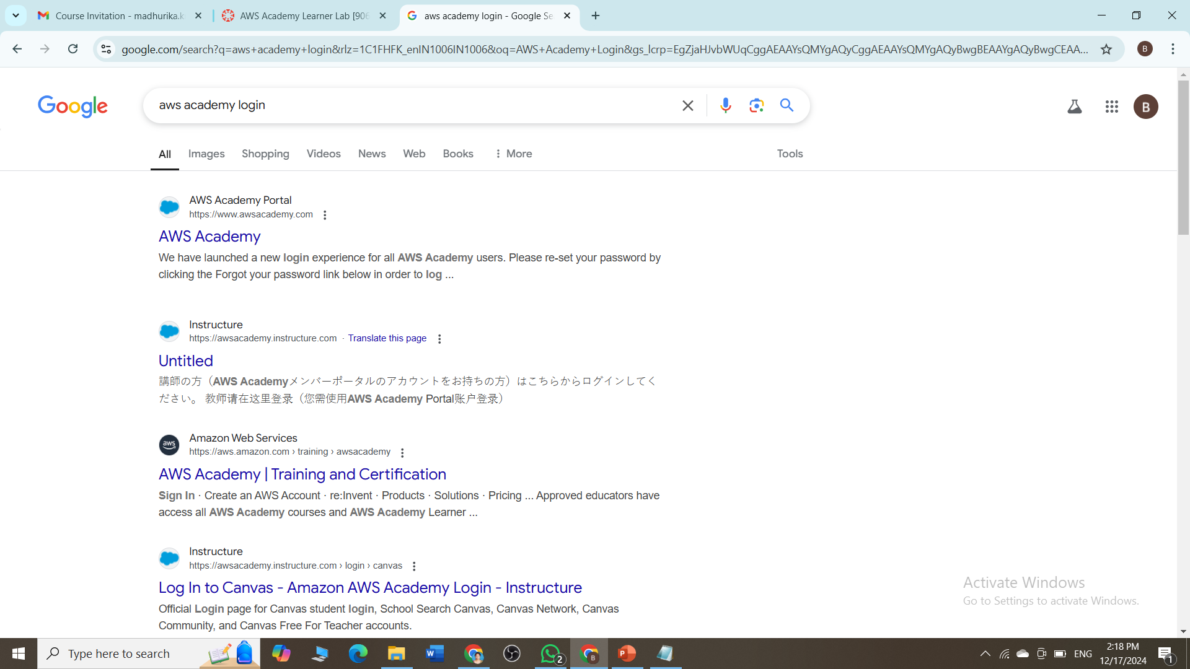
Search for Untitled and click

Slide 12
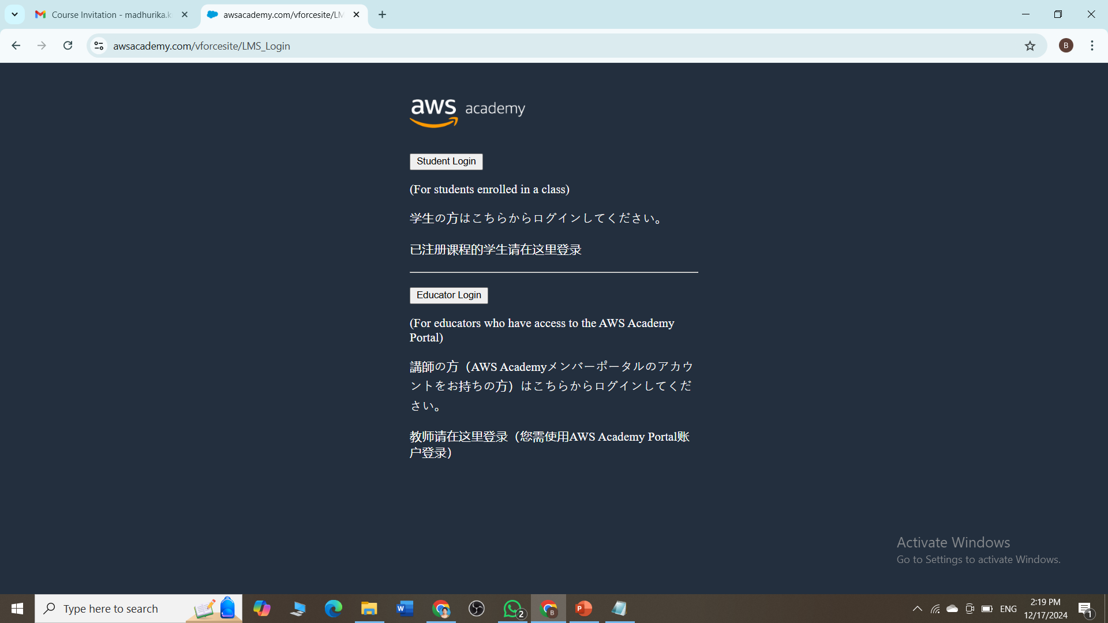
Click on Student Login

Slide 13
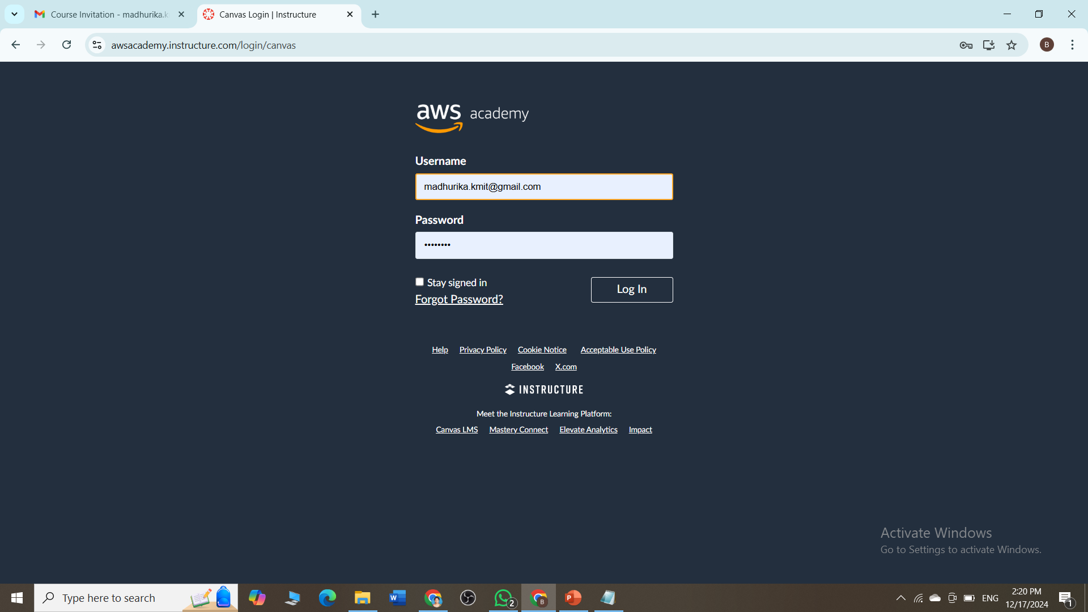
Fill the username and password→ click on login

Slide 14
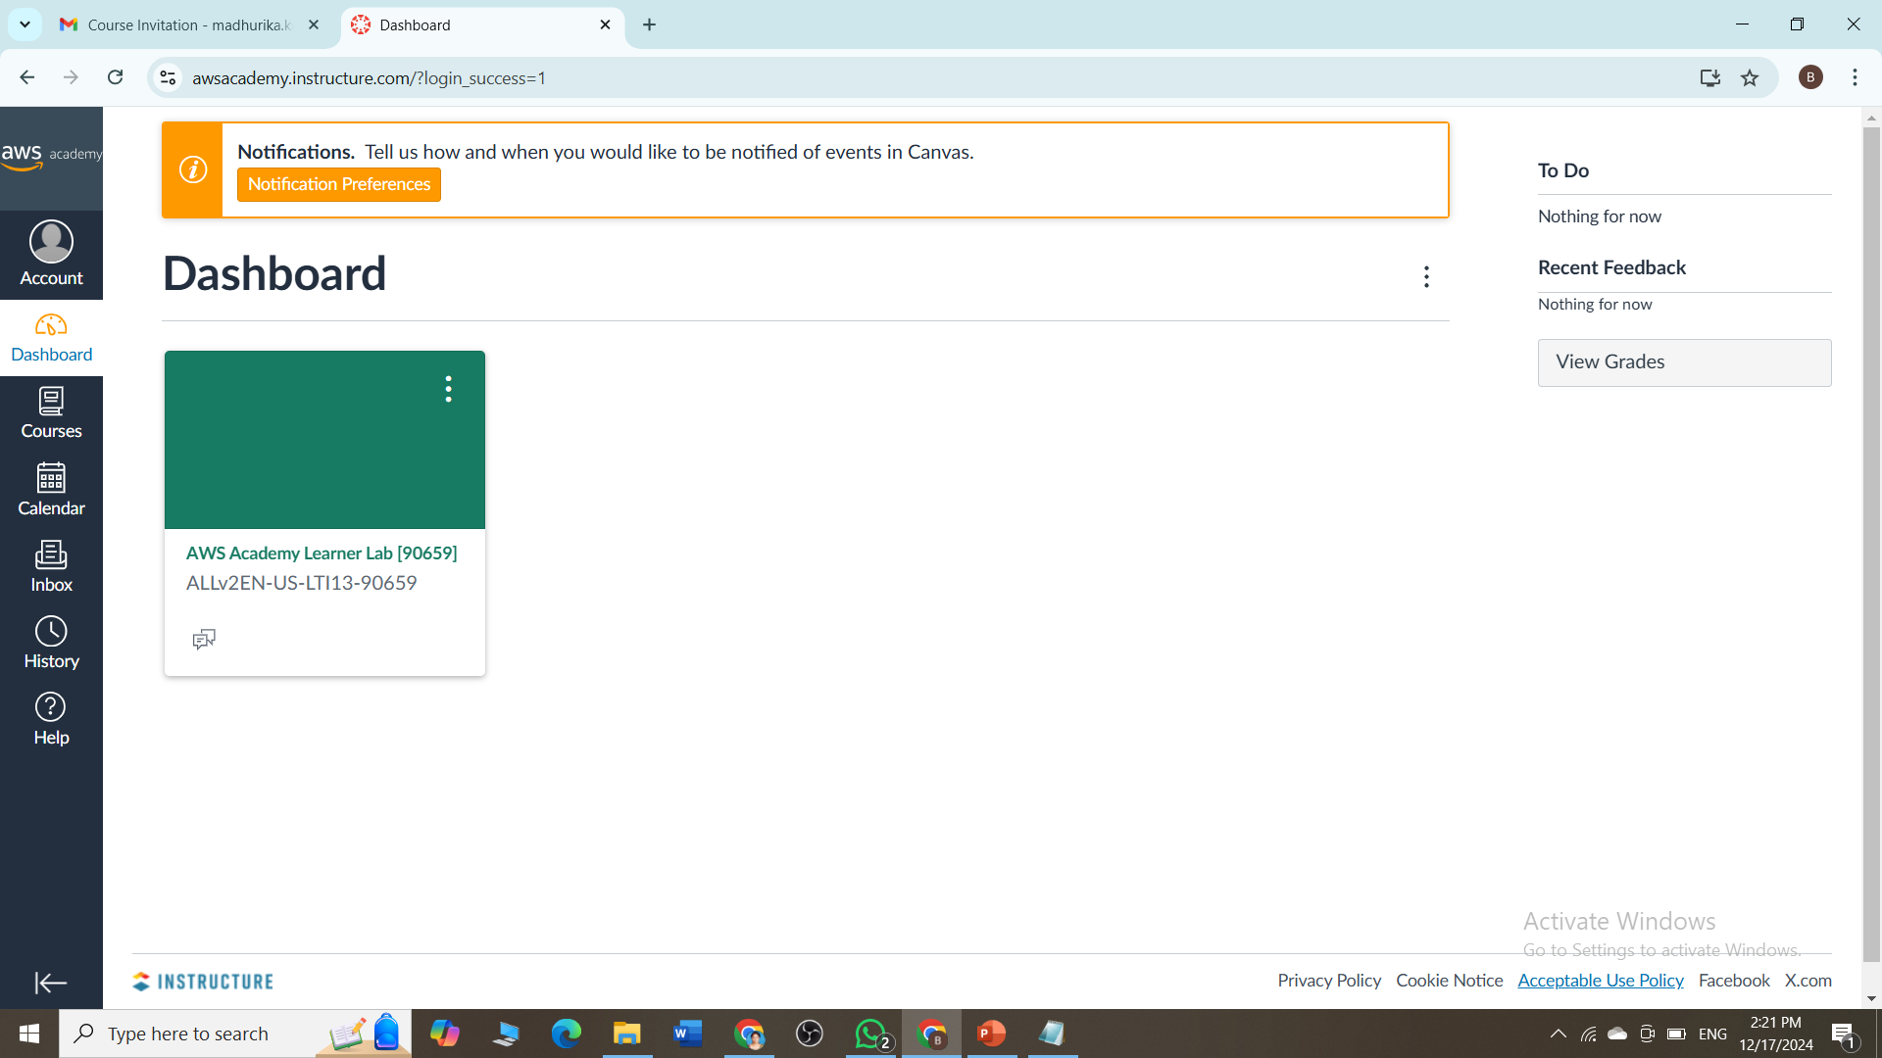
Click on the aws academy learner lab

Slide 15
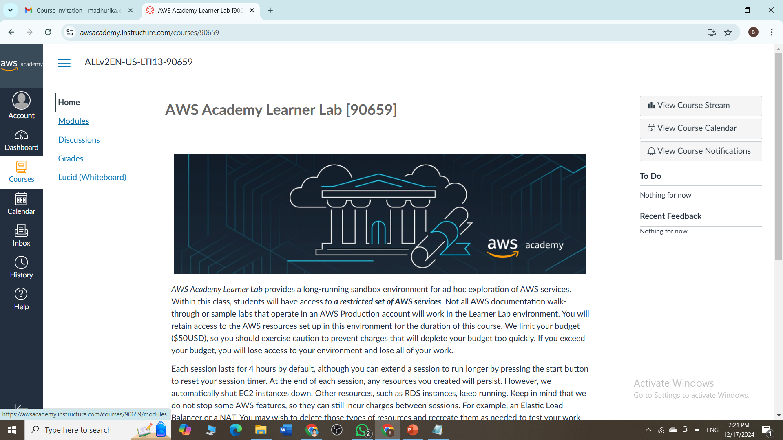
Click on Modules

Slide 16
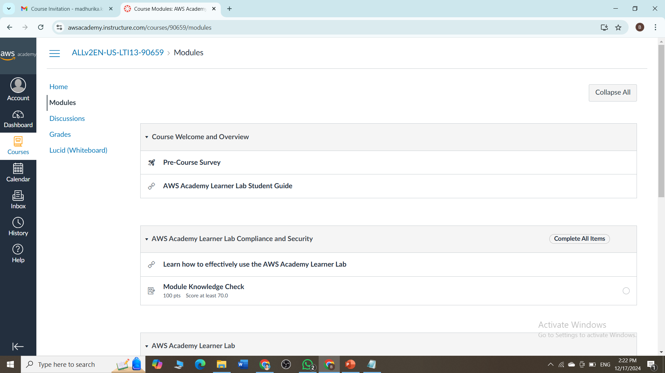
Scroll down

Slide 17
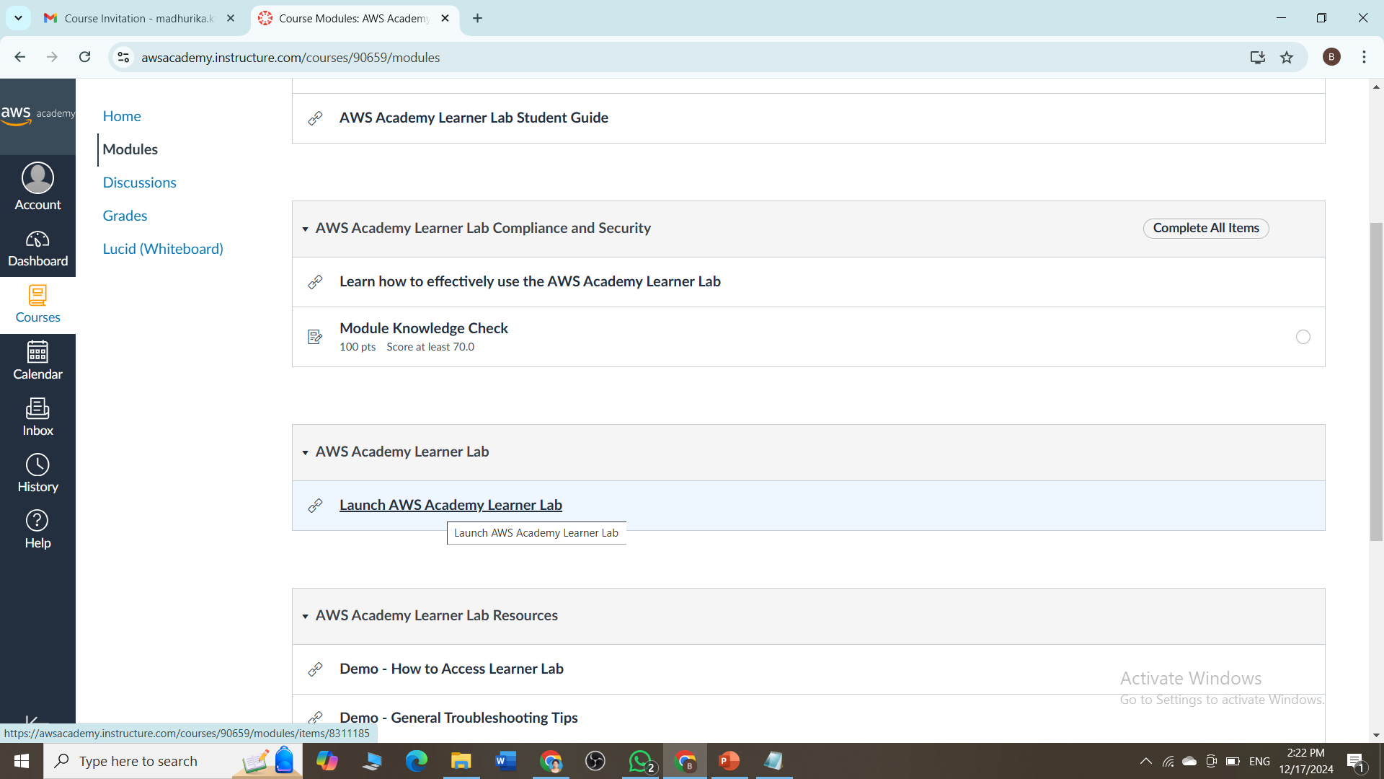
Scroll down and click on AWS Academy Learner Lab

Slide 18
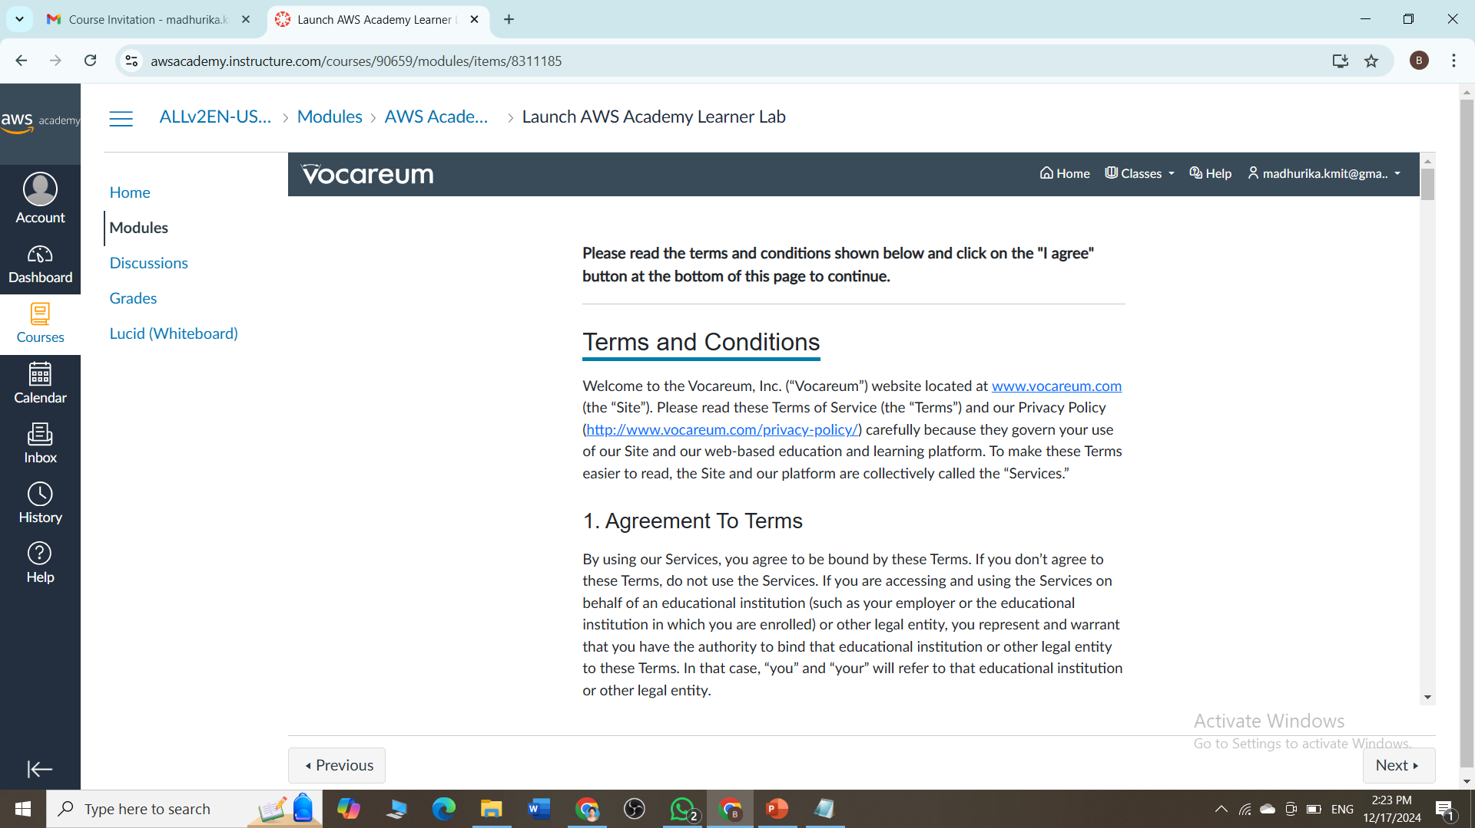
Scroll down after reading the terms & conditions

Slide 19
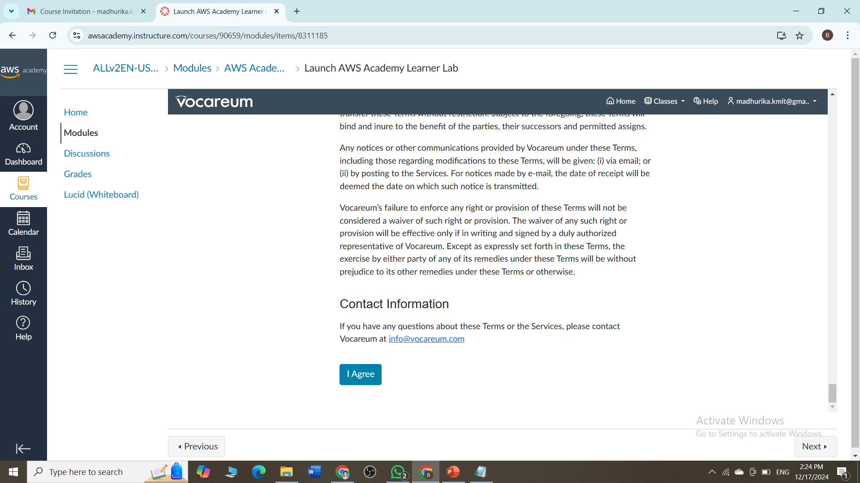
Scroll down and click on I Agree

Slide 20
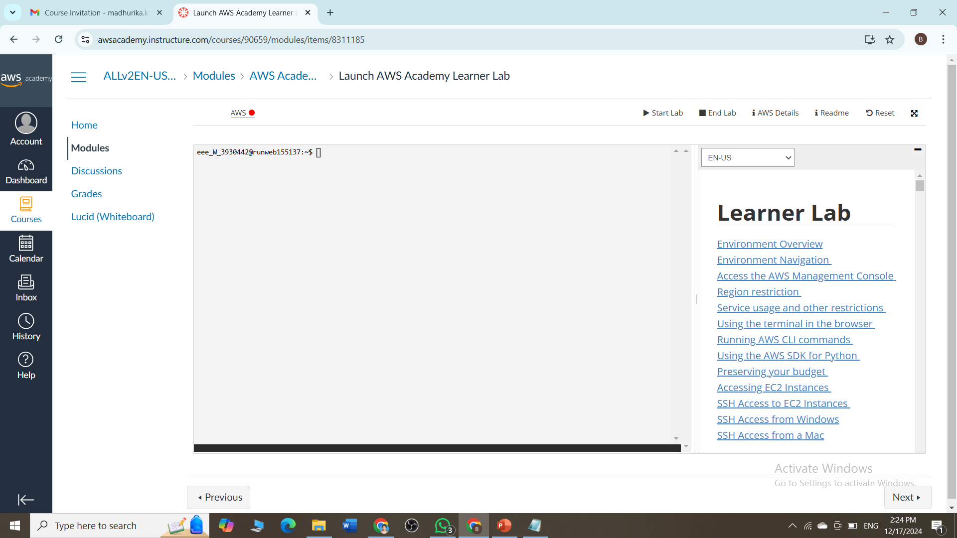
If there is red dot beside AWS it means the sandbox (AWS Learning Environment) is in stop state, click on Start Lab

Slide 21
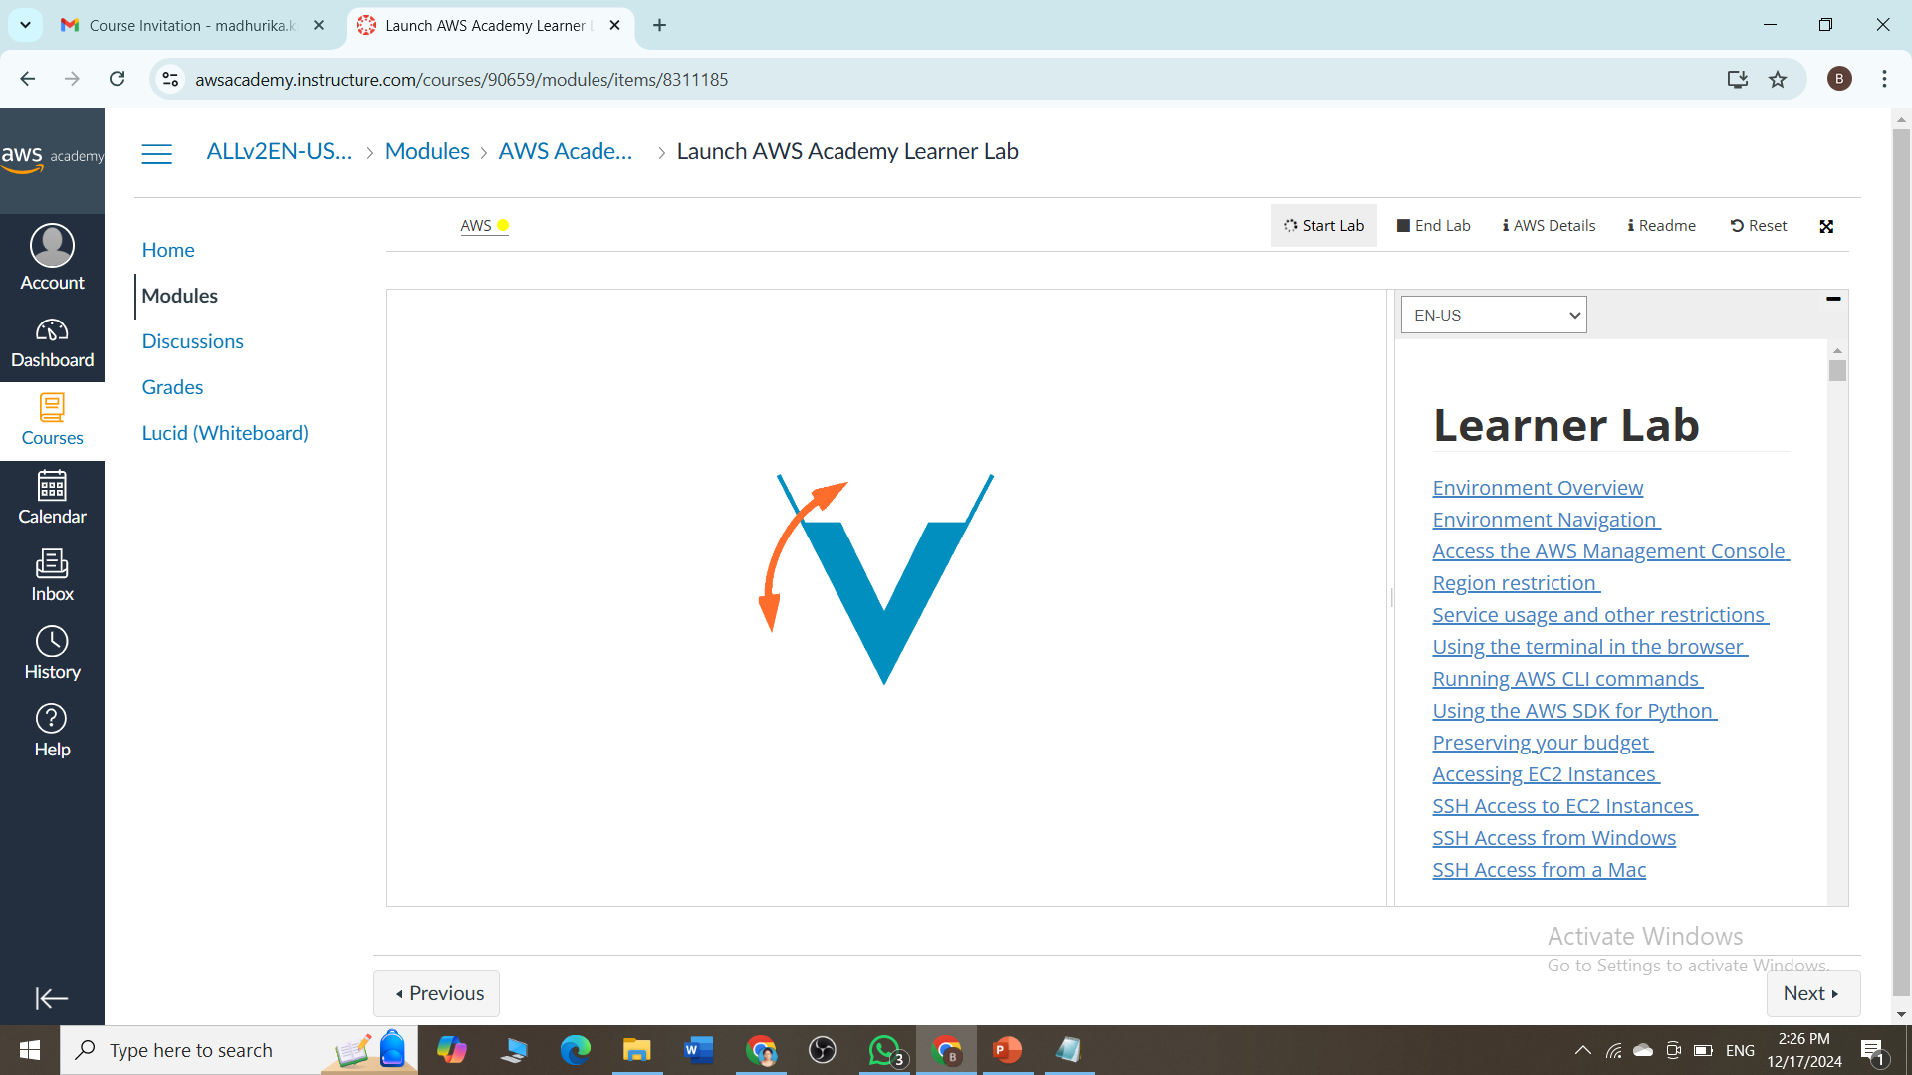
Once you Start the Lab, it will last for 4hrs and if you want to extend then comeback and start again to reset the timer

Slide 22

You are given free 50$, if you exceed you will not be able to access AWS with this email id again

Slide 23

Once the AWS turns green, click on it

Slide 24
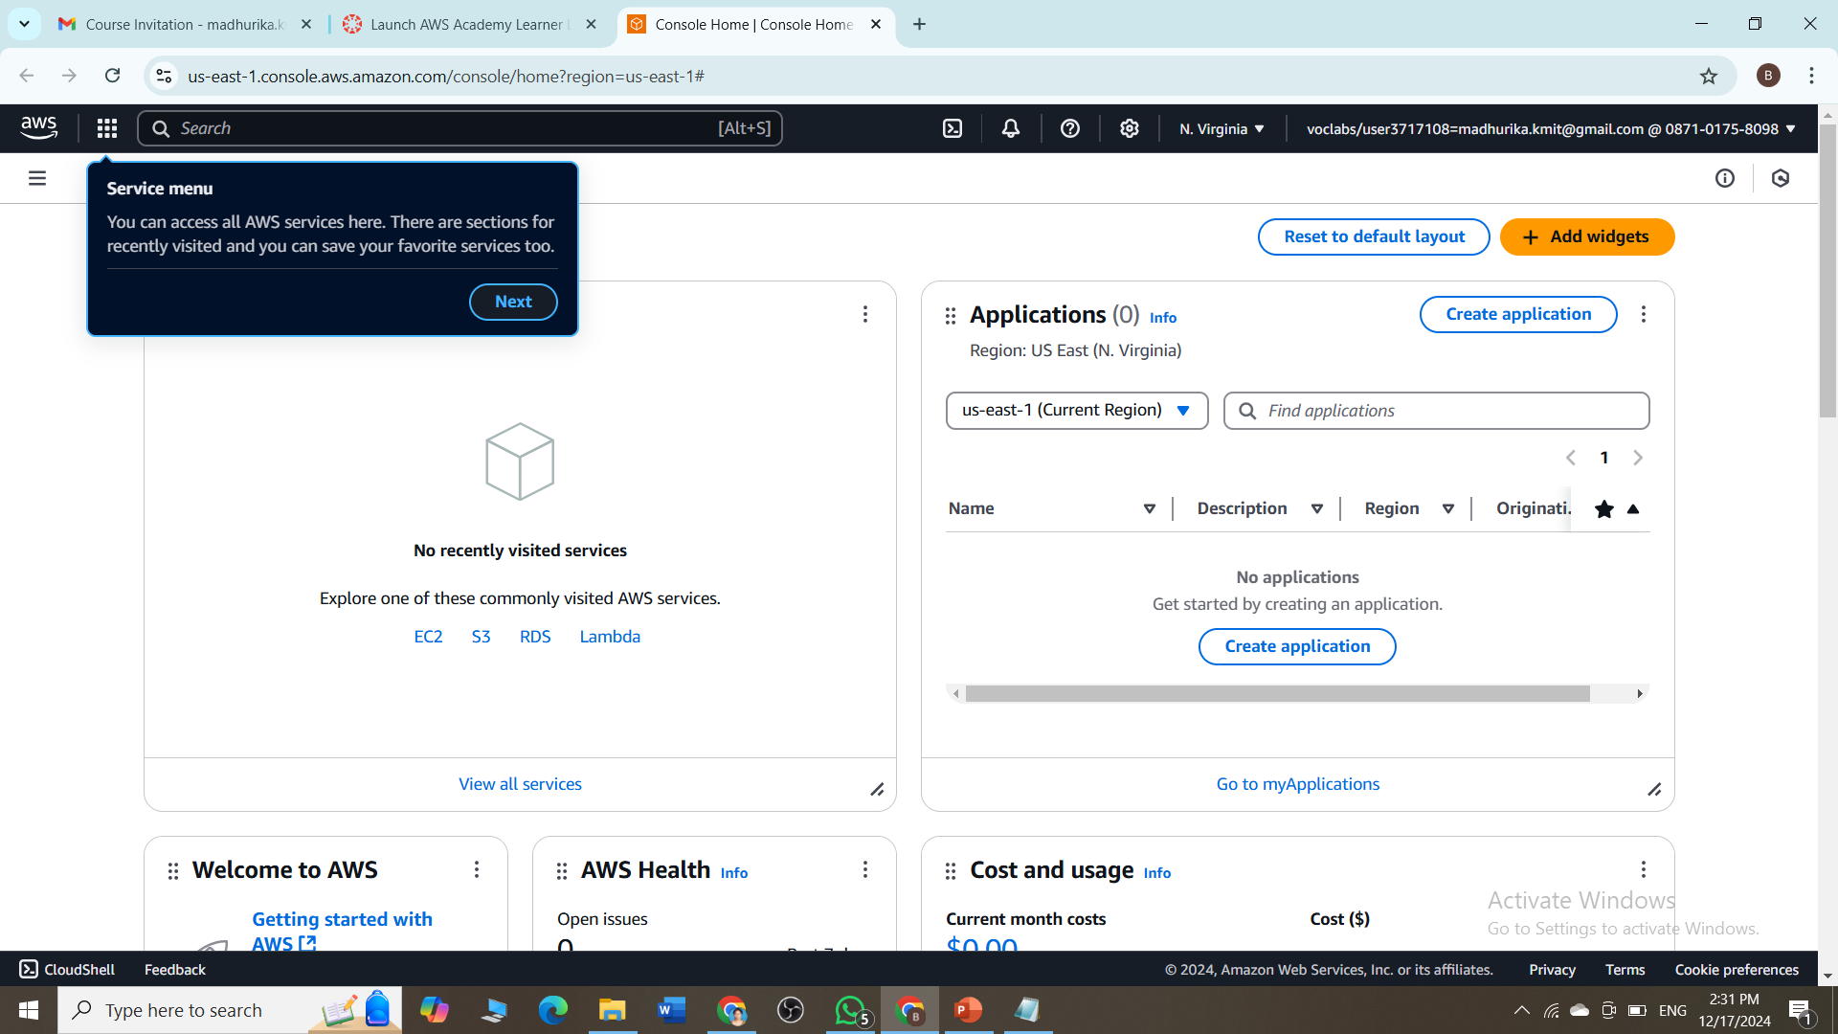
You will land to the AWS dashboard

Slide 25
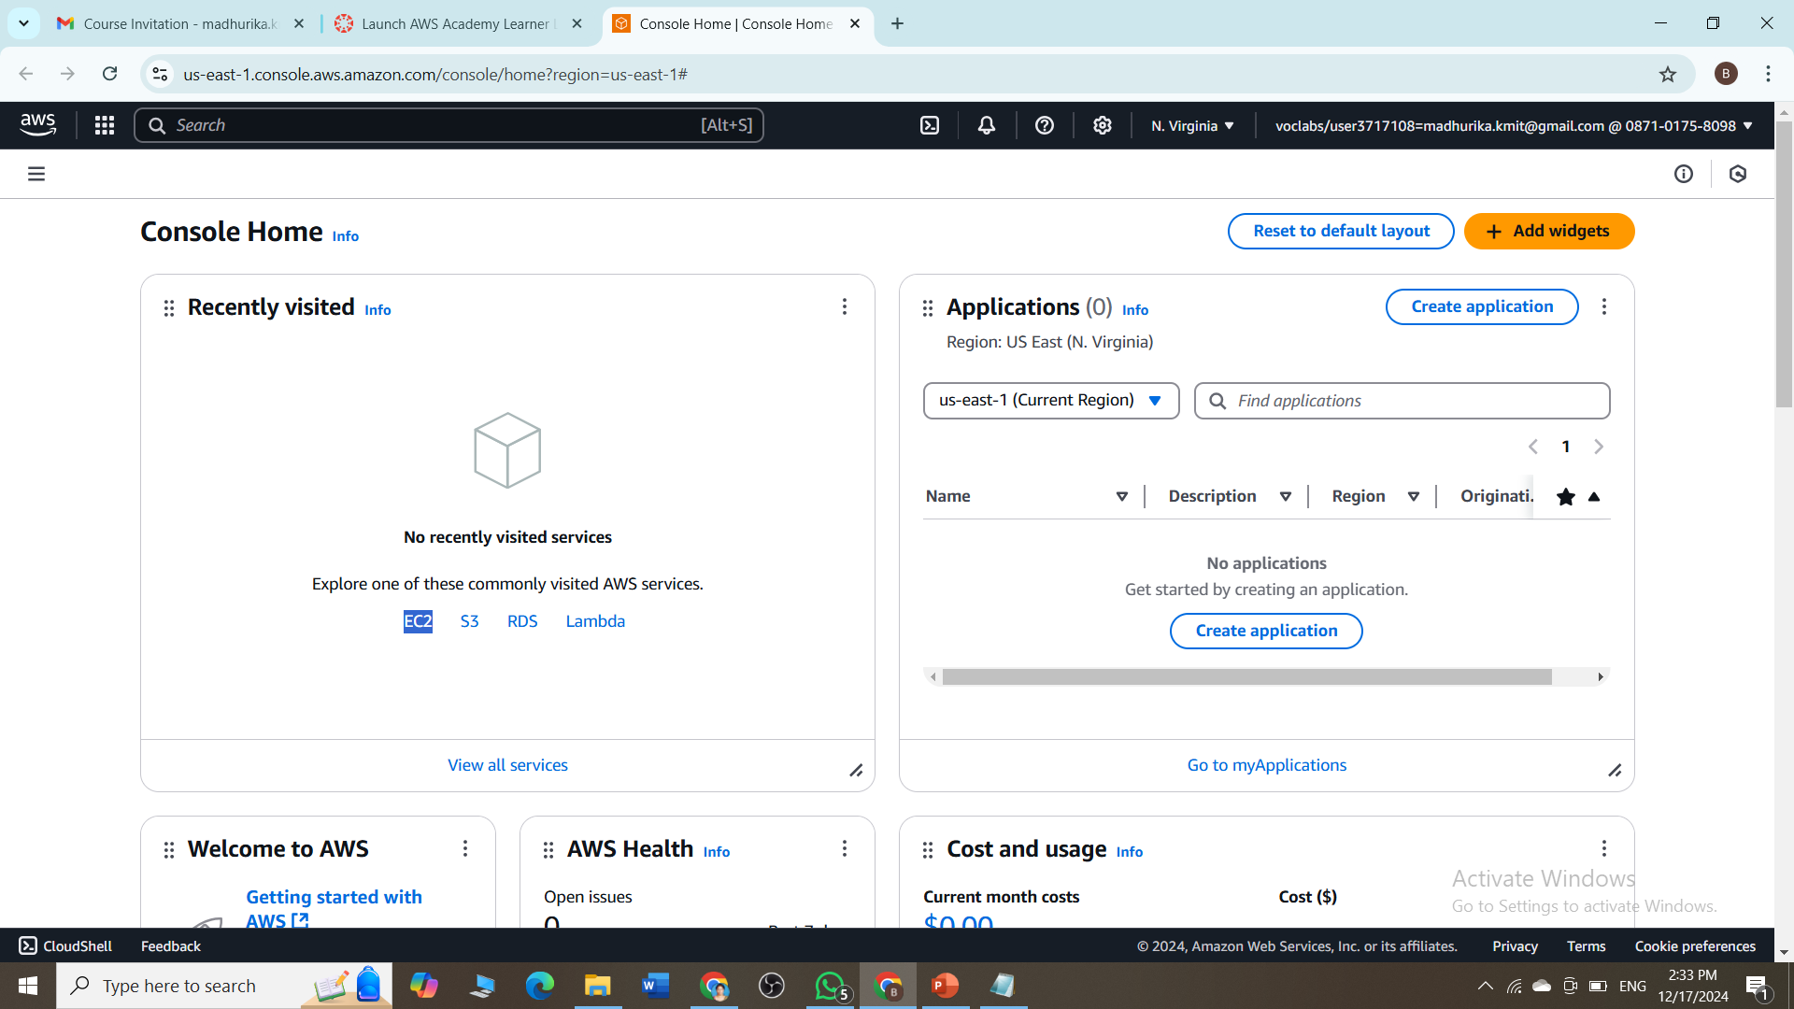
Click on EC2 in Recent visited box

Slide 26
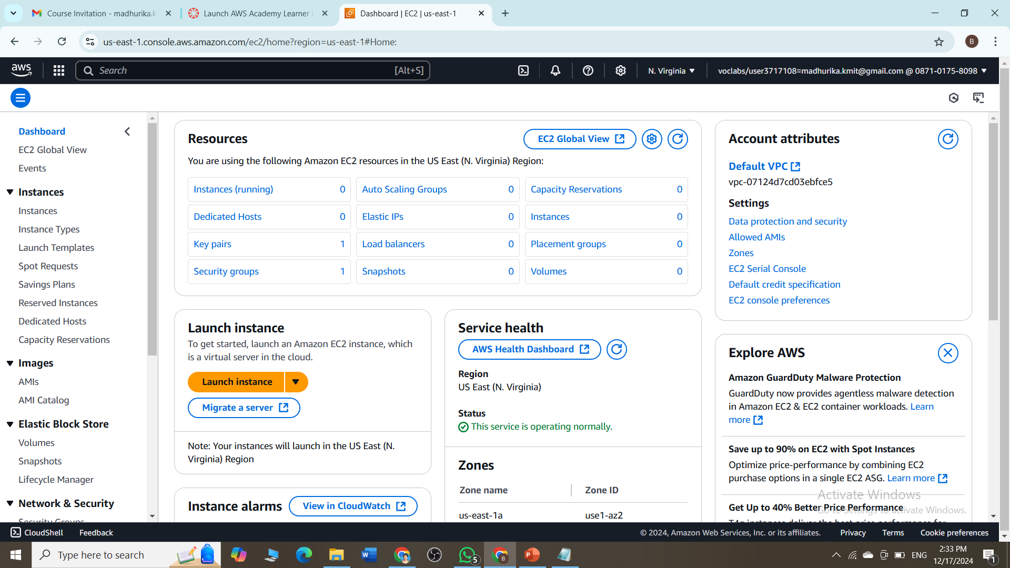
We can start the exercises from here

Slide 27
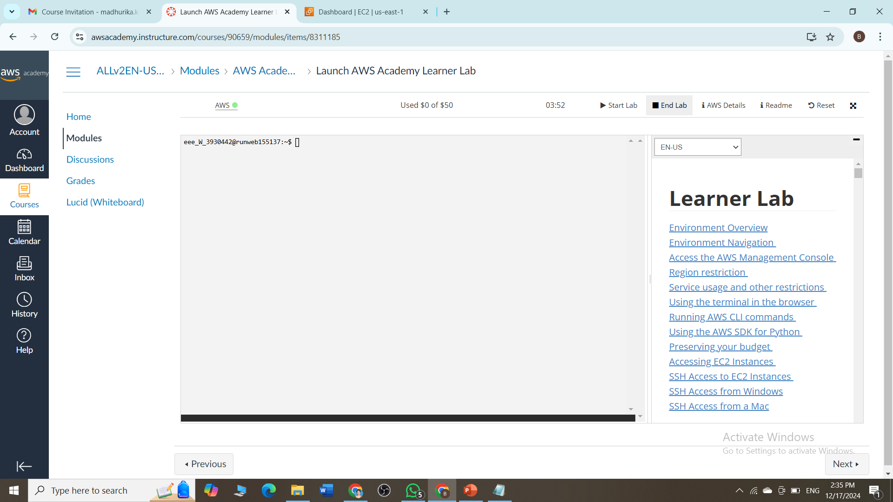
Once your lab work is done, click on end lab

Slide 28
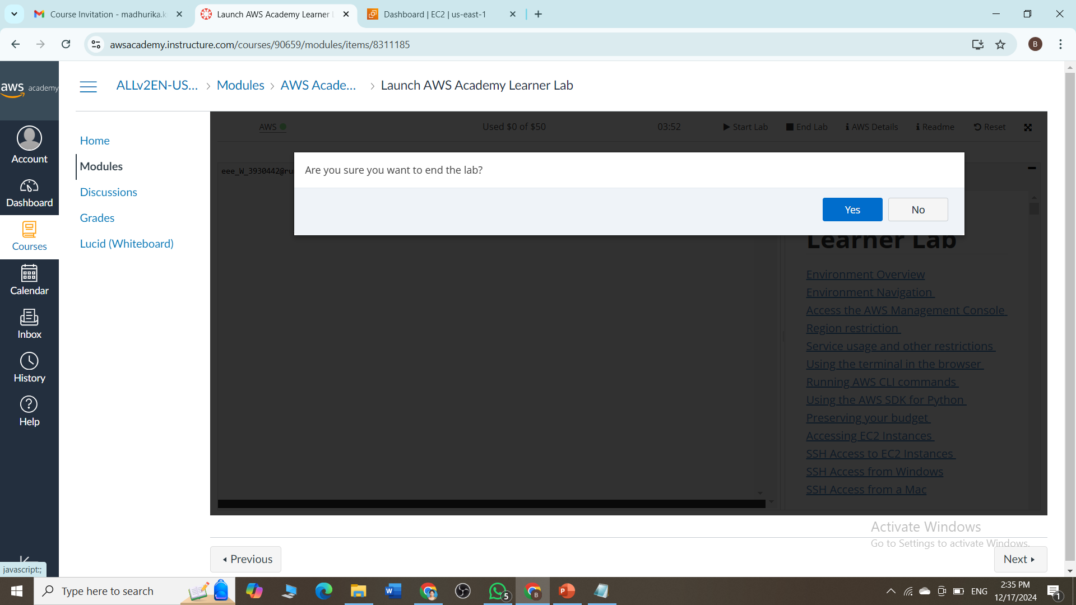
Click on yes to end the lab

Slide 29

Once you get the red color dot beside aws, it indicates stopped

