Slide 1

Dynamically Adaptable Software
Is All About Modeling Contextual Variability and Avoiding Failures
Presented by: Team 11
  Cameron L’Ecuyer
  Ruthvic Punyamurtula
  Sneha Mishra
  Navya Pillala

Slide 2

Dynamically Adaptable Software
Dynamically Adaptable Software (DAS) – self-adapting software that changes based on gathered context information
DAS can be considered a dynamic product software line (DSPL)
DSPLs use variability modeling to handle the diversity of their scopes

Slide 3
DSP Modelling
One of the most effective variable modeling techniques (VMTs) was context-aware feature modeling (CFM)
eCFM or extended CFM was created to handle limitations of CFM

Slide 4
Developing eCFM
Literature was reviewed to find the main VMTs
The VMTs were evaluated to find the top 10 models
The top 10 were then evaluated based on 12 criteria
Tropos Goal Model (TGMC) and CFM were found to be the best
CFM was found to be more effective than TGMC, although it had limited expressiveness
eCFM was developed to address limitations of CFM

Slide 5
Model Checking
Used to verify a systems behavior
Requires a model of the system’s behavior and a set of properties
Model checking tools can use this information to verify the model
Adaptive Modeling Transition Systems can model evolution of the environment and system
Dynamic Feature Transition Systems make up for some short comings of AMTSs

Slide 6
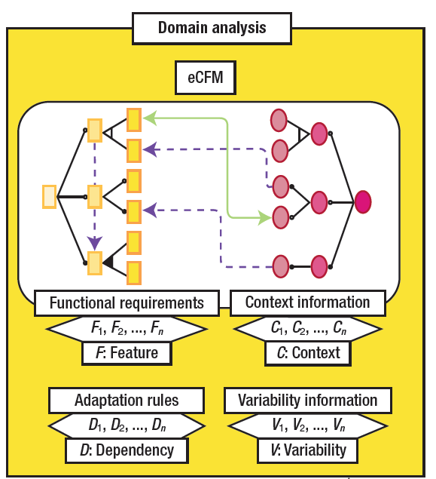
Approach to model checking DAS
Domain Analysis
Four main elements in DAS
Functional requirements – features
Context information – states
Variability information – mandatory/
optional/group/xor
Adaptation rules –
feature dependencies

Slide 7
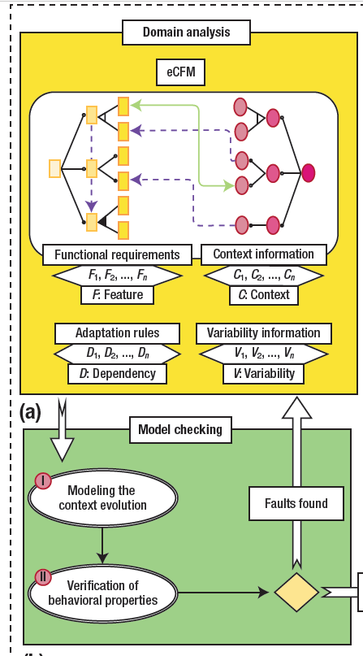
Approach - Ctd
Model Checking
Four main elements in DAS :
Functional requirements – features
Context information – states
Variability information – mandatory/
optional/group/xor
Adaptation rules –
feature dependencies

Slide 8
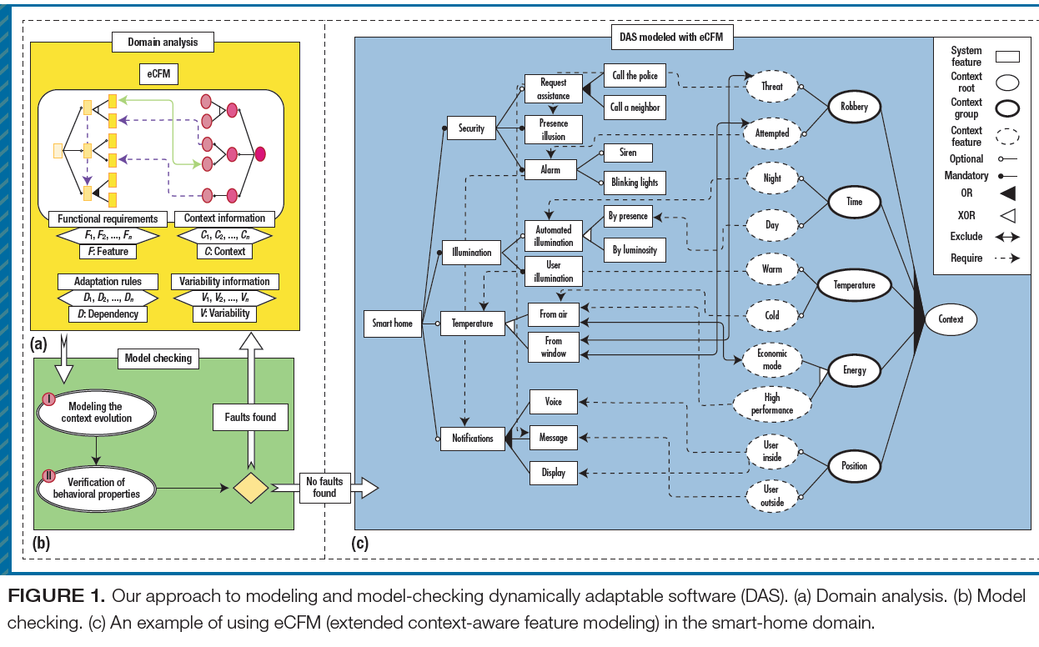
eCFM – Smart Home

Slide 9
eCFM – Main concepts
Context feature – active/inactive state of software
Context group – context features that can specify OR/XOR group relationship
Context root - model’s root and aggregates the context groups in an OR relationship
Organize context features into categories
Can model constraints among context features

Slide 10
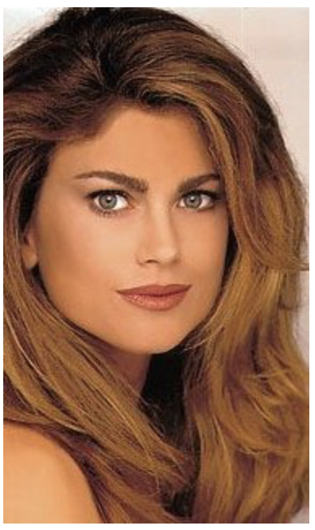
Model Checking with eCFM
What is Model Checking?
This kind of model??
Unfortunately, no….
Reference: https://courses.cs.washington.edu/courses/csep590/03su/Lectures/lecture1.ppt

Slide 11
Model Checking with eCFM
Engineers created a context evolution model.
Engineers use the information obtained from the DAS domain analysis to specify an eCFM model.
Engineers check the behavioral properties against the DAS’s adaptive behavior.

Slide 12
DAS behavioral properties in context of eCFM.
Configuration correctness - specifies that each DAS configuration at run time should conform to eCFM rules.
Rule liveness - specifies that each context feature must be active at a given instant.
Interleaving correctness - specifies that each adaptation rule is applied to the DAS, even when there’s an interleaving of adaptation rules.

Slide 13
Model Checking with eCFM
Feature liveness - specifies that each system feature should be active in some DAS configuration.
Variation liveness - specifies that each system feature should be activated in some DAS configuration and deactivated in another one.

Slide 14
Evaluation
CFM’s and eCFM’s are evaluated on two metrics
Expressiveness
Ease of use

Slide 15
The expressiveness of CFM and eCFM is calculated using likert scale.
The results indicated that 93.3 percent agreed or totally agreed that eCFM is more expressive than CFM.
Understanding contextual variability modeling eCFM,86.7 percent; CFM, 13.3 percent

Slide 16
Modeling DAS elements eCFM, 80 percent; CFM, 20percent
Including new elements—eCFM,80 percent; CFM, 20 percent
Modeling complex scenarios of DAS projects—eCFM, 100 percent.

Slide 17
Tips for Working with Dynamically Adaptable Software
Use suggestive context and feature names
Avoid using the exclude dependency.
Define context groups according to the context source.
Perform model checking as early as possible.

Slide 18
Thank You
Presented by: Team 11
CS5551 - ASE

