Slide 1

Is It Worth Responding to Reviews? Studying the Top Free Apps in Google Play
Critique by : Team 11
Ruthvic Punyamurtula – 30
Cameron L’Ecuyer – 17
Sneha Mishra – 21
Navya Ramya Sirisha - 26

Slide 2
Summary
Process of users reviewing the apps and developers responding to the reviews
Data : Tops apps (12000) in 30 categories, from Google play Store
Reason : Users Reviews Developer’s Profit
Criteria : A year before apps, as they tend to be stable
Collection : Web crawler extracts app names, ratings and comments
The crawler ran from 1 January to 2 March 2014 and during that time 10,713 apps data was collected
Limitation : only 500 latest reviews per app are accessible and could be collected by crawler
Manual analysis : Time consuming and iterative – grouping reviews
Automated analysis : Phase 1 - separated reviews into 25 groups, Phase 2 – observed the responses and rating changes

Slide 3
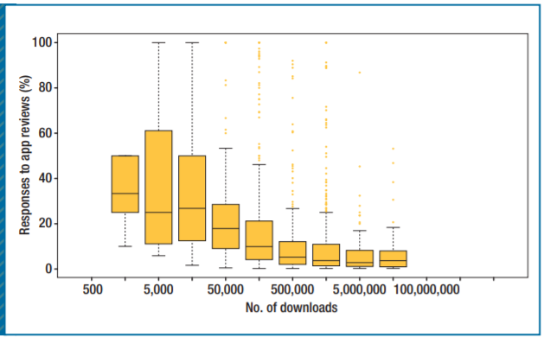
Results
Developers of only 13.8% of the 10,713 apps responded
Found that 38.7% of users increased their rating after a response
Median increase was one star (20 percent)
Avg rating for the apps whose developers did not respond was only 1.7 stars
Positive Aspects
Connecting Developers and users directly
Identifying the most common issues and responding in priority
Varied devices and versions have various outcomes
Categorizing the reviews and analyzing the reports
Improved ratings and app functionality

Slide 4
General Criticisms
Positive Criticism – the study attempted to investigate an area that had no previous research done on it, and they attempted to do it in an empirical way, and they are aware that their approach has limitations
Negative Criticism – the study only focused on the Google Play App store’s free apps, and only used data from 2013, and looked at apps that were popular a year before

Slide 5
Negative Aspects
App popularity was based off one source, Distimo
Some apps may be limited by the phone and operating system type
Limitations in the app stores prevent getting a full picture from the reviews
Only apps from one year prior were considered for the study
The window for observing change was only 20 days in April
Very few developers responded to reviews(around 14%)
Limited understanding of an apps domains limited the analysis
Non English language, or incoherent reviews were put in the same category

Slide 6
Questions
How do we determine the value of responding to reviews for any particular App and why did we focus on the top apps only?
If responding via responses can produce benefits for any apps, then won’t it alter the client’s requirements? What exactly is the focus of these responses ?

Slide 7
Questions (cont’d)
Which analysis is better to convince that developer’s response could increase the rating ? And in what terms ?
Can the research be relied on data provided by Distimo - the single source ?
Reviews in other languages are separated, what % of them were not considered which could impact the research?

Slide 8
Thank You !

