Slide 1

Building a drug ontology based on RxNorm and other sources
Ruthvic Punyamurtula
CS5560 - Knowledge Discovery and Management

Slide 2

Contents
RxNorm
CheBI
Drug Data, PRO, Drug BANK
Background
Inception – DrOn
Critique
Data Transformation
RDBMS & OWL
General Criticism & questions
Data
Ontology
Drug data
Data
Map
link
Data
Entity
Mechanoism

Slide 3
Background
Existing ontology resources
- RxNorm, ChEBI, SNOMED, DrugBank etc.,
None have historically comprehensive list of National Drugs Code
Inconsistent and Incorrect Description from artifacts
No inter operability with other ontologies

Slide 4
Inception - DrOn
Correct, Consistent, interoperable,NDCs
Used existing resource – base data, restructured, public availability
RxNorm : free, large data, normalized drug names
Historical NDCs, from 2008

Slide 5
Inception - DrOn
Correct, Consistent, interoperable,NDCs
Used existing resource – base data, restructured, public availability
RxNorm : free, large data, normalized drug names
Historical NDCs, from 2008

Slide 6
Critique – Extracting information from RxNorm
RxNorm maintains only active NDCs
What about lost/retired NDCs ? Is it consistent ?
RxNorm itself was completely consistent
5(out of 9) RRF files are processed

Slide 7
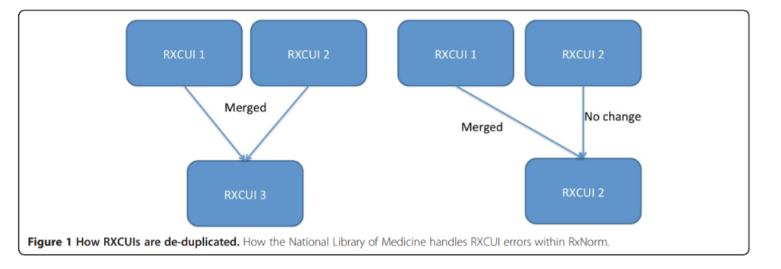
Critique – Extracting information from RxNorm
No reason why a particular RXCUI is designated as “Error” – no further processing
RXCUIs which are split - difficult to track

Slide 8


Critique – Mapping to ChEBI
Label/Related-synonym/Exact synonym
Few do not have mapping entity in ChEBI (processed material)
No information regarding Somatropin -> growth harmone
protein ontology
RxNorm Ingredients
ChEBI URI

Slide 9
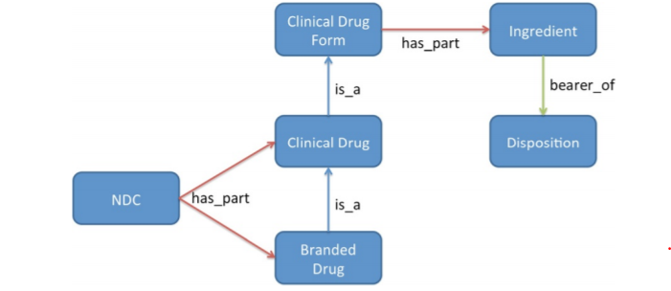
Data Transforming
Entities from RxNorm
Separate tables/Entity
Many-Many relationship
Coupled data

Slide 10
RDBMS & OWL 2.0
Ingredients (molecule types)
Disposition (drug mechanism)
Clinical Drug From
(Form/route)
Clinical Drug
(level of dosage)
Branded Drug
(name)

Slide 11
Critique – DrOn & questions
DrOn serving many use cases is not justified
Stats – 514268 (MIREOTed 2, OWL 51, ChEBI 1885, PRO 2, rest from RxNorm) – Easy development and high scalability, modularity
Several unused sub classes – capsule, tablet etc., (reorganizing structure and db schema)
Validation – Acetaminophen (found all NDCs)
No linking of drug to dosage forms (ex : inhaler)
Lacks logical definition of some terms
Requires regular manual intervention

Slide 12
Thank you
References
https://jbiomedsem.biomedcentral.com/articles/10.1186/2041-1480-4-44
https://www.ncbi.nlm.nih.gov/pubmed/24345026
Ruthvic Punyamurtula

