Slide 1
Restaurant Location – Recommender System
Submitted by
Ruthvic Punyamurtula
IBM Data Science Professional Coursera Capstone

Slide 2
Introduction
Manhattan is the most densely populated of New York City’s 5 boroughs.
It's mostly made up of Manhattan Island, bounded by the Hudson, East and Harlem rivers.
Among the world’s major commercial, financial and cultural centers, it’s the heart of “the Big Apple”.
New York City has been called both the most economically powerful city and the leading financial center of the world, Manhattan is home to the world's two largest stock exchanges, the New York Stock Exchange and NASDAQ.
Manhattan has high population with a population density of 72,918.4/sq mi as of 2017.

Slide 3
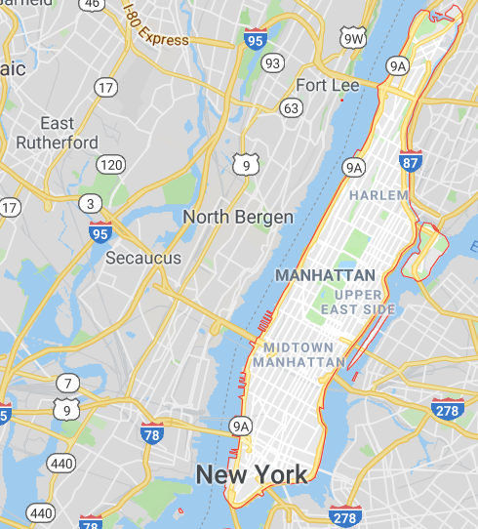
Business Problem
Due to its dense population there is a huge increase in demand for restaurant business and Manhattan is an ideal place to open a restaurant.
A newbie in restaurants chain plans to open their branch in Manhattan, New York City and the vendor does not have any idea in picking an ideal location which is economic as well as profitable to them.
So I being a data science practitioner would like to analyze the data and help them pick a right place.

Slide 4
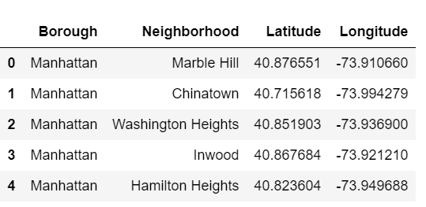
Data Description
The dataset used for this project is the json data of New York City and is available at https://ibm.box.com/shared/static/fbpwbovar7lf8p5sgddm06cgipa2rxpe.json
The data contains info about all the Borough, its neighborhood and their Latitude, Longitude info.
we will use FourSquare developer API
to extract data for all the restaurants
in Manhattan

Slide 5
Methodology
The location data of Manhattan, New York City is downloaded in the format of JSON files, which is then converted to a panda’s data frame
Import Folium library, to display map of Manhattan city and its neighborhoods
Gather data of all the existing Restaurants of Manhattan with the help of FourSquare API and store it in panda’s data frame
Then based on postal codes, restaurant were grouped to determine the density. Below is the current restaurants of Manhattan city
Then one hot encoding is used to convert the categorical variable (for our scenario, restaurant name variable is used)
I used for K-mean clustering on the preprocessed data. Since K-mean clustering is an efficient model for pattern recognition, data segregation and comparison

Slide 6
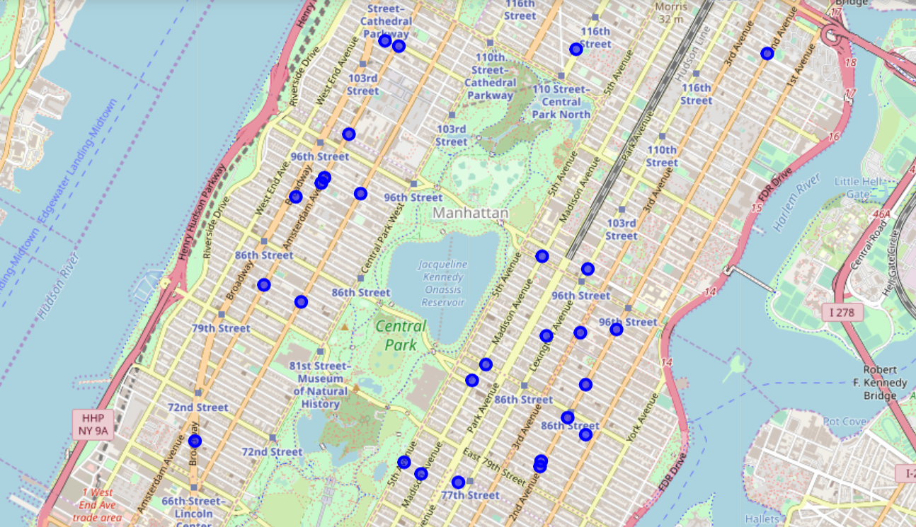
Maps
Identified the locations and marked them using Folium

Slide 7
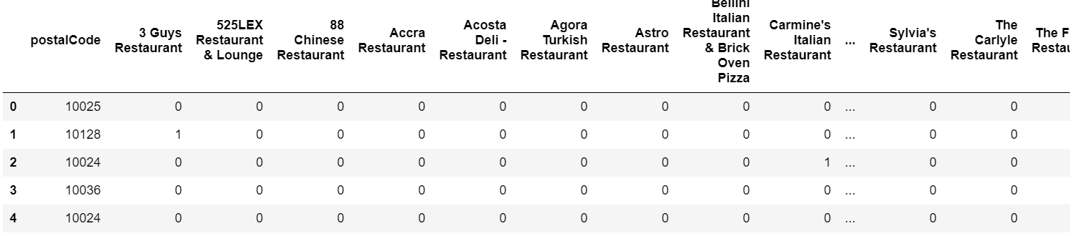
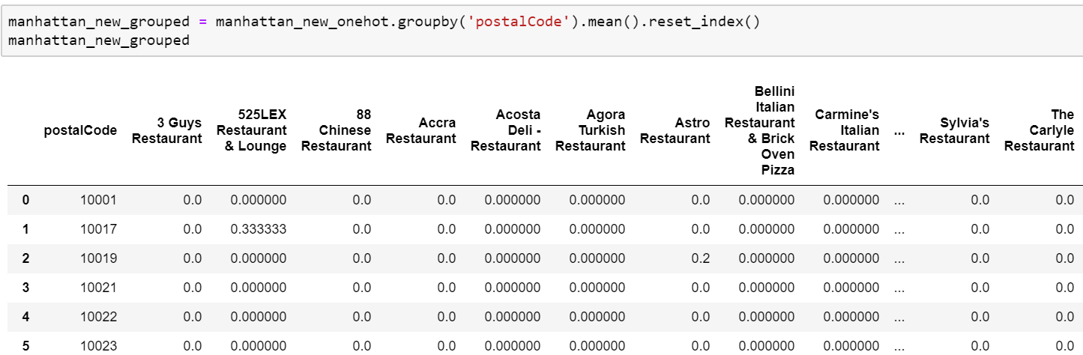
Data Processing
One hot encoding Grouping based on postal codes

Slide 8
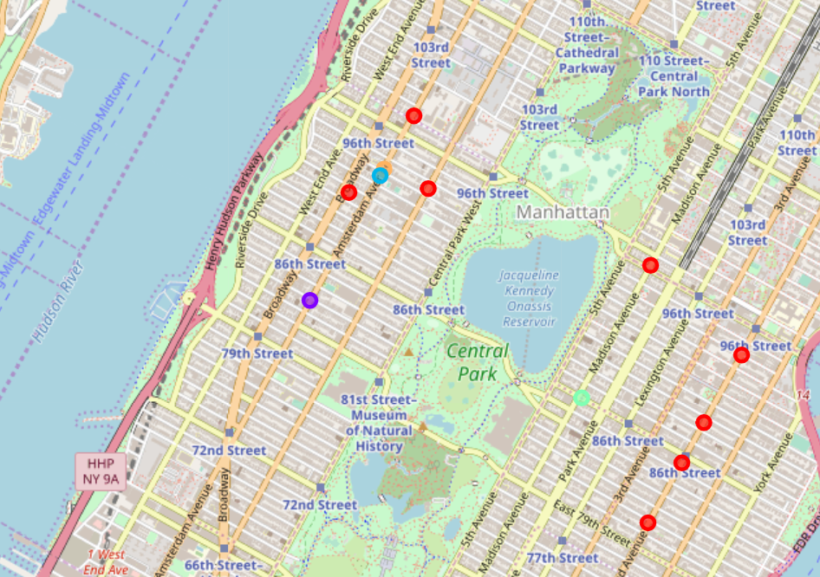
Results
k-mean clustering is performed using 5 clusters.
The results showed that some of the locations have a higher density of cafes while some other has lower density of restaurants.
Hence, places with low density will be ideal for opening restaurants.

Slide 9
Recommendation
Based on the business analysis of the restaurant density. The neighborhood regions under postcode 10024, 10029, 10027 are optimal for opening a restaurant.

Slide 10
Conclusion
In this project we aimed to do a business analysis to find a suitable location opening a new restaurant in Manhattan of New York City using the Manhattan data and FourSquare data. I choose k-mean which clustered the restaurant according to postal code. After analyzing the cluster, we found the best place to open a restaurant.

Slide 11
Thank You for your time
Ruthvic Punyamurtula

