Slide 1
Detecting Ransomware Before Encryption: AI-Based Network Anomaly Detection
Balancing Automated Detection with AI Governance
Ruthvik Nath Bandari
AI for Cybersecurity, Module 1 Assignment
September 2026

Slide 2
Ransomware: Present in 44% of Data Breaches
— Ransomware is now present in 44% of data breaches, up 37% year-over-year (Verizon,
2025).
— Median ransom payments reached US$115,000; still, 64% of victims refused to pay
(Verizon, 2025).
— Average cost of an extortion or ransomware incident reaches $5.08 million when disclosed
by the attacker (IBM, 2025).
— This presentation examines whether AI-based anomaly detection can mitigate
ransomware, and where it falls short.
2
Notes:
I will examine how AI-based network anomaly detection can help catch ransomware before encryption, using my own lab results as evidence.

Slide 3
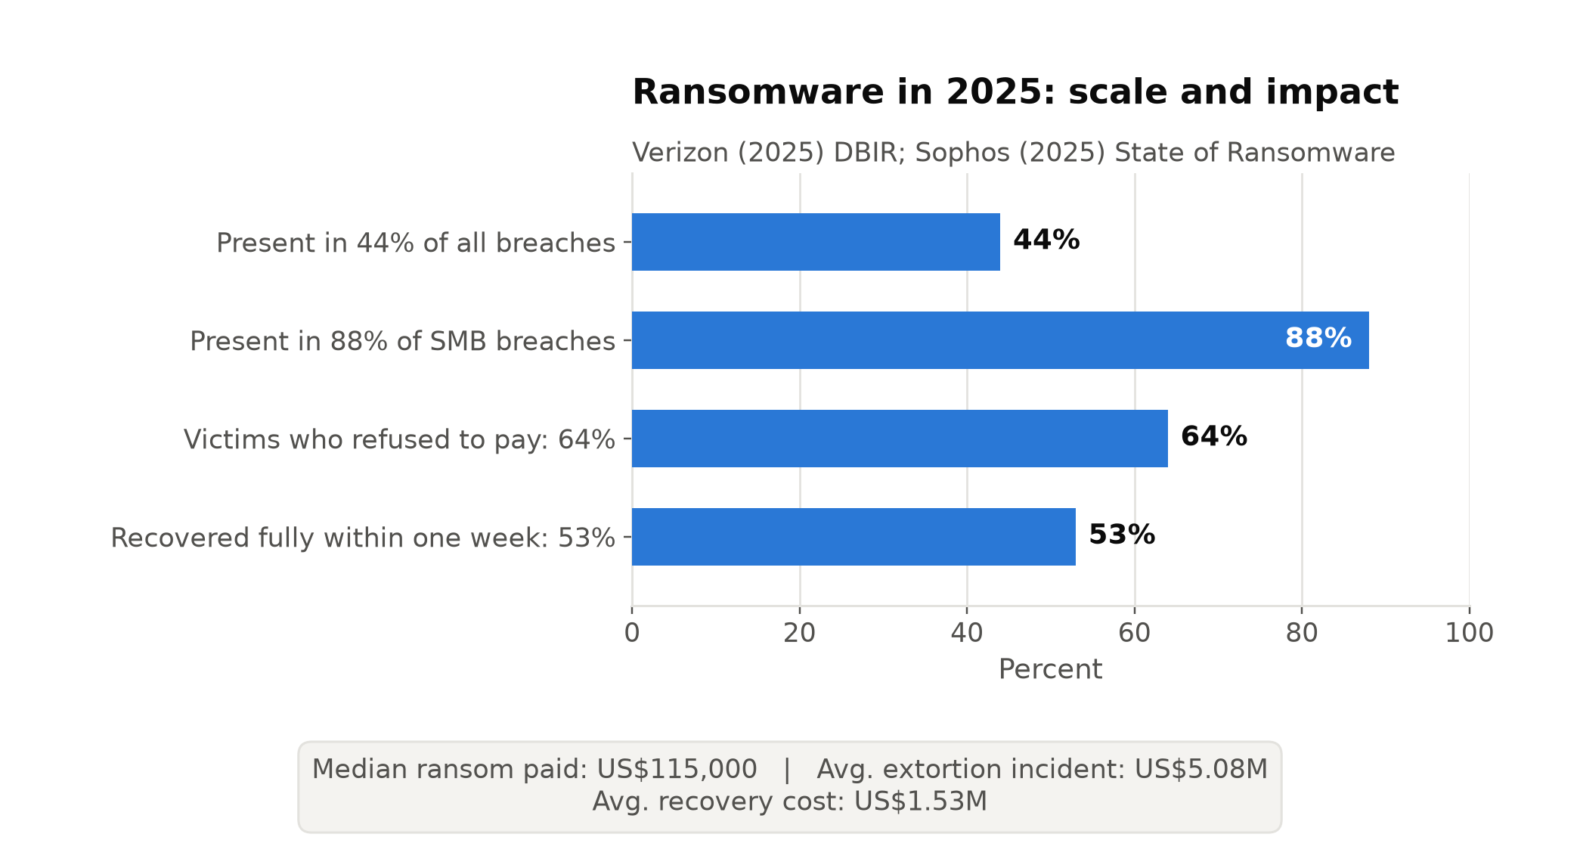
How Ransomware Escalates and What It Costs
— Ransomware appears in 44% of
breaches overall, and 88% of breaches
at small and medium businesses
(Verizon, 2025).
— Attacks rose 37% year-over-year;
median ransom payment reached
US$115,000 (Verizon, 2025).
— The kill chain includes
command-and-control beaconing prior to
deployment and lateral movement
flagged via abnormal SMB traffic
(Cybersecurity and Infrastructure
Security Agency [CISA] et al., 2023),
both occurring before encryption.
3
Notes:
Ransomware disproportionately hits smaller organizations. CISA notes that the damaging step, encryption, is preceded by detectable network behavior.

Slide 4
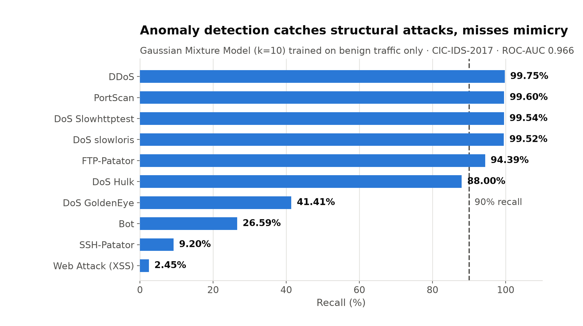
Network Anomaly Detection: Catching
Ransomware Before Encryption
— Parisi (2019, ch. 5): model normal network behavior
statistically (Gaussian density, clustering); flag
deviation from that baseline as anomalous.
— C2 beaconing and lateral movement are
network-visible deviations from baseline that occur
before encryption (CISA et al., 2023).
— My lab: a Gaussian Mixture Model (k=10), trained on
1,243,352 benign flows only, reached ROC-AUC
0.9655 on 627,314 held-out flows.
— Near-perfect recall on structural attacks (PortScan
99.60%, DDoS 99.75%) but weak recall where traffic
mimics normal sessions: SSH-Patator 9.20%, Bot
26.59%.
— The model catches some attack stages reliably and
misses others entirely.
4
Notes:
My own reproduced results on CIC-IDS-2017 show this concept in action: the model catches loud, structural attacks almost perfectly but struggles with attacks designed to look like normal traffic.

Slide 5
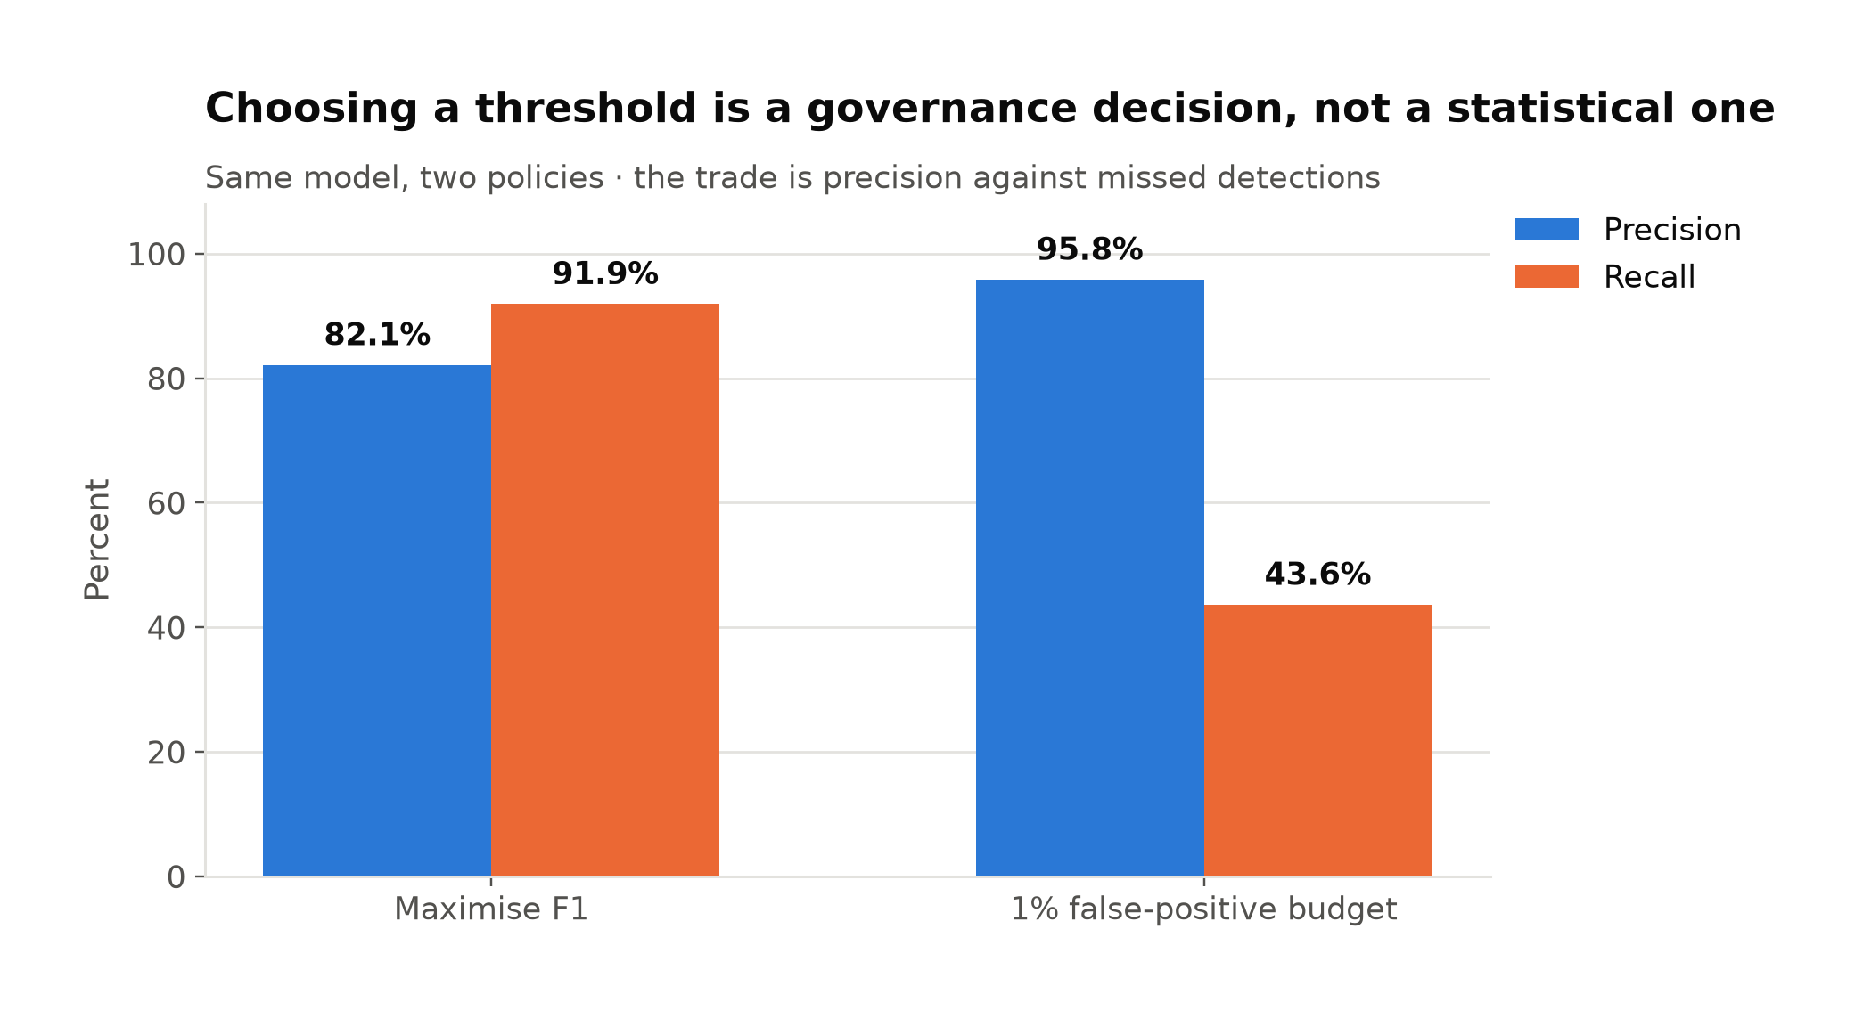
AI Governance: What Makes Automated Response
Safe
— An anomaly-detection IDS makes automated,
consequential decisions (blocking traffic,
quarantining hosts) at a chosen false-positive budget.
— My lab: a 1% false-positive budget yields 95.8%
precision at 43.6% recall, a governance decision
about acceptable harm.
— 63% of breached organizations either lack an AI
governance policy or are still developing one (IBM,
2025).
— One in five organizations reported a breach due to
shadow AI, and only 37% have policies to manage AI
or detect it (IBM, 2025).
— NIST's AI Risk Management Framework supplies the
thresholds, auditability, and oversight needed before
autonomous response is trustworthy (National
Institute of Standards and Technology, 2023).
5
Notes:
Choosing where to set the false-positive threshold is itself a governance decision: it determines how much harm from false alarms an organization accepts before it lets a model act autonomously. IBM's data shows most breached organizations haven't formalized that decision-making process.

Slide 6
Deploying Anomaly Detection Under AI
Governance
— Anomaly detection is most useful as an early-warning layer that still depends on a defined
false-positive budget and a person to authorize action beyond that threshold.
— My own lab work, comparing a single Gaussian model to a Gaussian Mixture Model, taught
me that model choice and threshold selection are inseparable, risk-based governance
decisions.
— Any future deployment of this model would need a documented threshold, an audit trail,
and a named person accountable for what it flags.
6
Notes:
This course taught me that AI in cybersecurity is a set of statistical choices with real consequences.

Slide 7
References
Cybersecurity and Infrastructure Security Agency, National Security Agency, Federal Bureau of Investigation, & Multi-State Information Sharing and Analysis Center. (2023). #StopRansomware guide (Version 3.0). Cybersecurity and Infrastructure Security Agency. https://www.cisa.gov/sites/default/files/2025-03/StopRansomware-Guide%20508.pdf
IBM. (2025, July 30). IBM report: 13% of organizations reported breaches of AI models or applications, 97% of which reported lacking proper AI access controls [Press release]. https://newsroom.ibm.com/2025-07-30-ibm-report-13-of-organizations-reported-breaches-of-ai-models-or-applications,-97-of-which-reported-lacking-proper-ai-access-controls
National Institute of Standards and Technology. (2023). AI risk management framework (AI RMF). U.S. Department of Commerce. https://www.nist.gov/itl/ai-risk-management-framework
Parisi, A. (2019). Hands-on artificial intelligence for cybersecurity. Packt Publishing.
Verizon. (2025). 2025 data breach investigations report. https://www.verizon.com/about/news/2025-data-breach-investigations-report
7

