Slide 1
Machine Learning-based Test Power analysis
Notes:
Niharika

Slide 2
Team members
Niharika Manhar (B20CS038)
Ruthvik K (B20AI037)
Notes:
Niharika

Slide 3
INTRODUCTION
Manufacturing is an important part in chip development and production process. The goal is to find defective chips. In order to ensure timely and cost effective testing non-functional operating conditions are created. This in turn creates power issues. The non-functional operating conditions exceed the power specification. This leads to unreliable test results and chip damage.Therefore, tests have to be checked in advance to ensure that they meet the power requirements to guarantee test power-safety.
Notes:
Niharika

Slide 4
PROBLEM
Accurate power and timing simulations need considerable resources and excessive runtime. Furthermore, the analyses can only be performed in a very late stage of the development process close to tapeout . The complete simulation of all tests is therefore infeasible. A small subset of tests is typically chosen to be simulated accurately.
A critical issue we face here is the selection of tests covering the scenarios which can lead to power issues during the test application. So we need to identify the worst-case test power related issues by means of prediction.
Notes:
Niharika

Slide 5
SOLUTION
We propose the use of machine learning based power prediction for test selection to avoid these conditions.
Few preselected tests are accurately simulated. Training vectors and analysis results are used to train the model and then using this model to predict power analysis of target test vectors.
Advantages
Prediction time is very less as compared to actual process
Predicted values are highly reliable with small variance to actual values
Increases possibility to cover critical tests during sign-off.
Notes:
Niharika

Slide 6
MODELS APPLIED
We worked on the datasets, each with different set of columns to test how would it affect the test power accuracies.
The models we used are listed below:
Linear regression
Ridge regression
Nearest neighbours regression
Decision tree regression
Random forest regression
Neural network regression
Notes:
Ruthvik

Slide 7
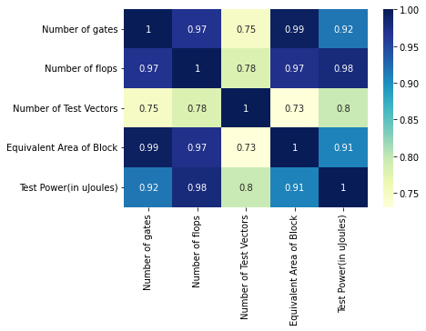
Dataset 1
The first dataset had the following columns: number of gates, number of flops, number of test vectors, equivalent area of block, and test power which is the output value.
The correlation matrix is shown here.
Notes:
Ruthvik

Slide 8
We have analyzed the dataset where we consider the features that are mentioned above and implemented various kinds of algorithms and calculated the mean square error for each of them and tried to decrease the mean square error. The best result we are getting is from using Linear Regressor and it is 9.688475288523276e-25.
We further focussed on the features which actually make an impact on Test Power.
The training data set is important for the tuning of the generated model. Typically, the larger the training test is, the smaller is the error between the predicted value and the actual value.
Notes:
Ruthvik

Slide 9
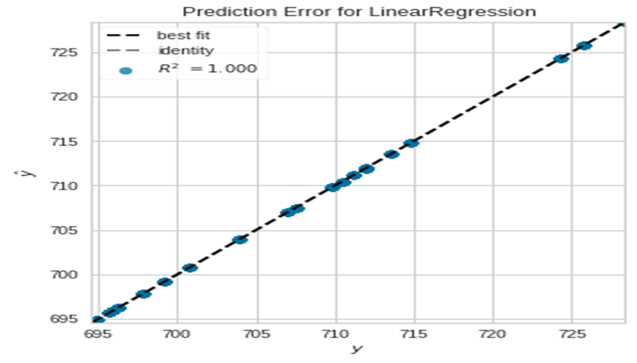
Visualization:
The R2 score is almost 1 and the predicted values almost overlap the test values, as the MSE is very less.
Notes:
Ruthvik

Slide 10
For this dataset we also performed regression analysis using different ensemble learning methods along with the usual models. That is Random Forest, Bagging and Boosting Regressors.The MSE’s for the Ensemble Learning Models were
mean square error using Random Forest Regressor: 9.688475288523276e-25
mean square error after Bagging: 3.7010520121940847e-25
mean square error after Boosting: 0.0007794173805528917
Notes:
Ruthvik

Slide 11
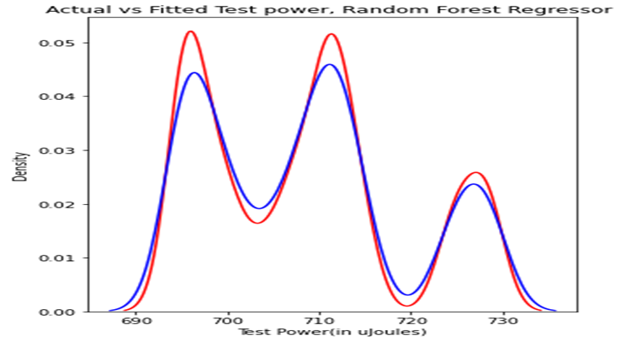
Visualization:
Similar plots were obtained while performing regression using Bagging and Boosting techniques.
Notes:
Ruthvik

Slide 12
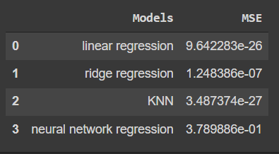
And for the usual models the MSE’s obtained were:
Notes:
Ruthvik

Slide 13
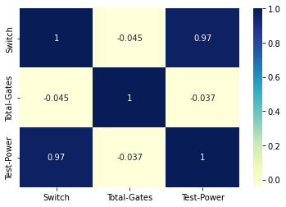
Dataset 2
Considering the No of switches in the test vector as a separate feature i.e;finally with No of switches and total gates as features with Test Power as target we implemented the models.
Notes:
Niharika

Slide 14
We tried to implement the regression models considering test vectors of size 50 and total gates using these some regression models we have done the prediction and this did not give any result as the size of test vector is 50 and that float value could not fit in the regressor models.
So we took Number of Switches into consideration instead of the Test Vector of size 50 and did the further analysis.That is considering the features as No of Switches and Total no of gates with target as Test power we implement the regression models.
Notes:
Niharika

Slide 15
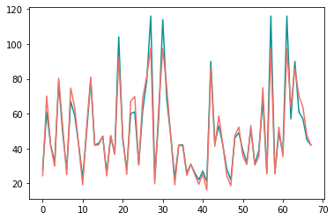
Applying Ridge Regression, MSE obtained is
35.527891743811495
Here is the Visualisation of predicted values and test values, we can see some values are not predicted correctly, blue lines appear clearly above the red ones.
Notes:
Niharika

Slide 16
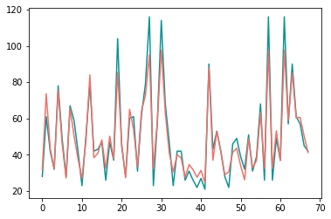
Applying KNN model, MSE obtained is
44.24764705882354
Even here we can clearly see some of the predicted values are not correct comparing it with Ridge Regressor from the plot we can see the blue lines appear more on Knn model so predictions done by Ridge Regressor is better than Knn, MSE’s also show us the same.
Notes:
Niharika

Slide 17
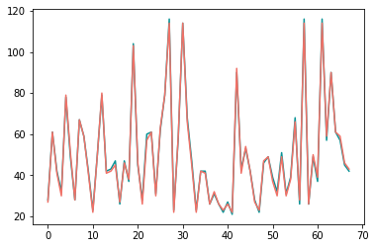
Applying Decision Tree Regressor model, MSE obtained is
1.7205882352941178
This model is better considering the models implemented before we can clearly see it through the plot and even with MSE.
Notes:
Niharika

Slide 18

Applying Random Forest regressor, MSE obtained
1.0709322433407087
The plot is almost same as that of Decision tree model even the MSE is almost same, But by a small margin this model is better than the decision tree model .
Notes:
Niharika

Slide 19

Applying Neural Network regressor, MSE obtained is
0.8796303817055585
This is the best prediction, we can clearly see how there is almost an entire overlap of both predicted and actual Test Power.
Even the MSE is very less compared to all the models implemented before.
Notes:
Niharika

Slide 20
As neural network was giving the best result we wanted to check how the MSE updates by increasing epochs by applying Artificial Neural Network Model, building this model with the help of three hidden layers and from tensorflow using Sequential() class to develop our neural network with appropriate activation functions and perform the forward propagation, Now after this for backward propagation we use Adams Optimizer and loss function considered is MSLE() mean squared logarithmic error. Then training the model we analyse how the MSLE varies with change in epochs.
Notes:
Ruthvik

Slide 21
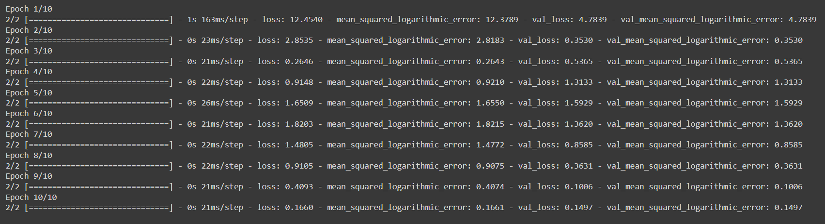
Notes:
Ruthvik

Slide 22
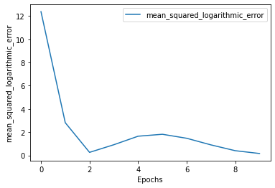
We can observe how the MSLE values decrease with increase in number of epochs.
Notes:
Ruthvik

Slide 23
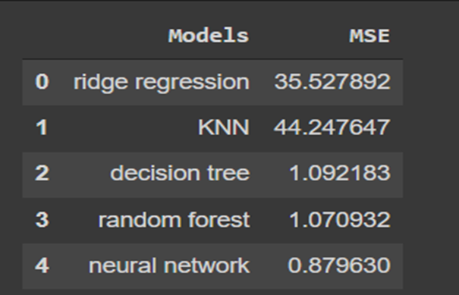
Final Comparison of the models we implemented:
Notes:
Ruthvik

Slide 24
Conclusion:
Here, the Neural Network-based learning algorithm has been found to be the best in terms of run time and error rate. Overall, it has been shown that machine learning-based prediction is an effective alternative to the accurate simulation of all test patterns to identify power-critical tests when the latter is infeasible.
Notes:
Ruthvik

