Slide 1

Analyzing and Prediction of AMCAT Scores

Slide 2
About me
I’m Dwarasala Ruthvik Reddy , I have recently completed my Graduation from Raghu engineering college , in the stream of Information Technology.
Why you want to learn Data Science
I want to learn data science because it combines my passion for problem-solving with the ability to uncover patterns and insights from data. In today's world, data science skills are highly sought after across various industries, opening up numerous exciting career opportunities.
By mastering data science, I can contribute to better decision-making and drive innovations that have a positive impact on businesses and society. Additionally, the field of data science is continuously evolving with new technologies and methods, offering endless opportunities for learning and growth, which keeps me motivated and engaged.
LinkedIn URL : https://www.linkedin.com/in/ruthvik369/
Github URL: https://github.com/Ruthvik08

Slide 3
Objective of the Project
Perform comprehensive univariate and bivariate analysis to understand data distributions,detect outliers and find relationships among variables

Slide 4
Dataset Overview
The dataset contains around 40 independent variables and 4000 data points.The independent variables are both continuous and categorical in nature.The dataset contains a unique identifier for each candidate.

Slide 5
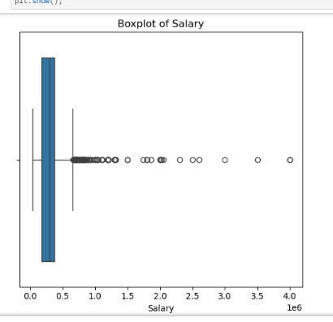
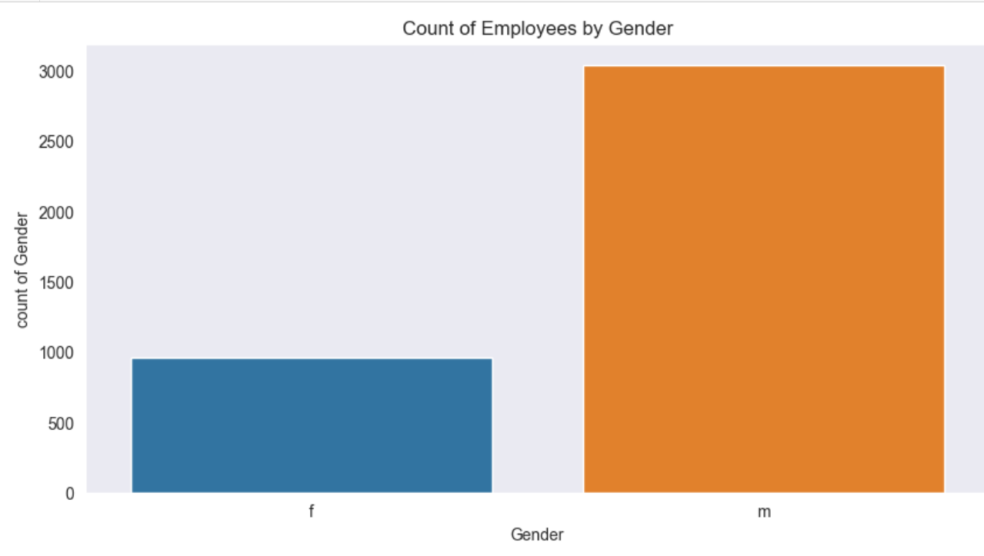
Univariate Analysis

Slide 6
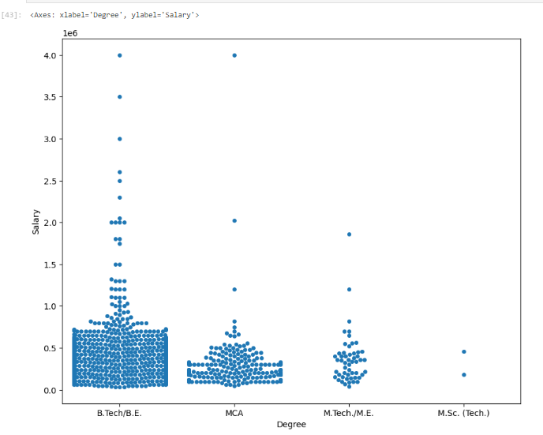
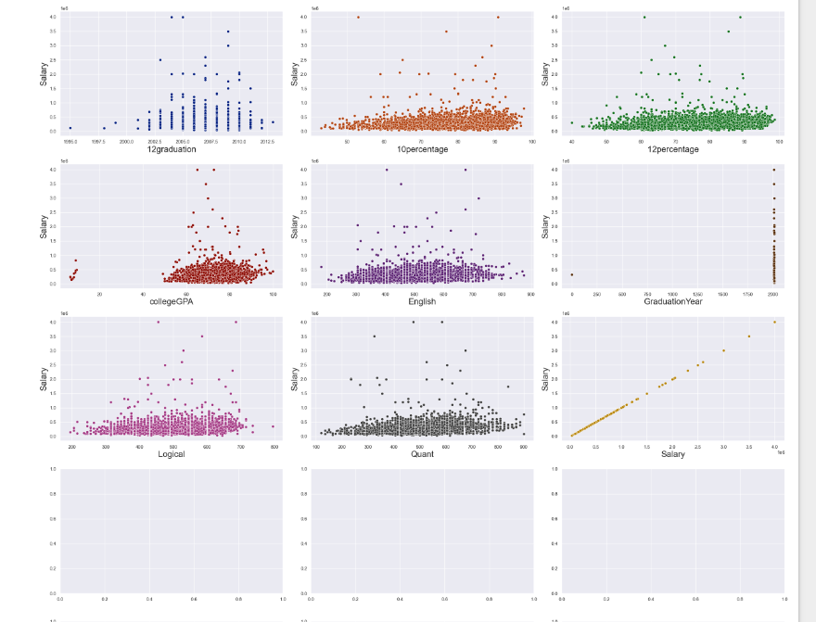
Bivariate Analysis

Slide 7
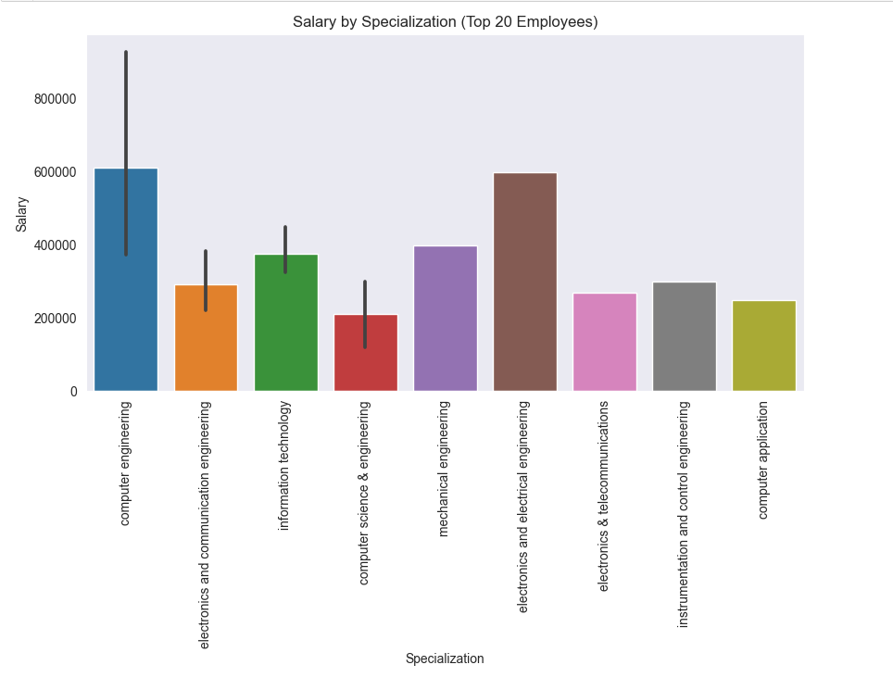
observations
This barplot shows the average salary for each specialization among the top 20 employees.The height of each bar represents the estimated average salary for each specialization.

Slide 8
Conclusion
Salary Distribution: The salary distribution shows a right skew, with outliers at the higher end, indicating a few individuals earn significantly more than others.
Gender Disparity: Males tend to occupy more positions across cities, and there might be a salary gap favoring males.
Salary Claim Validation: Based on the dataset, the average salary for Computer Science engineers does align with or slightly exceed the claim made in the Times of India article.
Job City Insights: Certain cities, like Bangalore, have a higher concentration of employees, potentially offering better salary prospects.

Slide 9

THANK YOU

