Slide 1
Wild Animal Detection and Alert System using YOLOv8
VIDYA JYOTHI INSTITUTE OF TECHNOLOGY (Autonomous)
Department of Artificial Intelligence
Under the guidance of:
Mr. A. Vijay Kumar
Assistant Professor – AI DEPT
Team 18 – Batch 2 Members:
K. Saketh Raja(20911A3596)
S. Rohith(20911A35B6)
K. Ruthvik(20911A3594)
P. Yashwanth(20911A35A8)

Slide 2
Problem Statement
Forest Officers are struggling with manual surveillance in vast natural habitats, hindering conservation efforts. Traditional methods like periodic surveys and camera traps lack real-time data and coverage. Budget constraints and a lack of automation further impede wildlife monitoring. To address these issues, a proposed system combines deep learning and instant messaging for affordable and continuous surveillance. Utilizing edge computing and free messaging channels, it aims to enhance real-time visibility and data-driven decision-making in conservation

Slide 3
Abstract
The goal is to develop an intelligent system that can automatically detect and identify wild animals using computer vision techniques. The system should capture video from a camera, analyze each frame to detect and classify different animal species, and send alerts via Telegram when dangerous wildlife are identified near human activity.
Department of Artificial Intelligence

Slide 4
Literature Survey
Paper | Title | Abstract | Authors
IEEE | Intelligent System for Detection of Wild Animals Using HOG and CNN in Automobile Applications | This paper unveils a newer dimension for wild animals’ auto-detection during active nocturnal hours using thermal image processing over camera car mount in the vehicle. HOG and CNN are used to extract features and detect animals in images. The system was tested on real scenarios and achieved ~91% accuracy in detecting wild animals. | Yuvaraj Munian, Antonio Martinez-Molina, Miltiadis Alamaniotis

Slide 5
Literature Survey
Paper | Title | Abstract | Authors
IEEE | Advanced Wild Animal Detection and Alert System using YOLO V5 Model | An advanced wild animal detection and alert system using you only look once version5(YOLO V5) model. The system utilizes you only look once version5 (YOLO V5) object detection algorithm to identify wild animals and alert users to their presence in real-time. The system employs a camera to capture real-time video, which is then sent to a computer running you only look once version5 (YOLO V5) algorithm. When the system detects a wild animal, it sends an alert to the wild animal by playing any sounds like bullets firing. The system is expected to have a significant impact on the safety of people in areas with high wildlife populations. | C.S. Madhumathi, V. Naveen, Nallamala Akshay, M.Sanjay Kumar, M.Mohammed Aslam

Slide 6
Literature Survey
Paper | Title | Abstract | Authors
Springer | Wild Animal Detection from Highly Cluttered Images Using Deep Convolutional Neural Network | This paper proposes a wild animal detection system using deep convolutional neural networks to monitor wildlife and detect animals from highly cluttered natural images. Graph cut is used for region proposals and CNN models like VGGNet and ResNet are used for feature extraction and classification. The system achieved up to 99.9% accuracy on a camera trap image dataset. | Gyanendra K. Verma, Pragya Gupta

Slide 7
Existing system
Existing Systems for Wildlife Monitoring
Manual Monitoring: Park ranger patrols have limited coverage.
Camera Traps: Motion cameras need frequent maintenance.
Radio Collars: Expensive collars with short ranges.
Satellite Tracking: High cost collars with delayed data access.
AI Wildlife Cameras
Emerging smart cameras with AI
Limited by camera field of view
Summary: Existing solutions have limitations like high costs, irregular coverage, lack of real-time capabilities. Need for automated, wide-area, and real-time monitoring.

Slide 8
Disadvantages
Environmental Factors: Weather conditions, lighting, and environmental factors such as vegetation density can affect the performance of computer vision systems.
High Initial Setup Costs: Implementing computer vision systems can be costly, including expenses for cameras, sensors, infrastructure, and software development or customization.
Power Requirements: Running cameras and processing equipment in remote areas can be challenging due to the need for a stable power source.
Limited Species Recognition: While computer vision can be trained to recognize specific species, it may struggle with less common or recently discovered species.
Department of Artificial Intelligence

Slide 9
Proposed System / Innovation
When a wild animal is detected, the system uses Twilio API to send an alert message with photo to a Telegram bot. Twilio provides messaging capabilities.
Uses the latest YOLOv8 object detection model to identify wild animals in real-time video capture. YOLOv8 further improves on YOLOv5 with greater accuracy and speed.
Employs a camera to capture real-time video fed into the YOLOv8 model running on an edge device or computer. Enables real-time analysis.
Telegram bot allows alerts to be delivered instantly to phones/devices of wildlife rangers or officials via the Telegram app.
YOLOv8 and Telegram bot provide faster and more reliable alerts compared to audio alerts.
Can be deployed in remote areas with just a camera and compute device running YOLOv8 and internet connectivity.

Slide 10
Objectives
Timely Alerts: Create a system that rapidly identifies the presence of wild animals near human settlements and sends immediate alerts to residents and authorities.
Accurate Detection: Develop an AI model capable of accurately recognizing various wildlife species to reduce false alarms.
Community Safety: Enhance the safety of people living near forests by providing them with advance warning about potential wildlife encounters.

Slide 11
Advantages
Continuous Monitoring: Computer vision systems can operate 24/7, providing continuous monitoring of wildlife in their natural habitats.
Remote Sensing: Computer vision can be deployed in remote or challenging terrains where human presence is difficult or dangerous.
Real-time Alerts: Computer vision systems can be programmed to send real-time alerts when specific animals or events of interest are detected.
Species Identification: Computer vision algorithms can be trained to recognize specific species or individuals within a species.

Slide 12
Methodology
Custom dataset collected and annotated for model training
YOLOv8 model trained on dataset using transfer learning
Model optimized for edge device deployment
Telegram bot integrated for real-time alerting

Slide 13
Algorithm
Input image passes through a backbone feature extractor (like CSPResNeXt) to produce feature maps at different scales.
The feature maps go through a neck module (like PANet) to enhance features.
An encoder module down samples the enhanced feature maps to produce three prediction scales.

Slide 14
Algorithm
For each scale, the model applies convolutional layers to make predictions:
Bounding box coordinates for potential objects.
Objectness scores for how likely each box contains an object.
Class predictions for each box.
The predictions from the different scales are combined and filtered to output the final detections. Low-scoring boxes are removed.

Slide 15
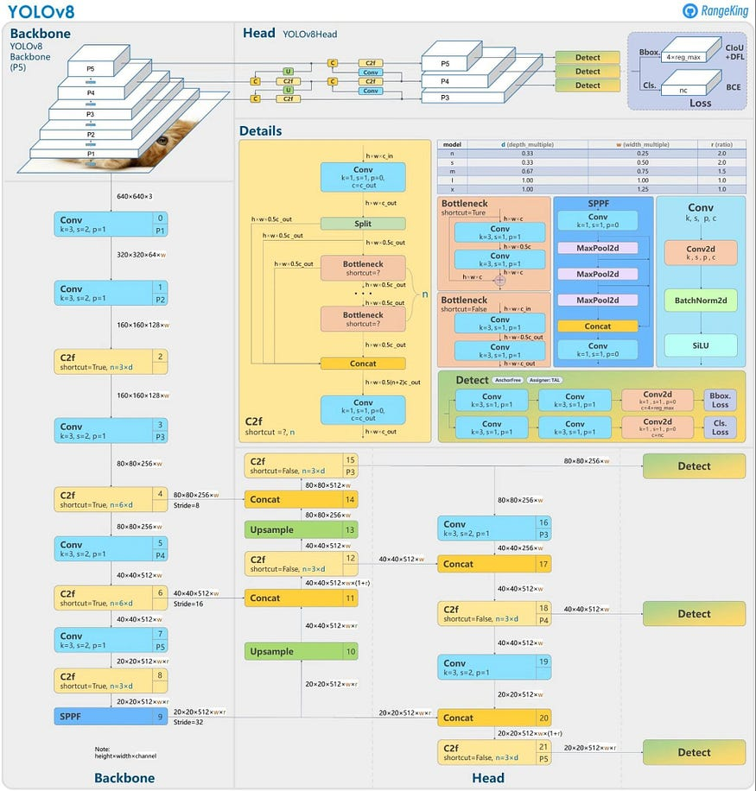
Architecture

Slide 16
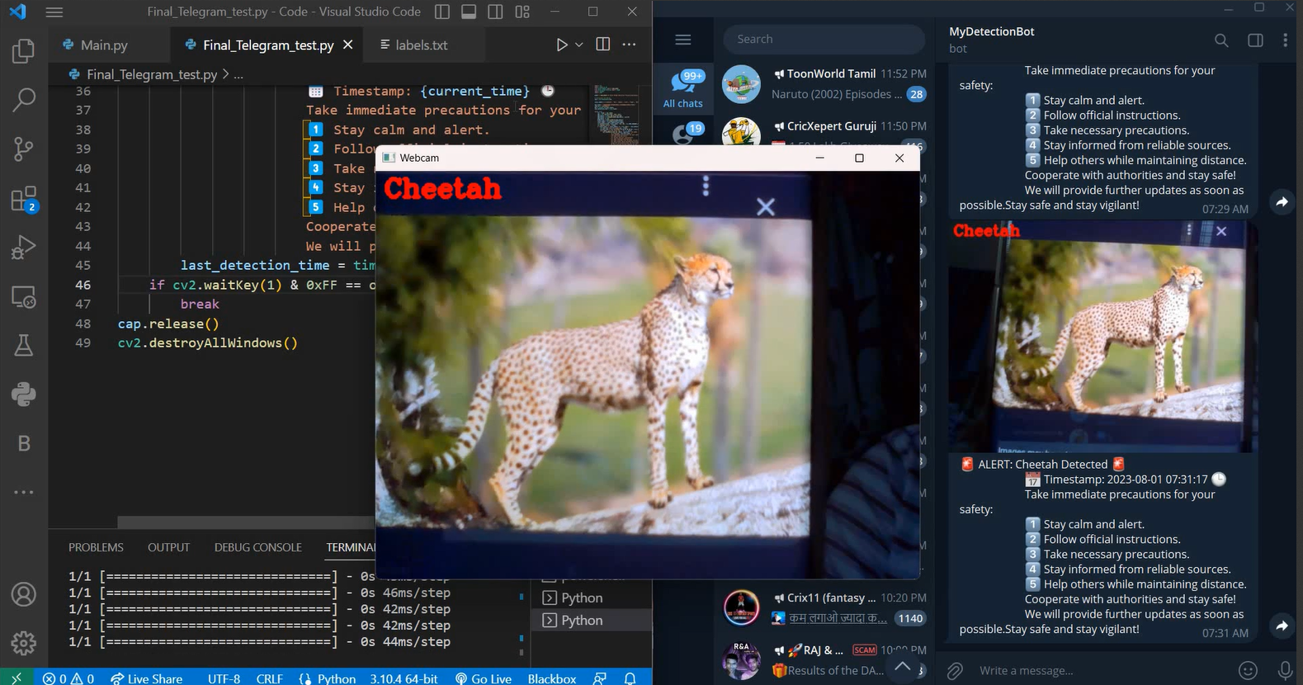
Implementation

Slide 17
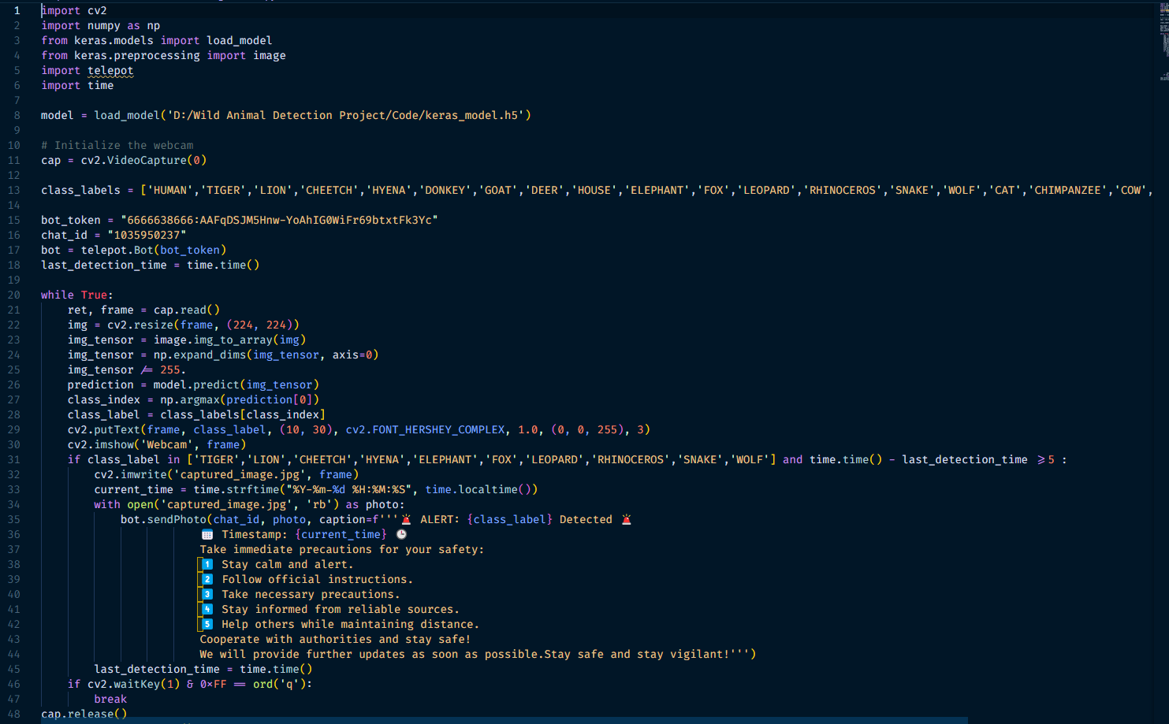
Code
Loading the trained model and classifying with pre-trained model and capturing details through telegram bot.

Slide 18
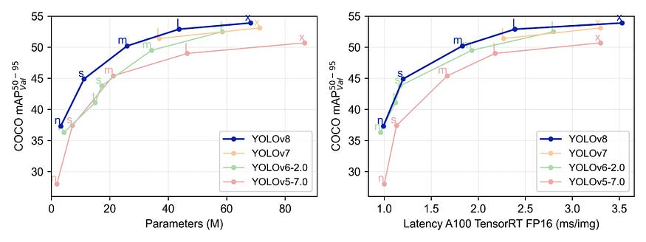
YOLOv8 vs previous versions
How does YOLOv8 compare to previous models?
The Ultralytics team has once again benchmarked YOLOv8 against the COCO dataset and achieved impressive results compared to previous YOLO versions across all five model sizes.

Slide 19
Conclusion
Our Wild Animal Detection and Alert System aims to enhance the safety and well-being of people living near forests by providing timely notifications about the presence of wild animals. By leveraging advanced AI-based detection techniques, we seek to minimize human-wildlife conflicts and foster a harmonious coexistence between communities and wildlife. Though the project is currently in progress, we are excited about its potential to make a positive impact on both human safety and wildlife conservation.

Slide 20
💐 Thank You 💐

