Slide 1
Improved STNNet: A Space-Time Neighbor-Aware Network for Drone-Based Crowd Density Estimation, Localization, and Tracking
VIDYA JYOTHI INSTITUTE OF TECHNOLOGY (Autonomous)
By : Batch-2: Team 20
V. K. Madhan [20911A35B8]
Srikari Rallabandi [20911A3572]
Anil Telaprolu [21915A3512]
Under the guidance of
Dr. Md. Nazeer
Professor
Department of AI

Slide 2
Abstract
In this research, we present an enhanced methodology for crowd counting, localization, and tracking in drone-captured scenarios. Our approach, referred to as STNNet, leverages Artificial Intelligence and Machine Learning techniques, specifically deep neural networks. We conduct comprehensive experiments on our DroneCrowd dataset, comparing STNNet with 12 existing state-of-the-art methods.
Our experimental results reveal the significance of statistical analysis in method evaluation. We meticulously formulate hypotheses, ensure consistent data collection, and employ appropriate statistical tests, such as t-tests and analysis of variance (ANOVA). These tests provide p-values and effect size measures, allowing us to assess the statistical and practical significance of observed differences.

Slide 3
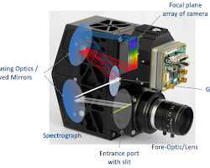
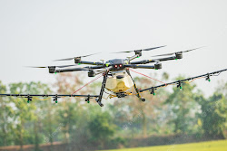
Introduction
Despite notable advancements, crowd counting and tracking algorithms face challenges when dealing with drone-captured videos. These challenges encompass viewpoint and scale variations, background clutter, and small scales. A critical impediment to the development and evaluation of these algorithms is the absence of large-scale benchmarks for drone-based crowd analysis. While some efforts have been made to create datasets for crowd counting, they predominantly focus on still images or inconsistent frames from surveillance cameras, owing to the complexities of data collection and annotation for drone-based crowd analysis.

Slide 4
Problem statement
Crowd counting, localization, and tracking in drone-captured scenarios pose significant challenges in computer vision and artificial intelligence. Accurate and efficient methods are required to estimate crowd densities, locate individuals, and track their movements from aerial footage. Existing approaches offer valuable insights but often exhibit limitations in accuracy and robustness.
This research addresses the need for an enhanced methodology that leverages deep learning techniques to improve the precision of crowd analysis in drone-captured data. The primary challenge is to develop a method that outperforms existing solutions in terms of Mean Absolute Error (MAE), Mean Squared Error (MSE), localization accuracy, and tracking performance. This paper aims to propose, implement, and evaluate such a methodology, providing statistically significant evidence of its superiority over state-of-the-art methods and contributing to advancements in the field of computer vision, artificial intelligence, and crowd analysis for aerial applications.

Slide 5
Literature survey
Paper Title | Author | Synonyms | publication
Planar Object Tracking in the Wild: A Benchmark | Pengpeng Liang Yifan Wu and Hu Lu et al. | Studied problem in vision-based robotic applications Several benchmarks have been constructed for evaluating state-of-the-art algorithms various challenging factors, like cale change, rotation, perspective distortion, motion blur, occlusion considered, | ICRA 2018 https://doi.org/10.48550/arXiv.1703.07938
Detection, Tracking, and Counting Meets Drones in Crowds: A Benchmark | Longyin Wen, Dawei Du, Pengfei Zhu | Constructed a benchmark with a new drone-captured largescale dataset, named as DroneCrowd Designed the Space-Time Neighbor-Aware Network (STNNet) as baseline. STNNet (w/o rel) produces 40.00% and 32.26% L-mAP and T-mAP scores | CVPR 2021 https://doi.org/10.48550/arXiv.2105.02440
Deformable ConvNets More Deformable, Better Results | Xizhou Zhu and Han Hu Stephen Lin et al. | reformulation of Deformable ConvNets that improves its ability to focus on pertinent image regions, through increased modeling power and stronger training Deformable ConvNets yields significant performance gains over the original model | CVPR 2018 https://doi.org/10.48550/arXiv.1811.11168

Slide 6
Literature survey
Paper Title | Author | Synonyms | publication
A benchmark for multi object tracking in crowded scenes | Patrick Dendorfer, Hamid Rezatofighi et. al. | Annotators in multiple object tracking, typically involves marking the position of each object in each frame and assigning unique identifiers to track objects across frames. Metrics for tracking benchmarks like Multiple Object Tracking Accuracy (MOTA), Multiple Object Tracking Precision (MOTP), used. Protocols define how trackers are evaluated, including the use of training and testing splits. | ICRA 2020 https://arxiv.org/pdf/2003.09003
Learning to Track: Online Multi-object Tracking by Decision Making | Yu Xiang; Alexandre Alahi et. al. | Each object's lifetime is modeled as an Markov Decision Processes (MDPs) as part of reinforcement learning and decision-making problems. Reinforcement learning is used for training agent is given reward associate to the accuracy of object associations. The MOT Benchmark is used for evaluating multiple object tracking | 2015 IEEE International Conference on Computer Vision (ICCV) DOI: 10.1109/ICCV.2015.534
Evaluating Multiple Object Tracking Performance: The CLEAR MOT Metrics | Keni Bernardin & Rainer Stiefelhagen | Precision in Estimating Object Locations: involves measuring the spatial accuracy of object predictions. Accuracy in Recognizing Object Configurations: the tracker handles object occlusions or changes in appearance | Springer 2020 https://doi.org/10.1155/2008/246309
Multi-Object Tracking on MOT21 STEP: Segmenting and Tracking Every Pixel | Weber, M., Xie, J., Collins | The Segmenting and Tracking Every Pixel (STEP) benchmark consists of 2 training sequences and 2 test sequences. dense pixelwise segmentation labels for every pixel. In this benchmark, every pixel has a semantic label and all pixels belonging to the most salient object class, pedestrian, have a unique tracking ID. | ICCV21-Workshop https://motchallenge.net/data/STEP-ICCV21/

Slide 7
Existing System
Existing system is better than 12 existing methods in terms of Mean Absolute Error (MAE) and Mean Squared Error (MSE) for density map estimation. It achieves a significant improvement over the second-best method, DM-Count, in the overall testing set.
It also excels in crowd localization, achieving the highest Localization mean Average Precision (L-mAP) score compared to other methods. It demonstrates the effectiveness of their approach in accurately localizing individuals within the crowd.
Existing method excels in crowd localization, achieving the highest Localization mean Average Precision (L-mAP) score compared to other methods. It demonstrates the effectiveness of their approach in accurately localizing individuals within the crowd.

Slide 8
Disadvantages of current implementation
Limited Context Integration
Scalability Challenges
Inferior Tracking Accuracy
Limited Adaptability to Dynamic Lighting Conditions
Inadequate Benchmarking
Less Effective Handling of Background Clutter
Insufficient Adaptation to Real-Time Applications

Slide 9
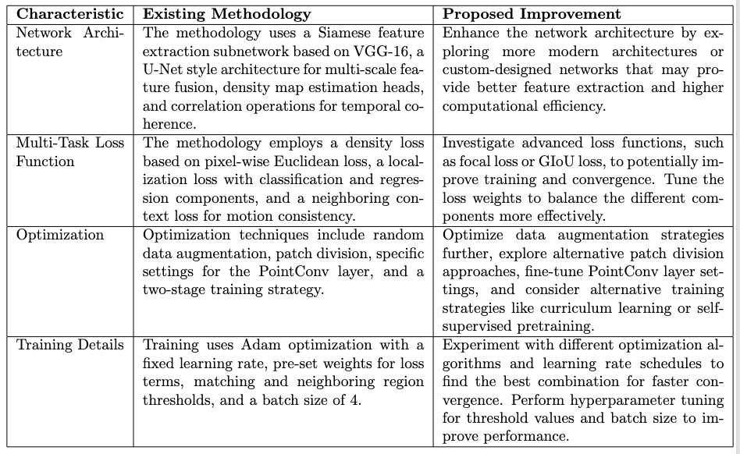
Existing Architecture & Proposed Improvement

Slide 10
Proposed System
In the context of our methodology improvement, statistical significance plays a pivotal role. We hypothesize that our enhanced approach will yield lower Mean Absolute Error (MAE) and demonstrate its effectiveness. By analyzing p-values and effect sizes, we ascertain that the observed improvements are not merely due to random variation but are statistically significant.
we emphasize the importance of replication and confidence intervals to bolster the robustness of our findings. By replicating experiments and reporting confidence intervals, we provide a comprehensive understanding of the observed effects.
Department of Artificial Intelligence

Slide 11
What do we propose?
We introduce the Space-Time Neighbor-Aware Network (STNNet) as a robust baseline solution that simultaneously tackles density map estimation, localization, and tracking. 1. Feature extraction subnetwork: employs two-branch CNNs to extract multi-scale features and exploits temporal relations by computing correlations between consecutive frames. 2. Density map estimation: heads facilitate crowd counting
3. Localization subnet, inspired by object detection methods, accurately identifies target locations in each frame.
4. Multi-object tracking methods are employed to predict long trajectories of targets. Extensive experiments on our DroneCrowd dataset, comparing our STNNet with 12 state-of-the-art algorithms, demonstrate its effectiveness for density map estimation, crowd localization, and tracking.

Slide 12
Innovation/Contribution
We present the DroneCrowd dataset, a comprehensive collection for density map estimation, localization, and tracking in dense crowds, setting new standards in data type, volume, annotation quality, and difficulty.
We introduce the Space-Time Neighbor-Aware Network (STNNet) as a holistic solution for density map estimation, localization, and tracking, addressing the unique challenges of drone-captured videos.
We design the neighboring context loss, which leverages spatial-temporal context, to enhance the training of the association subnet and achieve accurate motion offset predictions.

Slide 13
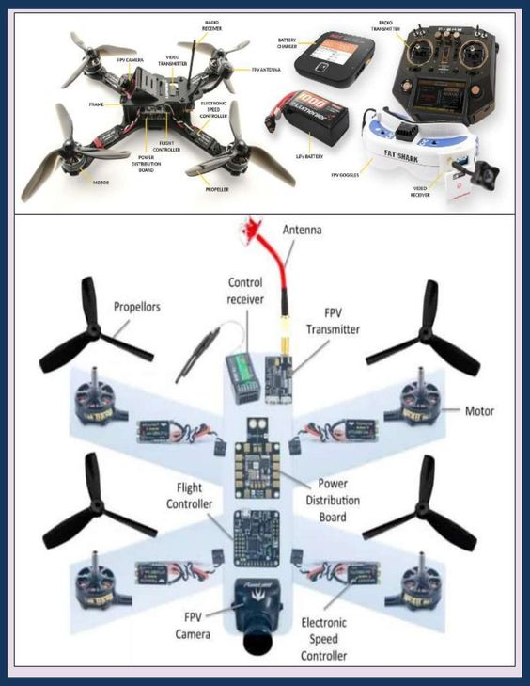
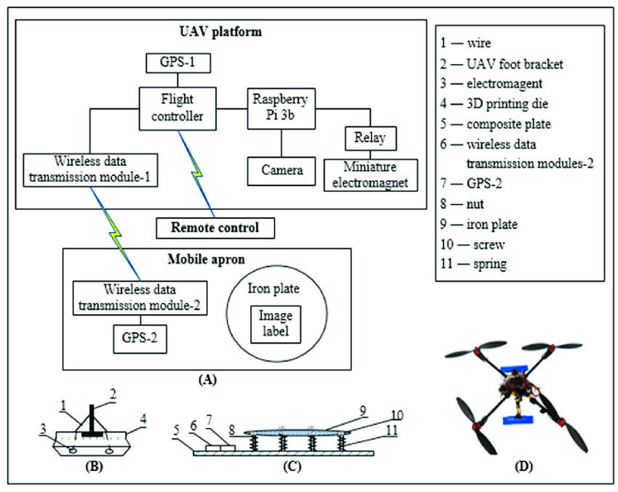
Drone architecture diagram
Department of Artificial Intelligence

Slide 14
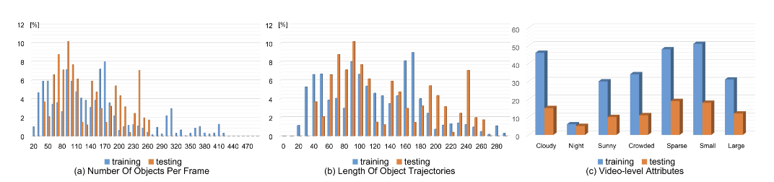
DroneCrowd Dataset
Data Collection and Annotation
Captured by drone-mounted cameras (DJI Phantom 4, Phantom 4 Pro, Mavic).
Various scenarios: campus, street, park, parking lot, playground, plaza.
Videos at 25 FPS, resolution 1920x1080 pixels.
Strict compliance with local laws to ensure privacy.
Annotated with over 4.8 million head points in 112 video clips.
Annotation by over 20 domain experts using vatic software.
Department of Artificial Intelligence

Slide 15
DroneCrowd Dataset
Attributes
Max/Min people per frame: 455/25, Avg. objects per frame: 144.8.
Dataset split: 82 training sequences, 30 testing sequences.
Video-level attributes: Illumination (Cloudy, Sunny, Night), Scale (Large, Small), Density (Crowded, Sparse).
Evaluation Metrics and Protocols
Density map estimation: MAE, MSE for accuracy and robustness.
Crowd localization: L-mAP at various distance thresholds.
Crowd tracking: T-mAP scores at different matching thresholds.
GitHub (Code + Dataset) : https://github.com/srikari-rallabandi-2208/STNNet.git
Department of Artificial Intelligence

Slide 16
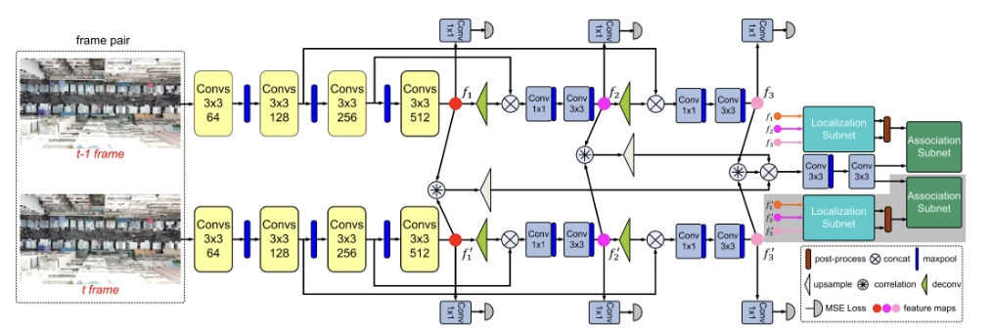
Architecture of STNNet
The yellow rectangles indicate the convolution groups in the VGG-16 backbone. The blue and green rectangles indicate the localization subnet and association subnet respectively. Colourful circles indicate feature maps at different stage.
Note: that the modules in the grey regions are removed in the testing phase.
Department of Artificial Intelligence

Slide 17
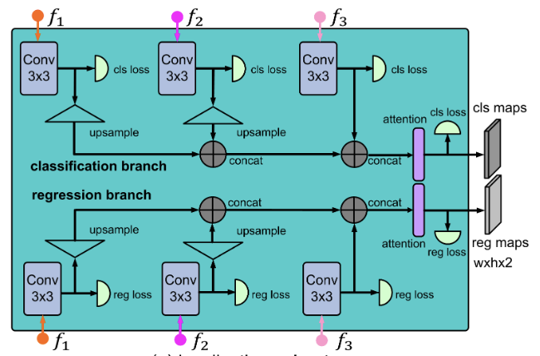
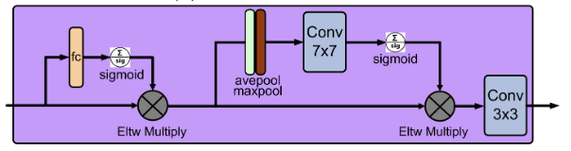
Network Architecture
channel and spatial attention
The localization subnet

Slide 18
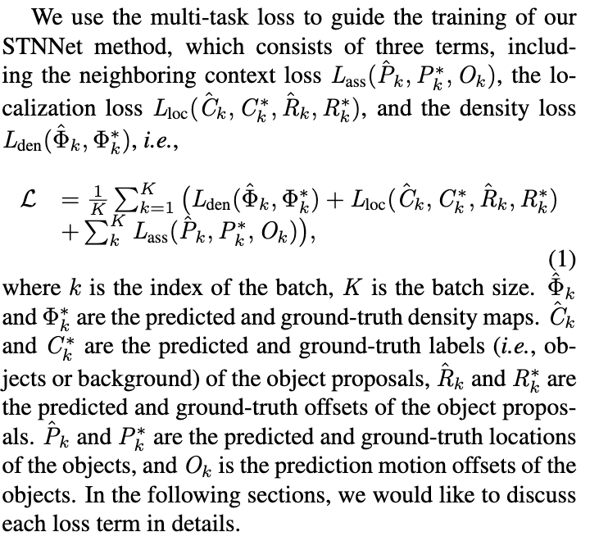
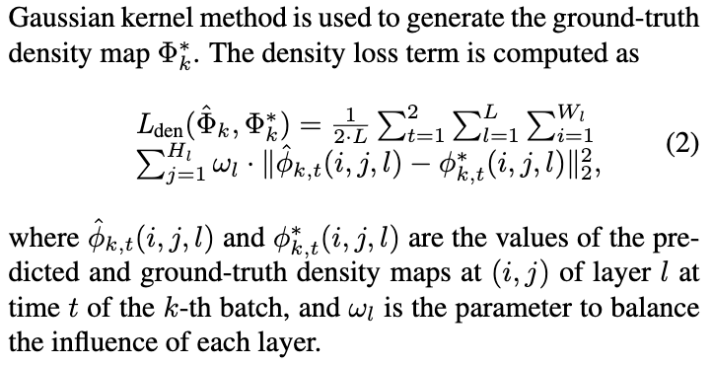
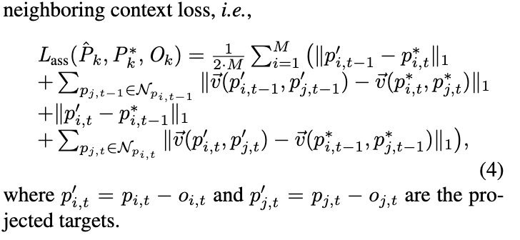
Evaluation Metrics

Slide 19
Research outcomes & Conclusion
DroneCrowd Dataset: It consists of drone-captured videos in various scenarios, annotated with over 4.8 million head points and video-level attributes. This dataset is notable for its scale, annotation quality, and diversity in terms of scenes and attributes.
STNNet Algorithm: A novel algorithm designed to tackle the challenges of density map estimation, crowd localization, and tracking simultaneously. With feature extraction, density map estimation, localization, and association,it's a comprehensive solution.
Neighboring Context Loss: This loss function penalizes large displacements of the relative positions of adjacent objects in the temporal domain, helping to improve the accuracy of motion offsets in tracking.
Experimental Results: Comparisons with 12 state-of-the-art algorithms showcase the superior performance of STNNet in terms of density map estimation, crowd localization, and tracking.

Slide 20
Reference
Yanyan Fang,Biyun Zhan,Wandi Cai,Shenghua Gao,and Bo Hu. Locality-constrained spatial transformer network for video crowd counting. In ICME, pages 814–819, 2019
Meng-Ru Hsieh,Yen-Liang Lin,and Winston H. Hsu. Drone-based object counting by spatially regularized regional proposal network. In ICCV, 2017
Yaocong Hu,Huan Chang,Fudong Nian,Yan Wang, and Teng Li. Dense crowd counting from still images with convolutional neural networks. J.Visual Communication and Image Representation, 38:530–539, 2016.
Siyu Huang, Xi Li, Zhiqi Cheng, Zhongfei Zhang, and Alexander G. Hauptmann. Stacked pooling: Improving crowd counting by boosting scale invariance. CoRR, abs/1808.07456, 2018
Department of Artificial Intelligence

Slide 21

Department of Artificial Intelligence

