Slide 1

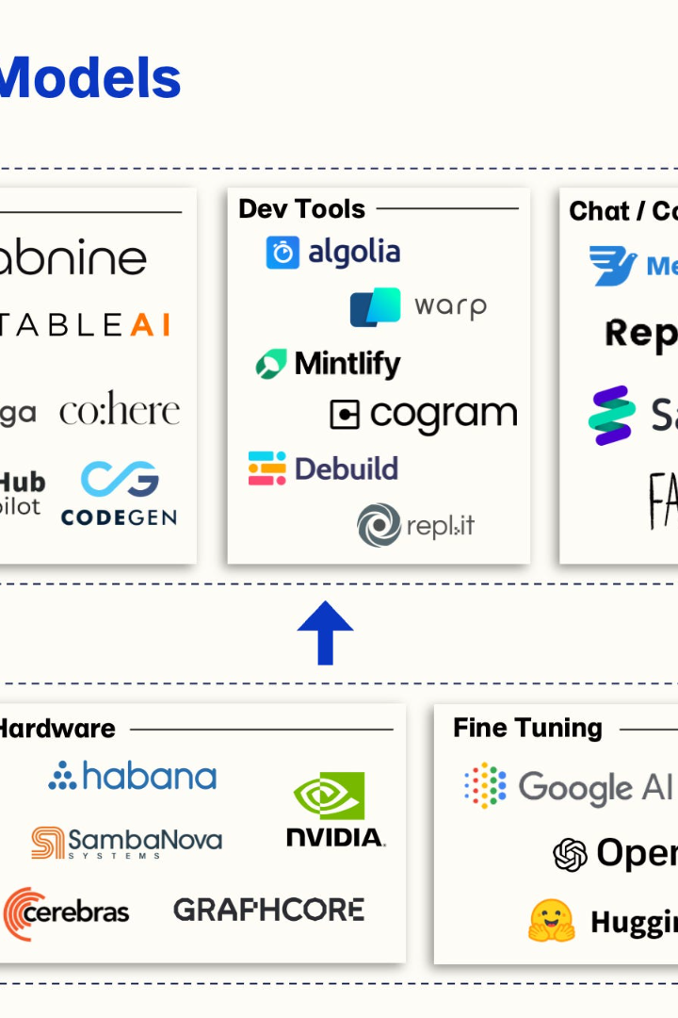
Introduction to Large Language Models (LLM)
By Saketh Raja (20911A3596)
Large Language Models (LLMs) are advanced natural language processing model.

Slide 2
What are Large Language Models?
Definition
Architecture
Training
LLMs are AI systems designed to process and generate human language with remarkable accuracy and fluency.
They are built using transformer-based architectures, enabling them to understand context and generate contextually relevant text.
LLMs are trained on large textual datasets, allowing them to generate highly coherent and context-aware responses.

Slide 3
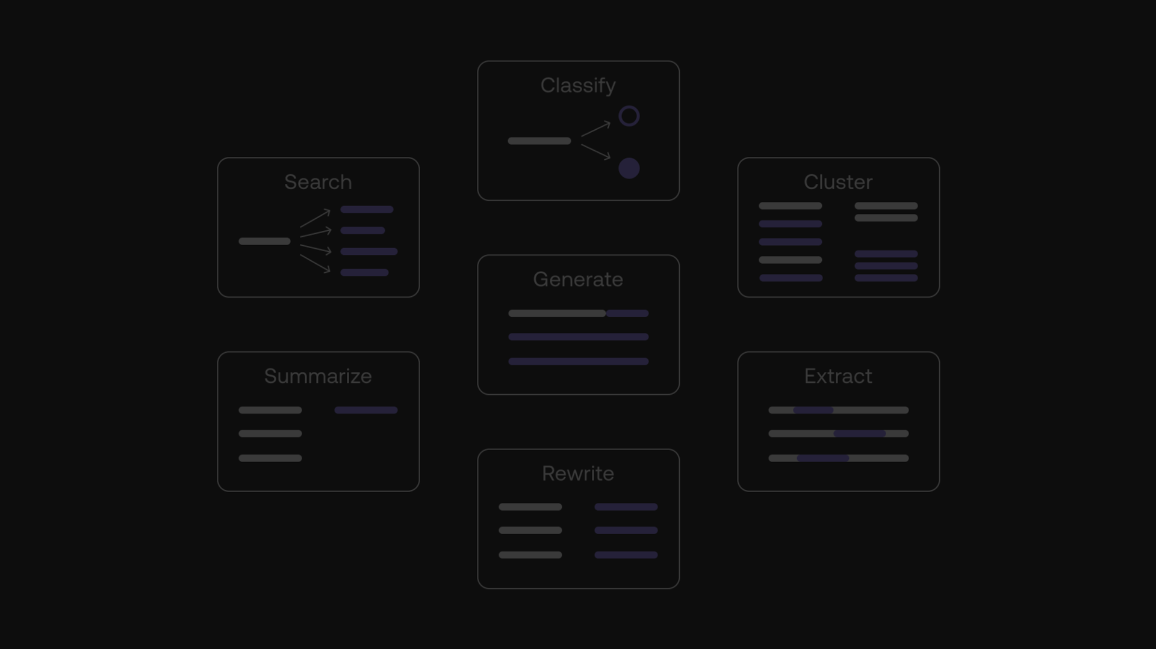
Applications of Large Language Models
1
Natural Language Generation
2
Language Translation
3
Information Retrieval
They facilitate accurate and nuanced translation of text across multiple languages, enhancing global communication.
LLMs excel in comprehending complex queries and quickly retrieving relevant information from large databases.
LLMs can generate human-like text, ranging from articles and stories to product descriptions and social media posts.

Slide 4



Benefits and Limitations of Large Language Models
Benefits
Limitations
LLMs improve language-based applications, automate content creation, and enhance user experience.
Challenges include bias in generated content, data privacy concerns, and energy-intensive training processes.

Slide 5
Ethical Considerations of Large Language Models
1
Transparency
Ensuring transparent communication about the capabilities and limitations of LLMs is crucial for responsible implementation.
2
Accountability
Developing mechanisms to hold creators and users of LLMs accountable for ethical and legal implications is essential.
3
Equity
Addressing biases and ensuring equitable access to LLMs is imperative for mitigating societal disparities.

Slide 6


Conclusion and Next Steps
Impact
Research
LLMs are reshaping industries and revolutionizing communication, paving the way for new opportunities and challenges.
Continued research into LLMs is crucial to enhance their capabilities, address ethical concerns, and harness their potential impact responsibly.

