Slide 1


CS209:Artificial Intelligence Course Project Title: Music Genre Classification Using Audio Features
Course Instructor: Prof. Dileep. A.D
Mentor Name: Vikash
1. Dontamsetti Kedar Subrahmanya Rishi
2. Diyyala Manasa
3. Aditya Prabhakar
4. Ruthwik Chetan Naik
Submitted by:Team 16
MC23BT003
MC23BT019
CS23BT017
CS23BT056

Slide 2
Introduction
Date:05/05/2025
Problem Statement
The Music Genre Classification dataset, sourced from a MachineHack Hackathon, provides a structured representation of audio features for a diverse collection of music tracks.
The objective is to develop machine learning models capable of genre classification based on its audio characteristics such as danceability, energy, acousticness, tempo, and other relevant features.
Purpose of the Project
This project allows streaming platforms to offer personalized recommendations, helps listeners select songs that match their moods, and makes it easier to discover new artists.
By understanding the relationship between musical attributes and genre classification can enhance recommendation systems, music analysis tools, and audio recognition applications.
2

Slide 3
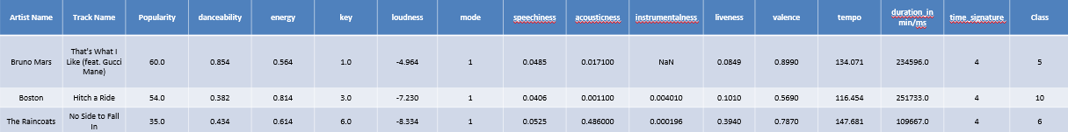
Dataset Overview:
Date:14/04/2025
1.Sorce: MachineHack Hackathon
2. 17796 training samples and 7713 test samples with 16 attributes and 1 target attribute.
3. Attributes: Artist Name, Track Name, Popularity, Danceability, Energy, Key, Loudness, Mode, Speechiness, Acousticness, Instrumentalness, Liveness, Valence, Tempo, Duration, Time Signature.
4. Target Variable : Class –(genre of the track): Rock, Indie, Alt, Pop, Metal, HipHop – Alt Music, Blues, Acoustic/Folk, Instrumental – Country, Bollywood
2

Slide 4
Overview:
Date:14/04/2025
1.Data Preprocessing - (Handling missing values ,outliers and Normalize numerical features)
2. Encode categorical variables - (artist name, track name, etc)
3.Perform EDA - (To identify feature distributions and correlations)
4.Training - (Train classification models to predict genre of a track)
5. Evaluate model performance - (using metrics such as accuracy, precision, recall, and F1-score.)
2

Slide 5
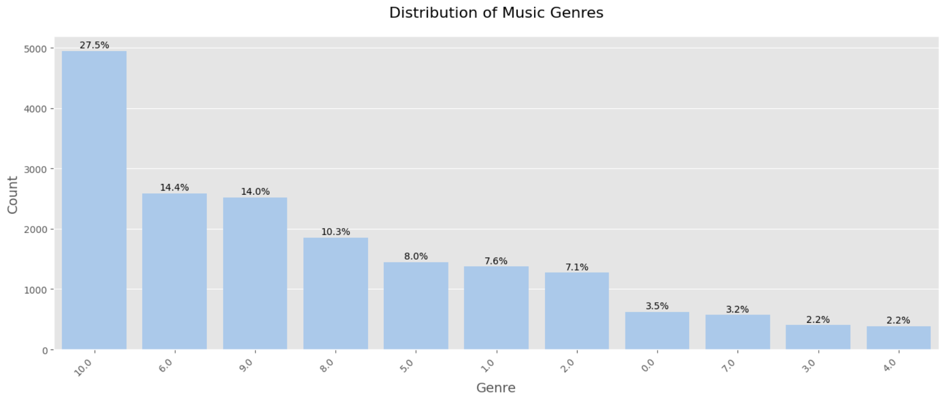
Data Preprocessing:
Date:14/04/2025
1.Duplicates:Removed Duplicates from the DataFrame
2.Missing Values: Removed Missing values by using median
3.EDA:
1.Distribution of Music genres:
=>Classes are very Imbalanced
2

Slide 6
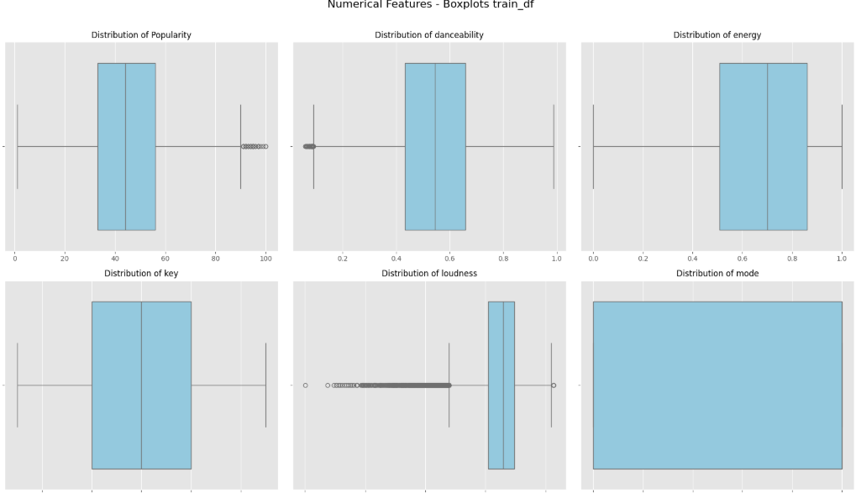
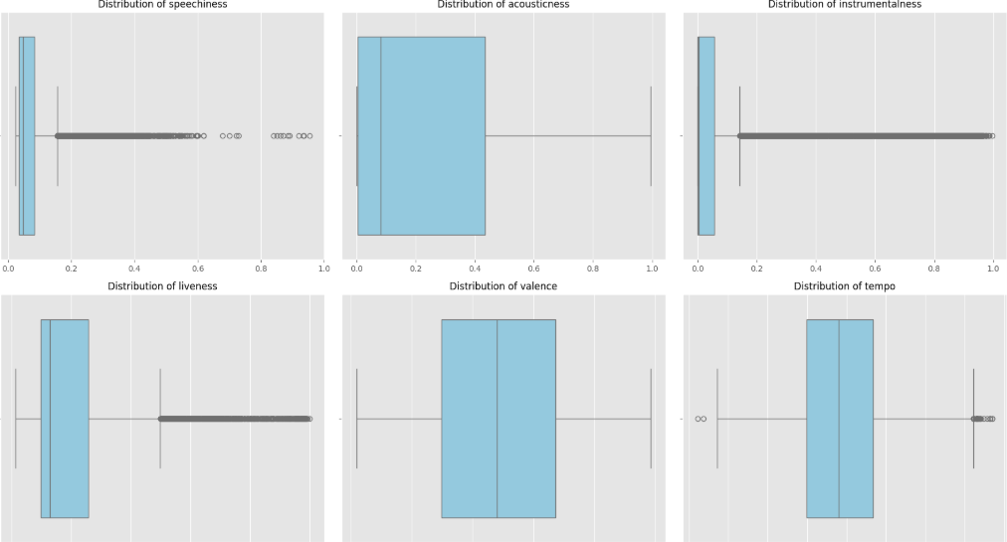
Date:14/04/2025
2.Boxplots:
2

Slide 7
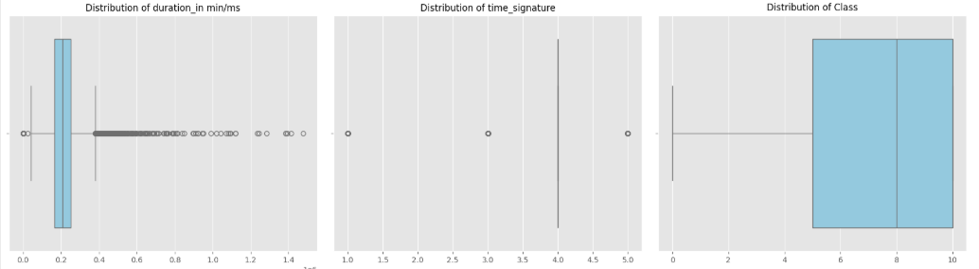
Date:14/04/2025
=>Replaced Outliers with median in every column.
2

Slide 8
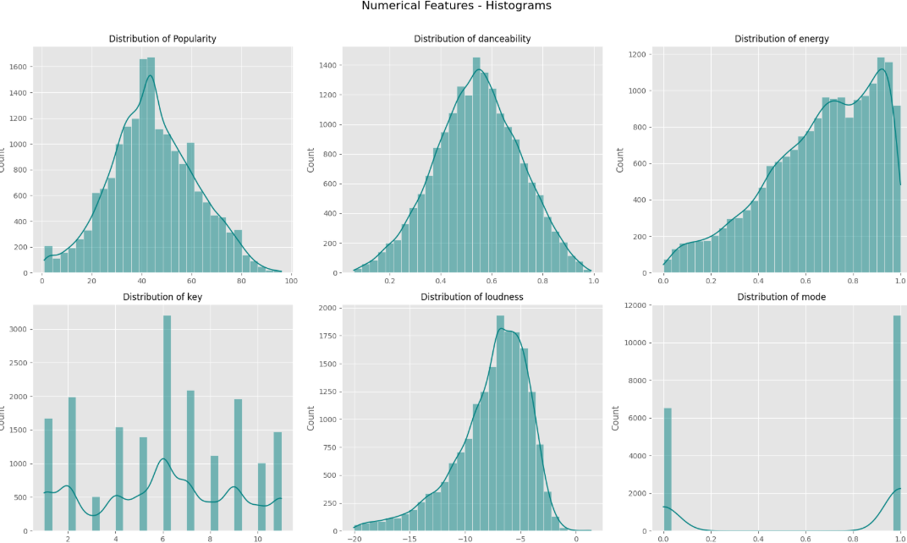
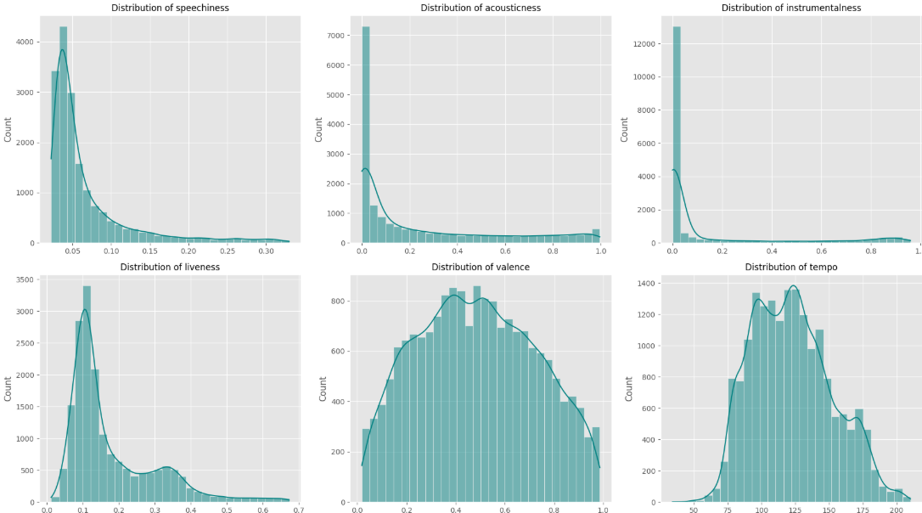
Date:14/04/2025
3.Histograms
2

Slide 9
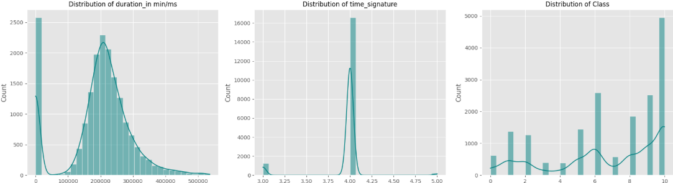
Date:14/04/2025
=>Data is skewed for most of the Features
2

Slide 10
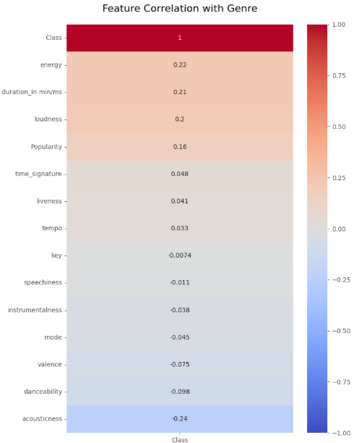
Date:14/04/2025
3.Correlation analysis:
=>Every column is very less correlated with Class abs(corr)<3
4.Standardized numerical features.
2

Slide 11
Date:14/04/2025
Training Methodology
1.Training Every model By using Stratified K-fold:
2.SMOTE is applied to make classes balance
3.Now Train Model on each Fold
4.Evaluate on Validation Fold
5.Keeps the prediction From best Performing fold
6.Store best accuracy , precision , recall , f1_score
7.Display Confusion matrix
2

Slide 12
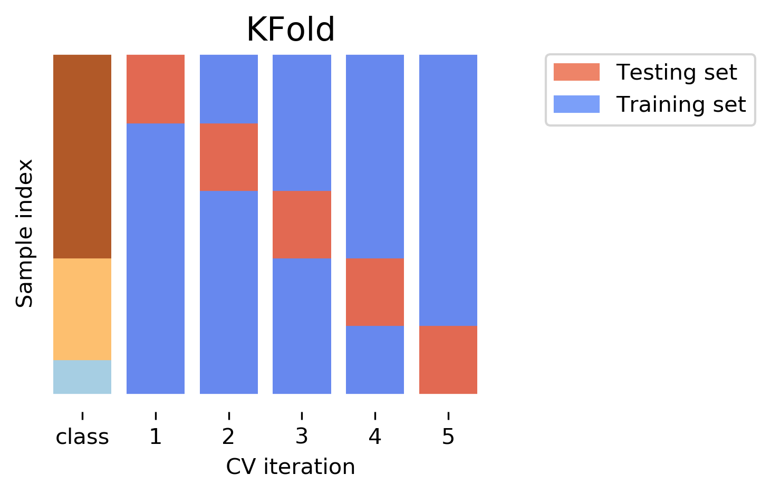
Date:14/04/2025
Training
1.Every model Trained By using Stratified K-fold:
Stratified K-Fold splits the dataset into K folds such that each fold has approximately the same class distribution as the full dataset.
This ensures that all training and validation sets are representative of the overall class balance
2

Slide 13
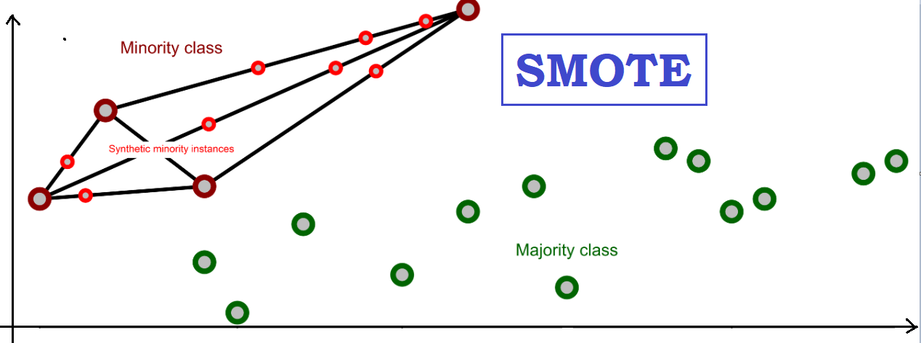
Date:14/04/2025
2.SMOTE(Synthetic Minority Oversampling Technique):
For the divided data from Stratified K-fold we apply SMOTE on train fold to Balances the classes in the training data by generating synthetic samples for minority classes.
1.Dark RED (minority class) and Dark GREEN are actual data
2.Light RED data created by SMOTE
2

Slide 14
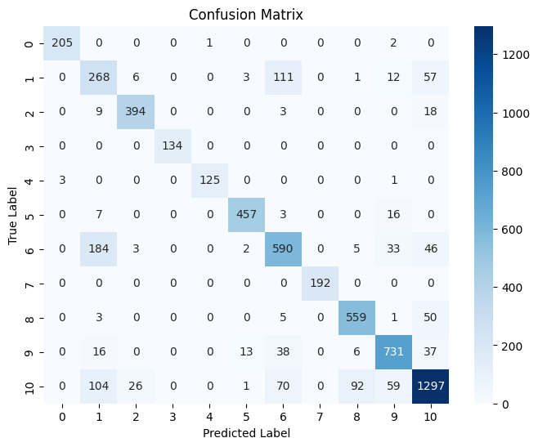
Date:14/04/2025
Random Forest(Highest Accuracy)
1.Best validation Accuracy=0.83,precision=0.82
recall=0.8781,f1_score=0.87
2.Why it performed well:
1. Handles high-dimensional data effectively.
2. Robust to overfitting due to ensemble averaging.
3. Capable of modeling complex feature interactions (e.g., between danceability, energy, and tempo).
Random Forest:
1. Ensemble of Decision Trees builds multiple decision trees and combines their outputs to improve prediction accuracy and stability.
2. Reduces Overfitting By averaging the results from many trees, it minimizes overfitting
3. Handles Complex Data Well It can capture nonlinear patterns, works well with both categorical and numerical features, and is robust to noise and missing data.
2

Slide 15
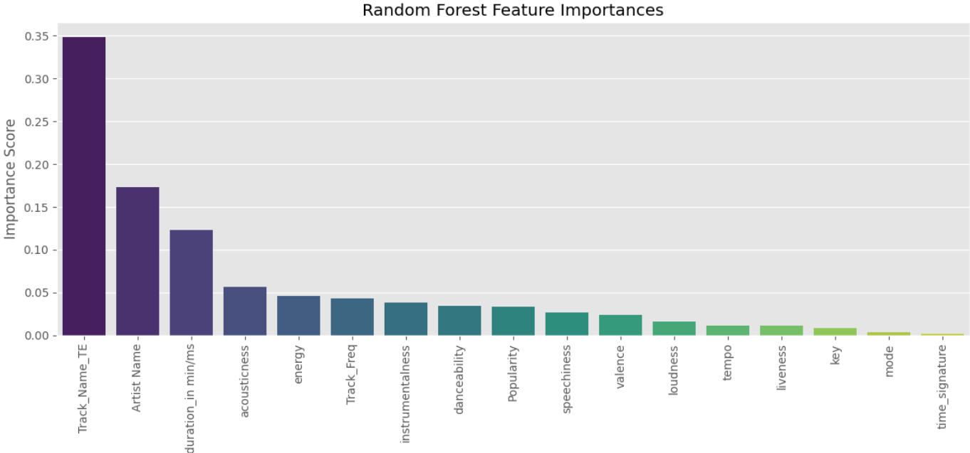
Date:14/04/2025
Feature Importance
2

Slide 16
Date:14/04/2025
Decision Trees
1.Best validation Accuracy=0.80,precision=0.84
recall=0.85,f1_score=0.84
Random Forest:
Splitting Data tree starts at the root and splits the data based on the feature that gives the best separation
Recursive Partition recursively creates branches by repeating the splitting process on each subset, forming a tree with decision rules at each node
3. Prediction input follows the tree from root to a leaf node
Limitations:
1.Prone to overfitting
2.Less robust to noise and outliers
3. More sensitive to small changes
2

Slide 17
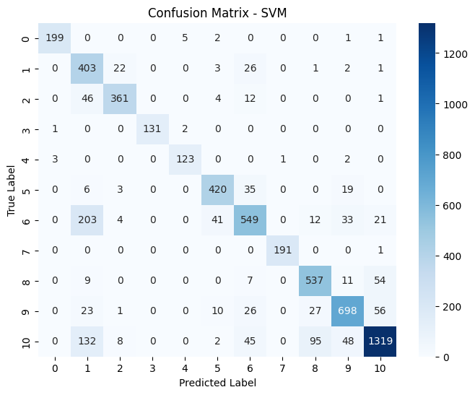
Date:14/04/2025
SVM with rbf Kernel
1.Best validation Accuracy=0.82,precision=0.86
recall=0.87,f1_score=0.86
SVM:
Captures Nonlinear Relationships: RBF kernel maps input features to higher dimensional space, allowing SVM find complex decision boundaries between classes.
2. Effective for Complex Datasets it works well when data is not linearly separable perfect for music genre classification with overlapping feature distributions.
3.Controls Flexibility with Parameters Parameters like C and gamma help balance the trade-off between accuracy and overfitting
Limitations :
1.Slow on large datasets
2.Harder to tune (kernel, C, gamma)
3.Not great for datasets with a lot of noise or overlapping classes
2

Slide 18

Date:14/04/2025
Neural Networks
1.Best validation Accuracy=0.80,precision=0.84
recall=0.86,f1_score=0.85
SVM:
Structure:
Contains layers of Neurons : input layer, hidden layer, output layer.Each Layer is Fully connected to subsequent Neurons by weights.
2. Learning Process:
learn by BackPropagation process.where the network adjusts its weights based on error between predicted output and the true output.error propagated backward from output to input layer.weights updated by gradient descent algorithm 3.Activation Functions: These functions are for non-Linearity and to learn complex patterns
Limitations :
1.Computationally expensive (needs GPUs/TPUs) 2.Takes time to train
3.Hard to interpret (black box models)
2

Slide 19
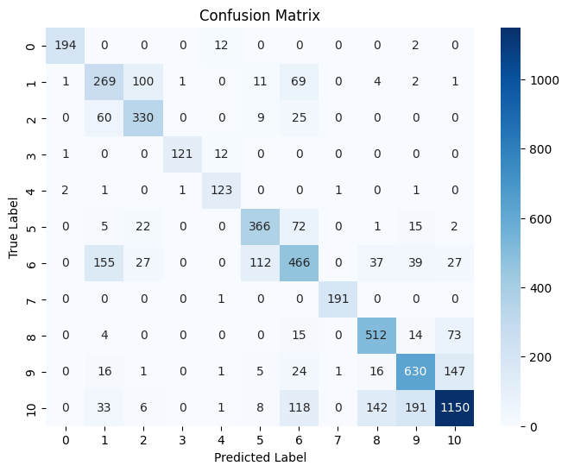

Date:14/04/2025
Logistic Regression
1.Best validation Accuracy=0.72,precision=0.77
recall=0.79,f1_score=0.78
Logistic Regression:
Classification Algorithm: It predicts the probability that a given input belongs to a certain class.
2. Uses the Sigmoid Function:
For predicting output(probability that x belongs to certain class) 3. Boundary: linear relation between input features and the log-odds of the target class.
Limitations :
1.Assumes linear relationship
2.Sensitive to outliers
3.Requires large sample size
2

Slide 20
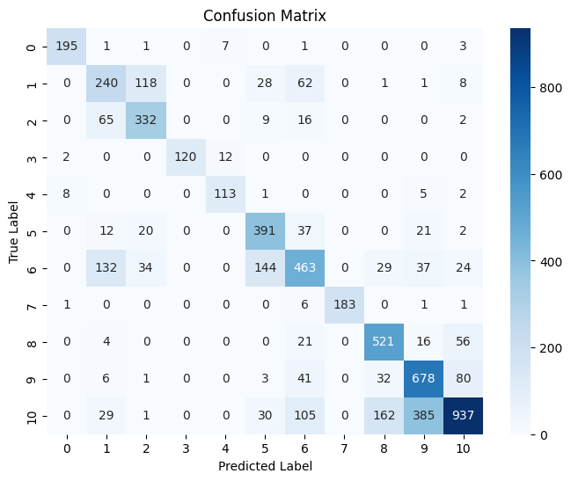


Date:14/04/2025
Naive Bayes
1.Best validation Accuracy=0.69,precision=0.75
recall=0.77,f1_score=0.76
Naive Bayes:
1.Bayes Therom:
2. Naive Independence Assumption:
all features are conditionally independent
3. Computation: categorical features: probabilities from frequency.
continuous features:
Limitations :
1.Strong Independence Assumption
2.If a feature never appears in training data for a class, it assigns zero probability
3.If features are dependent, performance drops.
2

Slide 21
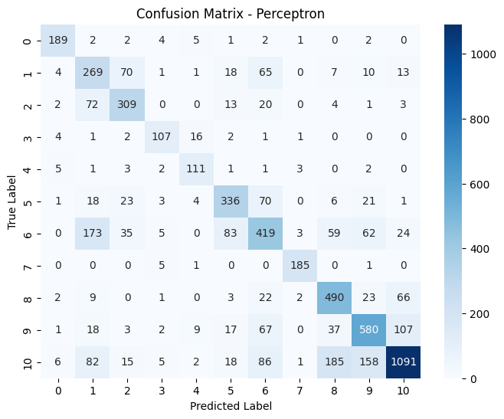


Date:14/04/2025
Perceptron Polynomial Model
1.Best validation Accuracy=0.68,precision=0.71
recall=0.74,f1_score=0.72
Perceptron:
1.Non Linear Transformation:
Original features to higher dimension
2. output:
3. Learning Process:
Weights are updated by above formula to minimize errors
Limitations :
1.Overfitting with high Degree Polynomials
2. Does not guarantee convergence if the data is not linearly separable
3. Higher computational complexity and memory usage.
2

Slide 22
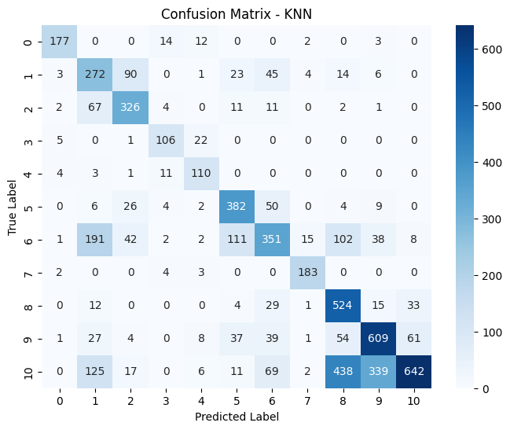
Date:14/04/2025
KNN Model
1.Best validation Accuracy=0.61,precision=0.67
recall=0.72,f1_score=0.67
KNN:
1.instance-based Learning:
memorizes the training data and makes predictions by looking at the most similar instances
2. output:
Distance between test and all other points in train
k-nearest neighbors and assigns the class label based on the majority class of these neighbors.
Limitations :
1.Slow prediction time (since it compares to every point in the dataset)
2.Sensitive to irrelevant features or scaling (standardization is usually required)
3. Poor performance on imbalanced data
2

Slide 23
Date:14/04/2025
KNN Model
1.Best validation Accuracy=0.61,precision=0.67
recall=0.72,f1_score=0.67
KNN:
1.instance-based Learning:
memorizes the training data and makes predictions by looking at the most similar instances
2. output:
Distance between test and all other points in train
k-nearest neighbors and assigns the class label based on the majority class of these neighbors.
Limitations :
1.Slow prediction time (since it compares to every point in the dataset)
2.Sensitive to irrelevant features or scaling (standardization is usually required)
3. Poor performance on imbalanced data
2

Slide 24
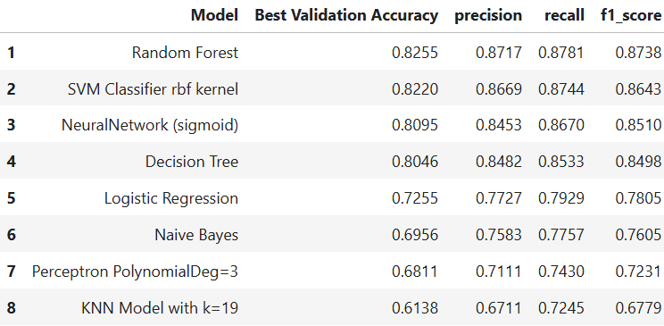
Date:14/04/2025
Comparison of Models
2

Slide 25
Date:14/04/2025
References
1. scikit – learn:- Libraries for machine learning in Python
2. Random Forests:- A foundational paper on the Random Forest algorithm.
2

