Slide 1
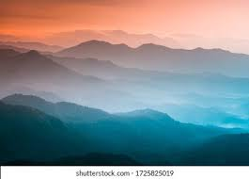
MOUNTAINS
Beautiful
Tall
Huge

