Slide 1



Crop and Fertilizer Recommendation System using Machine Learning

Slide 2

Learning Objectives
Understand soil, weather, and crop factors – Analyze environmental conditions affecting agriculture.
Collect and preprocess agricultural data – Gather, clean, and prepare data for analysis.
Apply ML models for crop and fertilizer prediction – Use machine learning to recommend suitable crops and fertilizers.
Optimize and evaluate model performance – Improve model accuracy and efficiency.
Deploy using Streamlit – Create an interactive web app for real-time recommendations.
Gain AI and Data Science skills – Develop expertise in AI-driven agriculture and data analysis.
GOAL
Source :
www.freepik.com/

Slide 3
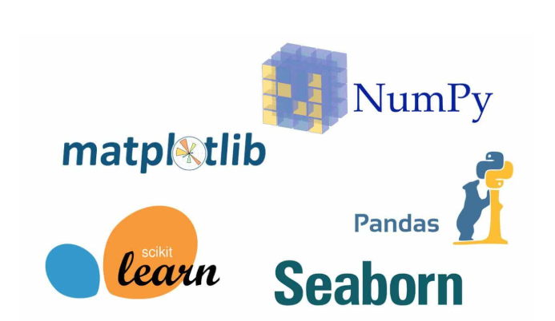

Tools and Technology used
Programming Language – Python
Libraries – NumPy, Pandas, Scikit-learn
Data Visualization – Matplotlib, Seaborn
Machine Learning Models – Decision Tree, Random Forest, SVM
Web Framework – Streamlit

Slide 4
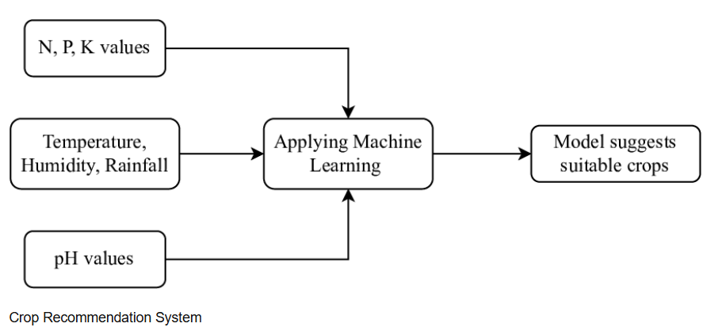
Methodology
Problem Analysis – Identify factors affecting crop yield and fertilizer use.
Data Acquisition – Collect relevant agricultural datasets on soil, weather, and crops.
Data Processing – Clean, preprocess, and normalize data for better accuracy.
Feature Extraction – Select important parameters influencing crop recommendations.
Model Training – Implement ML algorithms like Decision Tree, Random Forest, and SVM.
Performance Evaluation – Measure model effectiveness using accuracy and other metrics.
System Implementation – Develop an interactive interface using Streamlit.
Testing & Optimization – Validate predictions and refine the model for better results.

Slide 5
Problem Statement:
Agriculture plays a vital role in food security and economic growth, but farmers often struggle with selecting the right crops and fertilizers due to a lack of scientific guidance. Traditional methods rely on experience rather than data-driven insights, leading to low productivity and soil degradation.
This project aims to develop a Machine Learning-based Crop and Fertilizer Recommendation System that suggests the best crop for a given soil and climate condition and recommends suitable fertilizers. By leveraging data on soil nutrients, weather, and crop requirements, the system will help farmers make informed decisions, improve yield, and promote sustainable farming practices.

Slide 6
Solution:
The proposed Machine Learning-based Crop and Fertilizer Recommendation System will analyze key agricultural factors such as soil nutrients, temperature, humidity, and rainfall to suggest the best crop for a given region. By leveraging ML algorithms like Decision Tree, Random Forest, and SVM, the system will predict the most suitable crop based on historical data and predefined parameters. This data-driven approach will help farmers make informed decisions, leading to improved crop yield and resource efficiency.
Additionally, the system will recommend the appropriate fertilizers based on soil nutrient levels, ensuring balanced fertilization and preventing overuse of chemicals. A user-friendly interface built with Streamlit will allow farmers to input their soil and climate data easily, receiving instant recommendations. This solution aims to enhance agricultural productivity, reduce costs, and promote sustainable farming practices.

Slide 7
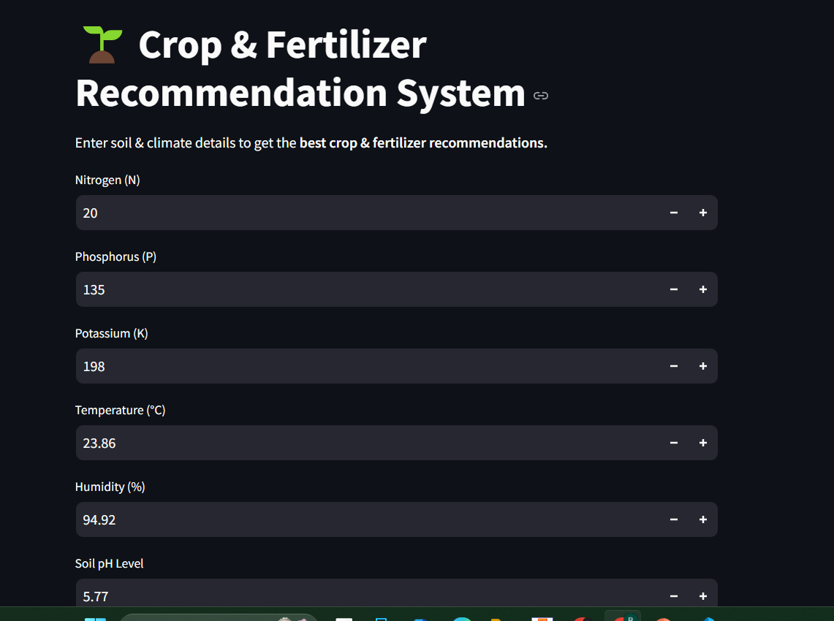
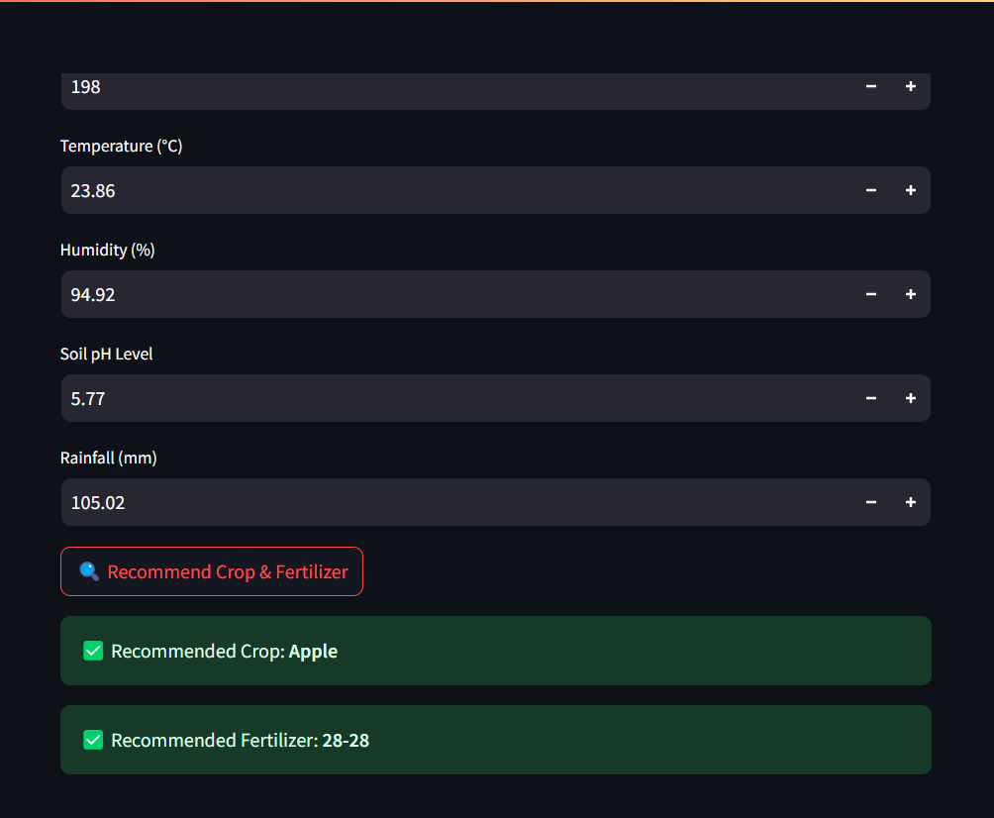
Screenshot of Output:

Slide 8
Conclusion:
The Machine Learning-based Crop and Fertilizer Recommendation System provides a data-driven approach to help farmers make informed decisions. By analyzing soil properties, weather conditions, and crop requirements, the system suggests the most suitable crops and fertilizers, leading to improved agricultural productivity and sustainability.
With a user-friendly interface and accurate predictions, this solution reduces dependency on traditional guesswork, minimizes fertilizer misuse, and enhances yield. By integrating technology into agriculture, the system contributes to efficient farming practices, increased profitability, and long-term soil health conservation.

