Slide 1
Exploratory Data Analysis of Mushroom Dataset
Rutik Kothwala
Chandani Thumar

Slide 2
Mushroom Dataset
Problem Definition
Data Description
Different Plots
Image processing
Conclusion

Slide 3
Problem Definition
To do an in-depth analysis of the Mushroom data so we will be able to know how different features are related to each other and which are the most important features in order to classify which Mushroom is Edible or Poisonous .
To Join the unstructured data in form of images with the Mushroom data set and connect it to postgresSQL database.

Slide 4
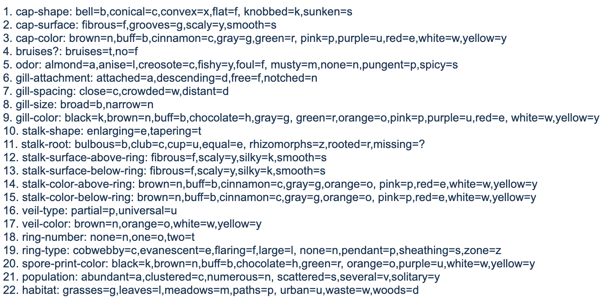
Data Description
The dataset we are using is of Mushrooms. The Mushrooms dataset contains 8000 rows and 22 columns. Each species is defined in two categories which are Edible and poisonous .
In Total there are 13 species of Mushrooms in our dataset.
We are using images of this 13 species in form of unstructured data

Slide 5
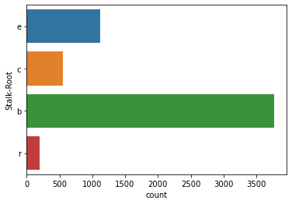
Different Plots
Count Plot :-

Slide 6
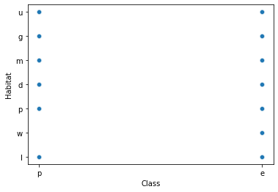
Scatter Plot :-

Slide 7
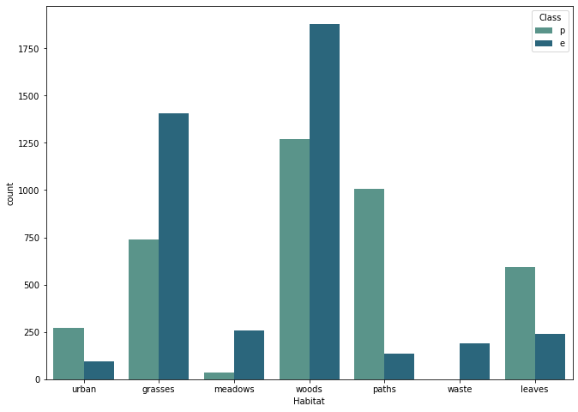
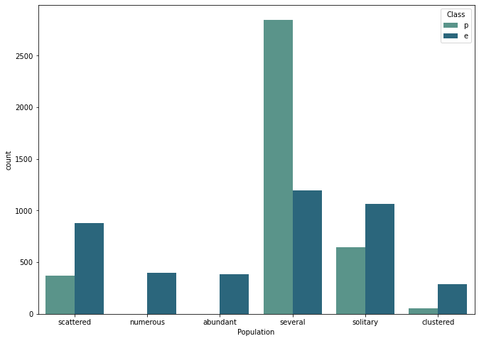
Count Plot with respect to target feature :-

Slide 8
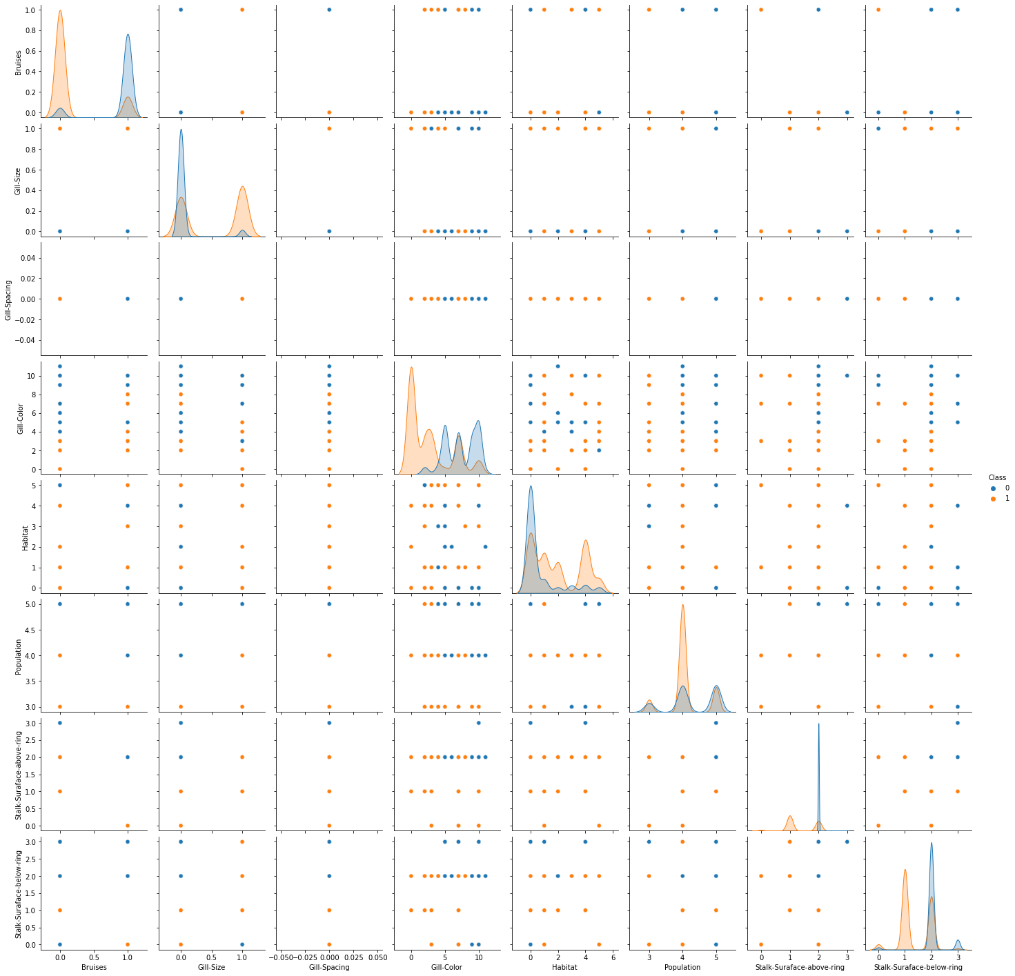
Pairplot :-

Slide 9
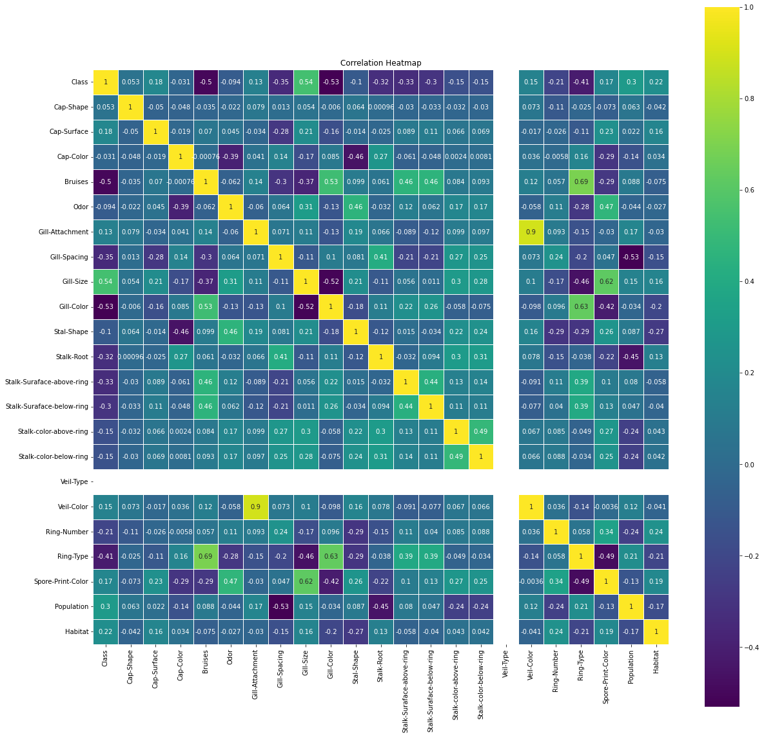
Heat Map :-

Slide 10
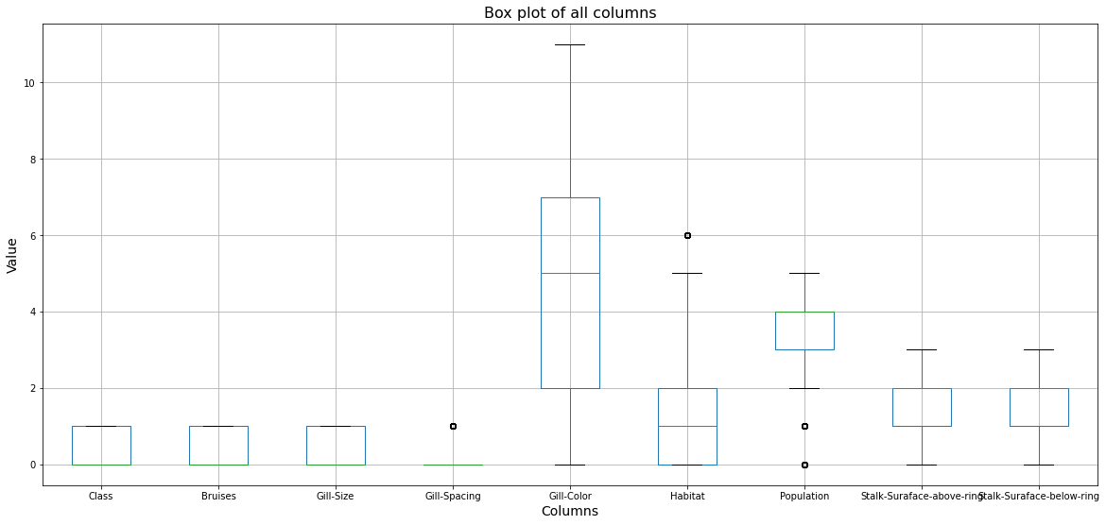
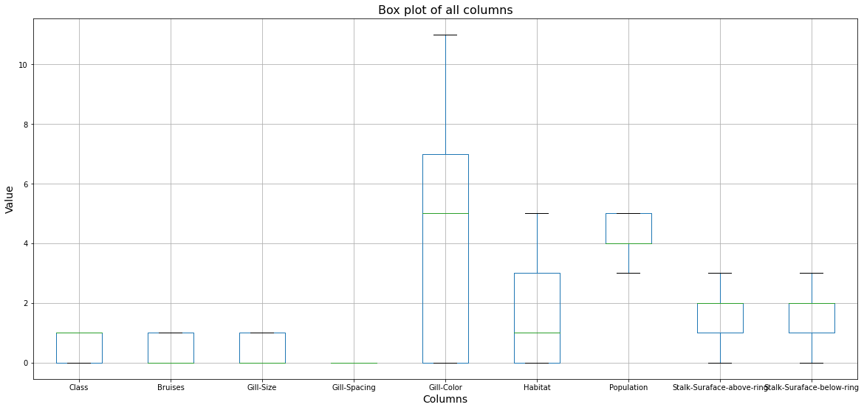
Outliers :-

Slide 11
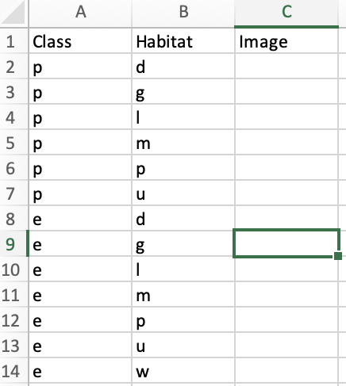
Image Processing:-
Classs :-
P : Poisonous
E : Edible
Habitat. :-
grasses=g,
leaves=l,
meadows=m,
paths=p,
urban=u,
waste=w,
woods=d

Slide 12
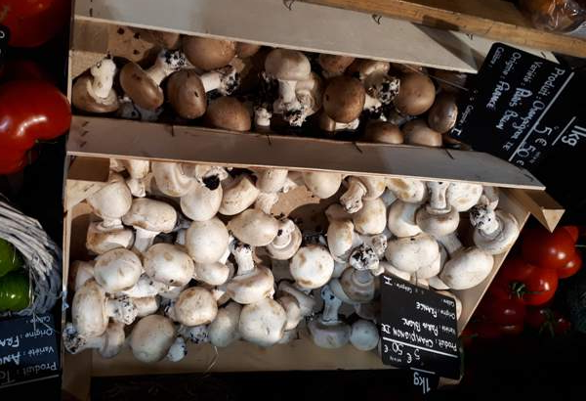
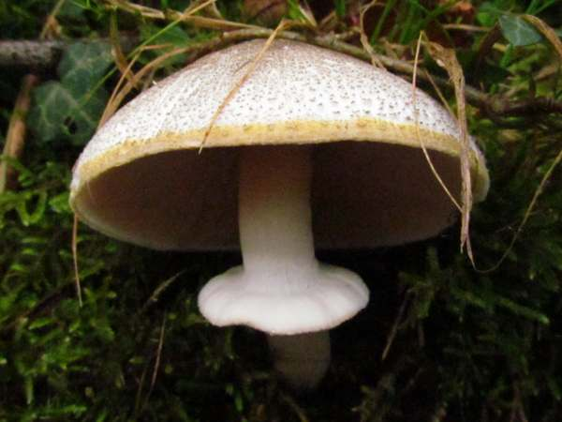
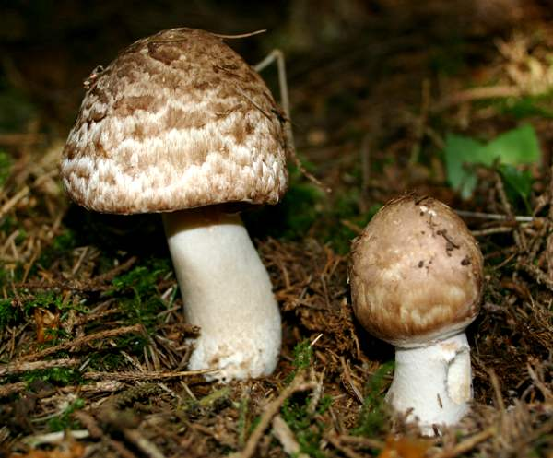
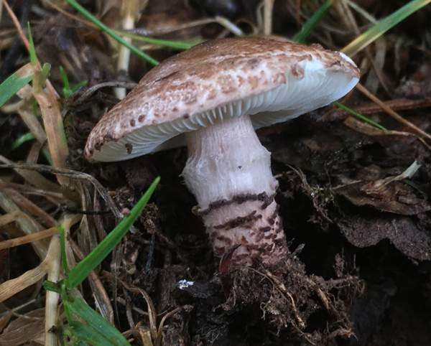
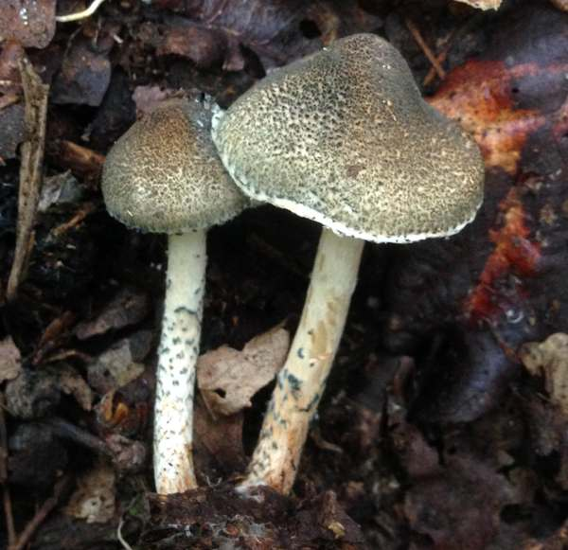
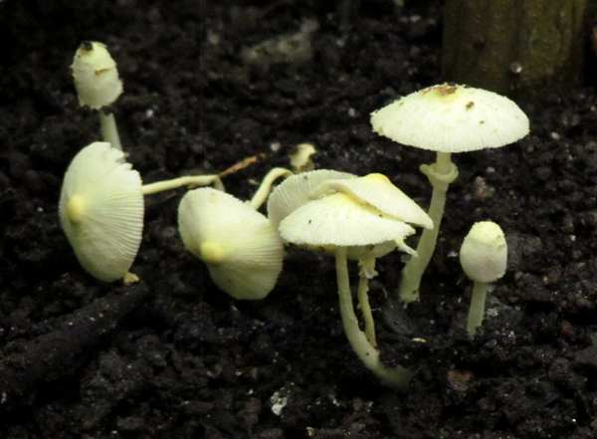
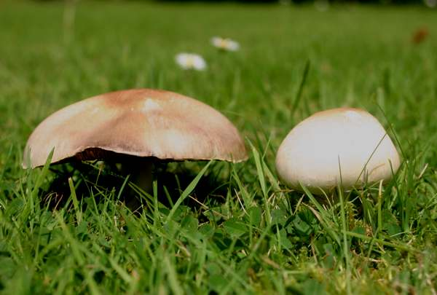
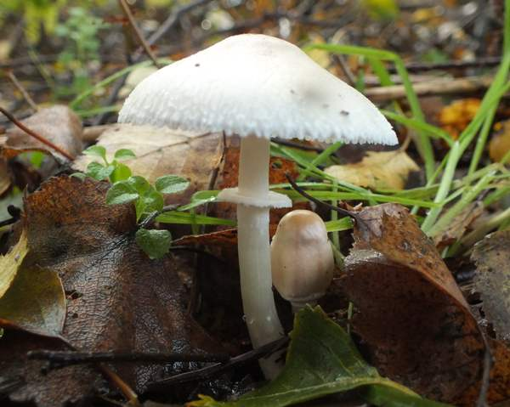
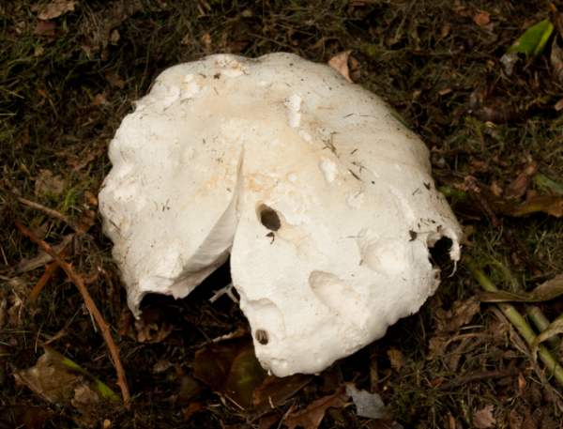
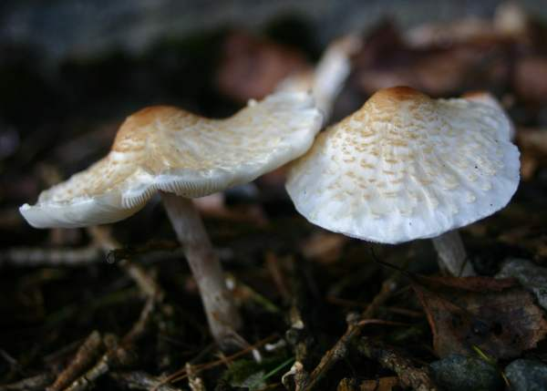
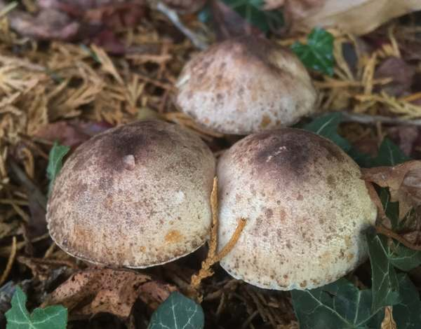
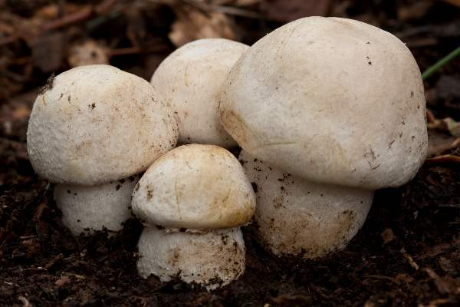
Mushroom Species Images

Slide 13
Thank You!!

