Slide 1

KultureHire
Data Analytics for Understanding Career Aspirations
A Data-Driven Analysis of Career Preferences
& Workplace Expectations
Presented by:
Rutuja Sarkate

Slide 2
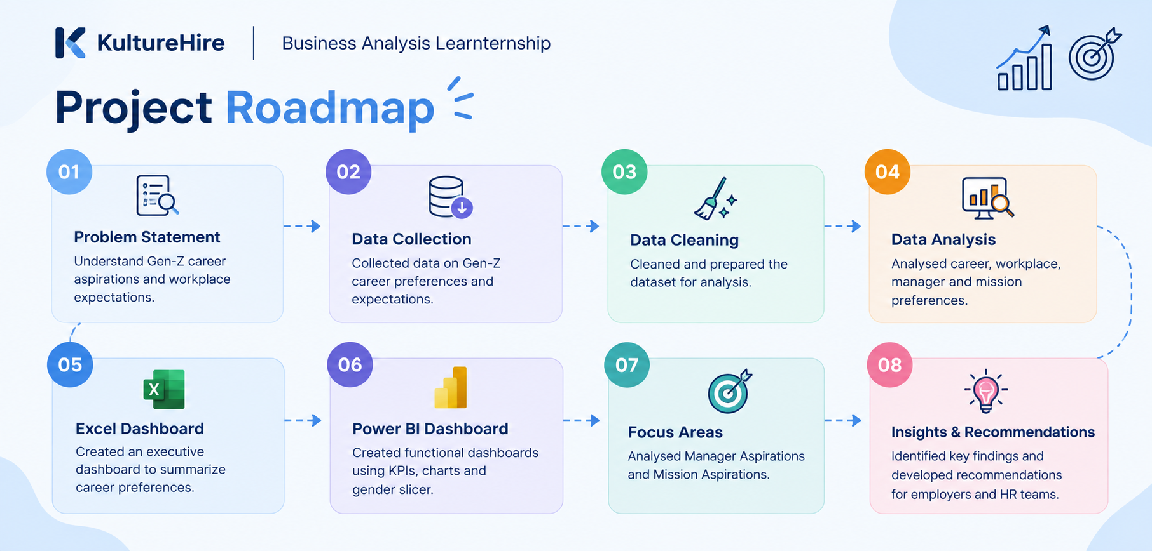

Slide 3
PROJECT OVERVIEW
Objective :To understand the career aspirations, workplace expectations and mission-related preferences of Gen-Z.
Scope of the Project:
Career aspirations and career influences
Preferred work environment
Manager and team preferences
Employer and learning preferences
Organizational mission and social impact
Target Audience
Employers
HR teams
Recruitment teams
Project Goal : To convert Gen-Z career-preference data into meaningful insights that can support better understanding of Gen-Z expectations.

Slide 4
PROBLEM STATEMENT
Understanding the career aspirations and workplace expectations of Gen-Z to help employers create a more supportive, meaningful and growth-oriented work environment.

Slide 5
WHAT?
Understanding their career aspirations and workplace expectations
WHO?
Gen-Z students and young professionals
WHY?
To identify the factors that influence their career and workplace preferences
WHERE?
Across areas such as career, work environment, managers, employers and organizational mission
HOW?
By analysing collected Gen-Z career-preference data and presenting the findings through Excel and Power BI dashboards

Slide 6
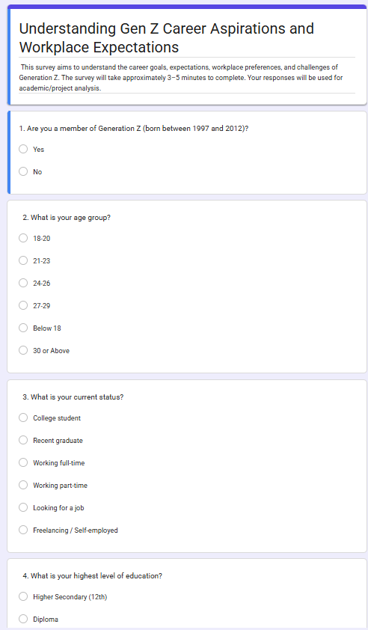
DATA COLLECTION
Survey-based data collection
13,897 responses
Career & workplace preference questions
Responses collected from Gen-Z participants
Sample of the survey used for data collection

Slide 7
SURVEY QUESTIONS
Are you a member of Generation Z (born between 1997 and 2012)?
What is your age group?
What is your current status?
What is your highest level of education?
Which field are you currently studying or working in?
What is your biggest career goal right now?
How clear are you about the career you want to pursue?
What is the most important factor when choosing a job?
What starting salary would you expect for your first full-time job in India?
Which type of work would you prefer?
How important is work-life balance to you?
Would you relocate for a good job opportunity?
How important is a supportive manager or team to you?
How long would you ideally stay with one company?
What should employers offer to attract Gen-Z employees?
What does career success mean to you?

Slide 8
DATA CLEANING & STANDARDIZING
Tools: Excel → Data Cleaning & Standardization
Cleaning Process
Renamed column headers
Made column names clear and user-friendly.
Cleaned field values
Standardized responses so they were easier to analyse.
Handled missing values
Identified and addressed null/missing values.
Formatted data types
Ensured each column had the appropriate format.
Split data where required
Organized values into separate rows where needed.
Prepared the final dataset
Saved the cleaned and standardized dataset for further analysis.

Slide 9
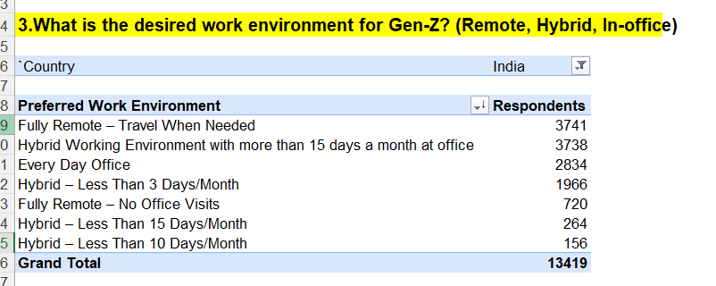
EXPLORATORY DATA ANALYSIS (EDA)
Business Questions
What industries are Gen-Z most interested in pursuing careers in?
What are the top factors influencing Gen-Z's career choices?
What is the desired work environment for Gen-Z?
(Remote, hybrid, in-office, etc.)
How do financial goals, such as salary and benefits, impact career aspirations among Gen-Z?
What role do personal values and social impact play in career choices for Gen-Z?
Excel Pivot Table – Preferred Work Environment (India)

Slide 10
EXCEL EDA – KEY FINDINGS
Parents are the strongest career influence
among the listed categories
Design & Creative Strategy is the most selected career
aspiration among the top five.

Slide 11
Fully Remote – Travel When Needed and Hybrid Working Environment with
more than 15 days a month at office have very similar response counts.
Every Day Office is also a significant preference.
Gen-Z career preferences therefore cover career choice, personal influence and work environment.

Slide 12
EXCEL EDA: INSIGHTS
Key Insights
Design & Creative Strategy is the most selected career aspiration among the top five.
Parents are the strongest career influence among the listed categories.
Fully Remote – Travel When Needed and Hybrid Working Environment with more than 15 days a month at office have very similar response counts.
Every Day Office is also a significant preference.
Gen-Z career preferences therefore cover career choice, personal influence and work environment.

Slide 13
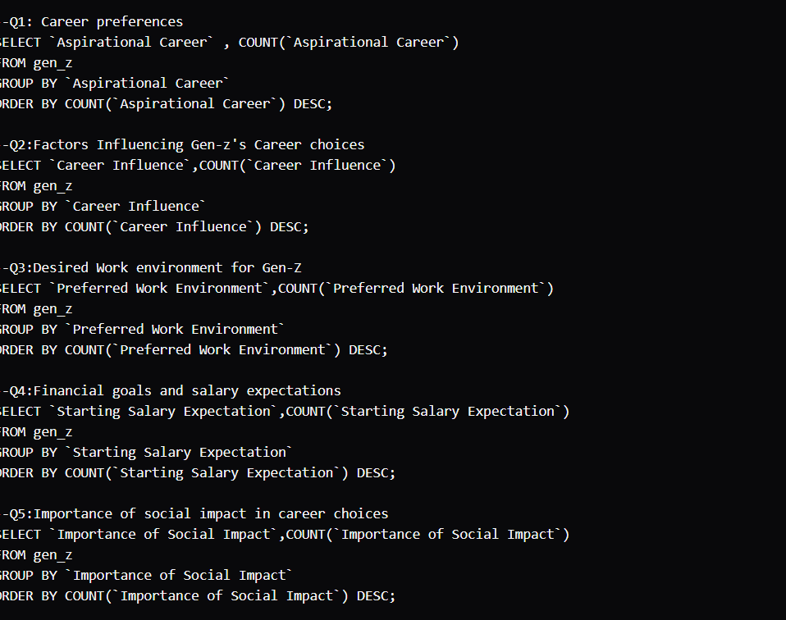
SQL BUSINESS INSIGHTS
BUSINESS QUESTIONS
01. Career Preferences
What career paths are most preferred by Gen-Z?
02. Career Influences
What factors influence Gen-Z’s career choices?
03. Work Environment
What work environment does Gen-Z prefer?
04. Financial Goals
What are Gen-Z’s starting salary expectations?
05. Social Impact
How important is social impact in career choices?

Slide 14
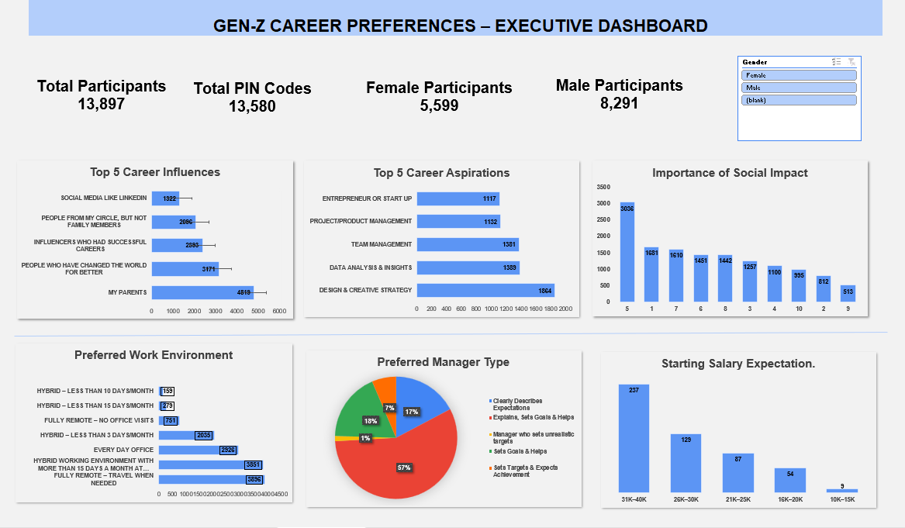
EXECUTIVE EXCEL DASHBOARD

Slide 15
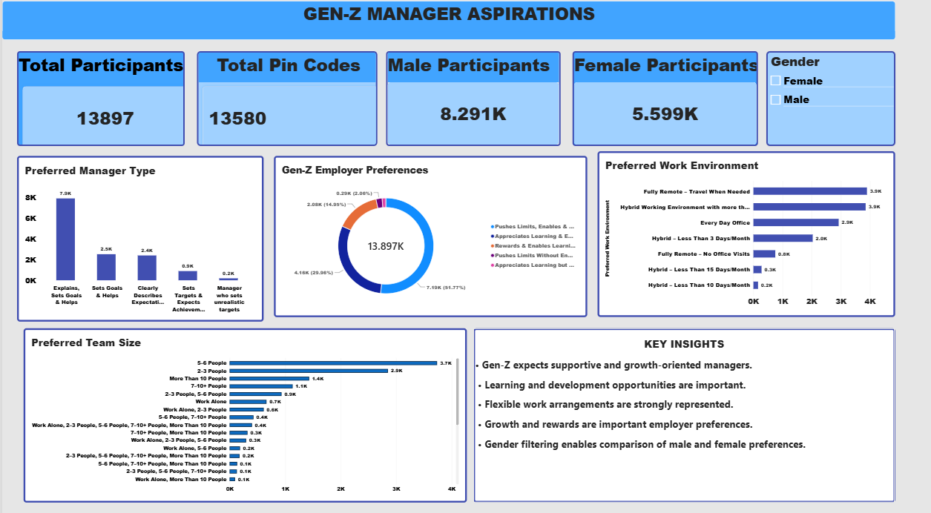
POWER BI FUNCTIONAL DASHBOARDS

Slide 16
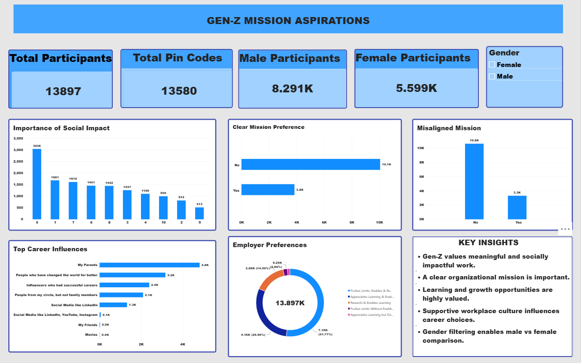

Slide 17
TCS COMPANY OVERVIEW
Tata Consultancy Services (TCS) is a global technology services company and part of the Tata Group.
Founded in 1968
Operates across 56 countries
Has 194 service delivery centers
Provides technology and digital transformation services
Focuses on emerging technologies, including AI
Serves clients across industries worldwide
HOW DATA CAN SUPPORT TCS
Use your Gen-Z survey + employee-review data:
Understand employee expectations: Identify what Gen-Z values in work, managers, learning and career growth.
Improve workplace experience: Use employee feedback on areas such as work-life balance and company culture.
Support career development: Compare Gen-Z's learning and career-growth expectations with employee feedback.
Improve compensation strategy: Consider salary and benefits expectations when designing roles for young employees.
Strengthen employee engagement: Use feedback and sentiment to identify areas that may need improvement.

Slide 18
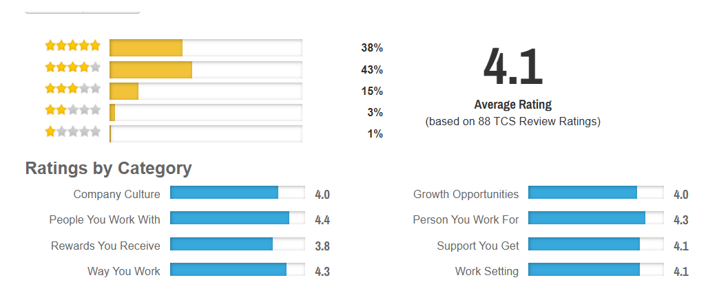
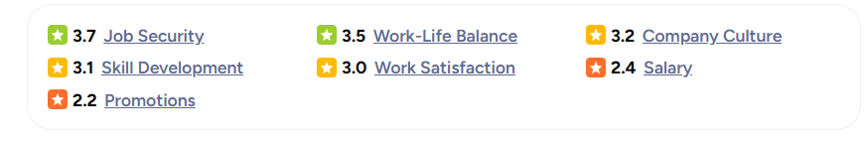
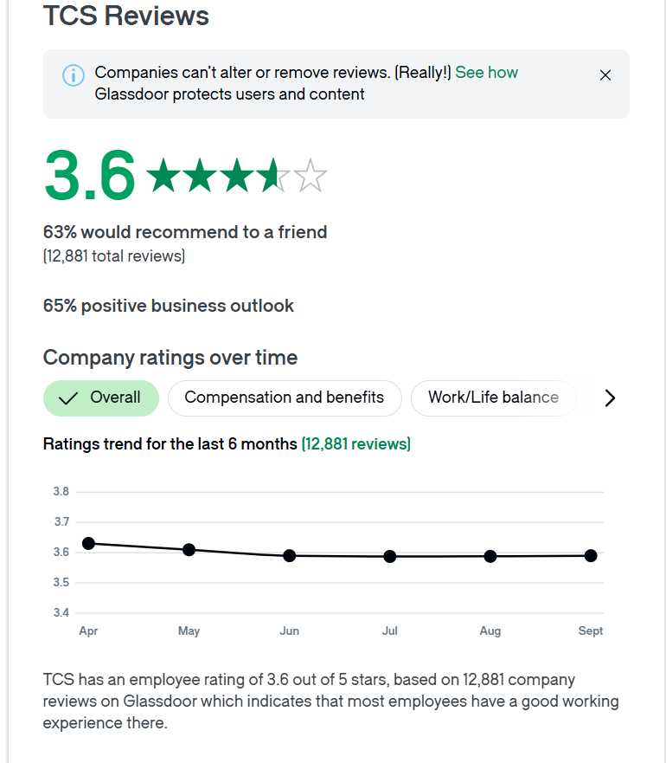
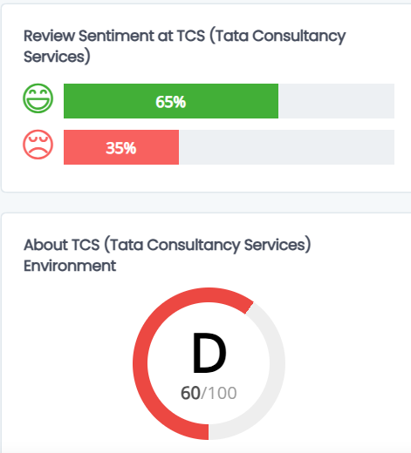
TCS EMPLOYEE REVIEW ANALYSIS
CAREERBLISS
AMBITIONBOX
GLASSDOOR
COMPARABLY

Slide 19
PROBLEM AREAS & RECOMMENDATIONS
1. Work Environment
2.Mission & Social Impact
Gen-Z shows strong preference for flexible work arrangements, particularly remote and hybrid working environments.
Recommendation: Organisations can provide flexible
work arrangements where feasible.
Gen-Z considers organisational mission and social impact when evaluating career choices.
Recommendation: Clearly communicate organisational
purpose and social impact.

Slide 20
3.MANAGER TYPE
4.CAREER ASPIRATIONS
Manager preferences vary among Gen-Z.
Recommendation:
Organisations should provide supportive, approachable and development-focused management that aligns with employee expectations.
Gen-Z has diverse career aspirations.
Recommendation:
Organisations should provide multiple career paths, role-specific learning opportunities and clear growth pathways to support different career aspirations.

Slide 21
THANK YOU

