Slide 1

ELECTION RESULT PREDICTION
BY ANALYZING TWEETS
By:
A40 Onkar Mane
A47 Rani Manwar
A51 Rutuja Ohal
A56 Sanket Chaudhary
Teacher : Smita Battalwar

Slide 2
LIST OF CONTENTS
01
03
05
07
09
INTRODUCTION
METHODOLOGY
WHY
TOOLS
CONCLUSION
02
04
06
08
10
PROJECT IDEA
ALGORITHM
BLOCK DIAGRAM
VISUALIZATION
REFERENCES

Slide 3

There are social media platforms like Facebook, Twitter and Google+ to share opinions, reviews and ratings. All major political parties and their members all over the world have their official accounts on Twitter with millions of followers. They consider this platform as a medium to connect with young people who might vote them. With significant rise of US users on Twitter during the pandemic, people have been more vocal to criticize or appreciate a political decision.
Twitter Sentiment Analysis of tweets regarding elections can be used by the general public as well as the political parties to understand the positive or negative views of people regarding a particular political party, thus, helping to predict the election results during that period.
Introduction

Slide 4

Project idea
We have design our project in a such a manner that it will predict the result of an election by using the tweets of the citizens.
It will analyze the sentiment of that Particular Tweet.

Slide 5
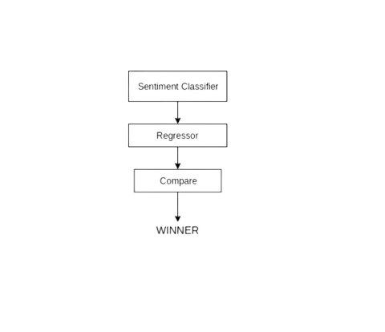
METHODOLOGY
1. Importing the Libraries.
2. Loading the Training Dataset.
3. Normalizing the Dataset
4. Reshape the data
5. Building the Model by Importing the Librarie.
7. Extracting the Actual Tweets.
8. Predicting the future Values.
9. Predicted Result.

Slide 6
ALGORITHM : SENTIMENT ANALYSIS
Sentiment analysis, also referred to as opinion mining, is an approach to natural language processing (NLP) that identifies the emotional tone behind a body of text. This is a popular way for organizations to determine and categorize opinions about a product, service, or idea.
READ MORE

Slide 7
Why
WHY SENTIMENT ANALYSIS IS NECESSARY?
SENTIMENT ANALYSIS (OR OPINION MINING) IS A NATURAL LANGUAGE PROCESSING (NLP) TECHNIQUE USED TO DETERMINE WHETHER DATA IS POSITIVE, NEGATIVE OR NEUTRAL. SENTIMENT ANALYSIS IS OFTEN PERFORMED ON TEXTUAL DATA TO HELP BUSINESSES MONITOR BRAND AND PRODUCT SENTIMENT IN CUSTOMER FEEDBACK, AND UNDERSTAND CUSTOMER NEEDS.

Slide 8
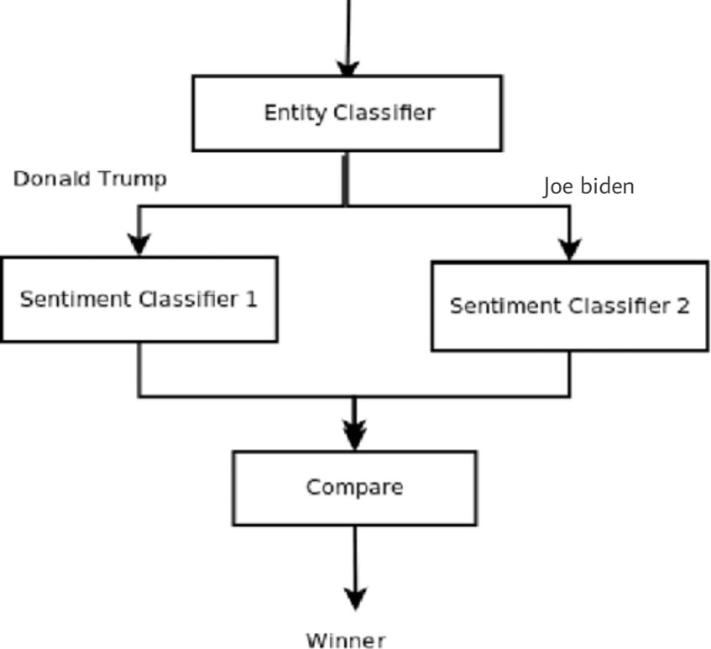

BLOCK DIAGRAM

Slide 9
Tools
➤ Tweepy — a type of RESTful API specifically for Twitter
➤ Textblob — processed textual data library tool (already trained on numerous textual data.)
➤ Pandas — data manipulation and analysis library
➤ NumPy — scientific computing library
➤ Matplotlib — plotting library
➤ Plotly — plotting library
➤ Seaborn — Data visualization library based on Matplotlib
➤ Wordcloud — library for a visual representation of textual data

Slide 10
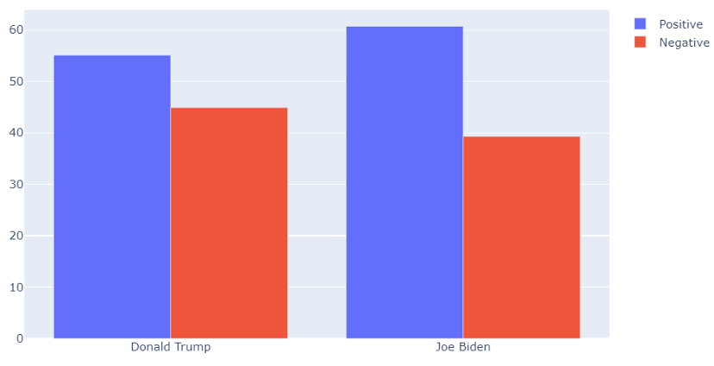
VISUALIZATION

Slide 11
CONCLUSION
THE PROPOSED SYSTEM CAN BE USED BY POLITICAL PARTIES TO IMPROVE THEIR CAMPAIGNING STRATEGIES DURING THE ELECTION PERIOD. IT CAN BE USED BY THEM AS A PART OF SOCIAL MEDIA ANALYTICS TO STUDY THE TRENDS OF OTHER POLITICAL PARTIES AS WELL.
POLITICAL ANALYST AND STRATEGIST CAN USE THIS METHODOLOGY, AS APPLICATION, AS A LONG TERM PLAN FOR A POLITICAL PARTY TO STUDY THE SENTIMENTS OF PEOPLE OVER A LONG TIME PERIOD.

Slide 12
REFERENCES :
1.HTTPS://WWW.ANALYTICSVIDHYA.COM/BLOG/2018/02/NATURAL-LANGUAGE-PROCESSING-FOR-BEGINNERS-USING-TEXTBLOB/
2.HTTPS://IEEEXPLORE.IEEE.ORG/DOCUMENT/9377201
3.HTTPS://THECLEVERPROGRAMMER.COM/2020/10/01/PREDICT-US-ELECTIONS-WITH-PYTHON/

Slide 13

THANKS
YOU

