Slide 1
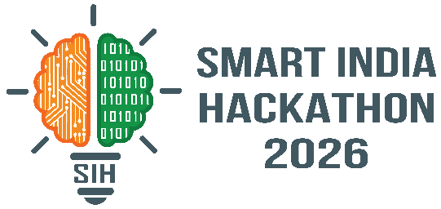


SMART INDIA HACKATHON 2026
Problem Statement ID – SIH26067
Problem Statement Title- Develop a web-based interactive 3D visualization platform that integrates numerical ocean model outputs and in-situ observation
Theme- Disaster Management
PS Category- Software
Team ID- 3B0D5B
Team Name – Ukdiche Modak

Slide 2
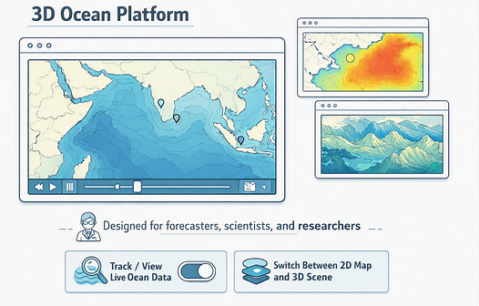
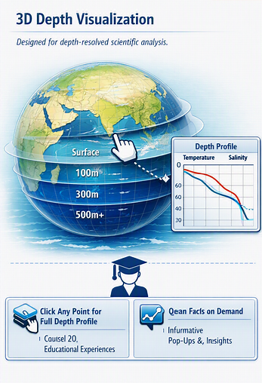
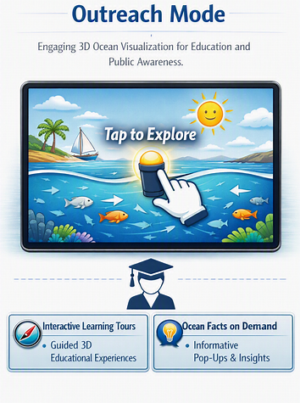
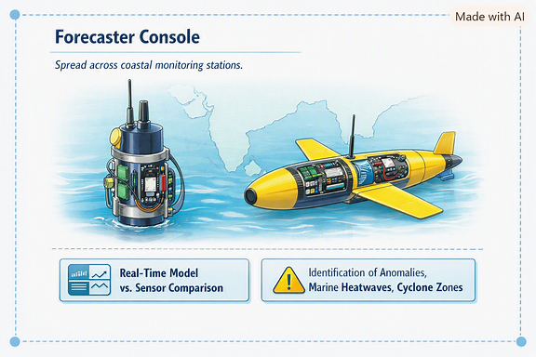
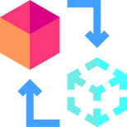



SAGAR-DRISHTI
SAGAR-DRISHTI is a browser-based platform that combines 3D visualization, live data, and AI for a faster, clearer, and more accurate ocean forecasting process.
SOLUTION
PROTOTYPE
3D ocean scene for forecasters to rotate the field, navigate depth layers, and compare instrument readings against model predictions
Browser client for scientists to explore variables, animate time, and export depth-vs-parameter profile charts instantly
Co-location engine automatically matches real Argo/Glider readings to the nearest model grid point and timestamp
Outreach mode for public and students to explore a simplified, curated 3D ocean with plain-language explanations
We solve the problem with a unified visualization platform tailored for India's coastline, offering real-time 3D rendering, model-observation validation, and modular sensor integration.
We visualize 4 real datasets with a fully browser-native 3D engine, giving forecasters zero-install access to live ocean model and instrument comparisons..
WHY WE STAND OUT ?
Real-Time Model-Observation Engine
Forecasters can instantly compare live model predictions against real sensor readings for faster decisions.
Depth aware 3-D rendering
Our platform renders true volumetric ocean structure, not flat maps, revealing layers invisible in 2D tools.
Browser Native Solution with Zero Installation
Our platform ensures consistent access and performance across any device, with no setup required.
Modular Sensor Integration for Scale and Extensibility
Our architecture supports new instruments and variables, ensuring growth from prototype to operational system.
2

Slide 3

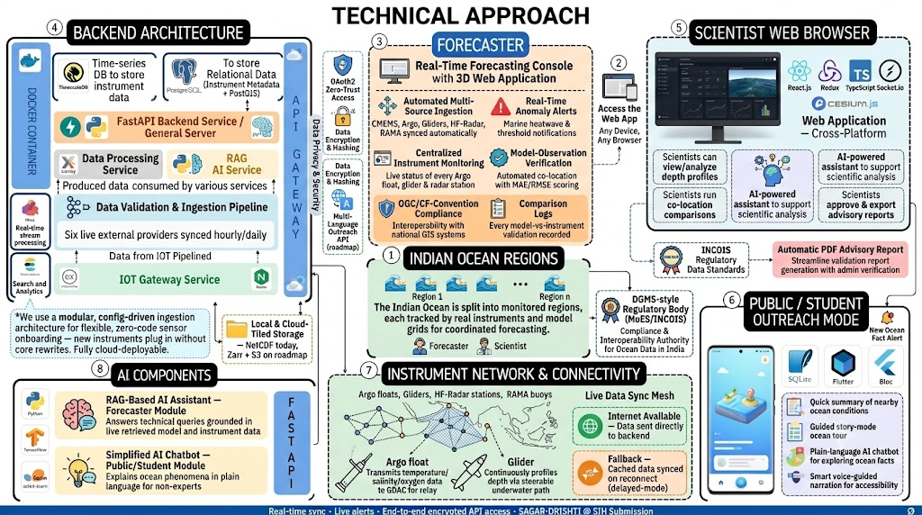
3

Slide 4
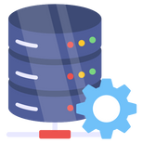




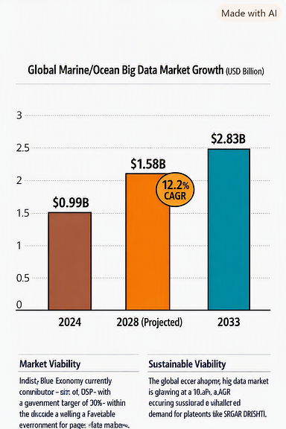
FEASIBILITY AND VIABILITY
FEASIBILITY
CHALLENGES
Technical Feasibility
Our entire stack relies on mature, freely available, open-source technologies — WebGL is supported natively in every modern browser, and our source data (Copernicus Marine Service, Argo, IOOS) is published under open data-access policies with no licensing barrier. There is no dependency on proprietary or unavailable technology.
.
1. Handling Massive Multi-Dimensional Datasets in a Browser Our source datasets exceed 5.8 GB per file, spanning latitude, longitude, depth, and time — far too large to load directly into a browser without causing severe lag or crashes.
2. Real-Time 3D Rendering Across Varying Hardware INCOIS forecasters and public users will access the platform on a wide range of devices, from powerful workstations to modest institutional laptops, and WebGL performance varies significantly across GPU classes.
Operational Feasibility
The Government of India is already actively investing in this exact space — MoES's Deep Ocean Mission budget grew from ₹3,064.8 crore (2024–25) to ₹3,649.8 crore (2025–26), and the 2024 PRITHVI Scheme allocated ₹4,797 crore across ocean and climate observation systems. Our platform slots directly into this existing, funded, growing institutional push rather than needing to create demand from scratch.
3. Integrating Heterogeneous Instrument Data Formats Argo floats, gliders, and future sensors like HF-Radar each arrive in different file formats and structures, risking a fragile pipeline that breaks every time a new instrument type is added.
4. Meeting Government-Grade Security & Interoperability Standards Before any real INCOIS deployment, the platform must support role-based access, audit logging, and OGC-standard interoperability — requirements a hackathon-stage prototype doesn't yet fully implement.
Economic Feasibility
Our platform is built entirely on open-source software — React, Three.js, FastAPI, xarray — eliminating the recurring per-seat licensing costs of tools like MATLAB or ArcGIS, which typically run into lakhs of rupees annually per institution. This makes deployment substantially cheaper to scale across INCOIS's forecaster and researcher base than the desktop tools it would replace.
Data & Regulatory Feasibility
Our architecture is built around CF-Convention and OGC WMS/WCS standards — the same standards INCOIS's own data already complies with — meaning integration doesn't require new data-governance approval processes, only adoption of a new visualization layer on top of existing, already-compliant data pipelines.
How we plan to overcome them:
Market Viability
The global Marine/Ocean Big Data Market is growing at a 12.2% CAGR, from $0.99B (2024) to $2.83B (2033) — while India's Blue Economy, still only ~4% of GDP, has a government target of 10%+ within the decade.
Institutional Viability
MoES's Deep Ocean Mission budget grew from ₹3,064.8 Cr → ₹3,649.8 Cr in one year, showing sustained government investment in this exact space.
1. Volumetric Tiling & Scoped Delivery Zarr-style chunking serves only the exact slice requested — never the full dataset.
needed later.
2. Adaptive Rendering (LOD) Grid resolution auto-downsamples on lower-end hardware — degrades gracefully, never crashes.
3. Modular Ingestion Framework New instruments onboard via config files, not core code rewrites.
4. Security Built In from Day One OAuth2, audit logging, and OGC compliance are architected in from the start — no redesign

Slide 5
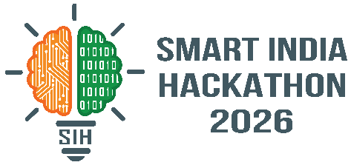
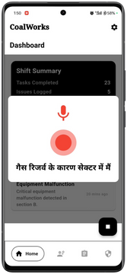


























IMPACTS AND BENEFITS
OPERATIONAL BENEFITS
SCIENTIFIC BENEFITS
PUBLIC BENEFITS
Though model validation once took manual cross-checking, the system pays off by cutting decision time to seconds, preventing forecast d
elays, and enabling faster, more confident coastal advisories.
Improved model-observation validation leads to more accurate ocean forecasting, potentially strengthening early warning systems and reducing the ecological impact of delayed disaster response.
SAGAR-DRISHTI enhances coastal safety and awareness while promoting science literacy through accessible outreach, contributing to informed communities and reduced disaster impact.
STAKEHOLDERS & IMPACTS
Sample Scenario
"The forecaster spots a temperature anomaly directly in the 3D ocean scene."
"Our co-location engine automatically matches the anomaly against the nearest model prediction."
"Cross-validation of the anomaly using AI-assisted RAG explanations."
"OGC-standard data export integrates directly into national GIS systems."
Anamoly detected
Notices unusual warming near the coast and flags it for verification.
Model-Observation Check
Advisory Verification
Reviews the validated comparison and approves it for official advisory issuance.
Data Utilization
Uses verified data for advisory records, audits, and long-term climate monitoring.
Forecaster
Duty Forecaster
Compares real Argo/Glider readings with model output, computing live accuracy metrics.
Senior Scientist
INCOIS Management
Government and Regulatory Bodies
Real-time validated data improves oversight for NDMA and MoES
Supports faster, more accurate coastal disaster advisories and policy decisions
Faster anamoly detection
Confident, Data-Backed Decisions Faster validation with live model-observation comparison and clear accuracy metrics.
Simplified Verification Real-time tracking of every validated anomaly, reducing risk of delayed advisories.
Reduced manual cross-checking, quicker first response, less forecaster workload.
OUR PROMISE
Our solution perfectly aligns with the UN Sustainable Development Goals — advancing ocean science, climate resilience, and coastal safety for India.
India’s Goal:
Reach ₹4,797 Cr cumulative ocean & climate research investment [PRITHVI Scheme, 2024] In FY2024-25, MoES's Deep Ocean Mission budget was ₹3,064.8 Cr, growing to ₹3,649.8 Cr in FY2025-26 — a 19.1% YoY growth rate.
*Consolidated Proof documents of all research is provided in slide 6
SAGAR-DRISHTI is projected to reduce model-validation time by up to 93%, validated against existing manual cross-checking workflows.
A 93% reduction cuts forecaster validation time from 15 minutes to under 60 seconds — directly strengthening India's coastal disaster advisory response targets.

Slide 6



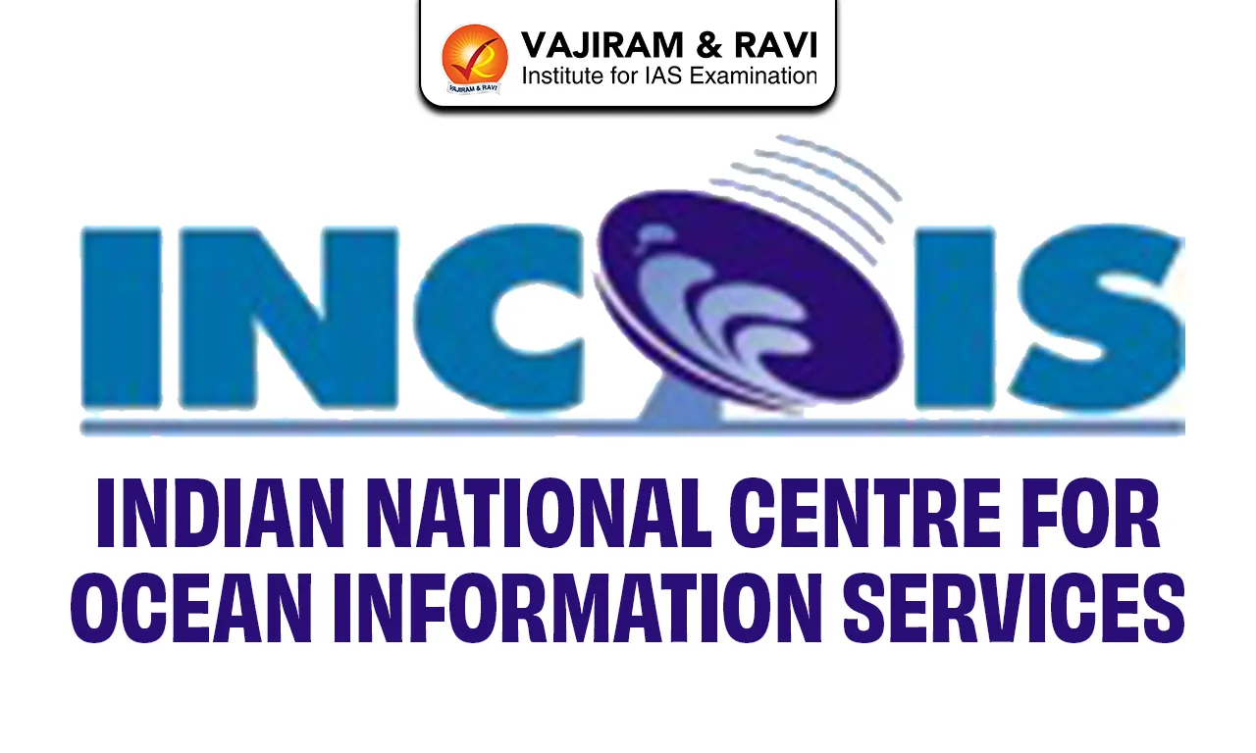
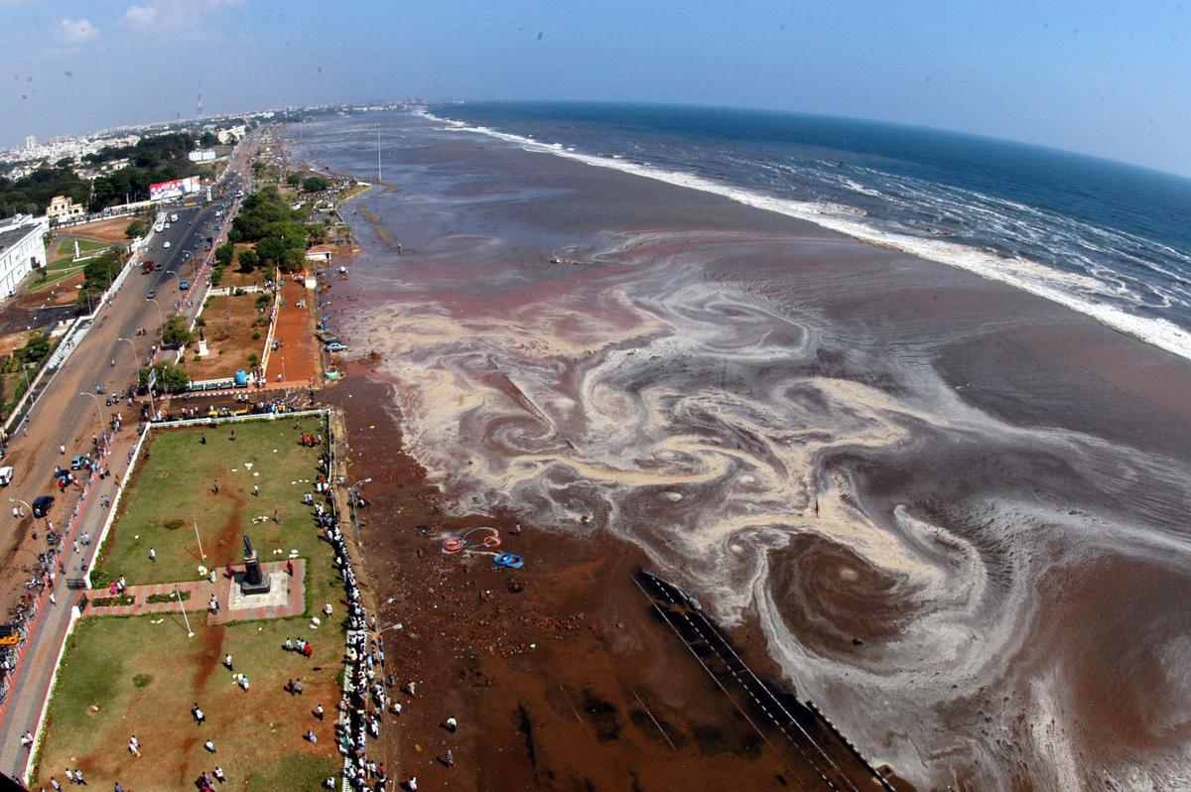

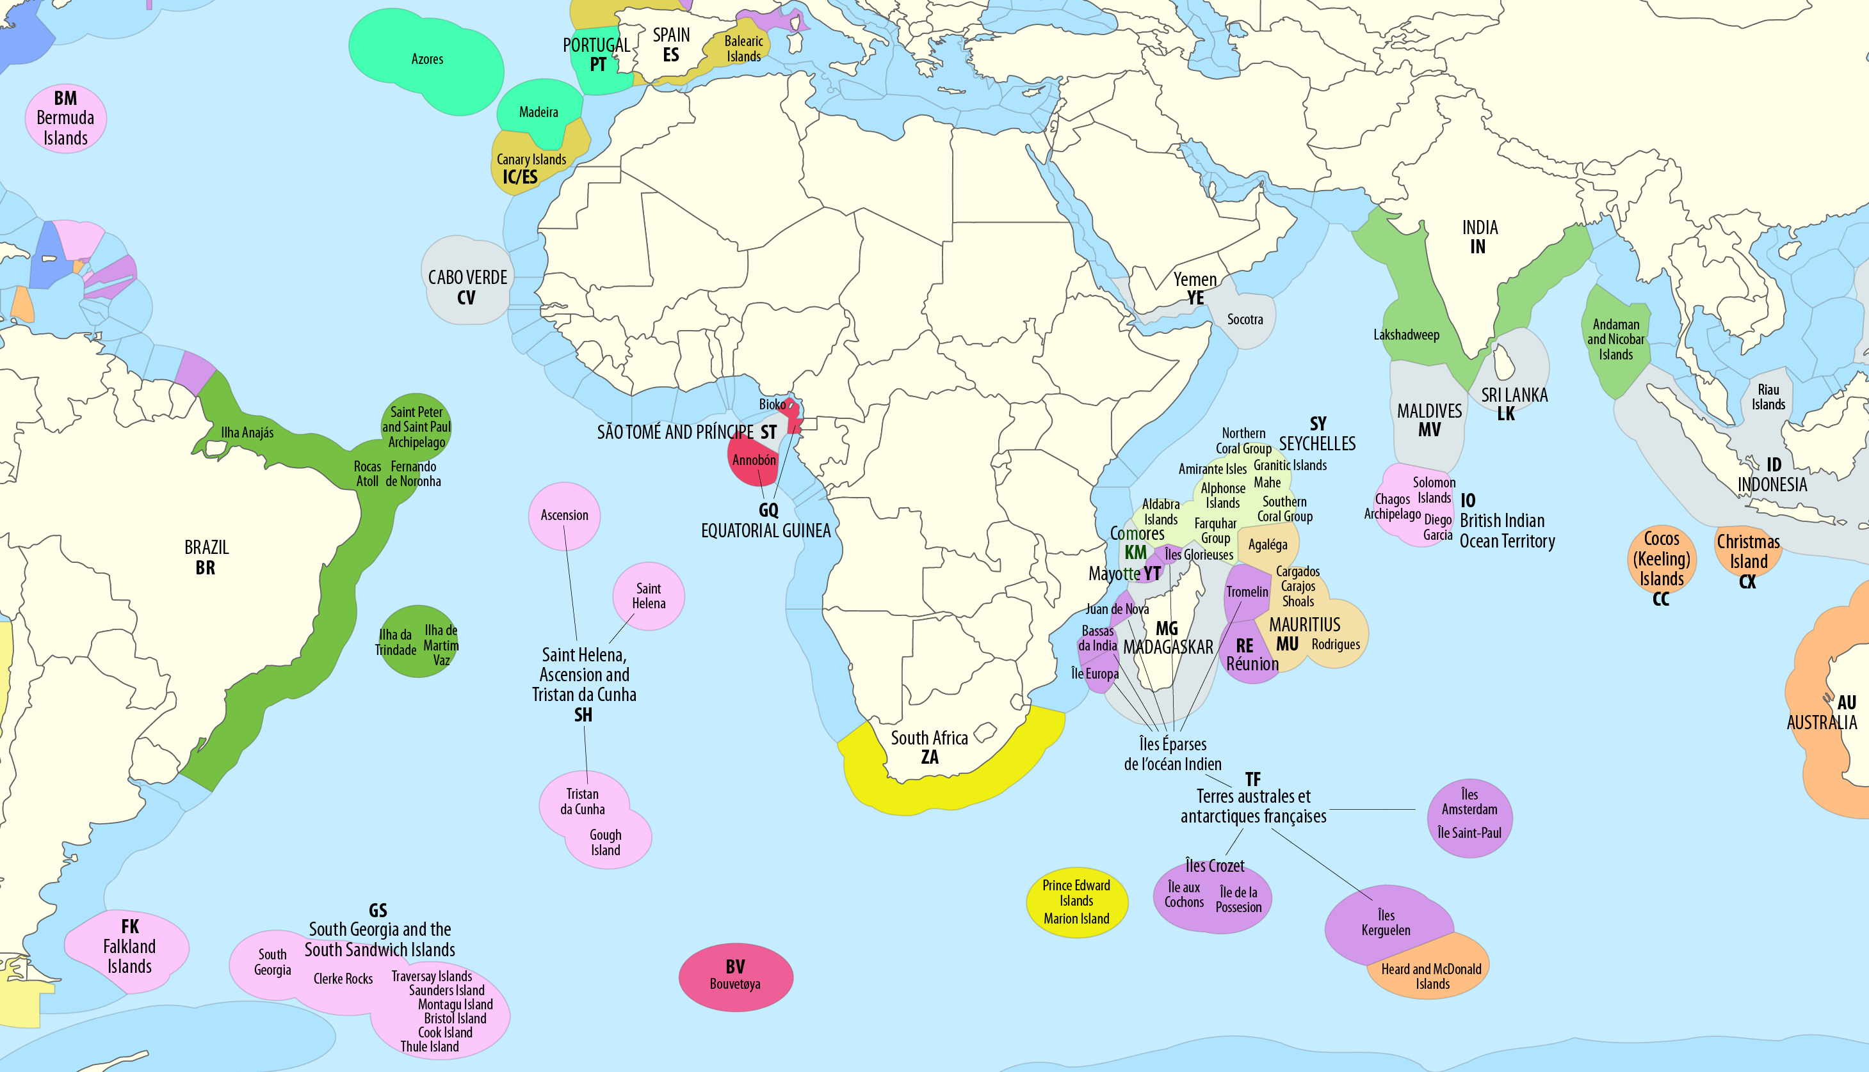
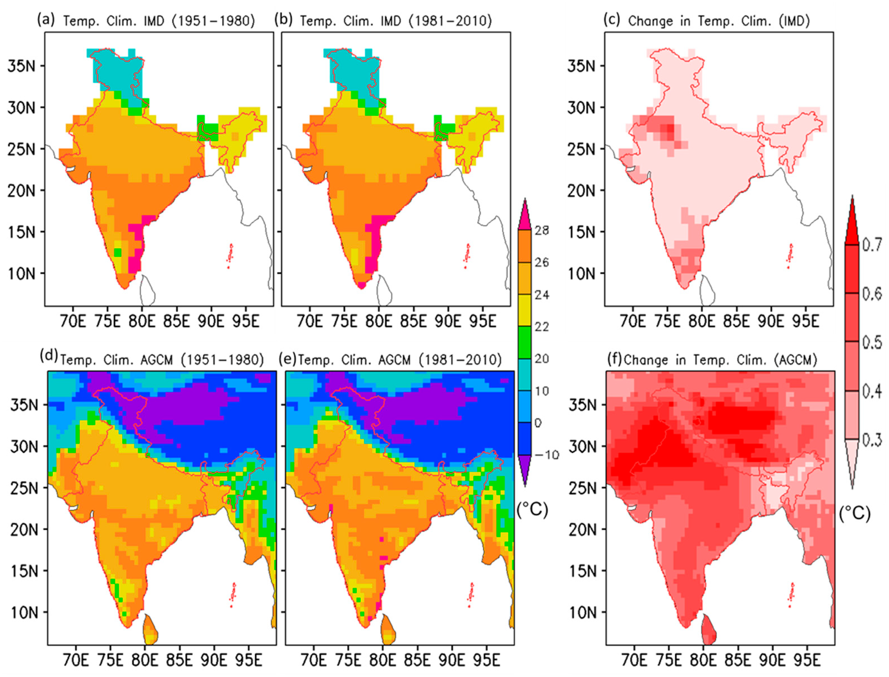
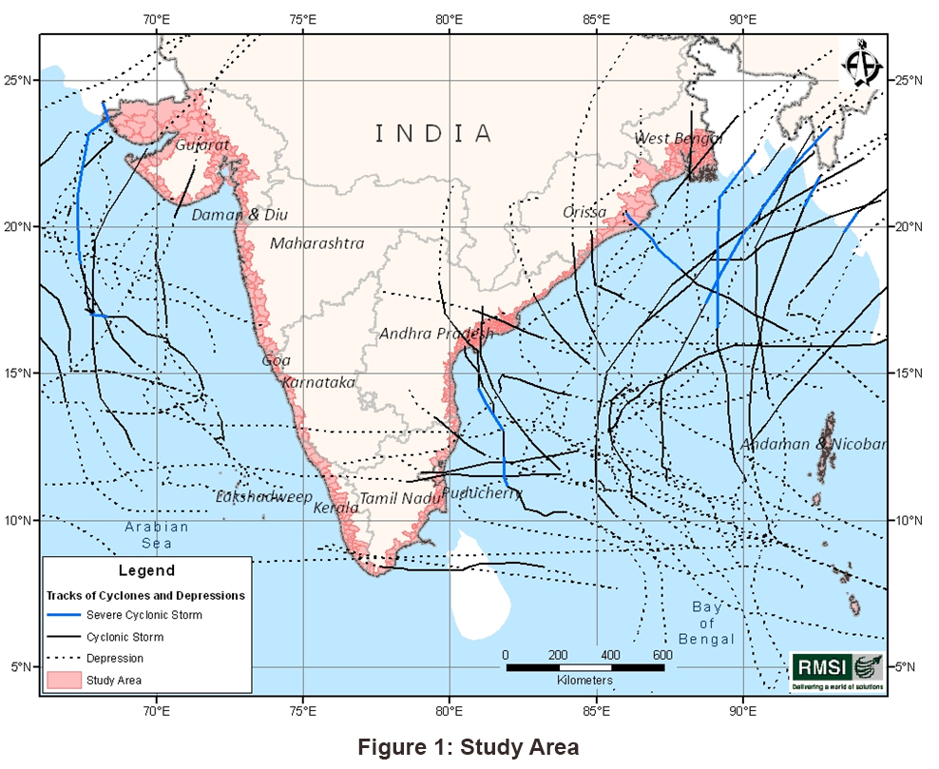
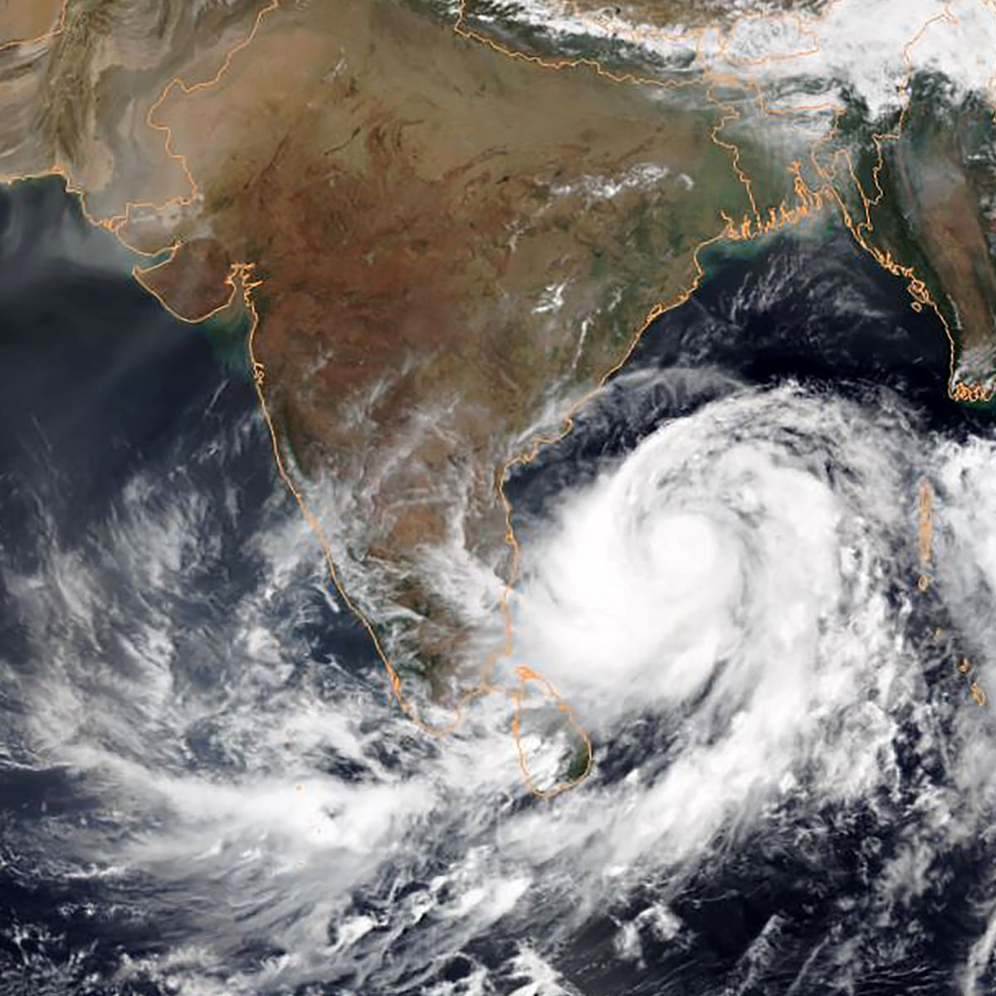





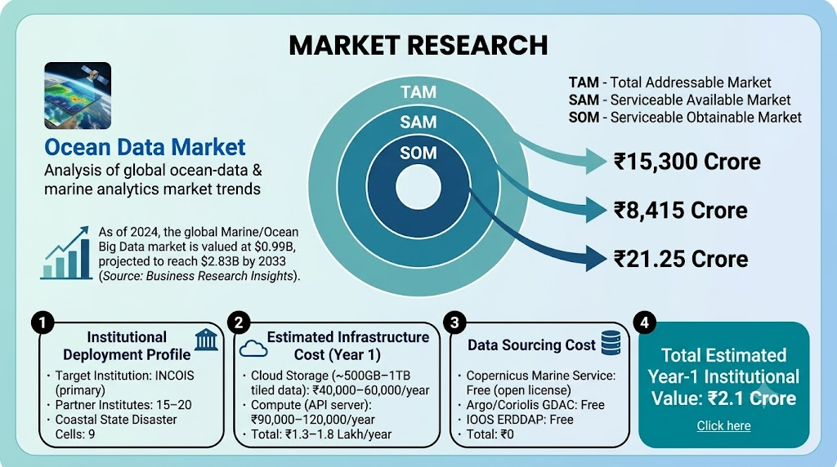



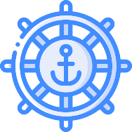

RESEARCH AND REFERENCES
Ocean-Geography : RESEARCH
Our Works
CLICK ON THE
GitHub
https://github.com/RutuRaj-1/Sagar_Drishti
Proof Documents
Consolidated proof documents of all the work
Click here
INCOIS — Indian Ocean Overview:
NDMA — Tsunami Hazard Profile: https://ndma.gov.in/Natural-Hazards/Tsunami n
IMAGES TO
https://incois.gov.in/site/services/global.jsp
VIsIT LINKs
Wikipedia — Exclusive Economic Zone of India: https://en.wikipedia.org/wiki/Exclusive_economic_zone_of_India
IMD/RSMC New Delhi — Cyclone Hazard Climatology (PDF): https://rsmcnewdelhi.imd.gov.in/uploads/climatology/hazard.pdf
OCEAN APIS
VISUALIZATION REFS
NDMA — Cyclone Hazard Profile: https://ndma.gov.in/Natural-Hazards/Cyclone
Springer Nature — Cyclone Disaster Mitigation and Management in India: An Overview: https://link.springer.com/chapter/10.1007/978-981-99-4105-6_7
Copernicus Marine Service: https://marine.copernicus.eu/
Three.js Documentation: https://threejs.org/docs/
India sees 5–6 cyclonic storms annually, with 13% of the world's cyclones forming in seas around India. The 2004 Indian Ocean Tsunami caused 18,045 deaths, and 26% of India's population lives within 100 km of the coastline — directly exposed to cyclones, storm surges, and tsunamis.
Coriolis GDAC: https://www.coriolis.eu.org/
Marching Cubes Algorithm: https://en.wikipedia.org/wiki/Marching_cubes
BACK END
FastAPI Documentation: https://fastapi.tiangolo.com/
xarray Documentation: https://docs.xarray.dev/
DESKTOP OCEAN SOFTWARE - REFERENCES
Ocean Data View (ODV) Desktop software for interactive exploration of oceanographic and other geo-referenced profile or trajectory data. Ocean Data View is one of the most widely used tools by oceanographers globally for visualizing and analyzing NetCDF-based ocean datasets, but requires installation and lacks web-based 3D rendering. Click here: https://odv.awi.de/
Copernicus Marine Toolbox Official Python/CLI toolbox for downloading and subsetting CMEMS ocean model data. Copernicus's own toolbox provides raw data access and basic plotting, but offers no interactive 3D visualization or real-time model-vs-instrument comparison — the exact gap SAGAR-DRISHTI fills. Click here: https://marine.copernicus.eu/access-data/copernicus-marine-toolbox
SAGAR-DRISHTI - @SIH Idea Submission
6

