Slide 1
TRAFFIC SIGN BOARDS RECOGNITION
Rutu M Belki (1CD21CS128)
Shania Britney Hoskins (1CD21CS143)
Sneha Hedgapure (1CD21CS152)
Sinchana Jain (1CD21CS150)

Slide 2
Contents
Introduction
System Requirements
Existing and Proposed Models
System Architecture
Implementation
Result
Conclusion

Slide 3
Introduction
The traffic sign detection system aims to accurately recognize and interpret traffic signs for enhanced driving capabilities.
Traffic sign board recognition is a critical aspect of autonomous driving and advanced driver-assistance systems (ADAS).
It involves the use of computer vision and machine learning techniques to detect and interpret traffic signs, providing real-time information to the vehicle or driver.

Slide 4
System Requirements
Hardware Requirements:
Processor: AMD Ryzen 5, Intel Core i5 or quad-core or higher recommended.
Memory (RAM): 8 GB or higher (16 GB recommended for larger datasets or deep learning models)
Storage: Solid-state drive (SSD) with at least 256 GB of free space
Graphics Processing Unit (GPU): NVIDIA GTX 1060 or equivalent with CUDA support (optional but recommended for accelerated deep learning tasks)
Camera: High-resolution camera capable of capturing clear images (resolution of 1080p or higher recommended)
Additional Hardware: Power supply unit, peripherals (e.g., monitors, input devices) as needed

Slide 5
System Requirements
Software Requirements:
Operating System: Windows 11, macOS, or Linux
Development Environment: Python 3.7 or higher
Software Libraries:
OpenCV (for image processing and computer vision tasks)
TensorFlow (for deep learning-based algorithms)
scikit-learn (for machine learning algorithms)
CARLA Simulator
Integrated Development Environment (IDE): Visual Studio Code
Dependencies: NumPy, SciPy, Matplotlib

Slide 6
Existing System
Tesla's Traffic Light and Sign Control represents one of the most advanced self-driving features available in the automotive industry.
Tesla's Traffic Light and Sign Control utilizes forward-facing cameras and GPS data to recognize and respond to traffic signals, including traffic lights, stop signs, and road markings.
It operates when Autosteer, Traffic-Aware Cruise Control, or Full Self-Driving (Supervised) is engaged, providing drivers with notifications on the touchscreen when approaching intersections.
The system slows down the vehicle as it approaches intersections, displaying a red line on the touchscreen to indicate where the vehicle will stop. To proceed, the driver must confirm by pressing down on the drive stalk or briefly pressing the accelerator pedal.

Slide 7
Existing System
Disadvantages:
Limited to Environmental Conditions
Reliance on Camera Visibility
Map Data Dependency
Tilted and distorted traffic sign boards
Scene Complexity
Lighting Conditions

Slide 8
Proposed System
The proposed traffic sign detection system aims to accurately recognize and interpret traffic signs for enhanced autonomous driving capabilities.
Data Collection and Preprocessing:
Acquired a German Traffic Sign Recognition Benchmark Dataset from Kaggle
CNN Architecture: Sequential
Integration with Simulation: CARLA
Generate scenarios with varying traffic sign placements, weather conditions, and lighting to ensure robustness

Slide 9
Proposed System
Advantages:
Using Simulated a Environment
Enhanced Safety
Improved Efficiency
Improved Accuracy and Robustness

Slide 10
System Architecture
Data collection involves acquiring a diverse traffic sign dataset. This dataset was already available on Kaggle which has over 43 different classes and a total of 39,209 images that we trained our model on.
Data augmentation techniques such as rotation, translation, scaling, and flipping are applied to increase the diversity of the dataset.
Training the CNN model involves selecting and optimizing the architecture, followed by training, parameter tuning, and validation steps to ensure optimal performance. We select the Sequential model with 4 convolution layers, 2 maxpooling layers and 1 fully connected one.

Slide 11
System Architecture
The CARLA simulator provides various maps one can choose from where they can spawn cars, signs, people, etc.

Slide 12
Implementation
DATASET:
classes = {
0: 'Speed limit (20km/h)', 1: 'Speed limit (30km/h)', 2: 'Speed limit (50km/h)',
3: 'Speed limit (60km/h)', 4: 'Speed limit (70km/h)', 5: 'Speed limit (80km/h)',
6: 'End of speed limit (80km/h)', 7: 'Speed limit (100km/h)', 8: 'Speed limit (120km/h)',
9: 'No passing', 10: 'No passing veh over 3.5 tons', 11: 'Right-of-way at intersection',
12: 'Priority road', 13: 'Yield', 14: 'Stop', 15: 'No vehicles',
16: 'Veh > 3.5 tons prohibited', 17: 'No entry', 18: 'General caution',
19: 'Dangerous curve left', 20: 'Dangerous curve right', 21: 'Double curve',
22: 'Bumpy road', 23: 'Slippery road', 24: 'Road narrows on the right',
25: 'Road work', 26: 'Traffic signals', 27: 'Pedestrians', 28: 'Children crossing',
29: 'Bicycles crossing', 30: 'Beware of ice/snow', 31: 'Wild animals crossing',
32: 'End speed + passing limits', 33: 'Turn right ahead', 34: 'Turn left ahead',
35: 'Ahead only', 36: 'Go straight or right', 37: 'Go straight or left',
38: 'Keep right', 39: 'Keep left', 40: 'Roundabout mandatory',
41: 'End of no passing', 42: 'End no passing vehicle with a weight greater than 3.5 tons’
}

Slide 13
TRAINING:
def load_images(path):
image_data = []
image_labels = []
for i in range(len(classes)):
class_path = os.path.join(path, str(i))
for img in os.listdir(class_path):
try:
image = cv2.imread(os.path.join(class_path, img), cv2.IMREAD_GRAYSCALE) # Read as grayscale
image_fromarray = Image.fromarray(image, 'L')
resize_image = image_fromarray.resize((IMG_HEIGHT, IMG_WIDTH))
image_data.append(np.array(resize_image))
image_labels.append(i)
except Exception as e:
print(f"Error in {img}: {e}")
image_data = np.array(image_data)
image_labels = np.array(image_labels)
return image_data, image_labels
# Load training data
X_train, y_train = load_images(train_path)
X_train = X_train / 255.0 # Normalize pixel values
# Reshape for the model input
X_train = X_train.reshape(-1, IMG_HEIGHT, IMG_WIDTH, 1)
# Split training and validation sets
X_train, X_val, y_train, y_val = train_test_split(X_train, y_train, test_size=0.3, random_state=42)
# Convert labels to categorical
y_train = utils.to_categorical(y_train, num_classes=len(classes))
y_val = utils.to_categorical(y_val, num_classes=len(classes))

Slide 14
CNN MODEL:
model = models.Sequential([
layers.Conv2D(filters=16, kernel_size=(3,3), activation='relu', input_shape=(IMG_HEIGHT, IMG_WIDTH, 1)), # Change input shape to (30, 30, 1)
layers.Conv2D(filters=32, kernel_size=(3,3), activation='relu'),
layers.MaxPool2D(pool_size=(2, 2)),
layers.BatchNormalization(axis=-1),
layers.Conv2D(filters=64, kernel_size=(3,3), activation='relu'),
layers.Conv2D(filters=128, kernel_size=(3,3), activation='relu'),
layers.MaxPool2D(pool_size=(2, 2)),
layers.BatchNormalization(axis=-1),
layers.Flatten(),
layers.Dense(512, activation='relu'),
layers.BatchNormalization(),
layers.Dropout(rate=0.5),
layers.Dense(len(classes), activation='softmax')
])

Slide 15
TESTING:
def preprocess_img(img):
img = cv2.cvtColor(img, cv2.COLOR_BGR2GRAY) # Convert to grayscale
img = cv2.resize(img, (IMG_HEIGHT, IMG_WIDTH)) # Resize to model's expected input size
img = img / 255.0 # Normalize
img = img.reshape(1, IMG_HEIGHT, IMG_WIDTH, 1) # Reshape for model input
return img
# Open camera
cap = cv2.VideoCapture(0)
if not cap.isOpened():
print("Failed to open camera.")
exit()
font = cv2.FONT_HERSHEY_SIMPLEX
predictions_deque = deque(maxlen=10) # Store last 10 predictions for smoothing

Slide 16
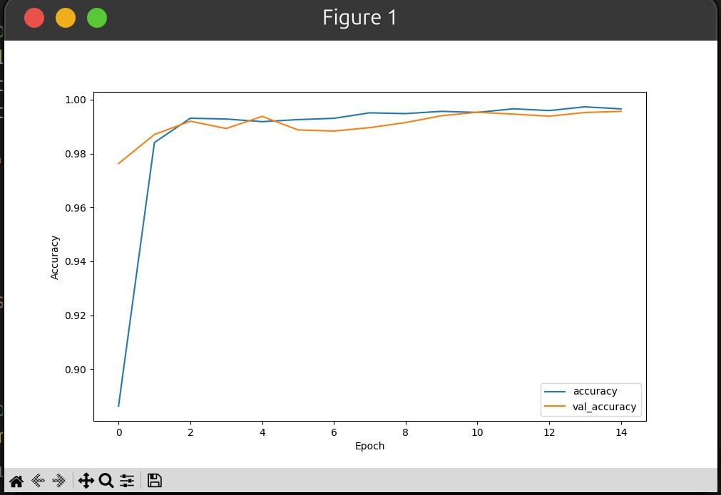
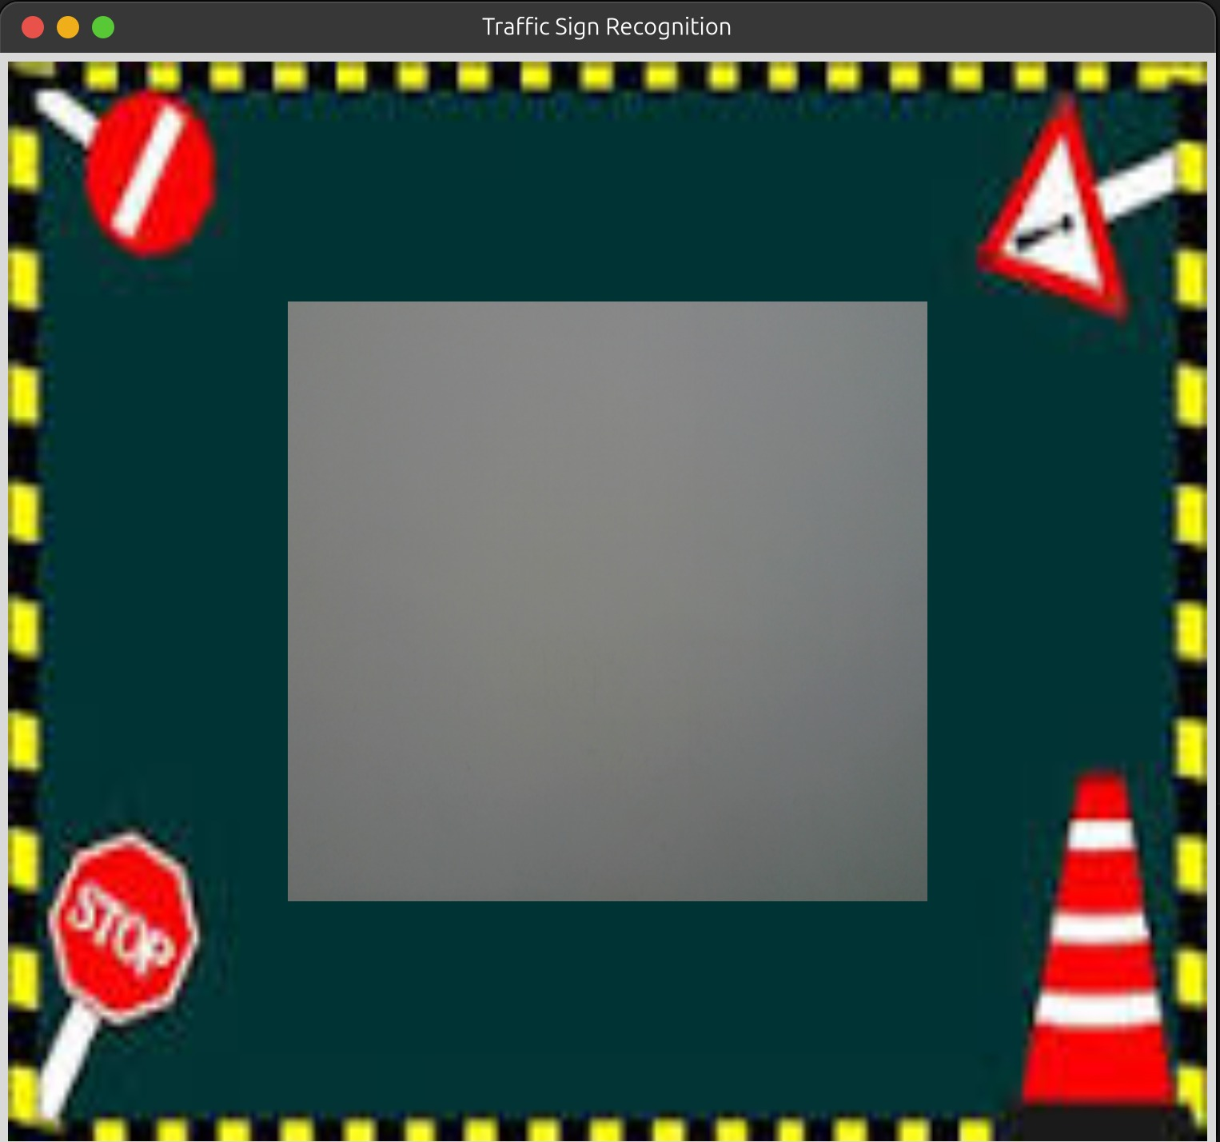
Result

Slide 17
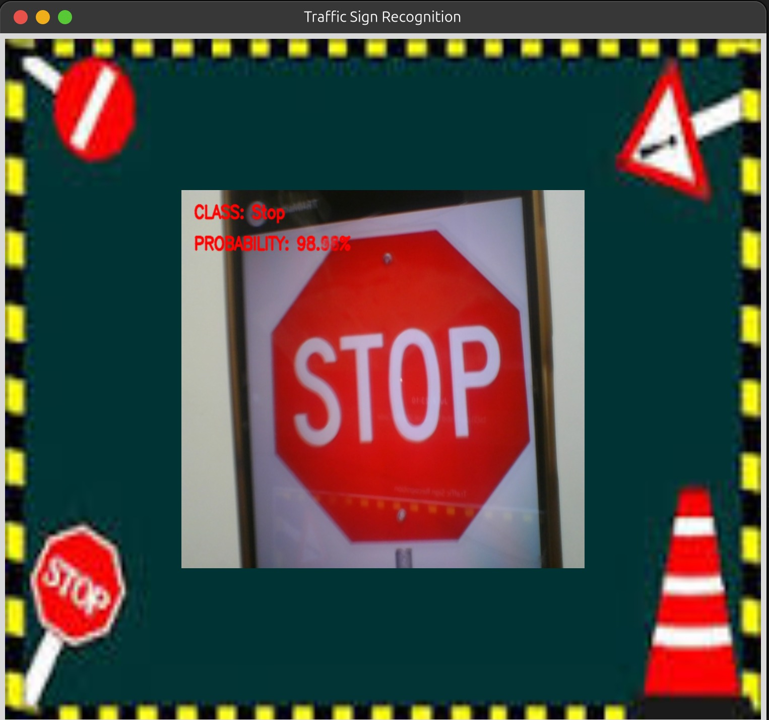
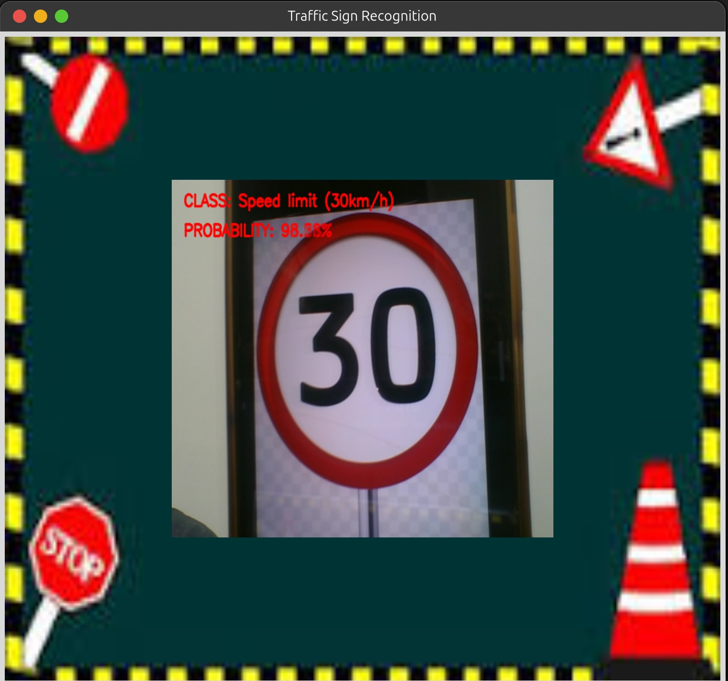

Slide 18
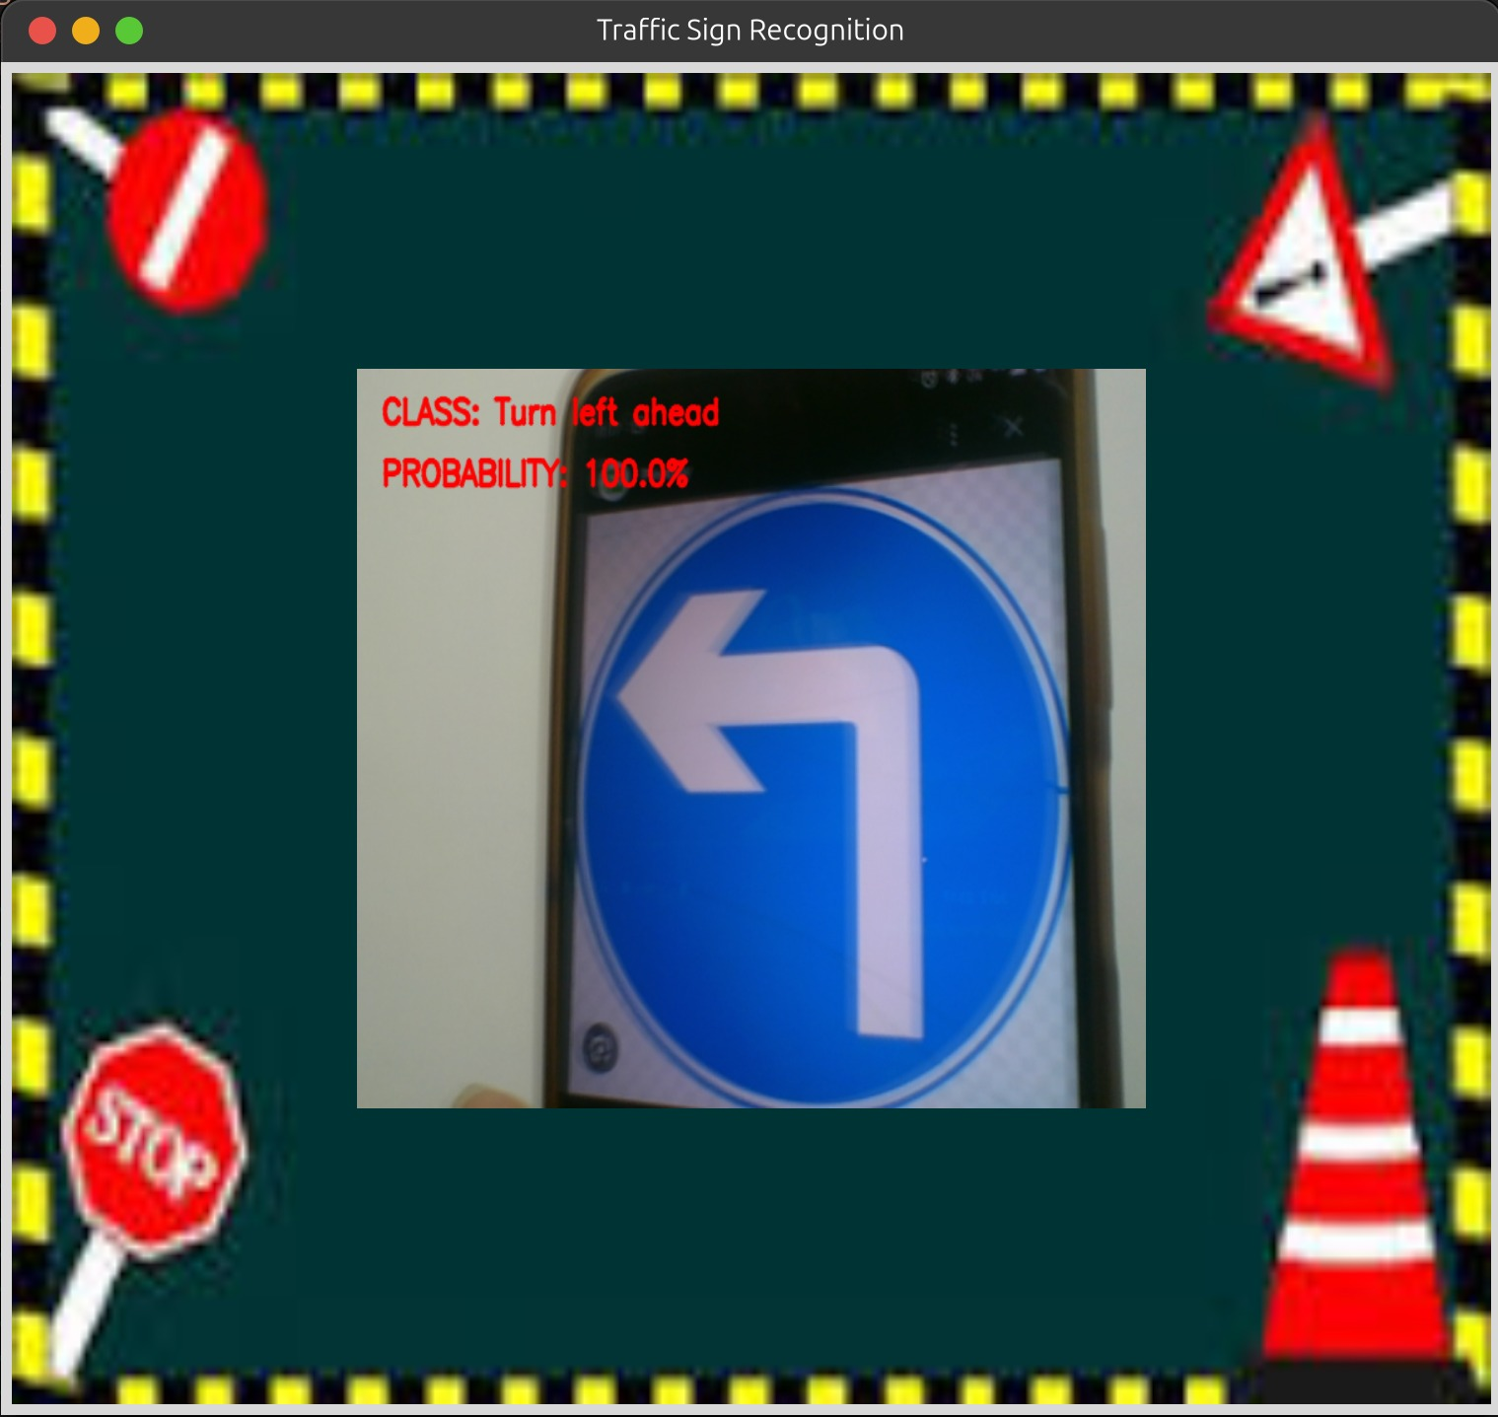
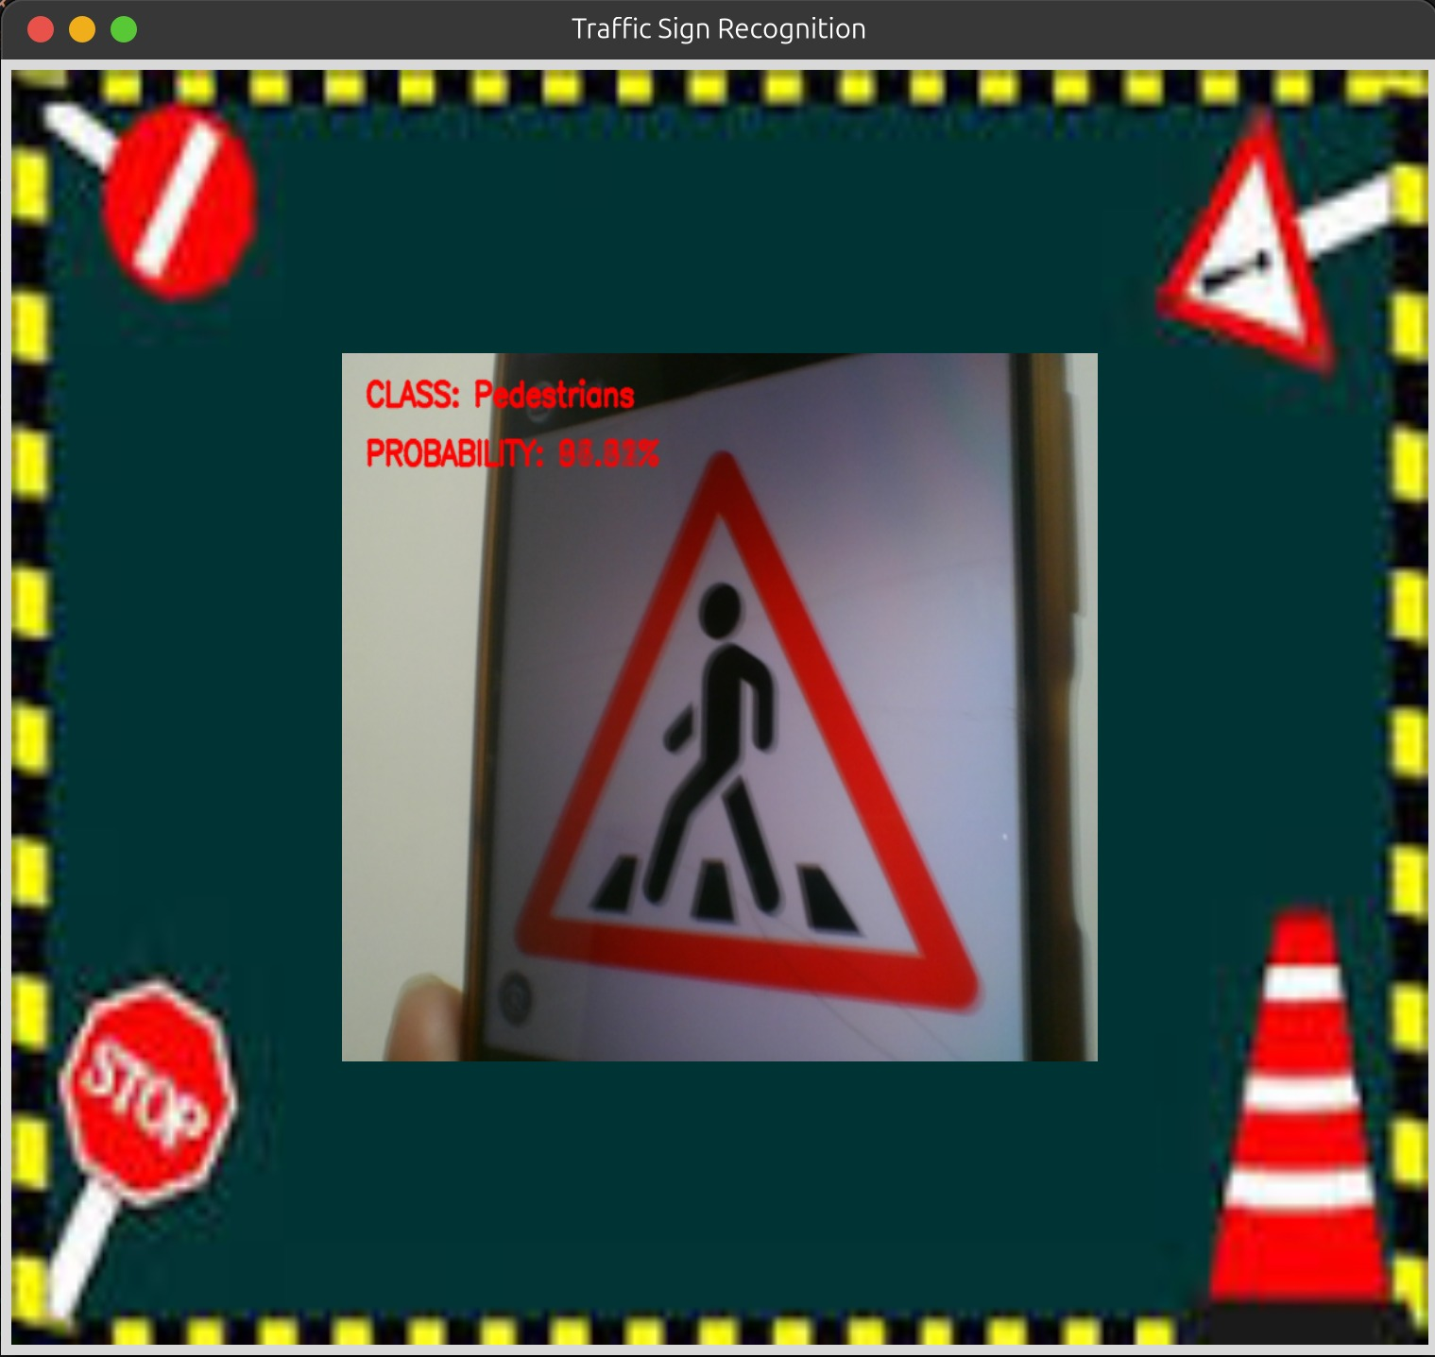

Slide 19
Conclusion
The goal of this research is to develop an efficient Traffic Sign Boards recognition system as this is a huge feat in the realm of emerging technologies.
The system has been around for barely over a year, and thus this project gave us an insight into the various hardships that the team must have faced.
Further research is going on in the industry aspect of this project, so that it can become an inherent feature in all vehicles around the world.

Slide 20
References
https://www.researchgate.net/publication/342987130_Difficulties_of_Traffic_Sign_Recognition
https://www.tesla.com/ownersmanual/modely/en_eu/GUID-A701F7DC-875C-4491-BC84-605A77EA152C.html
https://www.analyticsvidhya.com/blog/2021/12/traffic-signs-recognition-using-cnn-and-keras-in-python/
https://github.com/alen-smajic/Towards-Explainable-AI-System-for-Traffic-Sign-Recognition-and-Deployment-in-a-Simulated-Environment
file:///C:/Users/belki/Downloads/Wael-Recognition-of-Traffic-Signs.pdf

Slide 21
THANK YOU!

