Slide 1
Hooks
OW

Slide 2
Hooks
Helm hooks and ArgoCD hooks are both mechanisms used in Kubernetes-based environments to execute custom logic during specific lifecycle events
However, they serve different purposes and are integrated differently within their respective deployment and management tools.

Slide 3
Helm Hooks Types
Pre-install and Pre-upgrade Hooks:Executed before any resources are created or modified during installation or upgrade.Useful for tasks like provisioning infrastructure or setting up prerequisites.
Post-install and Post-upgrade Hooks:Executed after resources are successfully created or modified during installation or upgrade.Useful for tasks like initializing applications or performing cleanup.
Pre-delete Hooks:Executed before resources are deleted during uninstallation.Useful for tasks like exporting data or performing final cleanup actions.

Slide 4
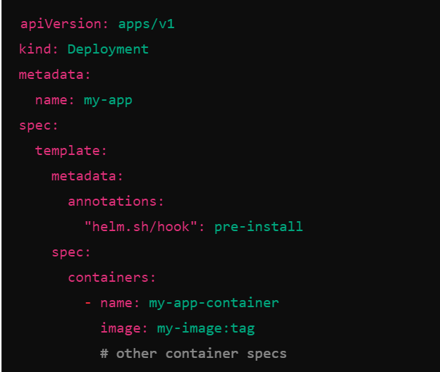
..

Slide 5
Argo CD Hooks
PreSync Hook: Executed before synchronization (deployment) of resources to the Kubernetes cluster.Useful for tasks like environment-specific configuration adjustments or validation checks.
Sync Hook: Executed during synchronization, after resources are applied but before status is reported back to ArgoCD.Useful for tasks that need to be performed immediately after applying resources.
PostSync Hook: Executed after synchronization is complete.Useful for tasks like notifications, logging, or triggering downstream processes.

Slide 6
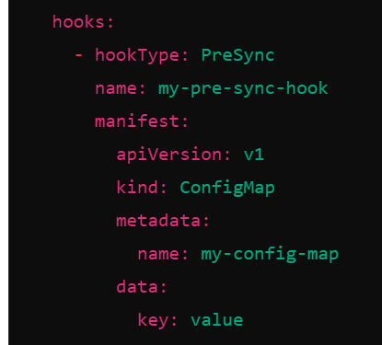
..

Slide 7
..
Integration: Helm hooks are integrated within Helm charts and managed by the Helm client during installation, upgrade, and deletion operations. ArgoCD hooks, on the other hand, are defined and managed within the ArgoCD Application manifest and executed by the ArgoCD controller during synchronization operations.
Lifecycle Stage: Helm hooks are primarily tied to Helm's lifecycle events (install, upgrade, delete), whereas ArgoCD hooks are specifically tied to ArgoCD's synchronization lifecycle (PreSync, Sync, PostSync).
Customization: Both Helm hooks and ArgoCD hooks allow customization through YAML definitions, but ArgoCD hooks offer a more integrated approach for Kubernetes-native deployments managed by ArgoCD.

