Slide 1
Application Set
OW

Slide 2
Problem Statement
Imagine you have a microservices architecture with multiple services, each needing to be deployed to development, staging, and production environments. You would need to create and manage separate ArgoCD applications for each service in each environment, which can be time-consuming and error-prone.
Solution: ApplicationSets

Slide 3
Definition
ApplicationSets in ArgoCD are a powerful feature that simplifies managing multiple applications across various environments or clusters.
ApplicationSets extend ArgoCD by making it easier to manage many applications with similar configurations. Instead of defining each application separately, ApplicationSets allow you to define a template and generate multiple applications based on this template.
ApplicationSets in ArgoCD simplify the management of multiple applications by using templates and generators to dynamically create and update applications.

Slide 4
How it Works?
Template-Based Configuration: You create a template that describes the common configuration for your applications. This template includes information like the source repository, paths to Kubernetes manifests, and other settings.
Dynamic Generation: ApplicationSets use "generators" to create multiple applications from the template. Generators can be based on different sources, such as directories in a Git repository, clusters.

Slide 5
Yaml
apiVersion: argoproj.io/v1alpha1
kind: ApplicationSet
metadata:
name: list-generator
spec:
generators:
- list:
elements:
- cluster: cluster1
url: https://cluster1.ow.com
- cluster: cluster2
url: https://cluster2.ow.com

Slide 6
How to register a remote cluster
Cluster Registration: Each Kubernetes cluster that Argo CD manages is registered within Argo CD itself. This registration involves creating a Kubernetes Secret in the Argo CD namespace that contains the necessary configuration details (like API server URL, authentication credentials, etc.) to access the cluster.
Centralized Control Plane: Argo CD operates as a centralized control plane for managing applications deployed across multiple Kubernetes clusters. It has a single instance of its application controller running within its own namespace.

Slide 7
Steps:
Cluster credentials are stored in secrets same as repositories or repository credentials. Each secret must have label argocd.argoproj.io/secret-type: cluster.
The secret data must include following fields:
name - cluster name
server - cluster api server url
namespaces - optional comma-separated list of namespaces which are accessible in that cluster. Cluster level resources would be ignored if namespace list is not empty.
clusterResources - optional boolean string ("true" or "false") determining whether Argo CD can manage cluster-level resources on this cluster. This setting is used only if the list of managed namespaces is not empty.

Slide 8
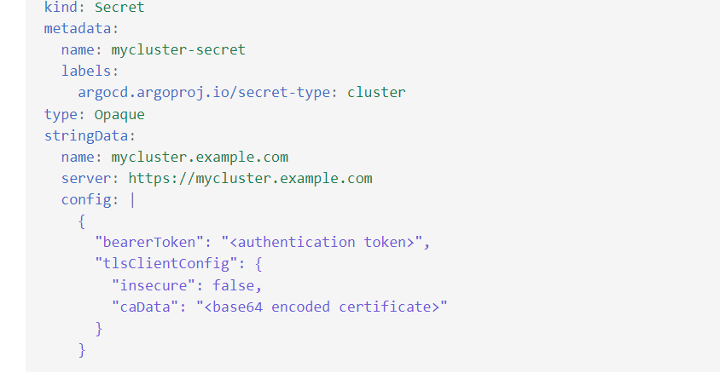
..

Slide 9
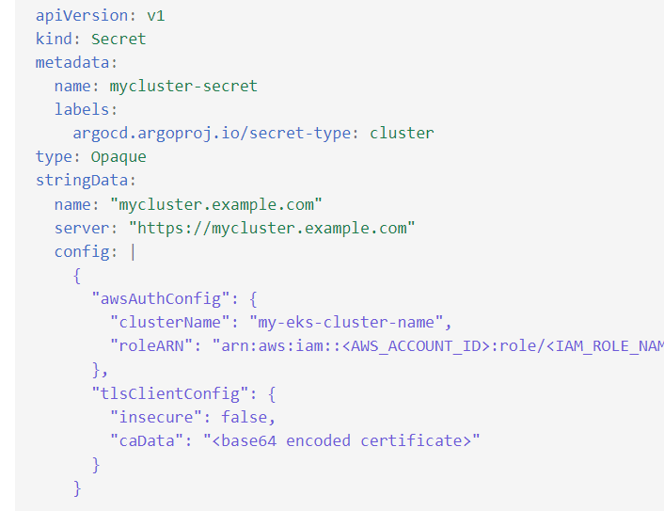
EKS Cluster

Slide 10
Cluster Generators
apiVersion: argoproj.io/v1alpha1
kind: ApplicationSet
metadata:
name: guestbook
spec:
goTemplate: true
goTemplateOptions: ["missingkey=error"]
generators:
- clusters:
selector:
matchLabels:
staging: "true"

Slide 11
.spec.template
template:
metadata:
name: '{{cluster}}-app'
spec:
project: default
source:
repoURL: https://github.com/your-org/your-repo
targetRevision: main
path: apps/{{cluster}}
destination:
server: '{{url}}'
namespace: default

Slide 12
Git generators
generators:
- git:
repoURL: 'https://github.com/your-org/your-repo.git'
revision: main
directories:
- path: 'environments/*'
template:
metadata:
name: '{{path.basename}}-app'
spec:
project: default
source:
repoURL: 'https://github.com/your-org/your-repo'
targetRevision: main
path: '{{path}}'

Slide 13
Matrix generators
generators:
- list:
elements:
- cluster: cluster1
url: https://cluster1.example.com
- cluster: cluster2
url: https://cluster2.example.com
- git:
repoURL: 'https://github.com/your-org/your-repo.git'
revision: main
directories:
- path: 'services/*'

Slide 14
Labs

