Slide 1
Argo CD
OW

Slide 2
What is argo CD
ArgoCD is a Kubernetes-native continuous delivery tool. It automates the deployment of applications to Kubernetes clusters. ArgoCD tracks application definitions and configurations in Git repositories.
It ensures the desired state in Git matches the actual state in the cluster. This approach improves consistency, reliability, and transparency in application deployments.
Questions : Why we need separate CD tools, What are the challenges?

Slide 3
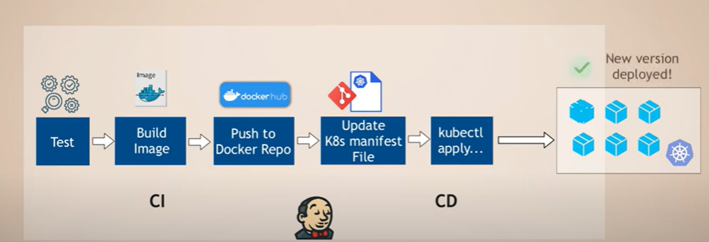
CICD (Continuous Delivery)

Slide 4
Challenges
Install and setup tools , like kubectl need to implement in CICD tool side.
Live monitoring is not possible for deployed components. No further visibility
Need to provide access to CICD tool to control the access, that become one of the security issue. Example provide Kubernetes access in Jenkins to deploy environment
No way to check the health.

Slide 5

How argo CD can solve the issue

Slide 6
Introduction
Argo CD is a pull-based GitOps tool for continual Delivery to Kubernetes Clusters
Argo run inside your Kubernetes cluster and connects to your source repositories.
It automatically detects changes you make Kubernetes resource definition and sync them to the cluster
It automates the process of deploying apps into your cluster by offering a declarative, GitOps-driven configuration process.

Slide 7
..
Argo uses declarative configuration to understand the desired state of your deployments. The resources in your Git repository declare this state;
Argo then automates the process of adding, altering, and removing Kubernetes cluster objects to achieve it.
Argo can prevent configuration drift by continually resyncing your cluster objects to the configuration declared in your repository, ensuring unintentional changes are quickly reversed.

Slide 8
What is GitOps?
GitOps, which uses Git as a foundational element for managing infrastructure and applications, offers a transformative approach by integrating version control and automation into the deployment pipeline.
Single Source of Truth: Git repositories store the desired state of the system, ensuring that configurations and application states are consistent, transparent, and easily auditable.
Automated deployment processes reduce the risk of human error, and the ability to revert to previous states quickly helps maintain stability.

Slide 9
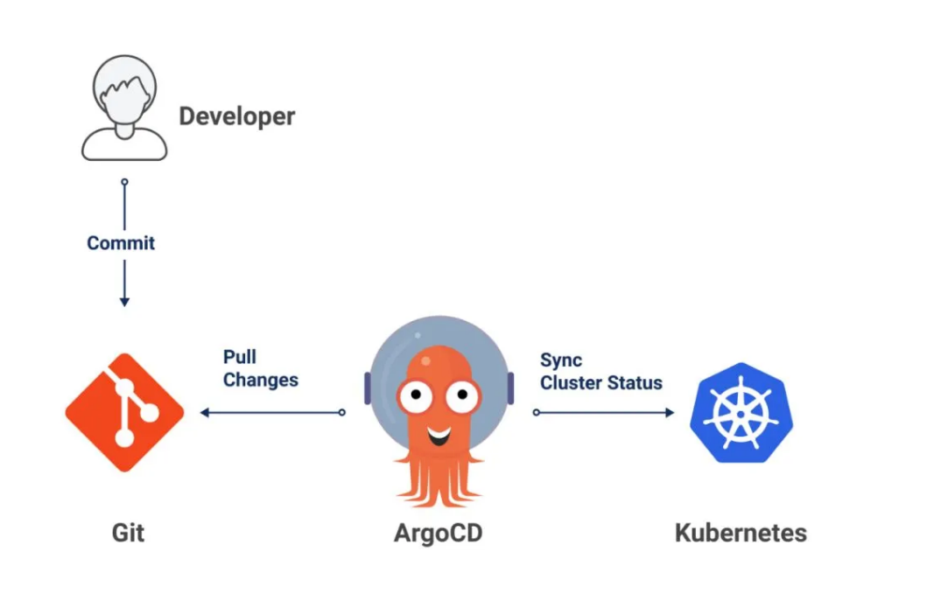
..

Slide 10
Principles
Declarative Configuration: All resources are defined declaratively.
Version Control: System and application states are stored in version control systems, enabling history tracking, rollbacks, and the use of standard Git operations.
Automated Deployment: Automated tools ensure that the production environment matches the state described in a Git repository.
Monitoring and Reconciliation: Continuous monitoring for divergence between the deployed state and the Git repository state, with automatic reconciliation when discrepancies are detected.

Slide 11
Benefits
Operational Efficiency: GitOps provides a clear, audit-friendly trail of all changes, greatly simplifying compliance and governance requirements.
Improved Deployment Velocity: Automating deployment processes reduces the potential for human error and speeds up delivery.
Better Reliability: The ability to quickly rollback to previous states enhances system stability

Slide 12
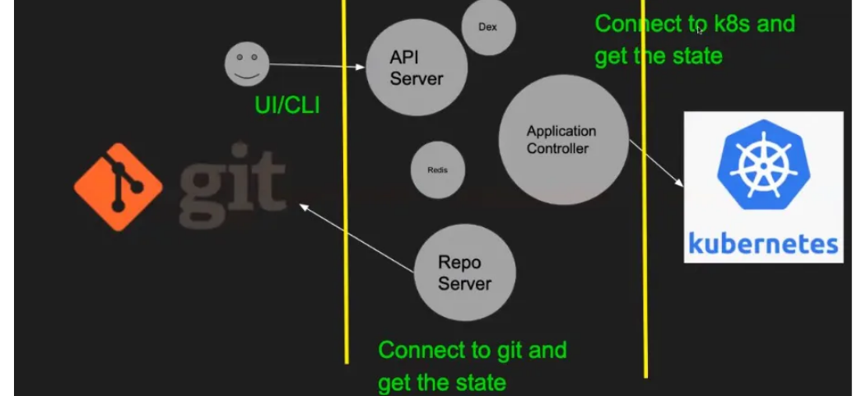
How argo CD works?

Slide 13
..
API Server: This component is used by the users to communicate to argo cd through UI or CLI and it also handles the authentication for the users.
Repository Server: This component connects to git and fetch the state of the git repository.
Application Controller: This component connects to kubernetes and fetch the state of the resources deployed in the kubernetes cluster.
CLI: The CLI is a command-line tool that you can use to manage Argo CD. It allows you to create, update, and delete applications, synchronise with Git repositories, and monitor the state of your clusters.

Slide 14
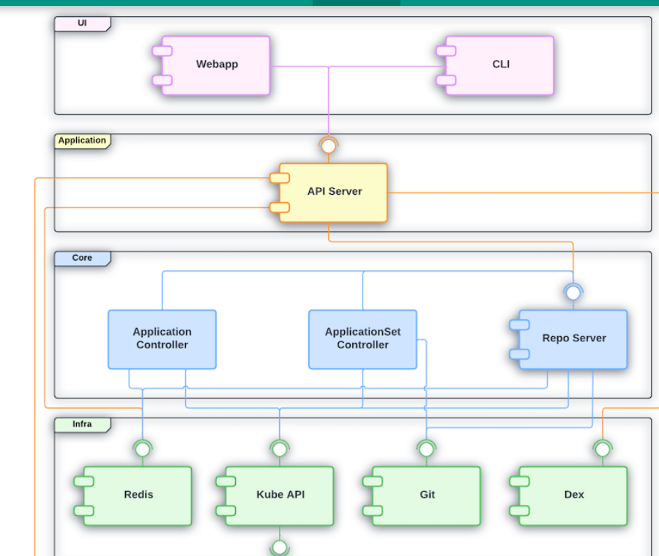
Architecture: Block Diagram

Slide 15
UI layer
What it is:
The user interface (UI) layer is the part of Argo CD that users interact with directly. It includes the web dashboard and command-line interface (CLI).
What it does:
Users use the UI to manage applications, view application status, sync changes, and handle other tasks

Slide 16
Application Layer
What it is:
The application layer consists of the features and functionalities that support the UI layer.
What it does:
It handles requests from the UI, processes them, and returns the required information. This includes things like creating, updating, and deleting applications.

Slide 17
Core Layer
What it is:
The core layer is the heart of Argo CD, where the main GitOps functionality is implemented.
What it does:
This layer includes components and Kubernetes controllers that monitor and reconcile the state of applications based on the desired state defined in a Git repository. It ensures that the actual state matches the desired state.

Slide 18
Infra layer
What it is:
The infrastructure (infra) layer consists of the external tools and services that Argo CD relies on.
What it does:
This includes Kubernetes itself, Git repositories, and other infrastructure components that Argo CD interacts with to perform its tasks. It provides the foundational services that Argo CD needs to operate.

Slide 19
Core Components
ArgoCD Server: The central service that provides the ArgoCD API and serves the web UI. It acts as the command center, allowing users to interact with ArgoCD through a graphical interface or via the CLI.
Repository Service: Responsible for interfacing with Git repositories to fetch configuration data and monitor for changes. This service ensures that ArgoCD is always in sync with the desired state as defined in the Git repositories.

Slide 20
..
Application Controller: The heart of ArgoCD’s operation, the Application Controller continually monitors applications deployed in Kubernetes against the desired state stored in Git. If it detects any discrepancies, it initiates the synchronization process to correct them.
Dex Server: An optional component that provides an identity federation service. Dex integrates with external identity providers (such as LDAP, SAML, GitHub, and others) to offer unified authentication and access control for ArgoCD.

Slide 21
..
Redis DB : Redis is used to manage and store the state of various ArgoCD components, ensuring that the system can quickly access and update application statuses and deployment data.
Cache: Redis acts as a caching layer to store frequently accessed data, which reduces the load on the primary database and speeds up query responses. This helps in maintaining real-time synchronization between the desired state in Git and the actual state in Kubernetes clusters.

Slide 22
Core features
Declarative Setup: ArgoCD uses Git repositories as the source of truth for defining the desired application state in Kubernetes.
Automatic Sync: It automatically syncs applications with their desired state in the Git repository, ensuring consistency and reliability.
Self-Healing Deployments: ArgoCD continuously monitors deployed applications and heals them by automatically applying the desired state from Git, thus reducing downtime and manual intervention.
Visual UI and CLI: Offers a user-friendly UI and a powerful CLI, catering to different preferences for managing deployments.

Slide 23
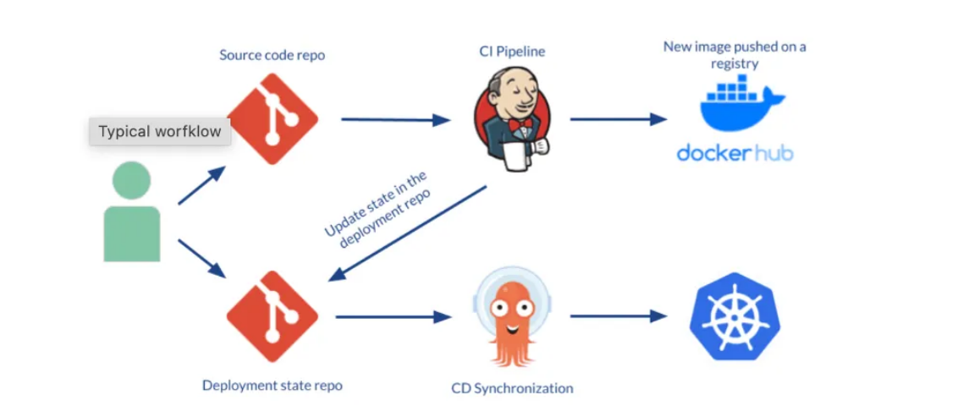
CD Workflow using Argo CD

Slide 24
..
A developer makes changes to an application, pushing a new version of Kubernetes resource definitions to a Git repo.
Continuous integration is triggered, resulting in a new container image saved to a registry.
A developer issues a pull request, changing Kubernetes manifests, which are created either manually or automatically.
The pull request is reviewed and changes are merged to the main branch. This triggers a webhook which tells Argo CD a change was made

Slide 25
..
Argo CD clones the repo and compares the application state with the current state of the Kubernetes cluster. It applies the required changes to cluster configuration.
Kubernetes uses its controllers to reconcile the changes required to cluster resources, until it achieves the desired configuration.
Argo CD monitors progress and when the Kubernetes cluster is ready, reports that the application is in sync.
ArgoCD also works in the other direction, monitoring changes in the Kubernetes cluster and discarding them if they don’t match the current configuration in Git.

Slide 26
Installation of Argo CD
Explain the Lab setup of EKS
EKS→argoCD→github

Slide 27
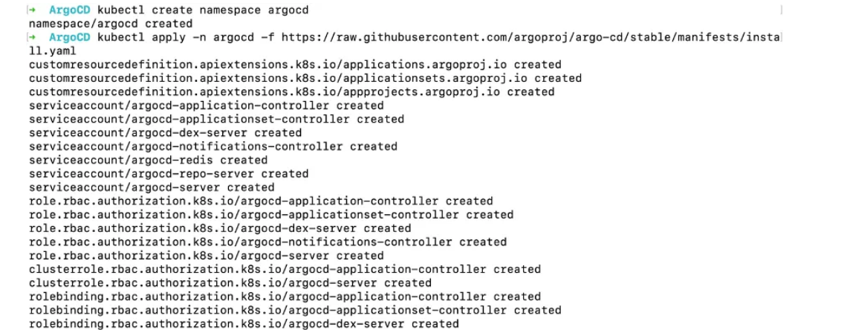
Installation
$kubectl create namespace argocd
$ kubectl apply -n argocd -f https://raw.githubusercontent.com/argoproj/argo-cd/stable/manifests/install.yaml

Slide 28
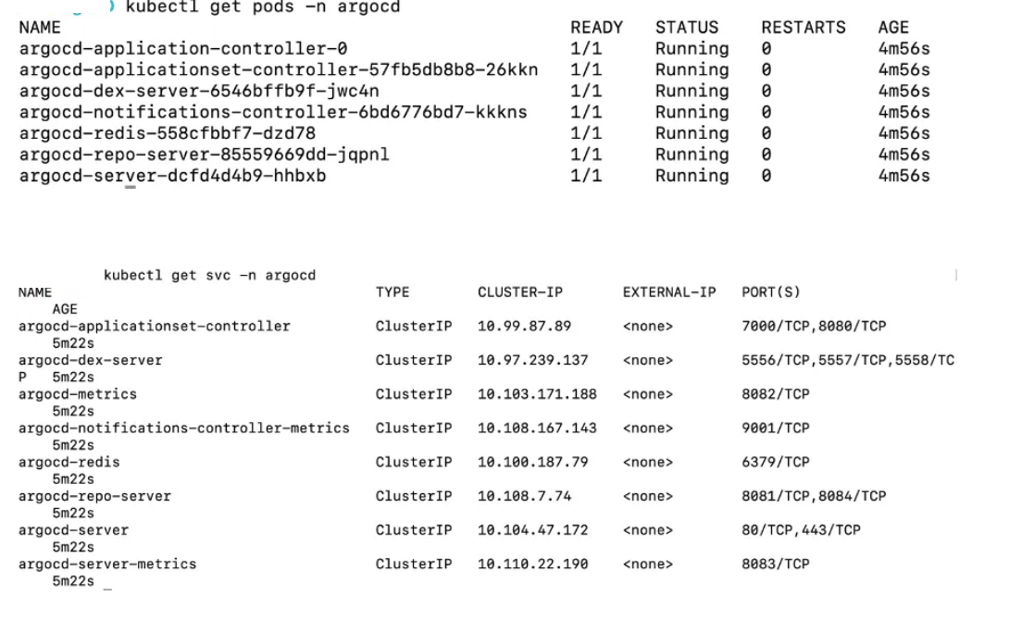
..

Slide 29
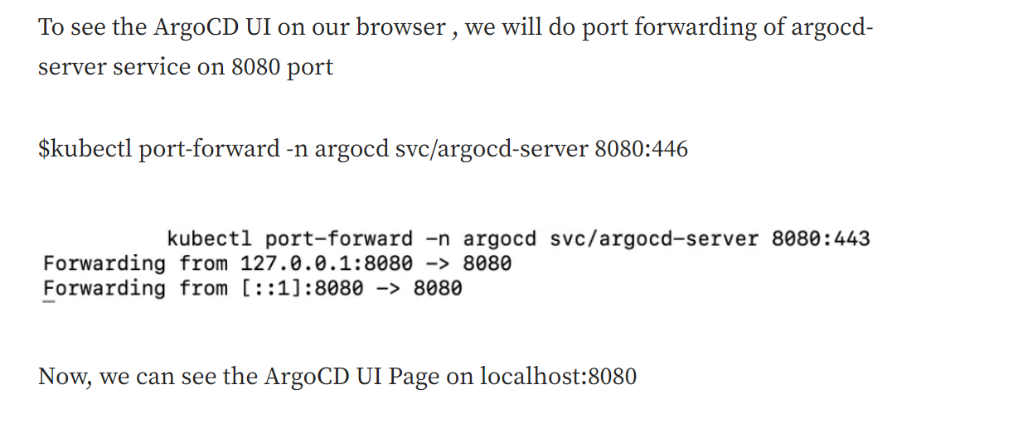
..

Slide 30
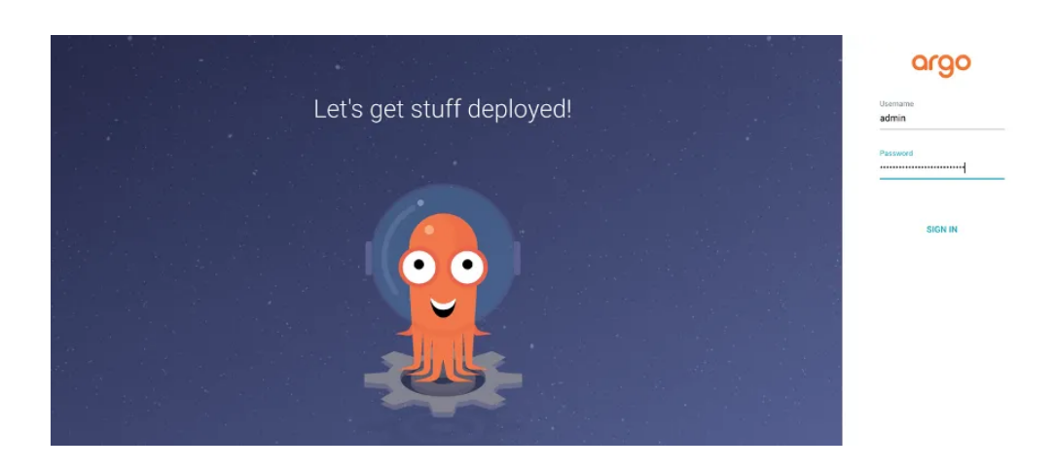
ARGO UI

Slide 31
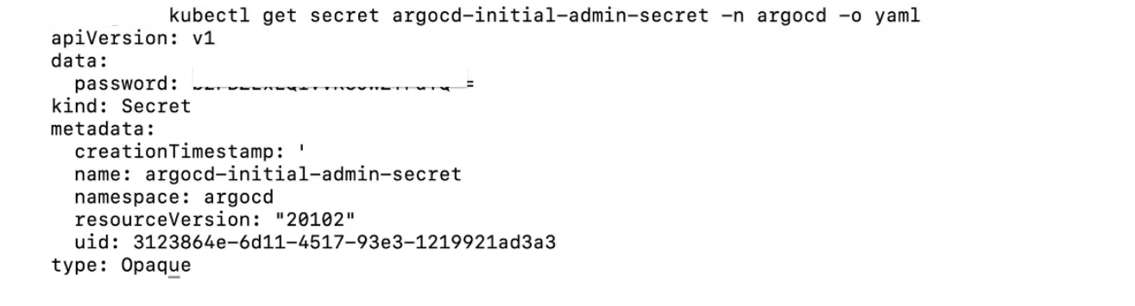
Initial password
The initial password for the admin account is auto-generated and stored as clear text in the field password in a secret named argocd-initial-admin-secret in your Argo CD installation namespace. You can simply retrieve this password using
$ kubectl -n argocd get secret argocd-initial-admin-secret -o jsonpath=”{.data.password}” | base64 -d; echo

Slide 32
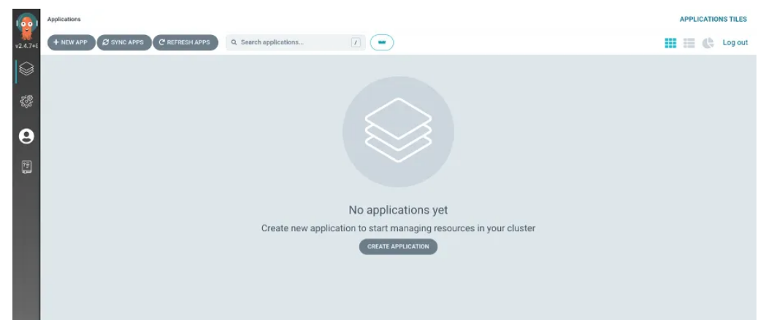
..

Slide 33
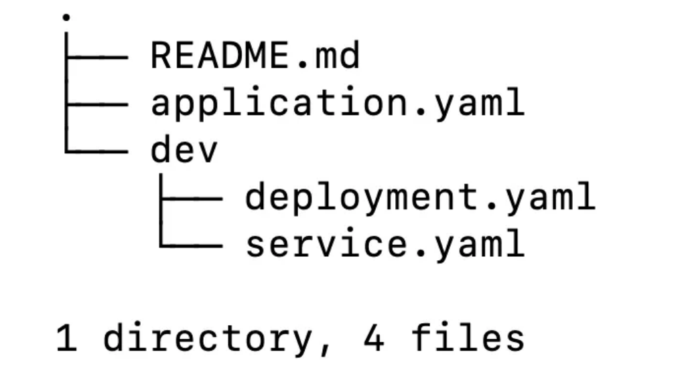
Workflow of ArgoCD

Slide 34
..
This is the directory structure which we are following where a folder (dev) is containing all the manifest yaml files and an application.yaml file which is the Kubernetes resource object representing a deployed application instance in an environment.
It has 2 fields where “source” references the desired state in Git and “destination” references to the target cluster and namespace.

Slide 35
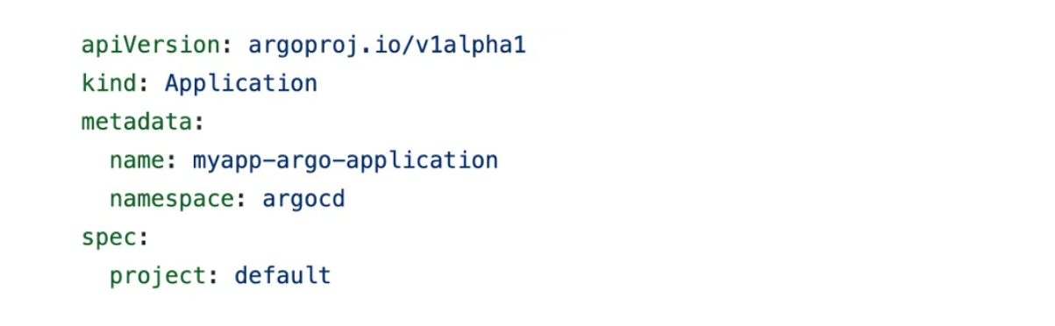
CRD: Kind

Slide 36
Explanation
This is the application CRD where kind is “Application” and namespace is “argocd” which tells that in the application that we are creating should be in argocd namespace where the argocd pods (controller , server ….etc) are running .
The project field is “default” → Every application belong to a single project ( If not specified , it will assume it as default )

Slide 37
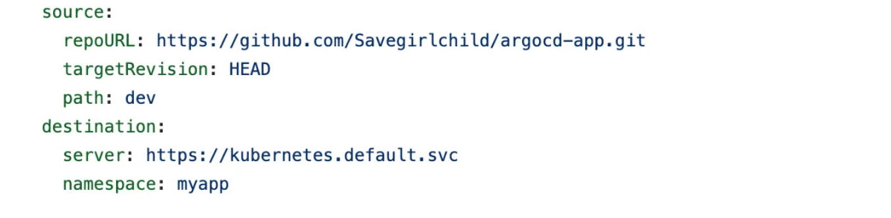
Source Field

Slide 38
explanation
The source field references the Git Repository where all the manifest files will be uploaded , repoUrl
Put the url of the Git Repository and targetRevision = HEAD .It takes the last commit in the repository , path = Dev which path in Git ,you want to sync your cluster with .

Slide 39
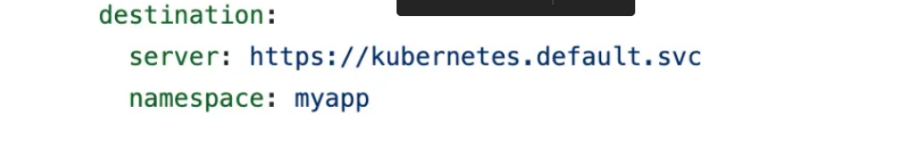
Destination Field
The destination field references the target cluster. In this we have a field as “server” Specifies the endpoint of the Kubernetes API Server and “namespace” Specifies which namespace you want your argocd to deploy your application to.

Slide 40
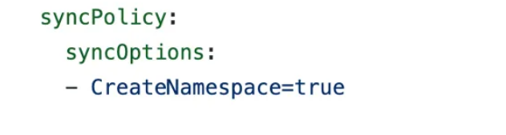
Sync Policy
The syncPolicy field -How to sync the desired state in the target cluster. Here , the field “CreateNamespace=True” ensures that the namespace specified exists in the destination and if not then it will create namespace

Slide 41
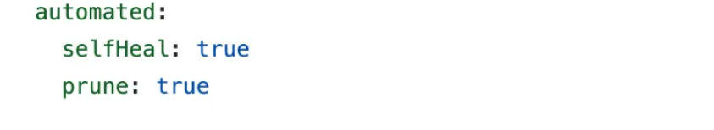
Self Heal
The automated “selfHeal=true” field → Cluster automatically sync with Git by ArgoCD which by default is set to off. “prune=true” → Automatically delete the component in Kubernetes cluster if your yaml files(CRD) are deleted from Git Repository.

Slide 42
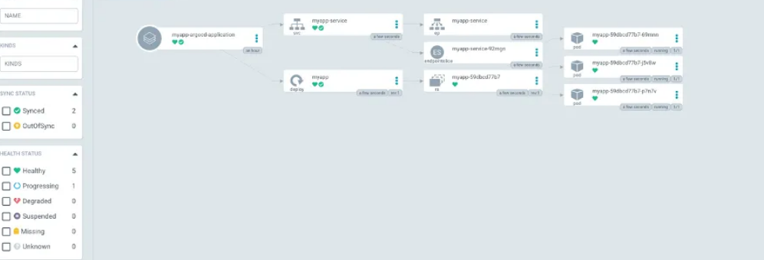
..

Slide 43
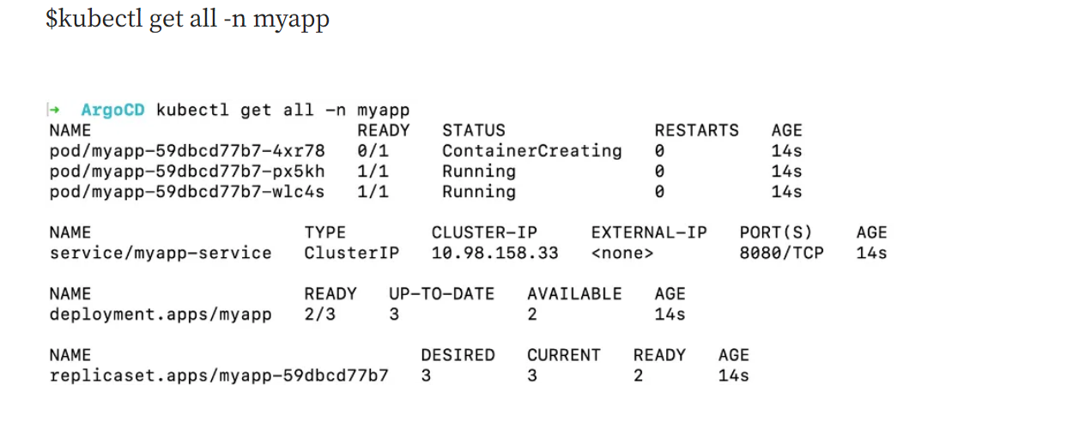
..

Slide 44
..
Labs

