Slide 1

EYE-CURSOR
A new vision for disabled people

Slide 2
ABSTRACT
One of the mankind’s major senses is its eyesight. Eye is different from other body parts that make up the human sensor array. Fiction has had people operating things using sight rather than hands a long time ago, yet the technology hasn't developed into the mainstream as of yet. The major reasons seem to be the cost of the system with most applications of gaze tracking being for specialist fields. The main objective of this presentation is to make a paralyzed person having good eye functioning to interact and work with computer in order to use it in an efficient way, in order to overcome his disabilities and communicate globally.

Slide 3
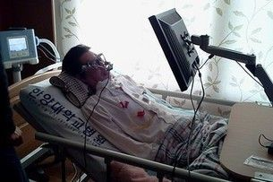
PROBLEM STATEMENT
Problem faced by people due to illness.
Important for handicapped and disabled.

Slide 4
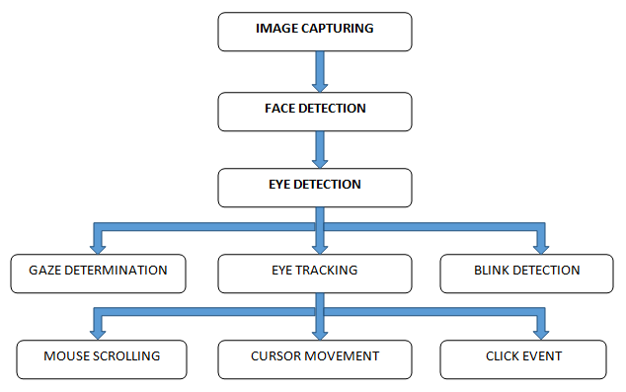
BLOCK DIAGRAM

Slide 5
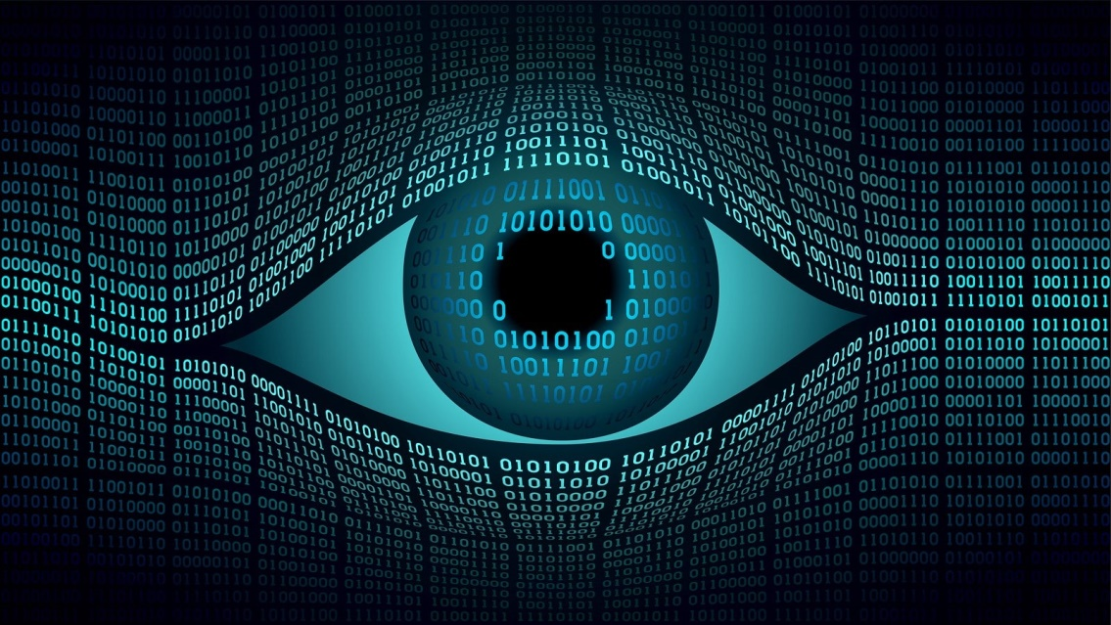
REQUIREMENTS
Software Requirements:
1. Python 3.6.8.
2. OpenCV.
Hardware Requirements:
1. Monitor.
2. HD Camera.
3. CPU 1.90GHz.
4. 4GB RAM.

Slide 6
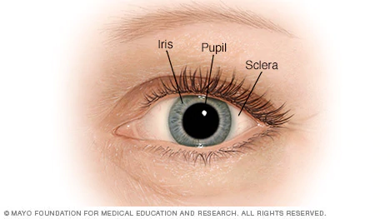
IMPLEMENTATION
Initialization.
Face detection.
Eye detection.

Slide 7
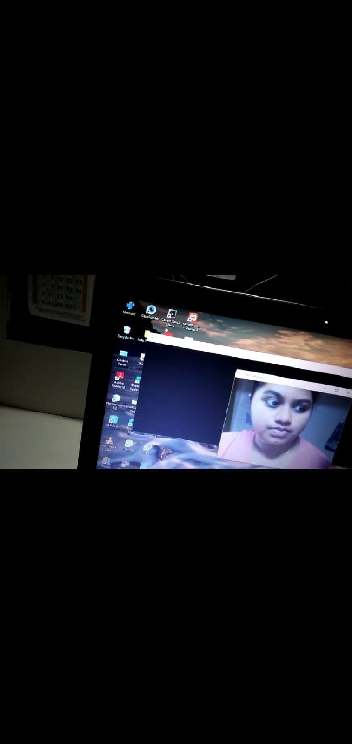
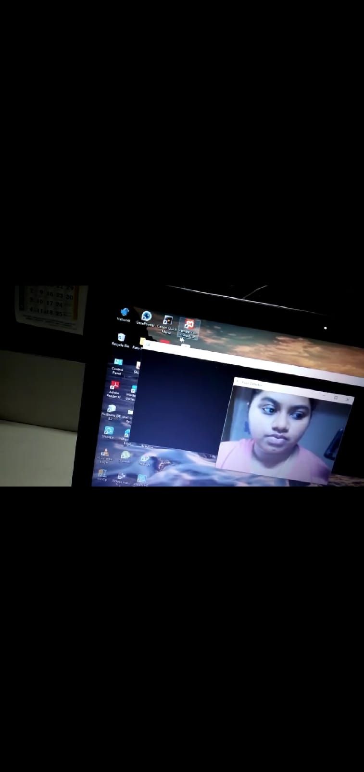
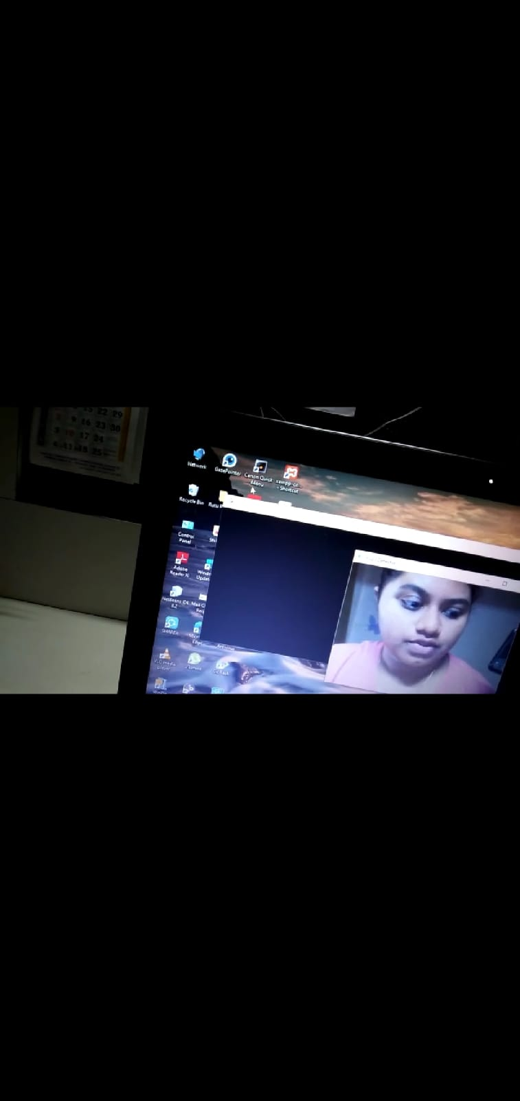
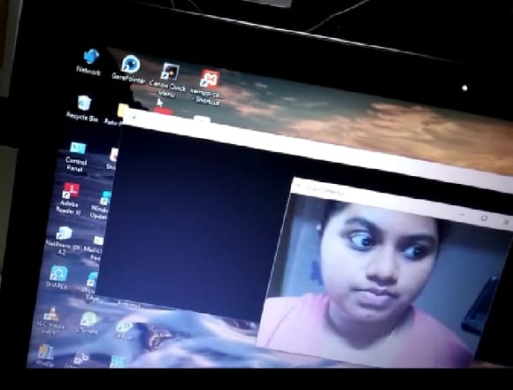
RESULT

Slide 8
CONCLUSION
Eye Mouse is a very helpful tool which can replace a normal mouse device.
Its simple, multipurpose and helpful in virtual or interactive computer gaming & advertisement.
A gift for Physically challenged people.

Slide 9
REFERENCE
https://www.hindawi.com/journals/cin/2017/5739301/
http://www.sitrc.sandipfoundation.org/wp-content/uploads/2018/07/3.3.5_146_A-Device-Controlled-Using-Eye-Movement.pdf
https://www.researchgate.net/publication/325919286_Eye-controlled_mouse_cursor_for_physically_disabled_individual

