Slide 1
MOVIE RECOMMENDATION SYSTEM
By:
Prasanna Lad (22)
Devesh Panchal (31)
Rutuja Parab (32)
Guided By:
Mr. Sunil Katkar Sir

Slide 2
ABSTRACT
Nowadays, the recommendation system has made finding the things easy that we need. Movie recommendation systems aim at helping movie enthusiasts by suggesting what movie to watch without having to go through the long process of choosing from a large set of movies which go up to thousands and millions that is time consuming and confusing. In this article, our aim is to reduce the human effort by suggesting movies based on the user’s interests. To handle such problems, we introduced a model combining both content-based and collaborative approach. It will give progressively explicit outcomes compared to different systems that are based on content-based approach. Content-based recommendation systems are constrained to people, these systems don’t prescribe things out of the box, thus limiting your choice to explore more. Hence, we have focused on a system that resolves these issues.

Slide 3
Software & Hardware Required
Language: Python, HTML
Libraries: Pandas, Pickle
Python Framework : Flask
Dataset : Movielens
Cloud Host: Heroku
Processor:Intel(R) Core(TM) i3-4030U CPU @ 1.90GHz 1.90 GHz
RAM:4.00 GB
System type:64-bit operating system, x64-based processor

Slide 4
Objective
To Give user there recommended movie list from there choices
Obtain correct recommendations from the working system.

Slide 5
Algorithm: Collaborative filtering
Collaborative filtering technique is to find similar group of user and provides recommendation based on similar taste within that groups.
A user might be interested in what similar users are interested in.
Collaborative filtering takes user’s ratings and similar user’s ratings into consideration

Slide 6
Collaborative filtering Working
Obtain movie rating for some movies form active user
Based on rating, find the top X neighbours
Calculate similarity score
Recommend movies with the highes score and most watched by similar users

Slide 7
Dataset: MovieLens
The MovieLens datasets, first released in 1998, describe people’s expressed preferences for movies. These preferences take the form of tuples, each the result of a person expressing a preference (a 0-5 star rating) for a movie at a particular time. These preferences were entered by way of the MovieLens web site1 — a recommender system that asks its users to give movie ratings in order to receive personalized movie recommendations.

Slide 8
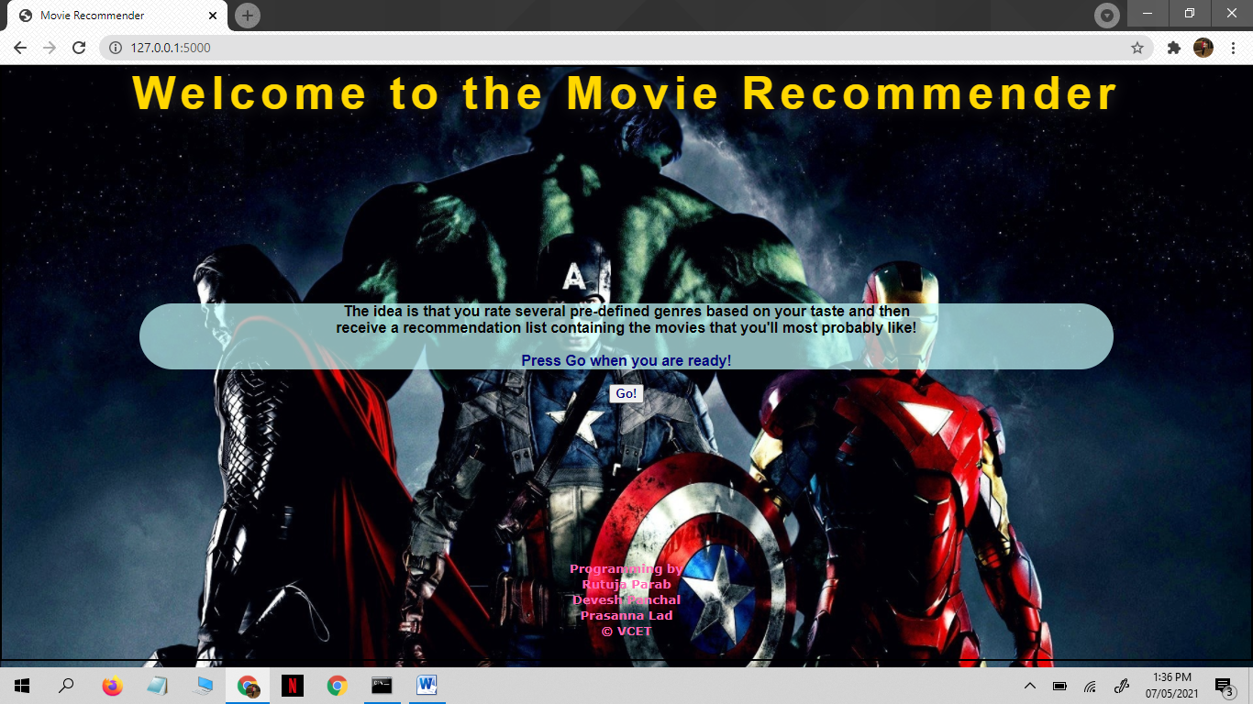
Implementation

Slide 9
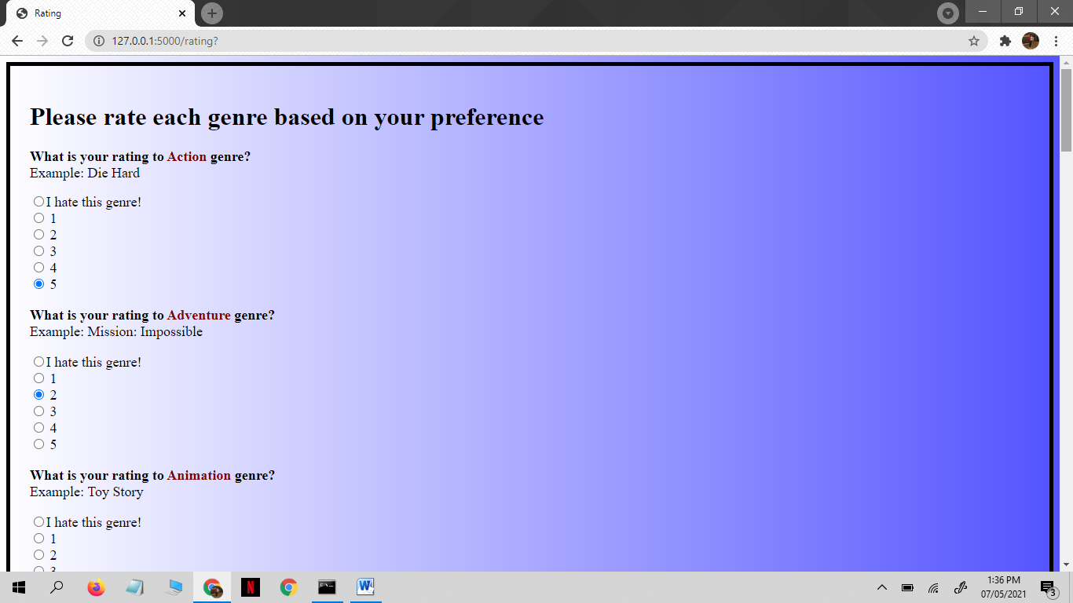

Slide 10
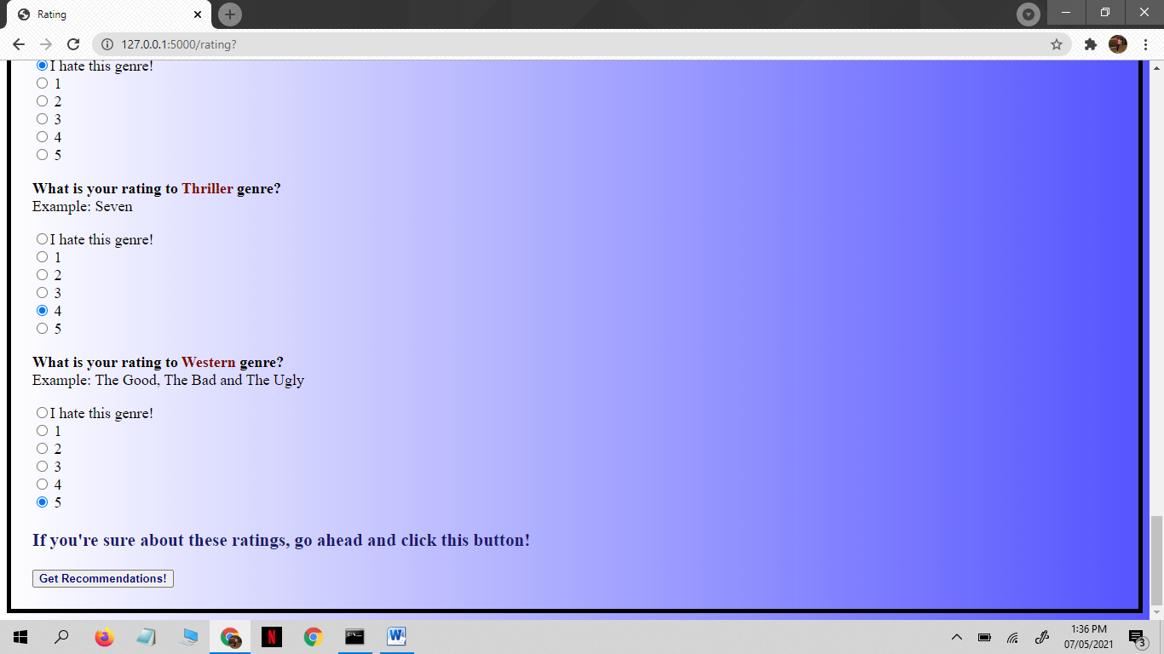

Slide 11
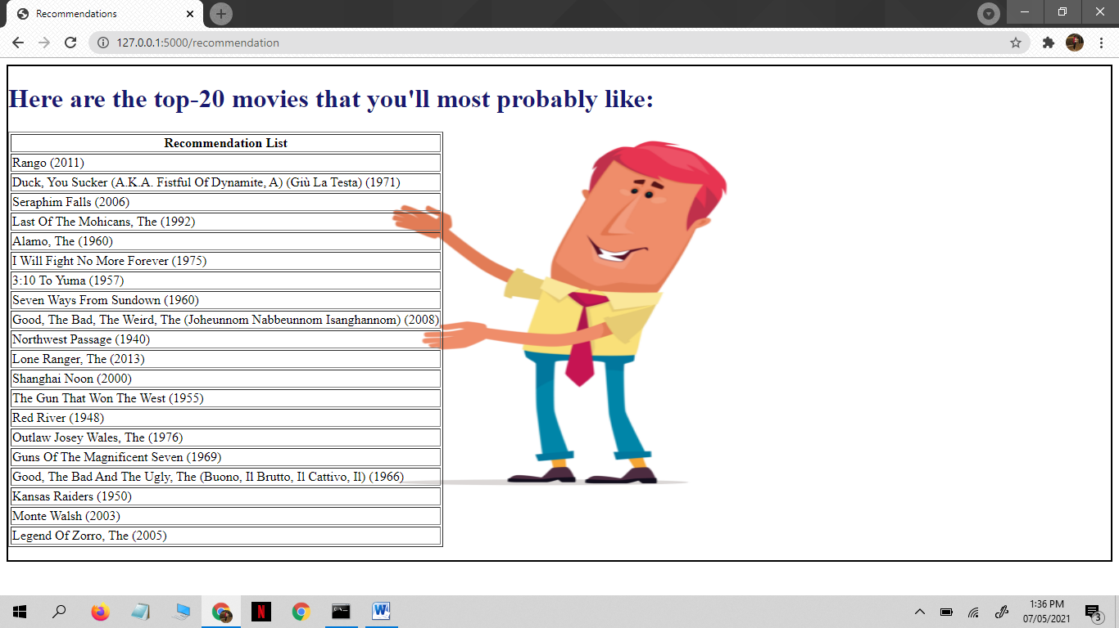

Slide 12
Future Scope
There are various areas of recommendation system discussed . Various techniques are also discussed which works in giving recommendation. So, scope of any recommender system is to build a model in such a way that their user gets proper recommendation and efficiency of the system is maintained.

Slide 13
Conclusion
Recommendation system open new opportunities of retrieving personalized information on the Internet. This strategy helps in improving accuracy of the recommendations.

