Slide 1



Tokyo-Olympics-Project-Dashboard-1
View in Power BI
Last data refresh:
8/25/2024 12:41:49 AM UTC
Downloaded at:
8/29/2024 3:17:50 AM UTC

Slide 2
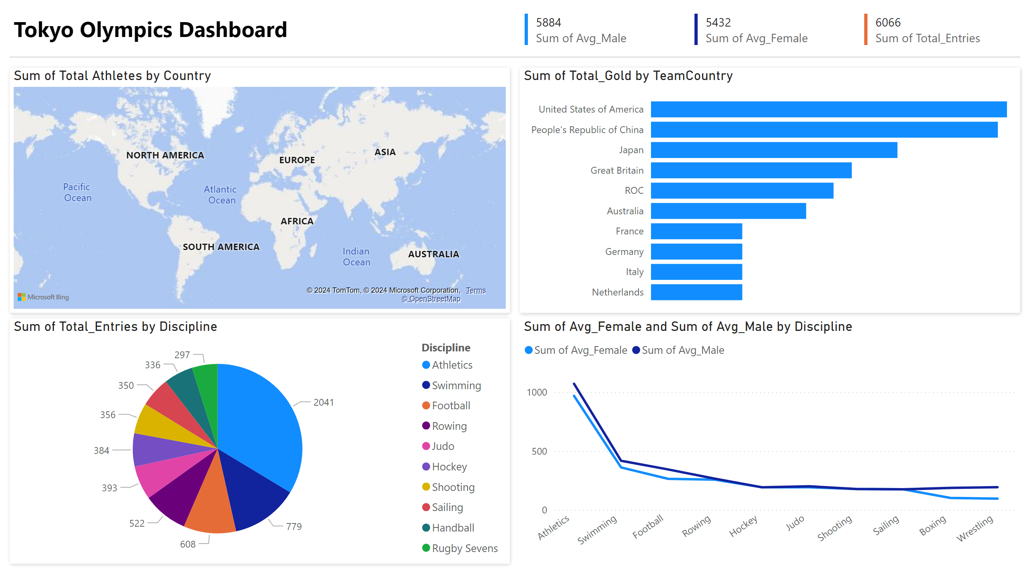
Page 1
Notes:
shape
No alt text provided
shape
No alt text provided
shape
No alt text provided
textbox
No alt text provided
multiRowCard
No alt text provided
multiRowCard
No alt text provided
multiRowCard
No alt text provided
shape
No alt text provided
barChart
No alt text provided
Sum of Total Athletes by Country
No alt text provided
pieChart
No alt text provided
lineChart
No alt text provided

