Slide 1
Movie Recommendation System
Group 14:
Janga Guru Pavani MT2023118
Shrey Salaria MT2021087
Nikita Mishra MT2023052
Rutuja Prabhudesai MT2023182

Slide 2
Overview
Background
Dataset
Preliminary Analysis
Approaches
Results
References

Slide 3
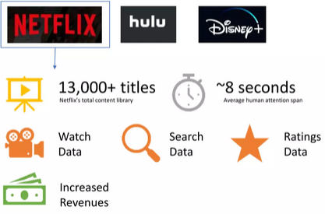
Background
Top Streaming Services
Need for a Recommendation system
Data used in Recommendation system
Impact of Recommendation system

Slide 4
Dataset
Source: https://grouplens.org/datasets/movielens/1m/
These files contain 1,000,209 anonymous ratings of approximately 3,900 movies made by 6,040 MovieLens users who joined MovieLens in 2000.
ratings.dat -> UserID::MovieID::Rating::Timestamp
Users.dat -> UserID::Gender::Age::Occupation::Zip-code
Movies.dat -> MovieID::Title::Genres

Slide 5
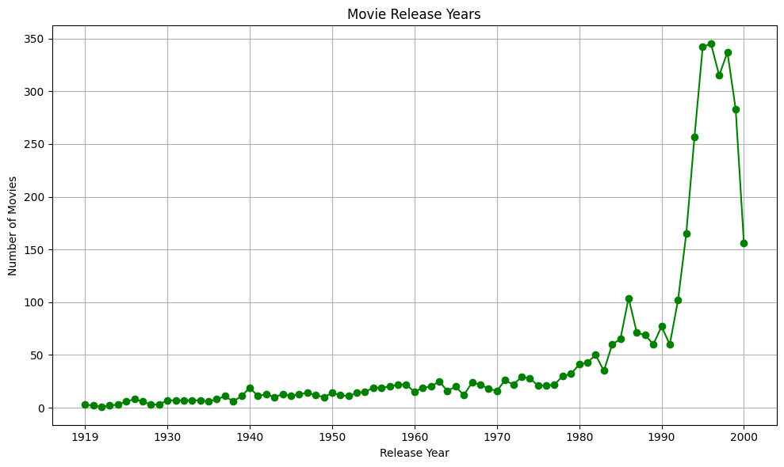
Preliminary Analysis
This plot is between Number of movies vs release year.
Majority of the movies were released in between 1990 to 2000

Slide 6
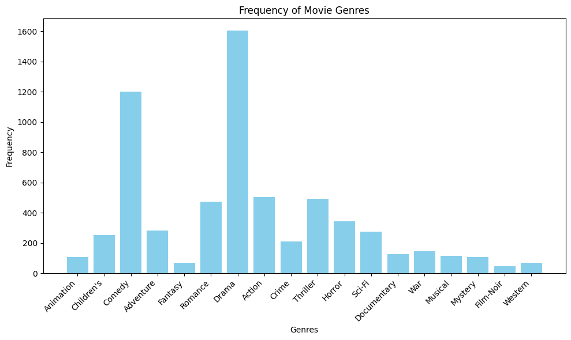
Preliminary Analysis
This plot is between frequency of movies vs genre
Drama and comedy has a lot of frequency

Slide 7
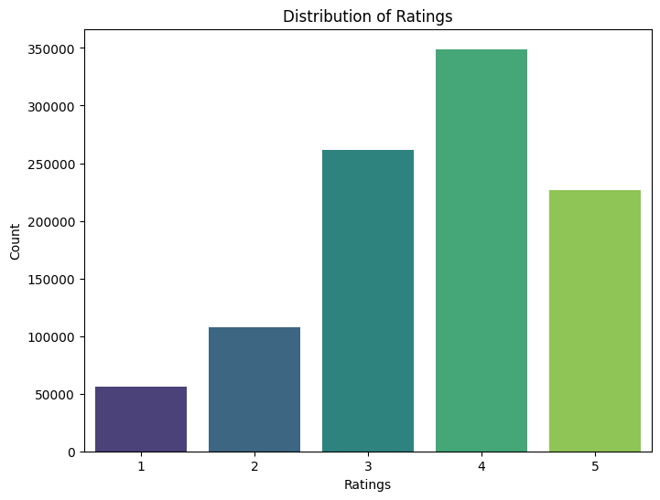
Preliminary Analysis
This plot shows distribution of ratings.
Ratings typically range from 1 to 5.
Rating '4' has been given by many users.

Slide 8
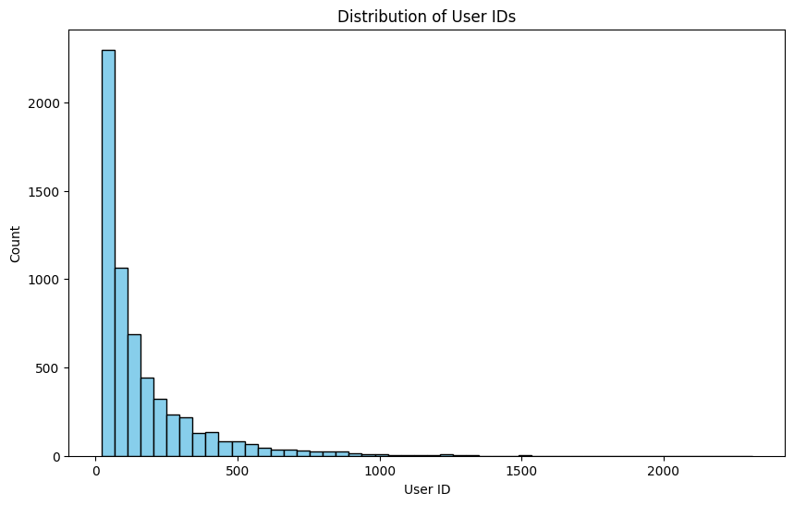
Preliminary Analysis
This plot shows distribution of user IDs
User Ids between 1 to 100 have rated movies than others.

Slide 9
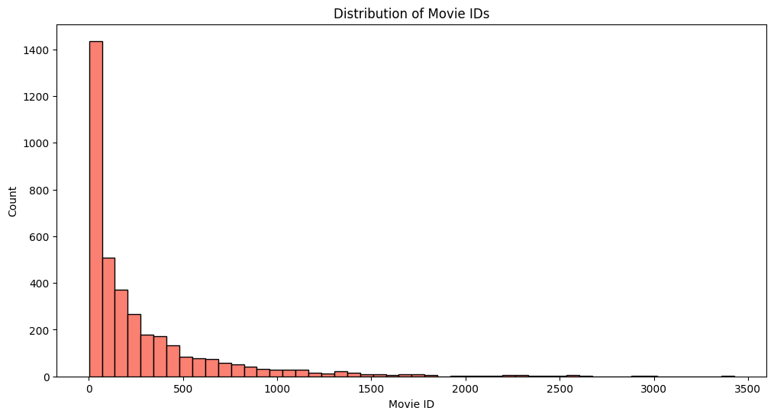
Preliminary Analysis
This plot shows distribution of movie IDs.​
Movie Ids between 1 to 500 have been watched more than others.
Movies with Id 2000 to 3500 rarely watched by anyone.

Slide 10
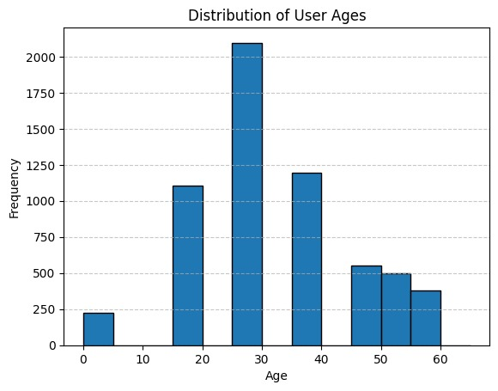
Preliminary Analysis
This plot shows distribution of user age.
Most users age range between 20 to 40.

Slide 11
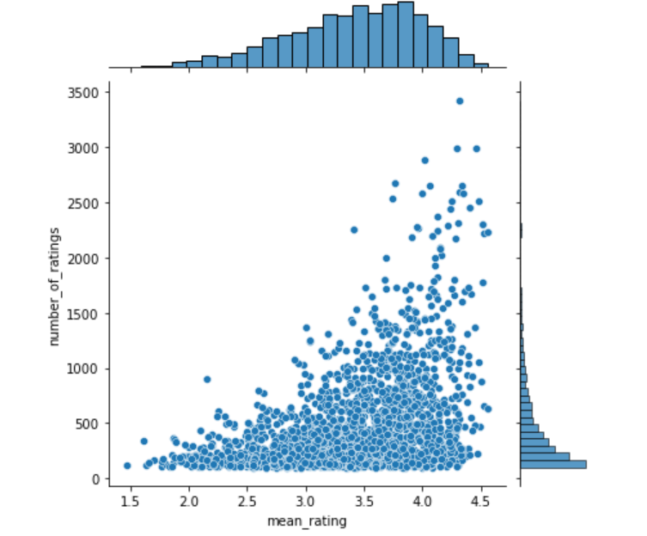
Preliminary Analysis
Main Scatter Plot:
Each point represents a movie.
Shows the relationship between the mean rating and the number of ratings for each movie
The upward trend from the scatter plot shows that popular movies get higher ratings.
Marginal Histograms:
The average rating distribution shows that most movies in the dataset have an average rating of around 4.
The number of rating distribution shows that most movies have less than 500 ratings.

Slide 12
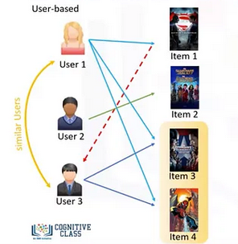
Approach(User based collaborative filtering)
Data preprocessing :
User-Movie data
Data Normalization:
matrix_normij=matrixij−r¯i
Similarity Calculation
Pearson(ui,uj)
Neighborhood Selection:
similar users and similarity
threshold using Pearson
correlation value.
Recommendation Generation

Slide 13
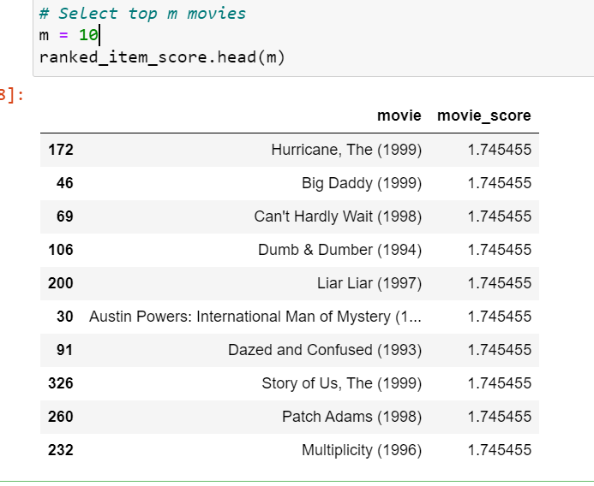
User-Based Collaborative Filtering
Recommend Items
In following code we are deciding which movie to recommend to the target user.
The recommended items are determined by the weighted average of user similarity score and movie rating
. The movie ratings are weighted by the similarity scores, so the users with higher similarity get higher weights.

Slide 14
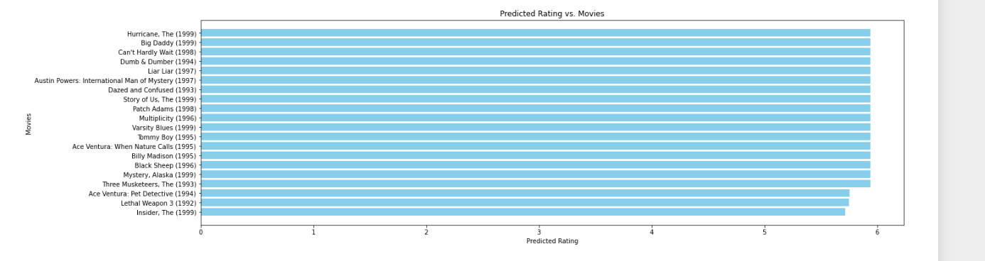
User-Based Collaborative Filtering
Predict Scores
If the goal is to predict the user's rating, we need to add the user's average movie rating score back to the movie score.

Slide 15
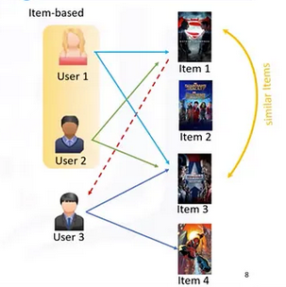
Approach(Item based collaborative filtering)
Data Preprocessing
Similarity Calculation
Neighborhood Selection
Recommendation Generation
Evaluation and Validation

Slide 16
Item based collaborative filtering
 | Cosine Similarity | Pearson Similarity
RMSE | 0.937 | 1.092
MAE | 0.815 | 0.968

Slide 17
Approach(Reduced SVD and K-means for recommendation)
Data preprocessing: user, movies used to generate user-genre matrix
First SVD and the K-means :
SVD(Singular Value Decomposition):
M=UΣVᵗ (using eigen values and vectors of A^{T}A.
Dimensionality Reduction: reduced dimensionality by taking only top K singular values and vectors.
K-means Clustering: Reduced matrices centroids are calculated.
Recommendation: Selected highly rated movies within clusters of target user.
We also tried first K-means and then SVD

Slide 18
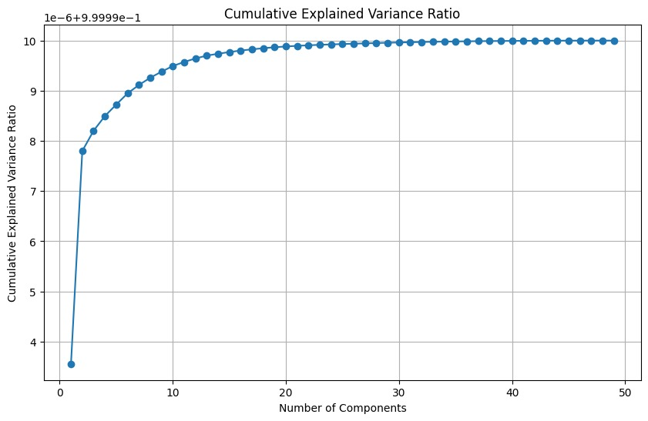
Reduced SVD
After SVD to get reduced vectors of user representation we found the K_reduced using elbow method.
The optimal value we got is 10.
Using this we calculated U_reduced, S_reduced and vt_reduced which are used for K_Mean clustering.

Slide 19
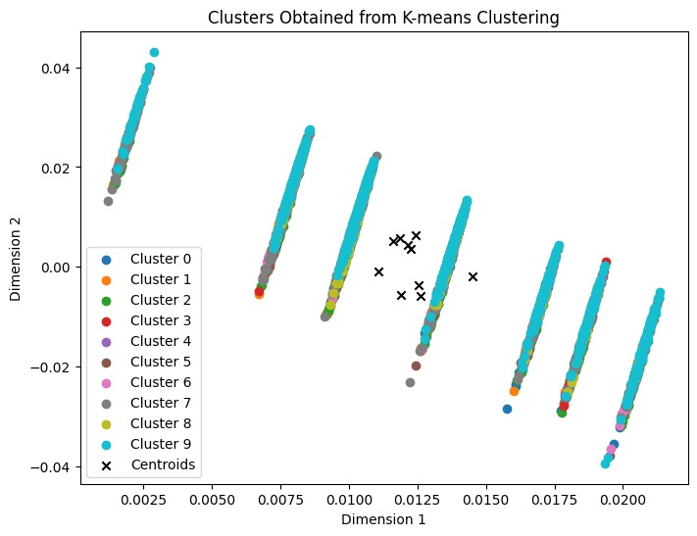
K-means
the optimal number of clusters (k) based on the silhouette score is 10.
Using the optimal value clusters were formed.

Slide 20
Results
Using user_id recommendations are
Recommended movies for User id: 104
162 Devil in a Blue Dress (1995)
317 Suture (1993)
537 Blade Runner (1982)
698 Mulholland Falls (1996)
736 Force of Evil (1948)
901 Maltese Falcon, The (1941)
910 Sunset Blvd. (a.k.a. Sunset Boulevard) (1950)
918 Notorious (1946)
930 Laura (1944)
1054 Crossfire (1947)
1055 Murder, My Sweet (1944)
1136 He Walked by Night (1948)
1137 Raw Deal (1948)
1138 T-Men (1947)
1163 Grifters, The (1990)

Slide 21
Thank you

