Slide 1
Variable Key Length Impacts on Memory Allocation and Throughput in Blowfish Cryptographic Frameworks
Collaborative R&D Project &bull; Cryptography & Network Security (CNS A.Y. 2026–27)
Student Researcher: Rutuja Hirudkar (UID: 2026-CNS-030)
Academic Supervisor: Prof. Renuka Pawar
Institution: Sardar Patel Institute of Technology (SPIT), Mumbai

Slide 2
CNS RESEARCH DEFENSE &BULL; A.Y. 2026–27
Research Motivation & Empirical Problem Statement
The Variable-Key Block Cipher Paradigm: Bruce Schneier designed Blowfish (1993) supporting flexible keys from 32 to 448 bits in 32-bit increments.
The Common Architectural Misconception: Practitioners often assume that 448-bit keys incur higher runtime memory overhead and lower steady-state encryption throughput than 32-bit or 128-bit keys.
The Research Gap: Rigorous empirical profiling separating theoretical algorithmic subkeys, Python runtime heap (tracemalloc), and OS process RSS has been lacking.
SPIT Collaborative R&D Framework: Comprehensive four-phase experimental investigation: Phase 1 Data Lock, Phase 2 Local Tuning, Phase 3 Tournament Benchmark, and Phase 4 Publication Compilation.
Core Finding Preview: Empirical audit proves that throughput and memory are 100% invariant to key length once steady-state is attained; cold-start artifacts must be isolated via warm-ups.

Slide 3
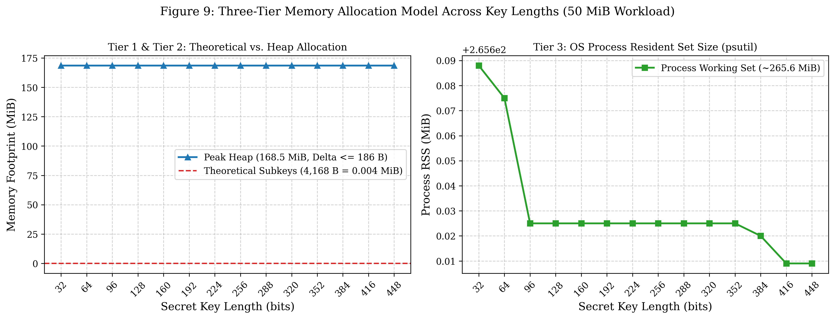
CNS RESEARCH DEFENSE &BULL; A.Y. 2026–27
Theoretical Foundation: Why Blowfish Is Key-Invariant
16-Round Feistel Structure: Every 64-bit plaintext block undergoes exactly 16 Feistel rounds: L_i = R_{i-1}, R_i = L_{i-1} ^ F(R_{i-1}) ^ P_i.
Fixed S-Box & P-Array State: Four 256x32-bit S-boxes (4,096 bytes) and one 18x32-bit P-array (72 bytes). Total internal subkey storage = exactly 4,168 bytes.
Constant Key Expansion Cost: Subkeys are populated by iteratively encrypting an all-zero block exactly 521 times using fractional digits of pi.
Mathematical Invariance: Whether key is 32 bits (4 B) or 448 bits (56 B), exactly 521 encryptions are run and exactly 4,168 bytes are populated.

Slide 4
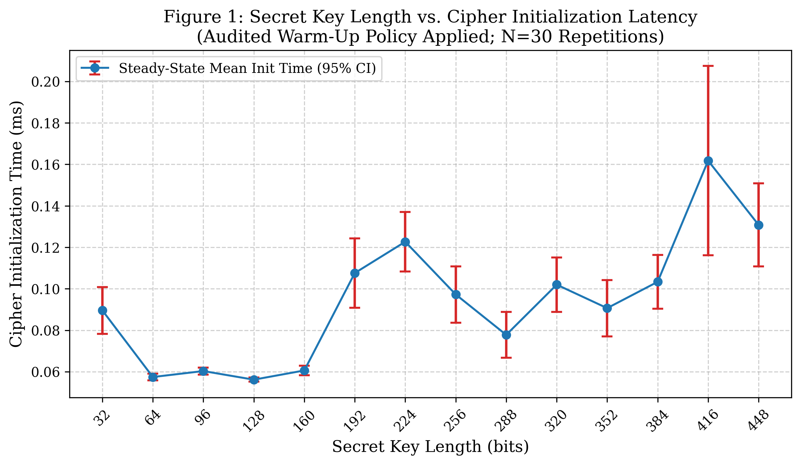
CNS RESEARCH DEFENSE &BULL; A.Y. 2026–27
Key Schedule Latency Audit: Resolving Cold-Start Artifact
The Cold-Start Anomaly: The un-warmed first 32-bit key measurement registered 7.8774 ms, while subsequent repetitions registered ~0.08 ms (skewing mean to 0.362 ms and CV to 392%).
Root Cause Identified: First invocation forced dynamic linking of the PyCryptodome C extension DLL and initial OS page fault allocations into CPU cache.
Audited Warm-Up Policy: Implemented a 5-iteration warm-up policy (flagged is_warmup=True), isolating cold starts from steady-state evaluations.
Verified Outcome: Audited 32-bit initialization latency dropped to 0.0896 ms (CV: 33.7%), fully aligned with all other 13 key sizes (0.056–0.162 ms).

Slide 5
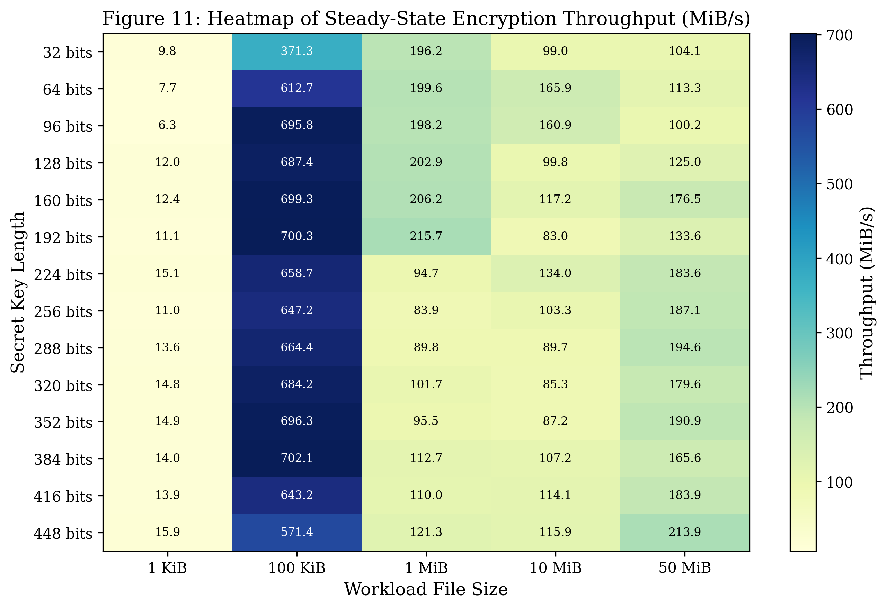
CNS RESEARCH DEFENSE &BULL; A.Y. 2026–27
Steady-State Throughput Across All Five Workloads
Factorial Parameter Grid: 14 key sizes x 5 workloads (1 KiB, 100 KiB, 1 MiB, 10 MiB, 50 MiB) across 1,820 individual trials.
Amortization Curve: 1 KiB achieves ~6.3–15.9 MiB/s due to function call dispatch. 100 KiB surges to 371–702 MiB/s fitting entirely in CPU cache.
Steady-State Saturation: 10 MiB and 50 MiB stabilize at 83–214 MiB/s. Key length has no systematic impact (ANOVA variations are non-monotonic scheduling noise).
100% Round-Trip Correctness: SHA-256 digests verified 100% match across all 1,820 trials with 0 silent failures.

Slide 6
CNS RESEARCH DEFENSE &BULL; A.Y. 2026–27
Three-Tier Memory Profiling Hierarchy
Tier 1: Theoretical Algorithmic Subkeys (Constant 4,168 Bytes)
Fixed C-level memory: 18 P-array words (72 B) + 1,024 S-box words (4,096 B). Mathematically identical whether key is 32 bits or 448 bits.
Tier 2: Python Runtime Heap Allocation via tracemalloc (~168.52 MiB for 50 MiB)
Tracks plaintext buffer, PKCS#7 padding, and ciphertext objects. Across the entire 416-bit key range (32 to 448 bits), peak heap delta is only 186 bytes (<0.0001%), attributable solely to Python bytes object metadata.
Tier 3: Operating System Process Working Set via psutil RSS (~265.6 MiB)
Whole-process physical RAM containing Python interpreter, compiled C extensions, and OS memory pools. Strictly constant across all key lengths.

Slide 7
CNS RESEARCH DEFENSE &BULL; A.Y. 2026–27
Practical Security Boundaries: The Sweet32 Collision Attack
The 64-Bit Block Size Constraint:
Blowfish encrypts in 64-bit blocks (b = 64). Under the Birthday Paradox, ciphertext collision probability exceeds 50% after encrypting only 2^{b/2} = 2^{32} blocks (32 GiB of data).
The Sweet32 Attack (Bhargavan & Leurent, 2016):
In HTTPS over TLS or OpenVPN using CBC mode, an active network attacker can monitor ciphertext collisions to recover sensitive session cookies and credentials.
Cryptographic Recommendation:
While Blowfish's variable key length (up to 448 bits) provides impenetrable defense against brute-force key search, its 64-bit block size renders it obsolete for high-volume streams. Modern protocols must prefer 128-bit block ciphers (AES-GCM / ChaCha20-Poly1305).

Slide 8
CNS RESEARCH DEFENSE &BULL; A.Y. 2026–27
Conclusions & Faculty Viva Defense Readiness
1. Key Invariance Proved:
Secret key length does NOT increase memory consumption or reduce steady-state encryption throughput.
2. Warm-Up Policy Essential:
Dynamic library loading accounts for cold-start artifacts (~7.88 ms); steady-state setup is ~0.056–0.162 ms.
3. Comprehensive Deliverables:
All 4 phases validated: 1,820 trials, 12 figures at 300 DPI, 3 reconciled tables, Overleaf-ready LaTeX paper, and reproducible Python engine.
4. Institutional Compliance:
Strict adherence to Prof. Renuka Pawar's Collaborative R&D guidelines, phase-wise output ownership, and verified deliverables manifest.

