Slide 1

Full-Stack E-Commerce Website Presentation
Built with MERN Stack and Razorpay Integration

Slide 2
FinTech SCE
Full-Stack E-Commerce Website
Name | Roll No. | PRN
Aakash Das | 321001 | 22111180
Rutuja Jadhav | 321029 | 22110268
Mugdha Kamate | 321034 | 22110689
Asmita Mudashi | 324039 | 22110618

Slide 3

Introduction
This presentation showcases a full-stack E-Commerce website built using the MERN stack and integrated with the Razorpay payment gateway.
Key technologies used include MongoDB, Express.js, React, Node.js, and Razorpay.

Slide 4

Key Features
For Customers:
Product Carousel
Filter Products
Sort Products
Categorize Products
Product Details & Reviews
Payment Gateway with Razorpay

Slide 5
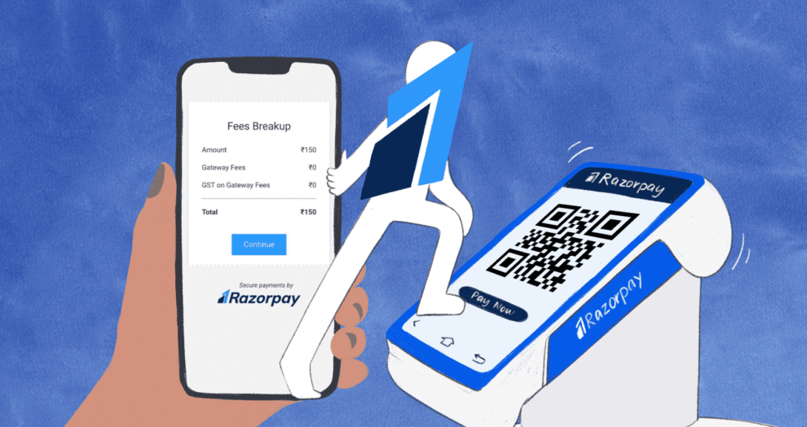
Integration with Razorpay
Step 1: Sign Up for a Razorpay Account
Step 2: Obtain API Keys
Step 3: Install Razorpay SDK
Step 4: Initialize Razorpay
Step 5: Create Payment Button
Step 6: Handle Payment Request
Step 7: Redirect to Razorpay Checkout
Step 8: Confirm Payment Status
Step 9: Handle Payment Responses

Slide 6
Demonstration

Slide 7
Conclusion
User friendly Interface
Payment Gateway Integration with Razorpay
Seamless shopping experience for customers

Slide 8
Thank You !!

