Slide 1

Title: Development of a Versatile and Fast Algorithm for Optimal Ship Routing
Guide: Dr. Y. Deshpande
Institution: B.Tech IT-C

Slide 2
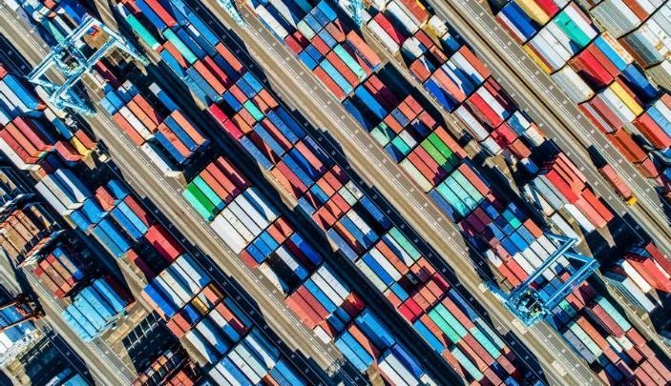
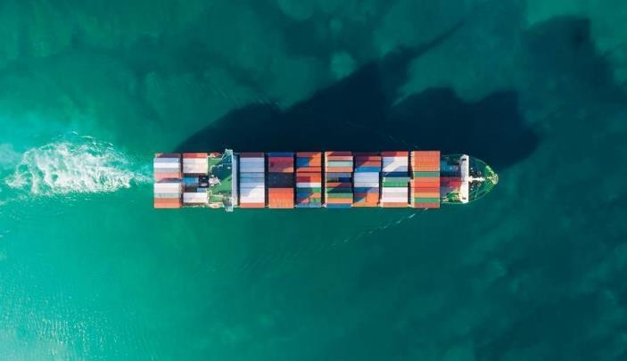
Agenda
Introduction
Project Motivation
Literature study
Problem statement and Scope
Description of problem statement
Technology Stack
Innovation and Originality
Timeline and project plan
Summary

Slide 3
Introduction
Background
Efficient ship routing is critical for reducing operational costs, ensuring timely deliveries, and enhancing maritime safety.
The complexity of global trade routes and varying ocean conditions necessitates the development of a versatile and fast algorithm.
Purpose of Project
To create an algorithm that optimizes ship routes by considering multiple variables such as weather, sea currents, fuel consumption, and safety regulations.
Highlighting the potential for substantial cost savings and reduced carbon emissions through improved efficiency.

Slide 4

Project Motivation
The global shipping industry’s role in international trade requires even small efficiency gains to translate into significant cost reductions.
Growing environmental concerns and regulatory pressure to reduce emissions.
Existing routing methods struggle with adaptability and real-time decision-making under varying conditions.

Slide 5
Literature Survey
Sr.No | Name | Description
1. | Modification of ship routing algorithms for the case of navigation in ice | The optimization task is set in such a way to allow finding the route segments where the icebreaker assistance is economically proven and optimize the sailing mode of double-acting ships. We also proposed the original and computationally efficient algorithm to reduce the number of points in a wavefront based on the Concave Hull method (for the wave-based approach).
2. | Composite particle algorithm for sustainable integrated dynamic ship routing and scheduling optimization | The problem addresses the operational measures such as speed optimization and slow steaming for reducing carbon emission. A mixed integer non-linear programming (MINLP) model is presented and it includes the issues pertaining to multiple time horizons, sustainability aspects and varying demand and supply at various ports.

Slide 6
Sr. No | Name | Description
3. | Liu, X.; Li, Y.; Zhang, J.; Zheng, J.; Yang, C. Self-adaptive dynamic obstacle avoidance and path planning for USV under complex maritime environment. IEEE Access 2019, 7, 114945–114954. | Local route planning and global path planning based on marine environmental data comprise the two categories of current ship weather routing research. Global route planning is the process of obtaining the static obstacle layout in the environment using the available environmental data, and then using a path planning search algorithm to find an appropriate path from the starting point to the global goal
4. | A Ship Routing System Applied at Short Sea Distances | A algorithm is implemented in order to obtain the optimal path under an energetic wave events. The methodological aspects are presented including the grid description and weather prediction systems
5. | Parallel Genetic algorithm for ship routing | Optimizes routes by considering obstacles, water currents, and tides to enhance navigation efficiency.
6. | Chimerical Genetic Algorithm for Cargo Vessel Routing | Addresses the Traveling Salesman Problem to minimize fuel consumption and travel time for cargo vessels.

Slide 7
Sr.No | Name | Description
7. | Hybrid Parallel Genetic Algorithm | Integrates genetic and distribution algorithms to handle complex routing conditions effectively.
8. | Optimal Route Finding System Using Weather Data | Leverages historical weather data and Dijkstra algorithm to determine the most efficient routes based on weather conditions.
9. | A branch-price-and-cut method for a ship routing and scheduling problem with split loads | We present a branch-price-and-cut method to solve a maritime pickup and delivery problem with time windows and split loads. The subproblem is a new variant of the elementary shortest path problem with resource constraints, where a multi-dimensional knapsack problem is solved to compute optimal cargo quantities.
10. | A Binary Particle Swarm Optimization Algorithm for Ship Routing and Scheduling of Liquefied Natural Gas Transportation | The aim of this paper is to propose a meta-heuristic Binary Particle Swarm Optimization (BPSO) algorithm to come with an optimized solution for ship routing and scheduling of LNG transportation. The application demonstrates what sellers need to do to reduce their costs and increase their profits by considering or removing some obligations.

Slide 8
Sr.No | Name | Description
11. | Ship Routing through Altimetry-Derived Ocean Currents | We investigate the potential of strategic ship routing through dynamic currents derived from satellite altimetry by simulating current patterns in a dynamic Gulf Stream region to reflect present and improved current estimation capabilities, using dynamic programming
12. | Ship weather routing based on modified Dijkstra algorithm | A modified Dijkstra algorithm using structure matrix and single linked list is applied to establish shortest time route in this passage.
13. | Ship routing in the black sea based on dijkstra algorithm | In the paper, we establish a model based on realistic wind and wave conditions present in the Black Sea and analyze the output given by an adapted Dijkstra algorithm.
14. | Ship emissions reduction using weather ship routing optimization | A heuristic pathfinding algorithm is used to obtain the minimum cost (i.e. optimised route) in terms of sailing time, using high-resolution wave forecasting.
15. | Development of a New Ship Adaptive Weather Routing Model Based on Seakeeping Analysis and Optimization | The model is based on a set of ship motion-limiting criteria and on the weather forecast maps, providing the sea state conditions the ship is expected to encounter along the scheduled route.

Slide 9
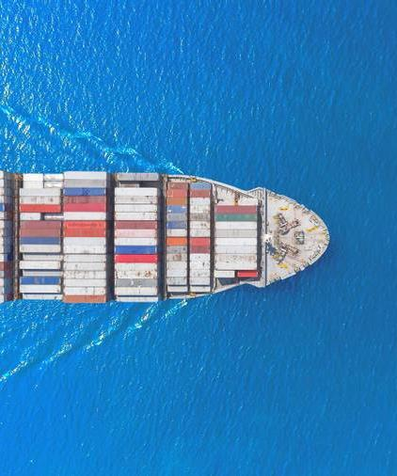
Problem Statement
The need for an algorithm that can dynamically optimize ship routing by integrating real-time data on weather, sea currents, fuel consumption, and safety regulations.

Slide 10
Scope
Design, implement, and test the algorithm across different ship types and routes.
Comparative analysis with existing routing methods.
Focus on algorithm architecture, coding, and validation.
Future phases will cover hardware integration and real-time deployment.

Slide 11
Proposed Solution
The algorithm will be a standalone software module integrated into existing maritime navigation systems.
It will optimize routes in real-time by processing live data inputs and provide decision-support for maritime professionals.
Adaptability to different ship types and operational scenarios, offering route comparisons based on predefined criteria.

Slide 12
Technology Stack
Programming languages
Python
Frontend
User interface for data input and route visualization
Backend
Data processing and integration with external data sources
Framework
Real time data processing framework, API integration with existing maritime system
C++
Database
For storing historical data and simulation result

Slide 13
Innovation and Originality
Real-time adaptability to changing maritime conditions.
Integration of multiple variables like weather, fuel consumption, and safety.
A focus on reducing carbon footprint by optimizing for fuel efficiency.
Versatility across different ship types and operational scenarios.

Slide 14
Timeline and Project plan
Week 1 - 2
Requirement analysis and initial algorithm design
Week 3 - 4
Algorithm development and coding
Week 5 -6
Testing and validation of algorithm
Week 7
Comparative analysis with existing methods
Week 8
Documentation and final presentation

Slide 15
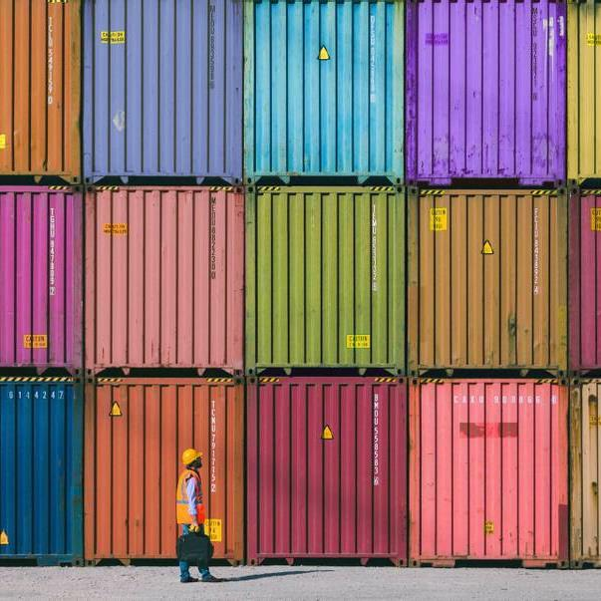
Summary
The project aims to develop a cutting-edge ship routing algorithm that is fast, adaptable, and capable of handling real-time data.
It has the potential to significantly improve maritime operational efficiency and reduce environmental impact.

Slide 16
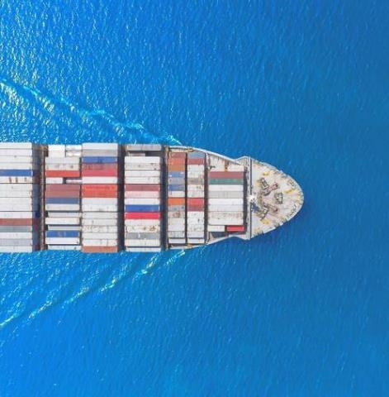
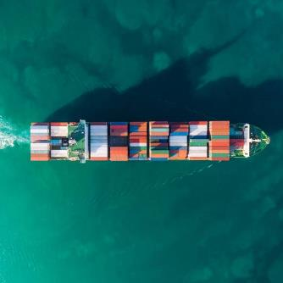
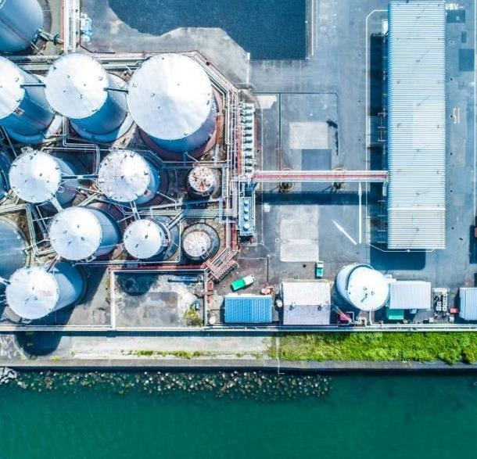
THANK YOU

